Slide 1
AIM-Spice 실습보고서 12
Scan Driver Circuit Design
11T-2C-4CLK
04.08
강석현, 오정석

Slide 2


회로 구조 변경
• Low Level이 -13V까지 내려가는 CLK1, CLK2를 추가로 활용해서 회로 설계.
• CKL1, CKL2는 CK1, CK2와 같은 파형, Low level = -13V
VGH
VGH
CK2
Scan[n-1]
CK2
Scan[n-1]
T3
CK1
T5_1
T3
CKL1
T5_2
T5_2
Q
Q
Q
T7
T7
Q
CKL2
T4
T4
C2
C2
Scan[n]
Scan[n]
CKL1
T9
CK1
QB
T8
T10
T2
QB
T6
CK1
T2_1
T2_2
T8
C1
T6
QB
T2_3
C1
VGL
8T-2C-2CLK
Scan Driver Schematic
11T-2C-4CLK
Scan Driver Schematic
VGL

Slide 3
ㄴㅇㅎㅁ
• 실습7에서 간략화한 회로의 TFT 채널 폭을 조정해 VTO를 음의 값으로 내려가며 동작한계 확인.
VGL
C1
T5_3
QB
QB
CK1
VGH
T8
T4
Scan[n]
Q
T6_1
C2
T5_2
VGH
T6_3
Q
T7
T2_1
T2_2
T3
T6_2
VGH
T5_1
T2_3
Scan[n-1]
CK2
VGH

Slide 4
Scan Driver 동작과정 (1)
VGH
(1)
Scan[n-1]
CK2
CK1
T3
CK1
CKL1
T5_2
CK2
Q
Q
T7
CKL1
CKL2
T4
C2
CKL2
CKL1
T9
T10
CK1
T8
Scan[n-1]
T2_1
T2_2
T6
QB
T2_3
C1
Q
QB
VGL
Scan[n]

Slide 5
Scan Driver 동작과정 (2)
VGH
(2)
Scan[n-1]
CK2
CK1
T3
CK1
CKL1
T5_2
CK2
Q
Q
T7
CKL1
CKL2
T4
C2
CKL2
CKL1
T9
T10
CK1
T8
Scan[n-1]
T2_1
T2_2
T6
QB
T2_3
C1
Q
QB
VGL
Scan[n]

Slide 6
Scan Driver 동작과정 (3)
VGH
(3)
Scan[n-1]
CK2
CK1
T3
CK1
CKL1
T5_2
CK2
Q
Q
T7
CKL1
CKL2
T4
C2
CKL2
CKL1
T9
T10
CK1
T8
Scan[n-1]
T2_1
T2_2
T6
QB
T2_3
C1
Q
QB
VGL
Scan[n]

Slide 7
Scan Driver 동작과정 (4)
VGH
(4)
Scan[n-1]
CK2
CK1
T3
CK1
CKL1
T5_2
CK2
Q
Q
T7
CKL1
CKL2
T4
C2
CKL2
CKL1
T9
T10
CK1
T8
Scan[n-1]
T2_1
T2_2
T6
QB
T2_3
C1
Q
QB
VGL
Scan[n]

Slide 8
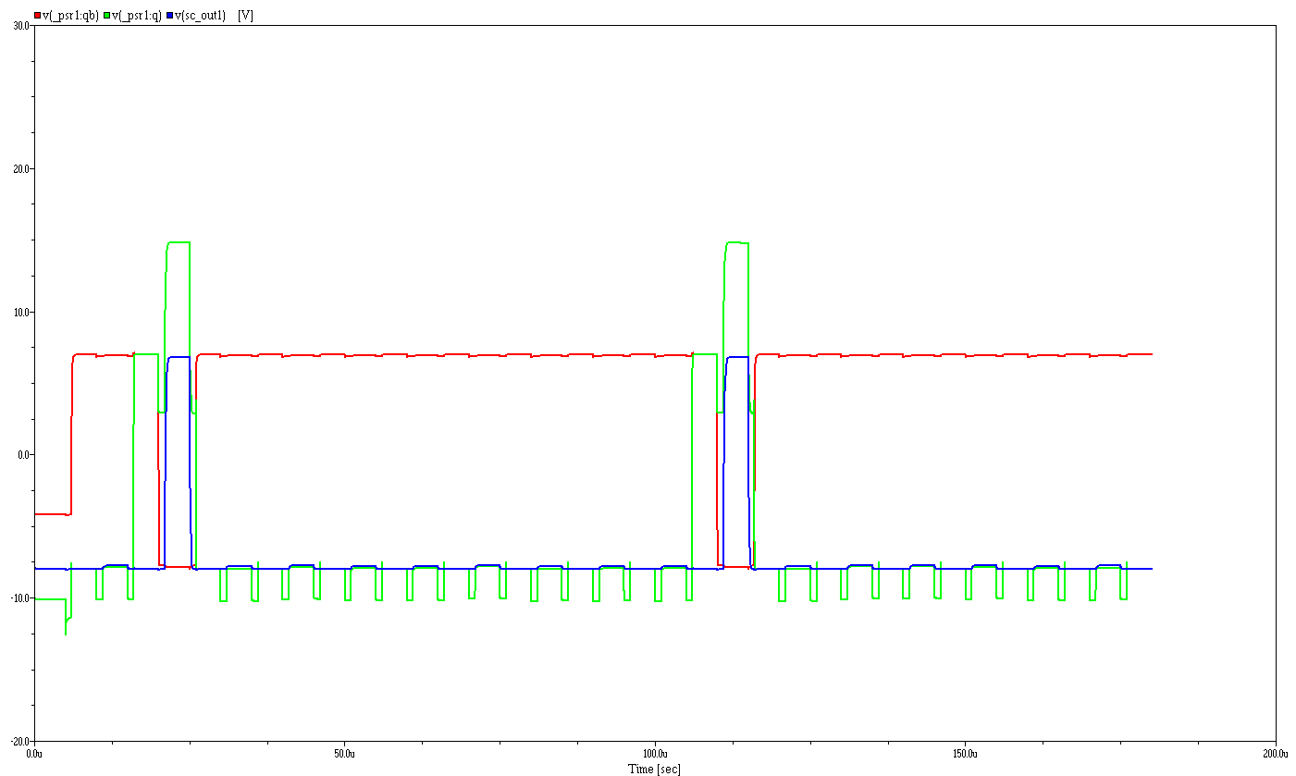
Q, Qb Simulation Result
• VTO = -2V

Slide 9
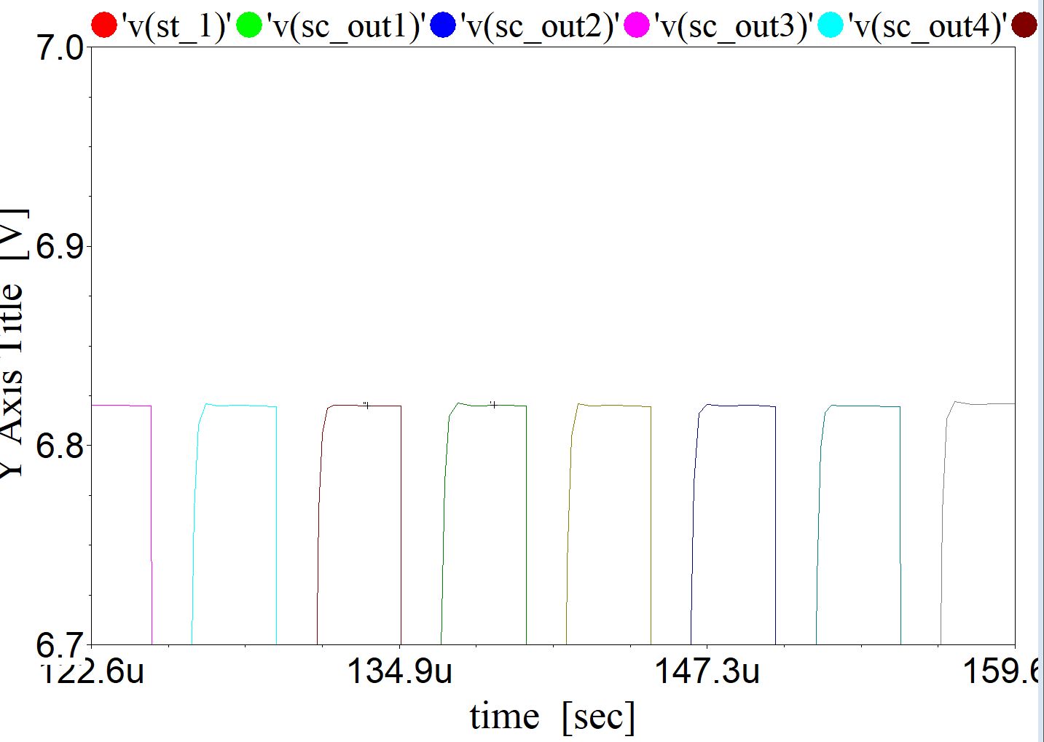

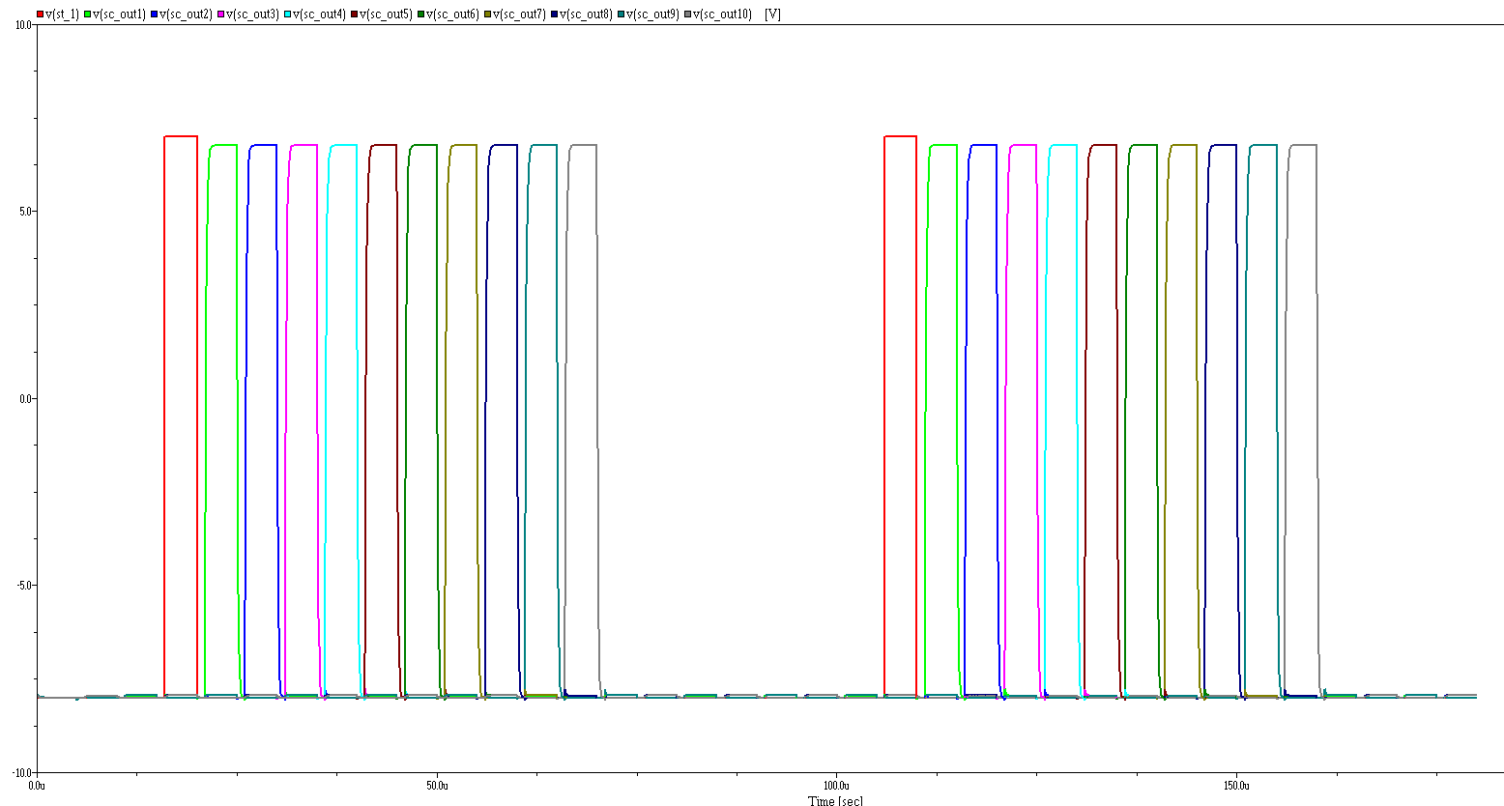
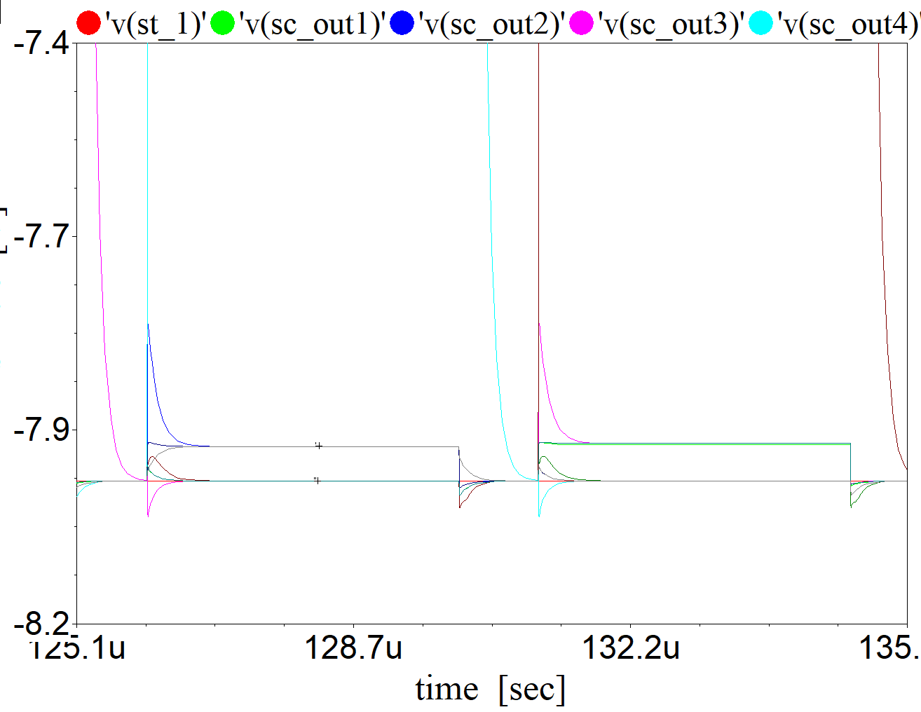

Scan[n] Simulation Result
• VTO = -2V
Scan 1 ~ 10

