Slide 1
Architecture

Slide 2
ECS Core
Entriy
Component
System
GameManager
System
Data (Json 활용 저장 및 로드)
Object
HUD
Environment
Function
Setting
TimingControl
HUDSetting
Camera
Init (TimingControl)
Player
BGM/SFXClip
SoundPlayer
HUDAchive
Light
Init (Setting)
Enemy
PlayerData
Player
HUDLobby
Map
JsonLoad
DamageSystem
EnemyData
EnemyPool
HUDInGame
JsonSave
ProjectileSystem
FieldData
DropItemPool
HUDEquipment
GameStart
FieldCtrlSystem
AchiveTable[]
FieldObejctPool
HUDLevelUp
Update
TBD….
PlayerInfoTable[]
HUDPlayerInfo
EquipItemTable[]
HUDInventory
WeaponItemTable[]
UseItemTable[]
DropItemTable[]
PerkTable[]
EnemyTable[]
FieldObejctTable[]

Slide 3
Unreal
Launch
FEngineLoop
FTrackedActivity::GetEngineActivity().Update(TEXT("Starting"), FTrackedActivity::ELight::Yellow);
FTaskTagScope Scope(ETaskTag::EGameThread);
#if !(UE_BUILD_SHIPPING)
// If "-waitforattach" or "-WaitForDebugger" was specified, halt startup and wait for a debugger to attach before continuing
if (FParse::Param(CmdLine, TEXT("waitforattach")) || FParse::Param(CmdLine, TEXT("WaitForDebugger")))
{
while (!FPlatformMisc::IsDebuggerPresent())
{
FPlatformProcess::Sleep(0.1f);
}
UE_DEBUG_BREAK();
}
#endif
BootTimingPoint("DefaultMain");
// Super early init code. DO NOT MOVE THIS ANYWHERE ELSE!
FCoreDelegates::GetPreMainInitDelegate().Broadcast();
// make sure GEngineLoop::Exit() is always called.
struct EngineLoopCleanupGuard
{
~EngineLoopCleanupGuard()
{
// Don't shut down the engine on scope exit when we are running embedded
// because the outer application will take care of that.
if (!GUELibraryOverrideSettings.bIsEmbedded)
{
EngineExit();
}
}
} CleanupGuard;
// Set up minidump filename. We cannot do this directly inside main as we use an FString that requires
// destruction and main uses SEH.
// These names will be updated as soon as the Filemanager is set up so we can write to the log file.
// That will also use the user folder for installed builds so we don't write into program files or whatever.
#if PLATFORM_WINDOWS
FCString::Strcpy(MiniDumpFilenameW, *FString::Printf(TEXT("unreal-v%i-%s.dmp"), FEngineVersion::Current().GetChangelist(), *FDateTime::Now().ToString()));
#endif
FTrackedActivity::GetEngineActivity().Update(TEXT("Initializing"));
int32 ErrorLevel = EnginePreInit( CmdLine );
// exit if PreInit failed.
if ( ErrorLevel != 0 || IsEngineExitRequested() )
{
return ErrorLevel;
}
{
FScopedSlowTask SlowTask(100, NSLOCTEXT("EngineInit", "EngineInit_Loading", "Loading..."));
// EnginePreInit leaves 20% unused in its slow task.
// Here we consume 80% immediately so that the percentage value on the splash screen doesn't change from one slow task to the next.
// (Note, we can't include the call to EnginePreInit in this ScopedSlowTask, because the engine isn't fully initialized at that point)
SlowTask.EnterProgressFrame(80);
SlowTask.EnterProgressFrame(20);
#if WITH_EDITOR
if (GIsEditor)
{
ErrorLevel = EditorInit(GEngineLoop);
}
else
#endif
{
ErrorLevel = EngineInit();
}
}
double EngineInitializationTime = FPlatformTime::Seconds() - GStartTime;
UE_LOG(LogLoad, Log, TEXT("(Engine Initialization) Total time: %.2f seconds"), EngineInitializationTime);
ACCUM_LOADTIME(TEXT("EngineInitialization"), EngineInitializationTime);
BootTimingPoint("Tick loop starting");
DumpBootTiming();
FTrackedActivity::GetEngineActivity().Update(TEXT("Ticking loop"), FTrackedActivity::ELight::Green);
// Don't tick if we're running an embedded engine - we rely on the outer
// application ticking us instead.
if (!GUELibraryOverrideSettings.bIsEmbedded)
{
while( !IsEngineExitRequested() )
{
EngineTick();
}
}
TRACE_BOOKMARK(TEXT("Tick loop end"));
#if WITH_EDITOR
if( GIsEditor )
{
EditorExit();
}
#endif
return ErrorLevel;
FTrackedActivity.GetEngineActiveity().Update()
ErrorLevel
PreInit
PreInitPreStartupScreen
FDelayedAutoRegisterHelper 에서 Phase 단계 설정 -> 단계 설정 후 Broadcast 및 clear 수행 -> Tset에 Phase 추가
PreInitPreStartupScreen

Slide 4
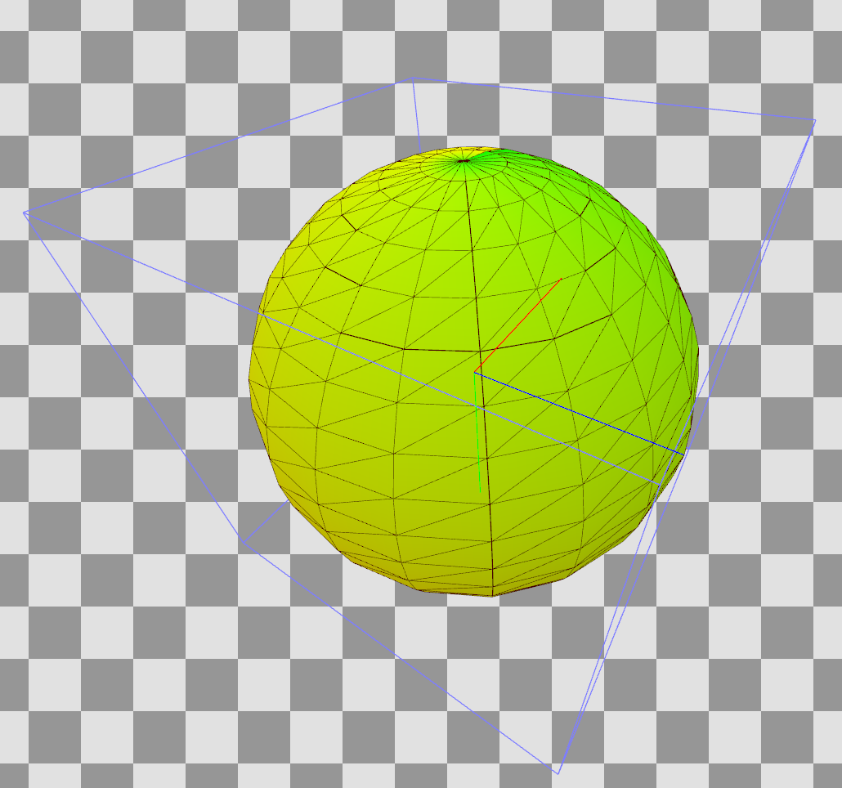
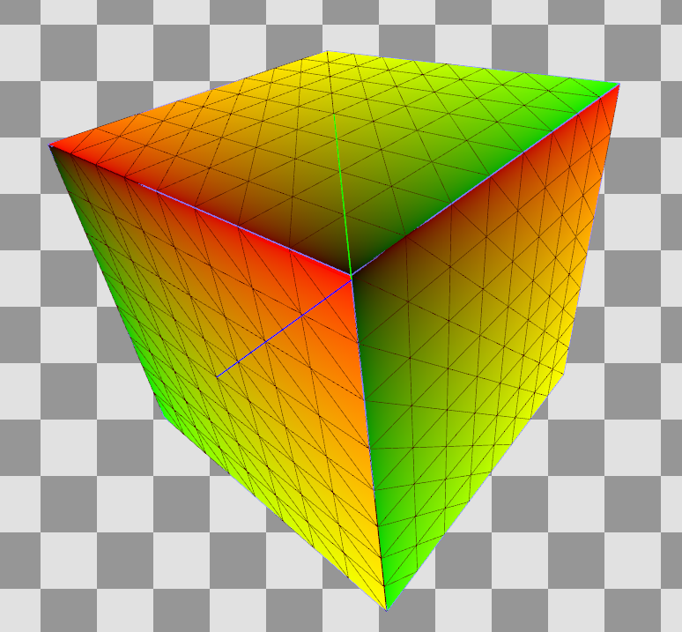
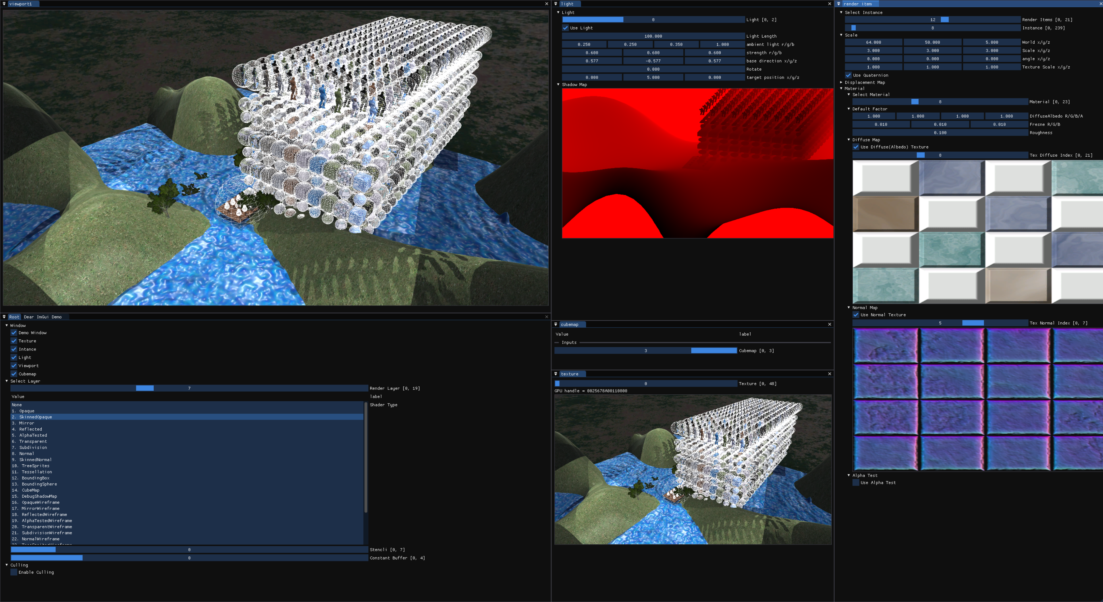
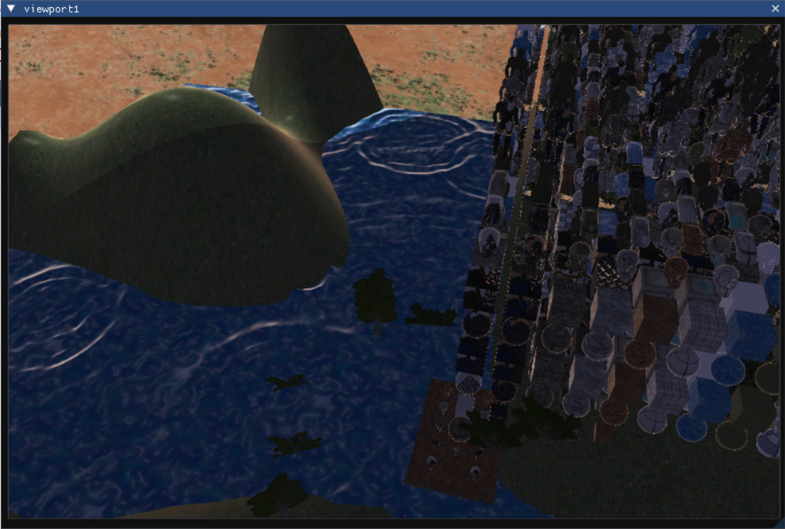
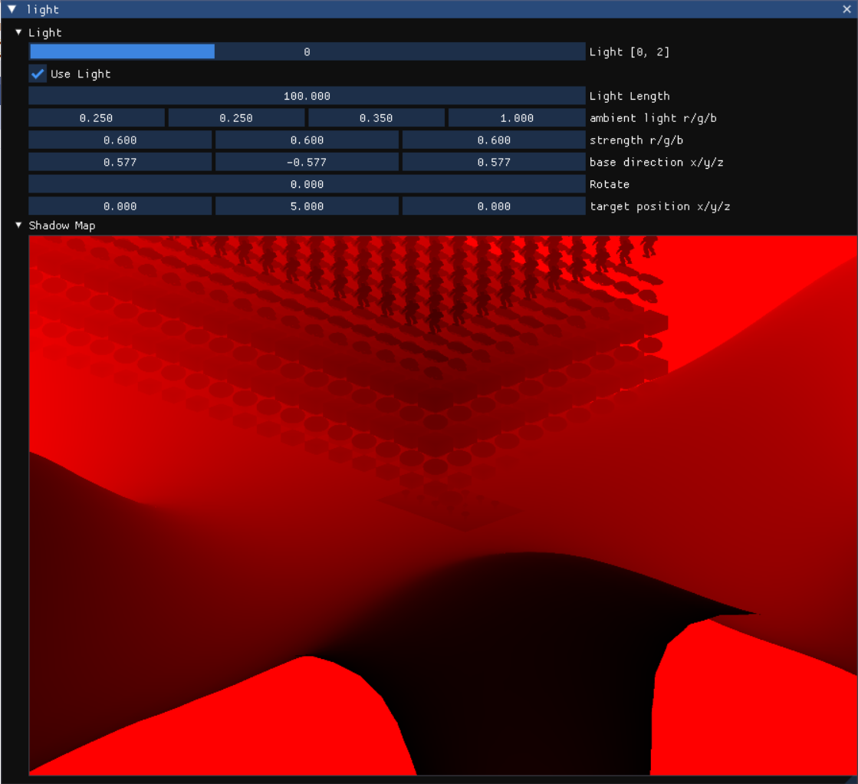
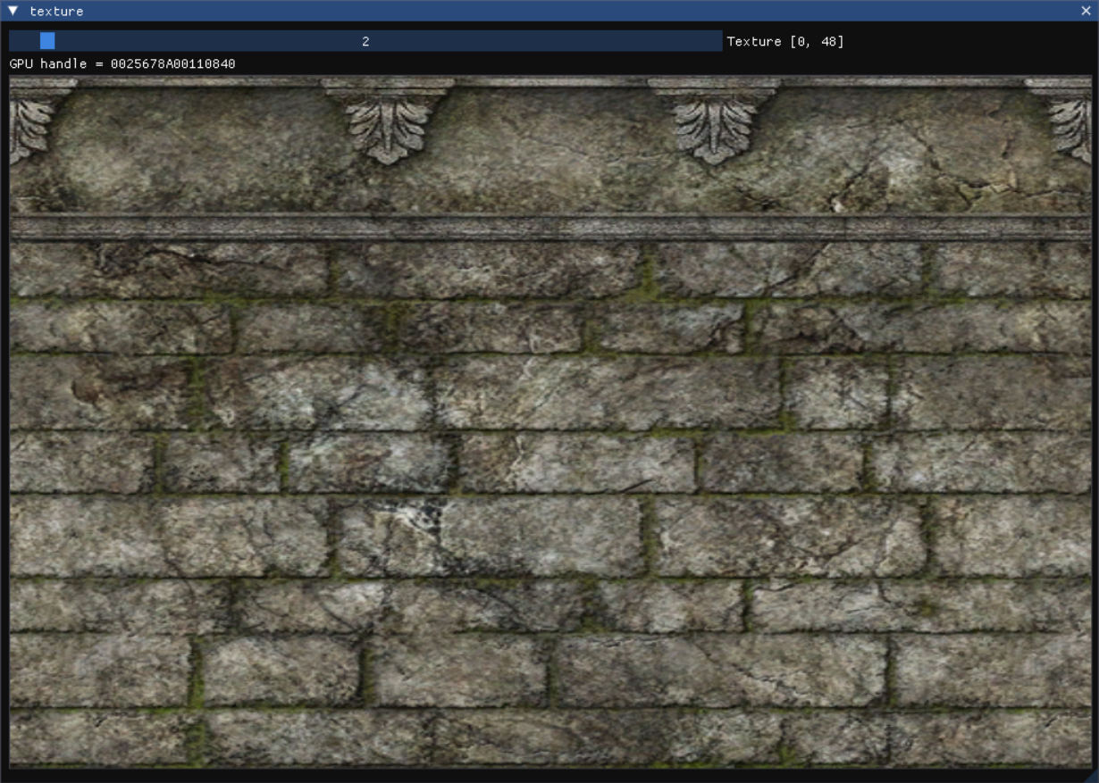
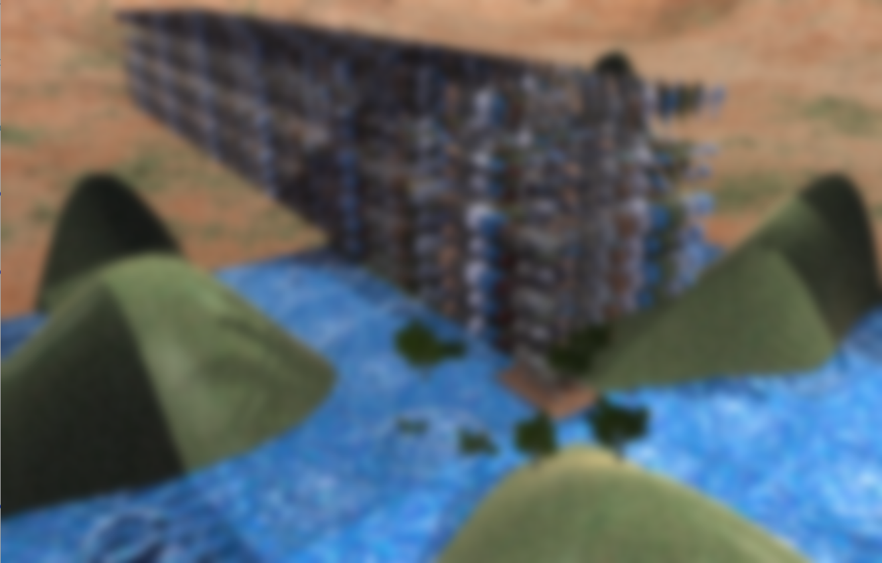
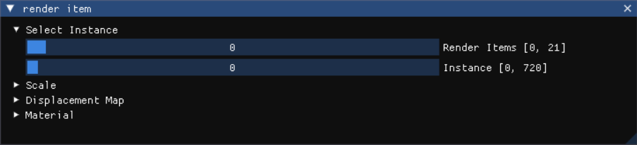
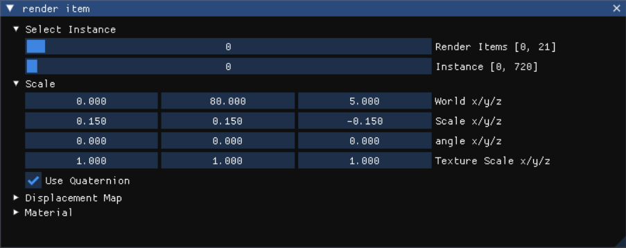
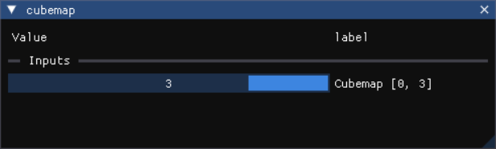
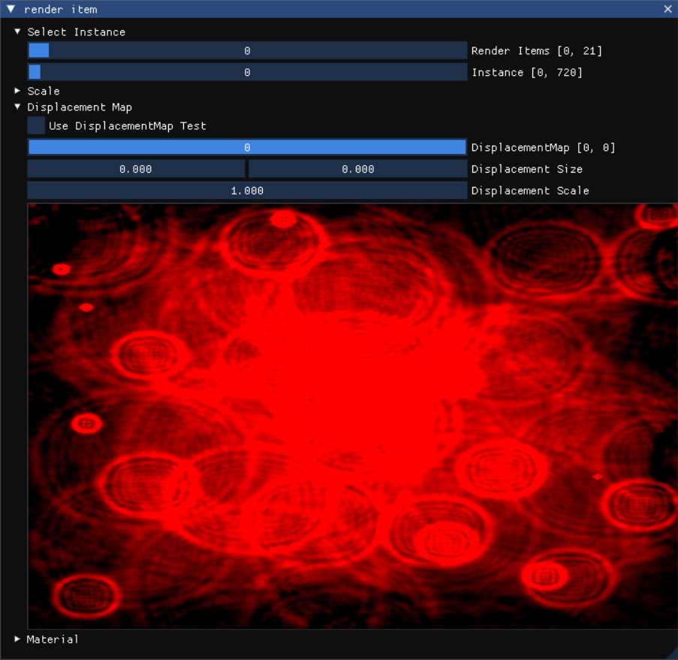
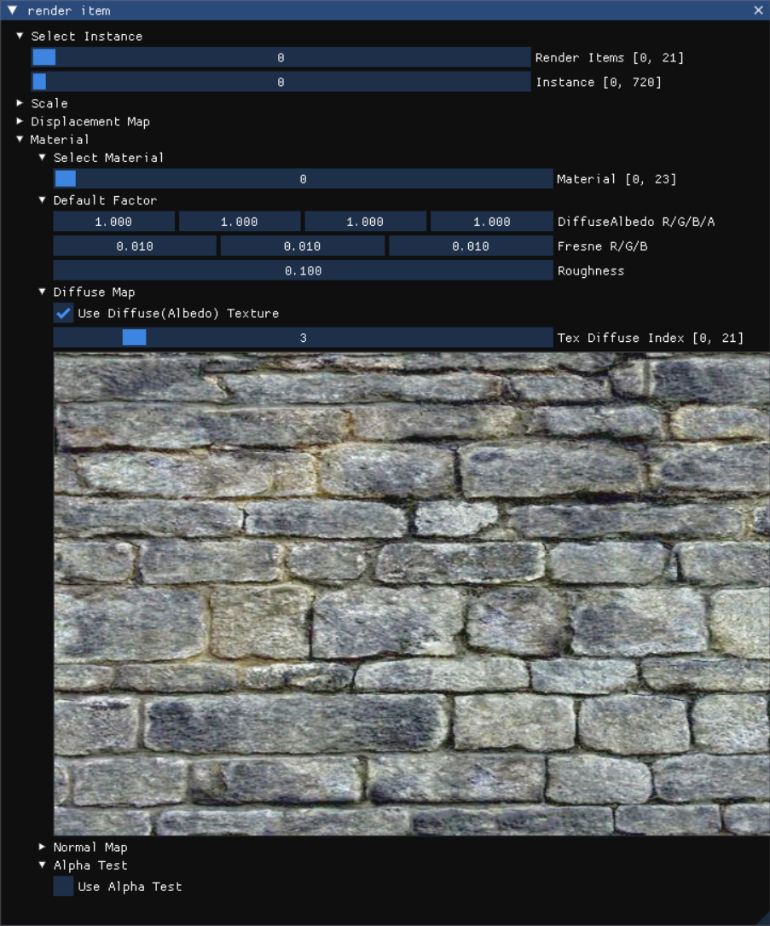
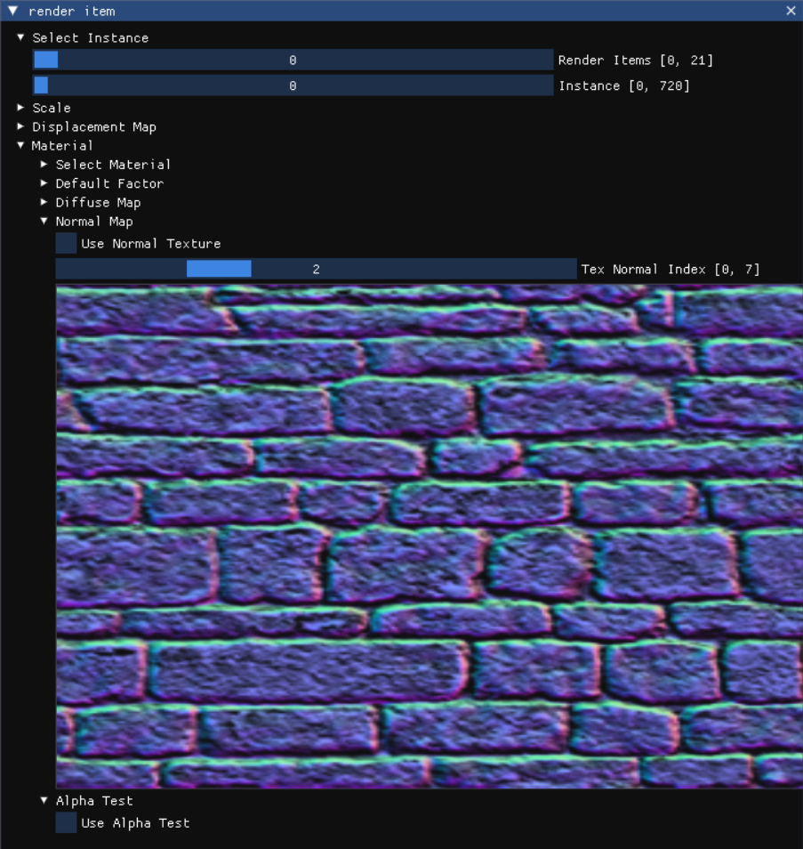
DX12 엔진 개발 | 1. Block Diagram
AppBase
MyApp::AppBase
Engine Core
Run()
Initialize()
InitMainWindow()
Initialize() (Override)
BuildMeshes()
GeometryGenerator
▼생성한 Mesh 예시
Initialize All Logic
InitMainWindow
RegisterWindowClass
AppBase::Initialize
Create Default Meshes
(Vertices & Indices)
BuildGeometry()
CreateBox/…/etc
While loop
InitDirect3D
MakeWindowHandle
Reset CMD List
Load Model Meshes
Merge Vertices & Indices
Create vertices & indices
PeekMessage
OnResize
Set Camera
Update Tangent Vector
Create Vertex Buffer
& Copy Vertex Data
FindBounding()
Update All Logic
Make Blur Filter
Build Geometry
Create Index Buffer
& Copy Index Data
Find space diagonal of polyhedron
Set data for rendering
MsgProc()
InitDirect3D()
Make GpuWaves
LoadTextures()
Create Submesh Geometry
(Index Count, Index & Vertex Location)
Assign center and extents
Set imgui data for rendering
ImGui_WndProcHandler
InitDebugLayer
Make ShadowMap
Load DiffuseMap Texture
Create Submesh Geometry
(Bounding Box & Bounding Sphere)
Find sphere radius
Execute CommandList
OnResize
Create Fence
Build Meshes
Load NormalMap Texture
Update() (Override)
OnKeyboardInput()
SkinnedData
Swap BackBuffer
OnMouseDown
CreateCommandObjects
(CMDQueue, CMDAllocator, CMDList)
Load Textures
Load 2DArray Texture
Sync Frame Resource
Update Camera Location
UpdateSkinnedAnimation()
GetFinalTransforms()
Interpolate()
Flush Command Queue
OnMouseUp
CreateRtvAndDsvDescriptorHeaps
Build Materials()
Load CubeMap Texture
Apply Keyboard Input
(Update Camera Location)
Update View Matrix
Check End Time (Loop Animation)
Find Parent Transform
If t <= front keyframe time
Clean Datas
OnMouseMove
CreateSwapChain
(Create Swap Chain & RTV)
Build Root Signature
BuildMaterials()
Update Materials
Update Cam Frustum
Compute final transforms
Find Root Transform
Root Scale/Translation/Rotation
== front Keyframe
Update Light Location
Apply Offset & Root Transform
Else if t >= back keyframe time
Build DescriptorHeaps
Set albedo factor
UpdateInstanceBuffer()
Root Scale/Translation/Rotation
== back Keyframe
FlushCommandQueue()
OnResize()
Build Shaders & Input Layout
Set fresnel factor
Update Instance Buffer
If culling is enable
Else
Update Fence Point
Flush Command Queue
Build Render Items
Set roughness factor
Update Material Buffer
Check object included in frustum
Root Scale/Translation/Rotation
== Lerp front & back Keyframe
Set new fence point
Reset Back & SRV Buffer
Build PSOs
Set metallic factor
Update Pass CB
Copy instance data
Wait GPU has completed commands up to fence point
Resize Swap Chain
Init Imgui
Set Texture Map Index
Update Skinned CB
Update Object Instance Count &
Update Instance CB for instance index
Frame Resource
UploadBuffer
Else if culling is disable
Create Back & SRV RenderTargetView
Flush Command Queue
BuildRootSignature()
Update objects with a dirty flag
LightData
FrameResource
UploadBuffer()
Create Back & SRV RenderTargetView
Constant Buffer View
1. cbInstance, b0
2. cbPass, b1
3. cbSkinned, b2
UpdatePassCB()
MaterialData
UploadBuffer<MaterialData>
Create Commit Resource
Create Depth Stencil buffer
Update View/Proj/ViewProj Matrix
InstanceData
UploadBuffer<InstanceData>
Get a CPU pointer
to the specified subresource
Flush Command Queue
Shader Resource View
1. gInstanceData, t0, Space0
2. gMaterialData, t1, Space0
Update Eye Position
SkinnedConstants
UploadBuffer<SkinnedConstants>
Update Light Factor
UploadBuffer<PassConstants>
~UploadBuffer()
Compute Shader Management Class (GPU Wave, BlurFilter, …, etc)
Descriptor Table
1. gDiffuseMap[], t0, Space1
2. gDisplacementMap[], t0, Space2
3. gNormalMap[], t0, Space3
4. gAOMap[], t0, Space4
5. gMetallicMap[], t0, Space5
6. gRoughnessMap[], t0, Space6
7. gEmissiveMap[], t0, Space7
8. gShadowMap[], t0, Space8
9. gSsaoMap[], t0, Space9
10. gTreeMapArray[], t0, Space10
11. gCubeMap[], t0, Space11
UpdateSkinnedCB()
PassConstants
UploadBuffer<InstanceConstants>
Release a CPU pointer
to the specified subresource
Constructor()
BuildShader()
Update Skinned Animation
InstanceConstants
Resource()
Build Shaders
Compile Shaders
Update Skinned Constant Buffer
EXInstanceData
Return Buffer Pointer
Build Resources
Describe the input elements for input-assembler stage
InstanceData
Update()
Build Root Signature
BuildResources()
Sampler
1. gsamPointWarp, s0
2. gsamPointClamp, s1
3. gsamLinearWarp, s2
4. gsamLinearClamp, s3
5. gsamAnisotropicWarp, s4
6. gsamAnisotropicClamp, s5
7. gsamShadow, s6
Render() (Override)
Bounding Box / Sphere
Update Bounding Box / Sphere
CopyData()
Build PSOs
Create Commit Resource
▼ RendorDoc 내 TimeLine
Reset Command Allocator
Transform
(Position/Rotation/Scale)
Update Affine Transform Matrix
Copy data to Buffer
Destructor()
BuildRootSignature()
Bind constant Buffer View
Default Destructor
Describe constant buffer view
Bind Shader Resource View
ImGui Core
DescriptorCount()
Describe Shader Resource view
BuildDescriptorHeaps()
Bind Root Descriptor Table
▼ Imgui 활용 예시
Return SRV Size
Describe Descriptor Table
Create SRV DescriptorHeap
Repeat MAX_LAYER_DEPTH
(Shadow Map Render Layer)
Execute()
Describe Sampler
Create ShaderResourceView
1. DiffuseMap
2. DisplacementMap
3. NormalMap
4. AOMap
5. MetallicMap
6. RoughnessMap
7. EmissiveMap
8. TreeMapMap
9. CubeMapMap
10. ShadowMap
11. SsaoMap
12. 2D Array Map
13. CubeMap
14. for Compute Shader SRV
Render DSV to Shadow Map
Set Root Signature
for the compute shader
Create Root Signature
Set Viewport & ScissorRect
Set Constant Buffer
for the compute shader
Change Resource state
(PRESENT -> RENDER_TARGET)
Set Compute Root Descriptor Table
BuildPSOs()
Set Render Target
(Back Buffer + SRV)
Dispatch
Create Compute Pipeline State
Repeat MAX_LAYER_DEPTH
(Main Render Layer)
DrawRenderItems()
OnResize() (Optional)
BuildDescriptors
(CPU Handle, GPU Handle)
BuildDescriptors()
BuildShadersAndInputLayout()
Set Pass CB
(0: Default, 1~3: Shadow Pass)
Repeat All Render Items
Update internal parameter
Bind the CPU and GPU handles
Create Shader Resource View
Compile Shaders with defines
Set Stencil Reference
Update Primitive Topology
(Pointlist, trianglelist, patchlist)
Update Rosources
Build Descripotrs
Create Unordered Access View
for Compute Shader
Describe the input elements for input-assembler stage
Set Pipeline State
Set Input Assembler Vertex Buffer
Update Descriptors
Draw Render Items
Set Input Assembler Index Buffer
▼ ViewPort
▼ Light 관리 (Shadow Map)
▼Texture Viewer
BuildRenderItems()
Repeat MAX_LAYER_DEPTH
(Post Process Layer)
Set Input Assembler Primitive Topology
▼ Compute Shader 활용
Create Render Items
If Skinned Mesh
Set the layer that will be rendered
Do Compute Shader Logics
(Blur, Update Displacement, Compute)
Set Constant Buffer View
(Skinned CB)
Set render Item material
Copy Back Buffer to SRV
Draw Indexed Instanced
(reuse geo to draw multiple objects)
Apply an affine transformation
Change Resource state
(RENDER_-> TARGET PRESENT)
▼ Render Item(Instance) 관리
▼ Render Item – Affine Transform 관리
▼Cubemap Control panel
Set bounding Box for debug
Set bounding Sphere for debug
BuildPSOs()
▼ Render Item – Displacement Map 관리
▼ Render Item – Material (Diffuse Map) 관리
▼ Render Item – Material (Normal Map) 관리
Create Pipeline States
1. Opaque (VS/PS)
2. Skinned Opaque (VS/PS)
3. Mirror (VS/PS)
4. Reflection (VS/PS)
5. Transparent (VS/PS)
6. AlphaTested (VS/PS)
7. Subdivision (VS/GS/PS)
8. Normal (VS/GS/PS)
9. TreeSprite (VS/GS/PS)
10. Tesselation (VS/HS/DS/PS)
11. BoundingBox (VS/PS)
12. CubeMap (VS/PS)
13. ShadowMap (VS/PS, DSV Only)
14. SkinnedShadowMap
(VS/PS, DSV Only)

Slide 5
DX12 with ECS 엔진 개발 | 1. Block Diagram
: Entity
: Component
: System
: Function
: Member Variable
ECSCoordinator
ECS 동작 관리 유닛
EntityManager ECS 동작 간 Entity 관리
SingletonComponentManager
Singleton Component 관리 유닛
ECSCoordinator::Init()
EntityManager::CreateEntity()
ArchetypeManager::SetSignature(Entity entity, const Signature& signature)
std::unordered_map<std::type_index, std::unique_ptr<ISingletonComponent>> mSingletonComponents
목적: 유일한 Component인 경우 관리
Step 1. Make Manager
ECS관련 Manager 객체 등록
Step 1. Entity Queue에서 front 값 획득
Step 1. 전달받은 Signature 정보 할당
ArchetypeManager
Step 2. Entity 정보 반환
[TimeComponent] = TimeComponent
SingletonComponentManager
[LightComponent] = LightComponent
EntityManager
std::queue<Entity> mAvailableEntities
(활용 가능한 Entity 관리)
std::array<Signature, MAX_ENTITIES> mSignatures
(Entity에 대응되는 Signature 관리)
SystemManager
Step 2. Register Component
전체 Component 등록 (동작 예시)
0
[0] = {4}
DX12_BoundingComponent
1
[1] = {4}
Direct X 관련 구조체 관리 System
DX12_MeshComponent
2
[2] = {4}
물리 관련 System
InstanceData
3
[3] = {5,6,7}
LightComponent
4
[4] = {5,6,7}
FMODAudioComponent
5
[5] = {0,1,5}
DirectX 12 관리를 위한 Singleton System
(사유: Window System의 메시지 처리 간 멀티스레드 처리 시 오류 발생
TransformComponent
6
[6] = {5,6,10}
RigidBodyComponent
7
[7] = {1,5,9,11}
GravityComponent
8
[8] = {5,9}
BoundingVolumnComponent
9
[9] = {5,9}
CFGInstanceComponent
…
…
PlayerControlComponent
MAX_ENTITIES(5000) - 1
[MAX_ENTITES-1] = {}
Audio 관리 System
TextureScaleComponent
Step 3. Register System & Signature
System 및 Signature 등록 (동작 예시)
ArchetypeManager Archetype 활용 데이터 관리 유닛
ArchetypeManager 중 Archetype 관리 방식
Archetype 활용 데이터 관리 유닛
FMODAudioSystem
ArchetypeManager::RegisterComponent()
ArchetypeManager::AddComponent()
Archetype
Archetype
Archetype
FMODAudioComponent {4}
Step 1. Component Type 등록
Step 2. Component Factory에 Component Type에 맞는 ComponentArray 등록
(실제 배열 생성은 Add Component 수행 시 Archetype에 따라 효율적으로 생성)
Step 1. Entity Location 정보 검사
목적: 현재 Entity가 포함된 Archetype 확인
Step 4. 목적지 Archetype 탐색
목적: Signature에 맞는 Archetype 확보
Member Variable
Member Variable
Member Variable
PhysicsSystem
Step 2. 신규 Signature 계산
목적: Component 추가 후 Archetype 판단
Step 5. 목적지 이동 처리
목적: Archetype 변경 시 기존의 Component를 신규 Archetype 경로 내 배열로 이동
ArchetypeManager* const mManager 목적: Manager에서 관리되는 생성자 참조
ArchetypeManager* const mManager 목적: Manager에서 관리되는 생성자 참조
ArchetypeManager* const mManager 목적: Manager에서 관리되는 생성자 참조
TransformComponent {5}
RigidBodyComponent {6}
GravityComponent {7}
Step 3. SharedComponent ID 결정
목적: 동일한 Archetype이나, ID에 따라 다른 배열로 관리 (e.g. Render Layer)
Step 6. Component 데이터 추가
목적: Archetype의 ComponentArray에 데이터 추가
const Signature mSignature
목적: Archetype에 해당하는 Signature 관리
const Signature mSignature
목적: Archetype에 해당하는 Signature 관리
const Signature mSignature
목적: Archetype에 해당하는 Signature 관리
LightSystem
const ComponentHandle mSharedComponentId
목적: 동일한 Signature라도 ID 별 Array 관리를 위함
const ComponentHandle mSharedComponentId
목적: 동일한 Signature라도 ID 별 Array 관리를 위함
const ComponentHandle mSharedComponentId
목적: 동일한 Signature라도 ID 별 Array 관리를 위함
LightComponent {3}
std::unordered_map<std::type_index, ComponentType> mComponentTypes
(Type에 대해 정수 Mapping을 진행하는 목적은 ArcheType 변경 발생 시 MoveArray 처리를 위함)
std::unordered_map<ComponentType, std::function<std::unique_ptr<IComponentArray>()>> mComponentFactories
(Unique 생성자 Mapping 목적은 ArcheType 에서 다양한 자료형을 관리하기 위함)
std::unordered_map<Entity, EntityLocation> mEntityLocations
(Archetype 내에서 Entity 정보의 위치 정보 관리)
std::unordered_map<Signature, std::unordered_map<SharedComponentID, std::unique_ptr<Archetype>>> mArchetypes
(System와 일치하는 Component 정의)
DX12_BoundingSystem
std::unordered_map<ComponentType, std::unique_ptr<IComponentArray>> mComponentArrays
목적: Signature와 동일한 Component Array 관리
예시: Component Type이 4인 경우
std::unordered_map<ComponentType, std::unique_ptr<IComponentArray>> mComponentArrays
목적: Signature와 동일한 Component Array 관리
예시: Component Type이 5인 경우
std::unordered_map<ComponentType, std::unique_ptr<IComponentArray>> mComponentArrays
목적: Signature와 동일한 Component Array 관리
예시: Component Type이 1,2,3,4,5,7,8,9,11인 경우
TransformComponent {5}
DX12_BoundingComponent {0}
DX12_MeshComponent {1}
BoundingVolumeUpdateSystem
[DX12_BoundingComponent] = 0
[DX12_BoundingComponent] = []() std::make_unique<ComponentArray<>
[0] = 0
[{4}][0] = make_unique<Archetype>
TransformComponent {5}
DX12_BoundingComponent {0}
DX12_MeshComponent {1}
[DX12_MeshComponent] = 1
[DX12_MeshComponent] = []() {return ComponentArray<>}
[1] = 1
[{5}][0] = make_unique<Archetype>
…
[1(DX12_MeshComponent)] = IComponentArray
PlayerControlSystem
[InstanceData] = 2
[InstanceData] = []() {return ComponentArray<>}
[2] = 2
[{5,6}][0] = make_unique<Archetype>
[2(InstanceData)] = IComponentArray
(std::vector<InstanceData>)
TransformComponent {5}
RigidBodyComponent {6}
PlayerControlComponent {10}
[LightComponent] = 3
[LightComponent] = []() {return ComponentArray<>}
[3] = 0
[{5,6,7}][0] = make_unique<Archetype>
[4] = std::vector<FMODAudioComponent>
[5] = std::vector<TransformComponent>
[3] = std::vector<LightComponent>
WorldMatrixUpdateSystem
[FMODAudioComponent] = 4
[FMODAudioComponent] = []() {return ComponentArray<>}
[4] = 1
[{0}][0] = make_unique<Archetype>
[4] = std::vector<FMODAudioComponent>
TransformComponent {5}
DX12_MeshComponent {1}
CFGInstanceComponent {9}
TextureScaleComponent {11}
[TransformComponent] = 5
[TransformComponent] = []() {return ComponentArray<>}
[5] = 0
[{0,1}][0] = make_unique<Archetype>
[5] = std::vector<TransformComponent>
Step 4. Entity 등록 및 Component 관리
Entity 별 필요한 Component 추가
[RigidBodyComponent] = 6
[RigidBodyComponent] = []() {return ComponentArray<>}
[6] = 0
[{0,1,5}][0] = make_unique<Archetype>
[7] = std::vector<GravityComponent>
[GravityComponent] = 7
[GravityComponent] = []() {return ComponentArray<>}
[7] = 0
[{5,6,10}][0] = make_unique<Archetype>
[8] = std::vector<BoundingVolumnComponent>
Step 1. Entity 획득
[BoundingVolumnComponent] = 8
[BoundingVolumnComponent] = []() {return ComponentArray<>}
[8] = 0
[{1}][0] = make_unique<Archetype>
[9] = std::vector<CFGInstanceComponent>
Step 2. Entity에 대한 Component 등록
[CFGInstanceComponent] = 9
[CFGInstanceComponent] = []() {return ComponentArray<>}
[9] = 1
…
[11] = std::vector<TextureScaleComponent>
ECSCoordinator::AddComponent()
[PlayerControlComponent] = 10
[PlayerControlComponent] = []() {return ComponentArray<>}
…
[{1,2,3,4,5,6,8,9,11}][0] = make_unique<Archetype>
Step 1. lock_guard(mutex) 설정
[TextureScaleComponent] = 11
[TextureScaleComponent] = []() {return ComponentArray<>}
…
…
Step 2. Entity에 할당된 Signature 획득
ISystem
System 별 Entity 배열 관리
→ mEntity 배열은 Signature과 동일한 모든 Entity를 보장함
→ 매우 효율적으로 모든 Component 제어 가능
Step 3. Component 중복 검사 (Assert)
SystemManager ECS 동작 간 System 관리 유닛, 동작 간 병렬처리를 같이 고려함
Step 4. Archetype 내 Component 등록
SystemManager::RegisterSystem()
SystemManager::EntitySignatureChanged ()
Step 5. Entity 내 Signature 정보 등록
Step 1. System 객체 생성
Step 2. Component 등록
Step 1. 모든 시스템 순회 간 Entity와 System의 Signature 일치 검사
Step 6. Entity Signature 정보 변화에 따른 System 내 Entity 배열 동기화
Step 3. Signature 등록
Step 4. BeginPlay 함수 등록
Step 5. Sync 함수 등록
Step 6. PreUpdate 함수 등록
Step 7. Update 함수 등록
Step 8. LateUpdate 함수 등록
Step 9. FixedUpdate 함수 등록
Step 10. FinalUpdate 함수 등록
Step 11. EndPlay 함수 등록
Step 2. Signature 일치 시 System 내 Entity 배열 업데이트
ECSCoordinator::Run()
std::unordered_map<std::type_index, std::unique_ptr<ISystem>> mSystems
(Entity 등록 시 Signature 검사 후 System 내 Entity 등록을 위해 System 배열 관리)
std::unordered_map<std::type_index, Signature> mSignatures
(System와 일치하는 Component 정의)
std::unordered_map<std::type_index, std::function<void()>> mSystemBeginPlayTasks
(System와 일치하는 Component 정의)
std::unordered_map<std::type_index, std::function<void()>> mSystemSyncTasks
(System와 일치하는 Component 정의)
std::unordered_map<std::type_index, std::function<void()>> mSystemPreUpdateTasks
(System와 일치하는 Component 정의)
std::unordered_map<std::type_index, std::function<void()>> mSystemUpdateTasks
(System와 일치하는 Component 정의)
std::unordered_map<std::type_index, std::function<void()>> mSystemLateUpdateTasks
(System와 일치하는 Component 정의)
std::unordered_map<std::type_index, std::function<void()>> mSystemFixedUpdateTasks
(System와 일치하는 Component 정의)
std::unordered_map<std::type_index, std::function<void()>> mSystemFinalUpdateTasks
(System와 일치하는 Component 정의)
std::unordered_map<std::type_index, std::function<void()>> mSystemEndPlayTasks
(System와 일치하는 Component 정의)
std::unordered_map<std::type_index, std::unique_ptr<ISystem>> mSystems
std::set<Entity> mEntity
각 System 별 Signature과 동일한 Entity 배열을 관리함
Step 1. BeginPlayAllSystems()
Step 2. while loop
[FMODAudioSystem] = make_unique<ISystem>
[FMODAudioSystem] = {4}
[FMODAudioSystem] =
[FMODAudioSystem] =
[FMODAudioSystem] =
[FMODAudioSystem] =
[FMODAudioSystem] =
[FMODAudioSystem] =
[FMODAudioSystem] =
[FMODAudioSystem] =
[FMODAudioSystem] = make_unique<ISystem>
std::set<Entity> mEntity
Step 1. WindowSystem::Sync()
[PhysicsSystem] = make_unique<ISystem>
[PhysicsSystem] = {5,6,7}
[PhysicsSystem] =
[PhysicsSystem] =
[PhysicsSystem] =
[PhysicsSystem] =
[PhysicsSystem] =
[PhysicsSystem] =
[PhysicsSystem] =
[PhysicsSystem] =
[PhysicsSystem] = make_unique<ISystem>
std::set<Entity> mEntity
Step 2. SyncAllSystems()
[LightSystem] = make_unique<ISystem>
[LightSystem] = {3}
[LightSystem] =
[LightSystem] =
[LightSystem] =
[LightSystem] =
[LightSystem] =
[LightSystem] =
[LightSystem] =
[LightSystem] =
[LightSystem] = make_unique<ISystem>
std::set<Entity> mEntity
Step 3. PreUpdateAllSystems()
[DX12_BoundingSystem] = make_unique<>
[DX12_BoundingSystem] = {0,1,5}
[DX12_BoundingSystem] =
[DX12_BoundingSystem] =
[DX12_BoundingSystem] =
[DX12_BoundingSystem] =
[DX12_BoundingSystem] =
[DX12_BoundingSystem] =
[DX12_BoundingSystem] =
[DX12_BoundingSystem] =
[DX12_BoundingSystem] = make_unique<>
std::set<Entity> mEntity
Step 4. UpdateAllSystems()
[BoundingVolumeUpdateSystem] = make_unique<ISystem>
[BoundingVolumeUpdateSystem] = {5,6,10}
[BoundingVolumeUpdateSystem] =
[BoundingVolumeUpdateSystem] =
[BoundingVolumeUpdateSystem] =
[BoundingVolumeUpdateSystem] =
[BoundingVolumeUpdateSystem] =
[BoundingVolumeUpdateSystem] =
[BoundingVolumeUpdateSystem] =
[BoundingVolumeUpdateSystem] =
[BoundingVolumeUpdateSystem] = make_unique<ISystem>
std::set<Entity> mEntity
Step 5. LateUpdateAllSystems()
[PlayerControlSystem] = make_unique<ISystem>
[PlayerControlSystem] = {5,6,10}
[PlayerControlSystem] =
[PlayerControlSystem] =
[PlayerControlSystem] =
[PlayerControlSystem] =
[PlayerControlSystem] =
[PlayerControlSystem] =
[PlayerControlSystem] =
[PlayerControlSystem] =
[PlayerControlSystem] = make_unique<ISystem>
std::set<Entity> mEntity
Step 6. FixedUpdateAllSystems()
…
…
…
…
…
…
…
…
…
…
…
…
Step 7. FinalUpdateAllSystems()
Step 3. EndPlayAllSystems()

Slide 6
DX12 with ECS 엔진 개발 | 1. Block Diagram
: Entity
: Component
: System
: Function
: Member Variable
: ECS System 활용
ECSCoordinator
ECS 동작 관리 유닛
EntityManager ECS 동작 간 Entity 관리
SingletonComponentManager
Singleton Component 관리 유닛
ECSCoordinator::Init()
EntityManager::CreateEntity()
ArchetypeManager::SetSignature(Entity entity, const Signature& signature)
std::unordered_map<std::type_index, std::unique_ptr<ISingletonComponent>> mSingletonComponents
목적: 유일한 Component인 경우 관리
Step 1. Make Manager
ECS관련 Manager 객체 등록
Step 1. Entity Queue에서 front 값 획득
Step 1. 전달받은 Signature 정보 할당
ArchetypeManager
Step 2. Entity 정보 반환
[TimeComponent] = TimeComponent
SingletonComponentManager
[LightComponent] = LightComponent
EntityManager
std::queue<Entity> mAvailableEntities
(활용 가능한 Entity 관리)
std::array<Signature, MAX_ENTITIES> mSignatures
(Entity에 대응되는 Signature 관리)
SystemManager
DirectX 12 데이터 관리 System
Step 2. Register Component
전체 Component 등록 (동작 예시)
0
[0] = {4}
DX12_BoundingComponent
1
[1] = {4}
DX12_MeshComponent
2
[2] = {4}
물리 관련 System
InstanceData
3
[3] = {5,6,7}
LightComponent
4
[4] = {5,6,7}
FMODAudioComponent
5
[5] = {0,1,5}
DirectX 12 관리를 위한 Singleton System
(사유: Window System의 메시지 처리 간 멀티스레드 처리 시 오류 발생
TransformComponent
6
[6] = {5,6,10}
RigidBodyComponent
7
[7] = {1,5,9,11}
GravityComponent
8
[8] = {5,9}
BoundingVolumnComponent
9
[9] = {5,9}
CFGInstanceComponent
…
…
PlayerControlComponent
MAX_ENTITIES(5000) - 1
[MAX_ENTITES-1] = {}
Audio 관리 System
TextureScaleComponent
Step 3. Register System & Signature
System 및 Signature 등록 (동작 예시)
ArchetypeManager Archetype 활용 데이터 관리 유닛
ArchetypeManager 중 Archetype 관리 방식
Archetype 활용 데이터 관리 유닛
FMODAudioSystem
ArchetypeManager::RegisterComponent()
ArchetypeManager::AddComponent()
Archetype
Archetype
Archetype
FMODAudioComponent {4}
Step 1. Component Type 등록
Step 2. Component Factory에 Component Type에 맞는 ComponentArray 등록
(실제 배열 생성은 Add Component 수행 시 Archetype에 따라 효율적으로 생성)
Step 1. Entity Location 정보 검사
목적: 현재 Entity가 포함된 Archetype 확인
Step 4. 목적지 Archetype 탐색
목적: Signature에 맞는 Archetype 확보
Member Variable
Member Variable
Member Variable
PhysicsSystem
Step 2. 신규 Signature 계산
목적: Component 추가 후 Archetype 판단
Step 5. 목적지 이동 처리
목적: Archetype 변경 시 기존의 Component를 신규 Archetype 경로 내 배열로 이동
ArchetypeManager* const mManager 목적: Manager에서 관리되는 생성자 참조
ArchetypeManager* const mManager 목적: Manager에서 관리되는 생성자 참조
ArchetypeManager* const mManager 목적: Manager에서 관리되는 생성자 참조
TransformComponent {5}
RigidBodyComponent {6}
GravityComponent {7}
Step 3. SharedComponent ID 결정
목적: 동일한 Archetype이나, ID에 따라 다른 배열로 관리 (e.g. Render Layer)
Step 6. Component 데이터 추가
목적: Archetype의 ComponentArray에 데이터 추가
const Signature mSignature
목적: Archetype에 해당하는 Signature 관리
const Signature mSignature
목적: Archetype에 해당하는 Signature 관리
const Signature mSignature
목적: Archetype에 해당하는 Signature 관리
LightSystem
const ComponentHandle mSharedComponentId
목적: 동일한 Signature라도 ID 별 Array 관리를 위함
const ComponentHandle mSharedComponentId
목적: 동일한 Signature라도 ID 별 Array 관리를 위함
const ComponentHandle mSharedComponentId
목적: 동일한 Signature라도 ID 별 Array 관리를 위함
LightComponent {3}
std::unordered_map<std::type_index, ComponentType> mComponentTypes
(Type에 대해 정수 Mapping을 진행하는 목적은 ArcheType 변경 발생 시 MoveArray 처리를 위함)
std::unordered_map<ComponentType, std::function<std::unique_ptr<IComponentArray>()>> mComponentFactories
(Unique 생성자 Mapping 목적은 ArcheType 에서 다양한 자료형을 관리하기 위함)
std::unordered_map<Entity, EntityLocation> mEntityLocations
(Archetype 내에서 Entity 정보의 위치 정보 관리)
std::unordered_map<Signature, std::unordered_map<SharedComponentID, std::unique_ptr<Archetype>>> mArchetypes
(System와 일치하는 Component 정의)
DX12_BoundingSystem
std::unordered_map<ComponentType, std::unique_ptr<IComponentArray>> mComponentArrays
목적: Signature와 동일한 Component Array 관리
예시: Component Type이 4인 경우
std::unordered_map<ComponentType, std::unique_ptr<IComponentArray>> mComponentArrays
목적: Signature와 동일한 Component Array 관리
예시: Component Type이 5인 경우
std::unordered_map<ComponentType, std::unique_ptr<IComponentArray>> mComponentArrays
목적: Signature와 동일한 Component Array 관리
예시: Component Type이 1,2,3,4,5,7,8,9,11인 경우
TransformComponent {5}
DX12_BoundingComponent {0}
DX12_MeshComponent {1}
BoundingVolumeUpdateSystem
[DX12_BoundingComponent] = 0
[DX12_BoundingComponent] = []() std::make_unique<ComponentArray<>
[0] = 0
[{4}][0] = make_unique<Archetype>
TransformComponent {5}
DX12_BoundingComponent {0}
DX12_MeshComponent {1}
[DX12_MeshComponent] = 1
[DX12_MeshComponent] = []() {return ComponentArray<>}
[1] = 1
[{5}][0] = make_unique<Archetype>
…
[1(DX12_MeshComponent)] = IComponentArray
PlayerControlSystem
[InstanceData] = 2
[InstanceData] = []() {return ComponentArray<>}
[2] = 2
[{5,6}][0] = make_unique<Archetype>
[2(InstanceData)] = IComponentArray
(std::vector<InstanceData>)
TransformComponent {5}
RigidBodyComponent {6}
PlayerControlComponent {10}
[LightComponent] = 3
[LightComponent] = []() {return ComponentArray<>}
[3] = 0
[{5,6,7}][0] = make_unique<Archetype>
[4] = std::vector<FMODAudioComponent>
[5] = std::vector<TransformComponent>
[3] = std::vector<LightComponent>
WorldMatrixUpdateSystem
[FMODAudioComponent] = 4
[FMODAudioComponent] = []() {return ComponentArray<>}
[4] = 1
[{0}][0] = make_unique<Archetype>
[4] = std::vector<FMODAudioComponent>
TransformComponent {5}
DX12_MeshComponent {1}
CFGInstanceComponent {9}
TextureScaleComponent {11}
[TransformComponent] = 5
[TransformComponent] = []() {return ComponentArray<>}
[5] = 0
[{0,1}][0] = make_unique<Archetype>
[5] = std::vector<TransformComponent>
Step 4. Entity 등록 및 Component 관리
Entity 별 필요한 Component 추가
[RigidBodyComponent] = 6
[RigidBodyComponent] = []() {return ComponentArray<>}
[6] = 0
[{0,1,5}][0] = make_unique<Archetype>
[7] = std::vector<GravityComponent>
[GravityComponent] = 7
[GravityComponent] = []() {return ComponentArray<>}
[7] = 0
[{5,6,10}][0] = make_unique<Archetype>
[8] = std::vector<BoundingVolumnComponent>
Step 1. Entity 획득
[BoundingVolumnComponent] = 8
[BoundingVolumnComponent] = []() {return ComponentArray<>}
[8] = 0
[{1}][0] = make_unique<Archetype>
[9] = std::vector<CFGInstanceComponent>
Step 2. Entity에 대한 Component 등록
[CFGInstanceComponent] = 9
[CFGInstanceComponent] = []() {return ComponentArray<>}
[9] = 1
…
[11] = std::vector<TextureScaleComponent>
ECSCoordinator::AddComponent()
[PlayerControlComponent] = 10
[PlayerControlComponent] = []() {return ComponentArray<>}
…
[{1,2,3,4,5,6,8,9,11}][0] = make_unique<Archetype>
Step 1. lock_guard(mutex) 설정
[TextureScaleComponent] = 11
[TextureScaleComponent] = []() {return ComponentArray<>}
…
…
Step 2. Entity에 할당된 Signature 획득
ISystem
System 별 Entity 배열 관리
→ mEntity 배열은 Signature과 동일한 모든 Entity를 보장함
→ 매우 효율적으로 모든 Component 제어 가능
Step 3. Component 중복 검사 (Assert)
SystemManager ECS 동작 간 System 관리 유닛, 동작 간 병렬처리를 같이 고려함
Step 4. Archetype 내 Component 등록
SystemManager::RegisterSystem()
SystemManager::EntitySignatureChanged ()
Step 5. Entity 내 Signature 정보 등록
Step 1. System 객체 생성
Step 2. Component 등록
Step 1. 모든 시스템 순회 간 Entity와 System의 Signature 일치 검사
Step 6. Entity Signature 정보 변화에 따른 System 내 Entity 배열 동기화
Step 3. Signature 등록
Step 4. BeginPlay 함수 등록
Step 5. Sync 함수 등록
Step 6. PreUpdate 함수 등록
Step 7. Update 함수 등록
Step 8. LateUpdate 함수 등록
Step 9. FixedUpdate 함수 등록
Step 10. FinalUpdate 함수 등록
Step 11. EndPlay 함수 등록
Step 2. Signature 일치 시 System 내 Entity 배열 업데이트
ECSCoordinator::Run()
std::unordered_map<std::type_index, std::unique_ptr<ISystem>> mSystems
(Entity 등록 시 Signature 검사 후 System 내 Entity 등록을 위해 System 배열 관리)
std::unordered_map<std::type_index, Signature> mSignatures
(System와 일치하는 Component 정의)
std::unordered_map<std::type_index, std::function<void()>> mSystemBeginPlayTasks
(System와 일치하는 Component 정의)
std::unordered_map<std::type_index, std::function<void()>> mSystemSyncTasks
(System와 일치하는 Component 정의)
std::unordered_map<std::type_index, std::function<void()>> mSystemPreUpdateTasks
(System와 일치하는 Component 정의)
std::unordered_map<std::type_index, std::function<void()>> mSystemUpdateTasks
(System와 일치하는 Component 정의)
std::unordered_map<std::type_index, std::function<void()>> mSystemLateUpdateTasks
(System와 일치하는 Component 정의)
std::unordered_map<std::type_index, std::function<void()>> mSystemFixedUpdateTasks
(System와 일치하는 Component 정의)
std::unordered_map<std::type_index, std::function<void()>> mSystemFinalUpdateTasks
(System와 일치하는 Component 정의)
std::unordered_map<std::type_index, std::function<void()>> mSystemEndPlayTasks
(System와 일치하는 Component 정의)
std::unordered_map<std::type_index, std::unique_ptr<ISystem>> mSystems
std::set<Entity> mEntity
각 System 별 Signature과 동일한 Entity 배열을 관리함
Step 1. BeginPlayAllSystems()
Step 2. while loop
[FMODAudioSystem] = make_unique<ISystem>
[FMODAudioSystem] = {4}
[FMODAudioSystem] =
[FMODAudioSystem] =
[FMODAudioSystem] =
[FMODAudioSystem] =
[FMODAudioSystem] =
[FMODAudioSystem] =
[FMODAudioSystem] =
[FMODAudioSystem] =
[FMODAudioSystem] = make_unique<ISystem>
std::set<Entity> mEntity
Step 1. WindowSystem::Sync()
[PhysicsSystem] = make_unique<ISystem>
[PhysicsSystem] = {5,6,7}
[PhysicsSystem] =
[PhysicsSystem] =
[PhysicsSystem] =
[PhysicsSystem] =
[PhysicsSystem] =
[PhysicsSystem] =
[PhysicsSystem] =
[PhysicsSystem] =
[PhysicsSystem] = make_unique<ISystem>
std::set<Entity> mEntity
Step 2. SyncAllSystems()
[LightSystem] = make_unique<ISystem>
[LightSystem] = {3}
[LightSystem] =
[LightSystem] =
[LightSystem] =
[LightSystem] =
[LightSystem] =
[LightSystem] =
[LightSystem] =
[LightSystem] =
[LightSystem] = make_unique<ISystem>
std::set<Entity> mEntity
Step 3. PreUpdateAllSystems()
[DX12_BoundingSystem] = make_unique<>
[DX12_BoundingSystem] = {0,1,5}
[DX12_BoundingSystem] =
[DX12_BoundingSystem] =
[DX12_BoundingSystem] =
[DX12_BoundingSystem] =
[DX12_BoundingSystem] =
[DX12_BoundingSystem] =
[DX12_BoundingSystem] =
[DX12_BoundingSystem] =
[DX12_BoundingSystem] = make_unique<>
std::set<Entity> mEntity
Step 4. UpdateAllSystems()
[BoundingVolumeUpdateSystem] = make_unique<ISystem>
[BoundingVolumeUpdateSystem] = {5,6,10}
[BoundingVolumeUpdateSystem] =
[BoundingVolumeUpdateSystem] =
[BoundingVolumeUpdateSystem] =
[BoundingVolumeUpdateSystem] =
[BoundingVolumeUpdateSystem] =
[BoundingVolumeUpdateSystem] =
[BoundingVolumeUpdateSystem] =
[BoundingVolumeUpdateSystem] =
[BoundingVolumeUpdateSystem] = make_unique<ISystem>
std::set<Entity> mEntity
Step 5. LateUpdateAllSystems()
[PlayerControlSystem] = make_unique<ISystem>
[PlayerControlSystem] = {5,6,10}
[PlayerControlSystem] =
[PlayerControlSystem] =
[PlayerControlSystem] =
[PlayerControlSystem] =
[PlayerControlSystem] =
[PlayerControlSystem] =
[PlayerControlSystem] =
[PlayerControlSystem] =
[PlayerControlSystem] = make_unique<ISystem>
std::set<Entity> mEntity
Step 6. FixedUpdateAllSystems()
…
…
…
…
…
…
…
…
…
…
…
…
Step 7. FinalUpdateAllSystems()
Step 3. EndPlayAllSystems()

