Slide 1
AN IMAGE IS WORTH 16X16 WORDS: TRANSFORMERS FOR IMAGE RECOGNITION AT SCALE

Slide 2
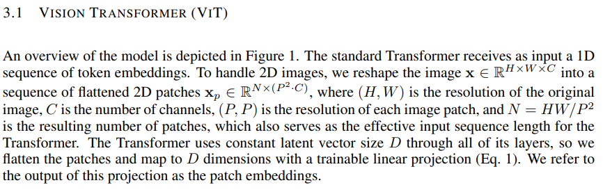


3. Method
3.1 Vision Transformer (VIT)
Patch
…
P
$$N = \frac{H}{P}×\frac{H}{P}=\frac{HW}{P^{2}}$$
H
P
…
…
…
C
W
$x∈R^{H×W×C}$
$x_{p}∈R^{N×(P^{2}∙C)}$

Slide 3
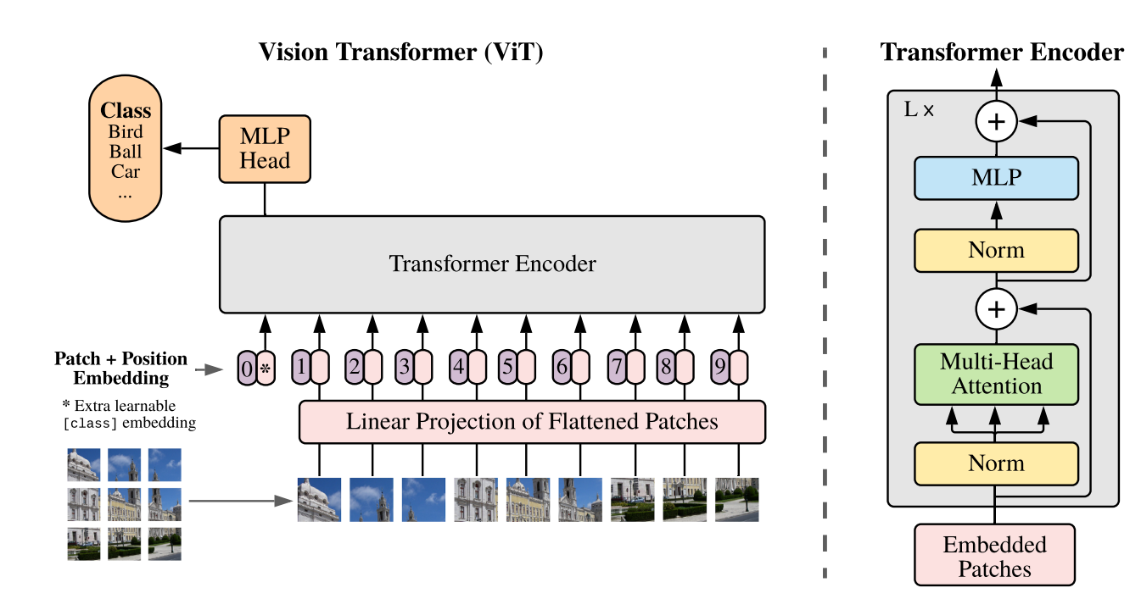
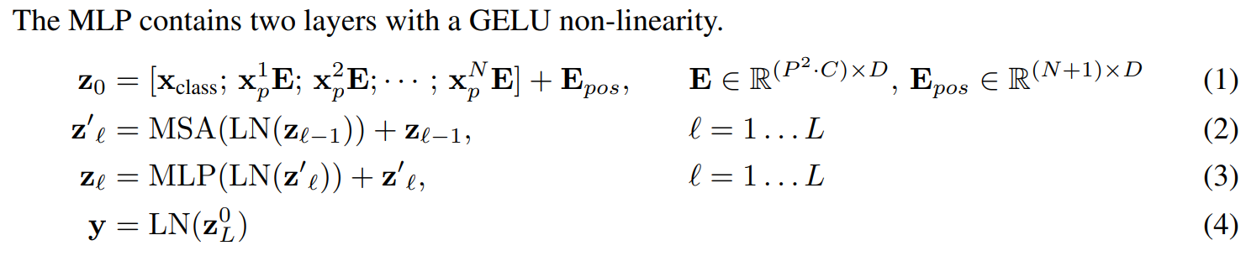


3. Method
3.1 Vision Transformer (VIT)
Linear Projection
P
P
Constant Latent Vector
P
[0.2 0.3 0.4 … 0. 1]
D dimension
Skip Connection
$$x_{p}^{1} ⋯ x_{p}^{N}$$
$$x_{p}^{1}E;x_{p}^{2}E;⋯;x_{p}^{N}E$$

Slide 4
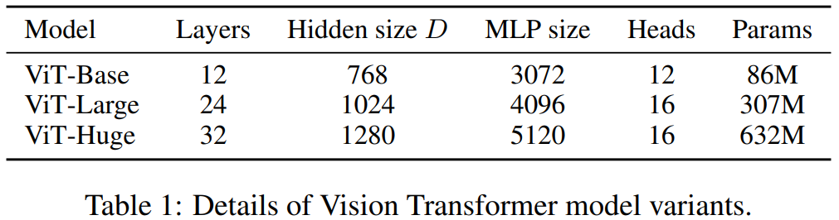
3. Method
3.1 Vision Transformer (VIT)
mlp_head_units = [2048, 1024]
D
1024
2048

Slide 5
3. Method
3.1 Vision Transformer (VIT)
12
64
1024
4
Dataset = CIFAR-100
P
P=32
H
H=W=224
P
W

Slide 6
3. Method
3.1 Vision Transformer (VIT)
mlp_head_units = [2048, 1024]
softmax
100
D
1024
2048

