Slide 1
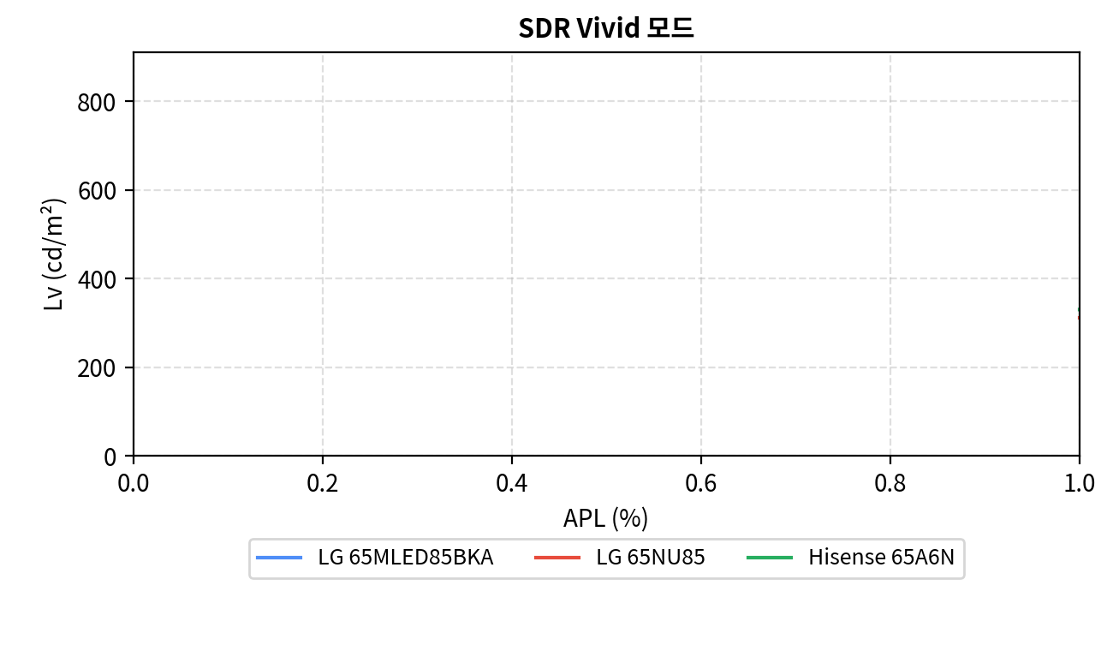

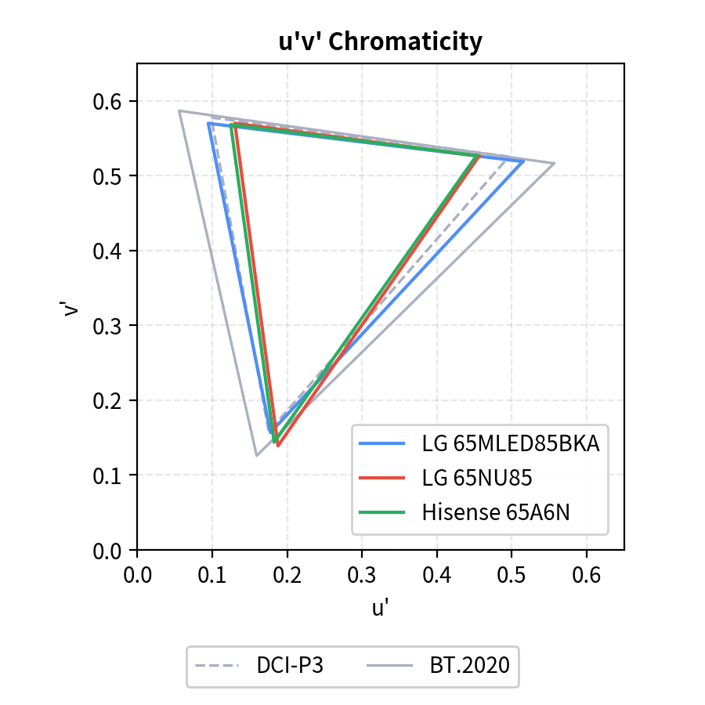
LG 65MLED85BKA, LG 65NU85, Hisense 65A6N
Category | Item |  | LG_65MLED85BKA | LG_65NU85 | Hisense_65A6N
White Luminance [nit] | HDR vivid | 10% | 797 | 314 | 327
 |  | 100% | 590 | 316 | 325
 | SDR vivid | 10% | 811 | 312 | 328
 |  | 100% | 593 | 313 | 326
 | Contrast Ratio |  | 7134.6 | 1414.4 | 6466.3
 | Black |  | 0.1 | 0.2 | 0.1
Color Gamut[%] | DCI-P3 (%) |  | 96.8 | 82.4 | 82.9
 | BT.2020 (%) |  | 75.8 | 61.5 | 61.3
Reflectance [%] (SCI/SCE)
Local Dimming Count [block]

