Slide 1
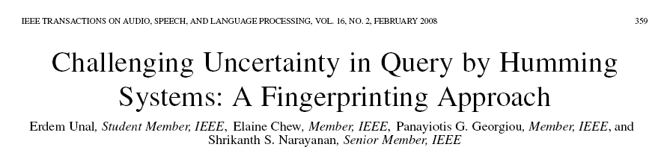
현경우

Slide 2
검색 방법
wave-to-midi
energy
pitch
voice
midi-to-midi
Edit Distance
Dynamic Time Warping
Dynamic Programming
Hidden Markov Model
Fingerprint

Slide 3
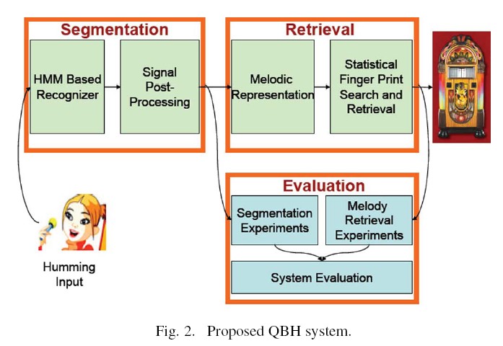
Evaluation

Slide 4

Evaluation

Slide 5
wave-to-midi

Slide 6
MIREX
Music Information Retrieval Evaluation eXchange (MIREX)
음악 정보 추출 대회
2005, 2006, 2007년 열림. 2008년 예정

Slide 7
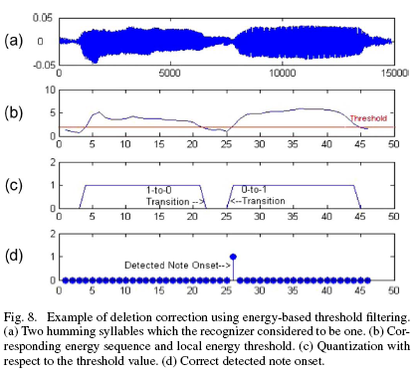
Energy

Slide 8
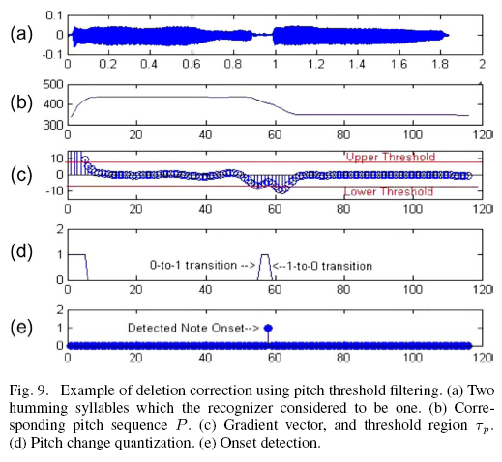
Pitch

Slide 9
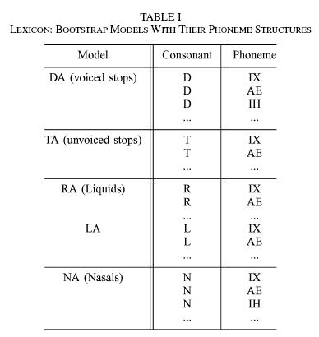
Speech Recognition

Slide 10
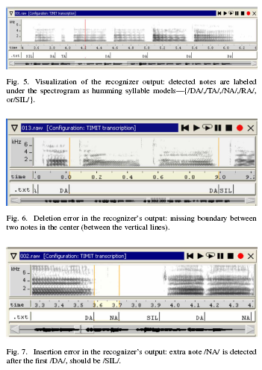
Speech Recognition

Slide 11
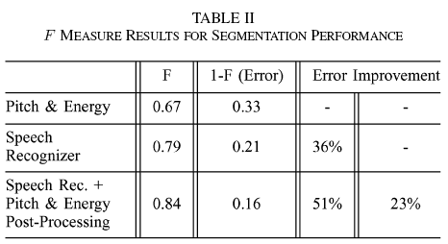
Performance

Slide 12
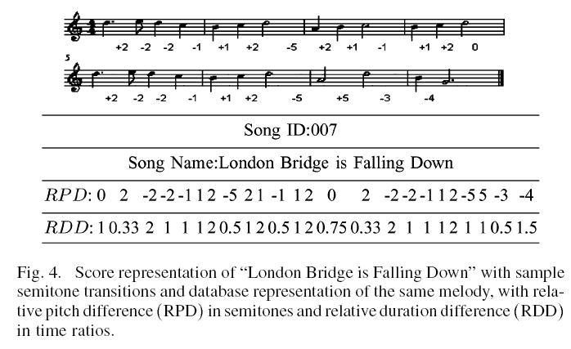
Semitone Transitions

Slide 13
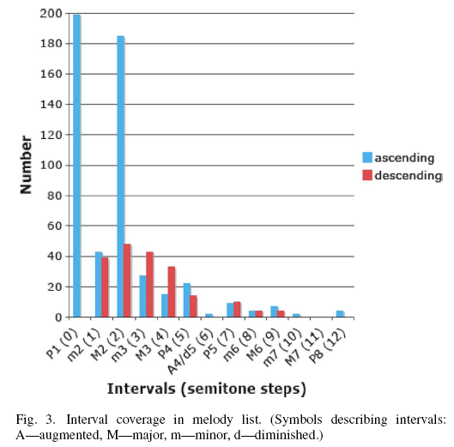
Interval Coverage

Slide 14


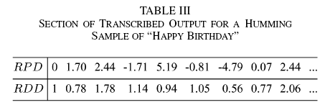

Slide 15
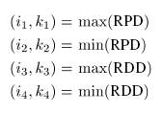
The 4 generic FingerPrints

Slide 16
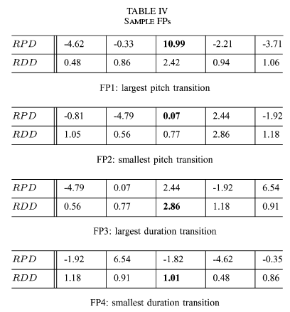
Sample FingerPrints

Slide 17
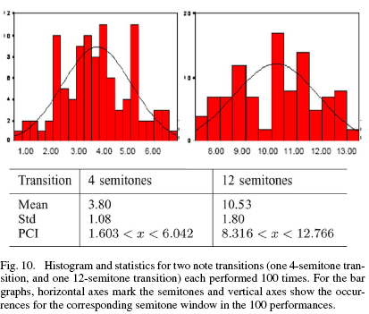
Uncertainty & Variability

Slide 18
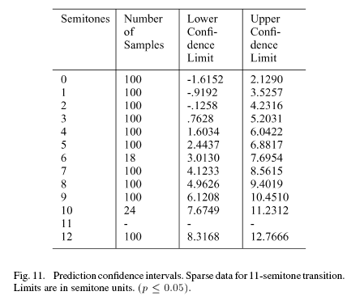
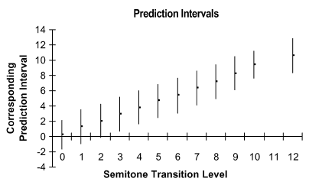
Prediction Intervals

Slide 19
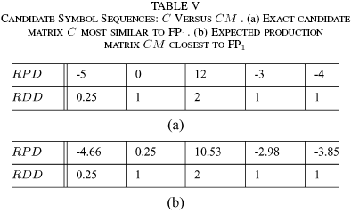



Total Error(TE), SimiLarity(SL)

Slide 20
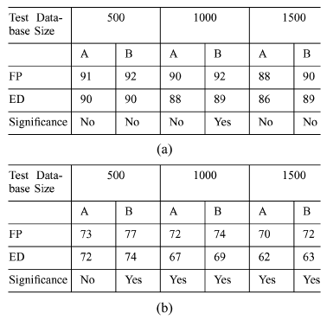
FPs vs ED

Slide 21
Future Work
Use logamthic metric
Use the fingerprints approach
Use the evaluation tool

