Slide 1
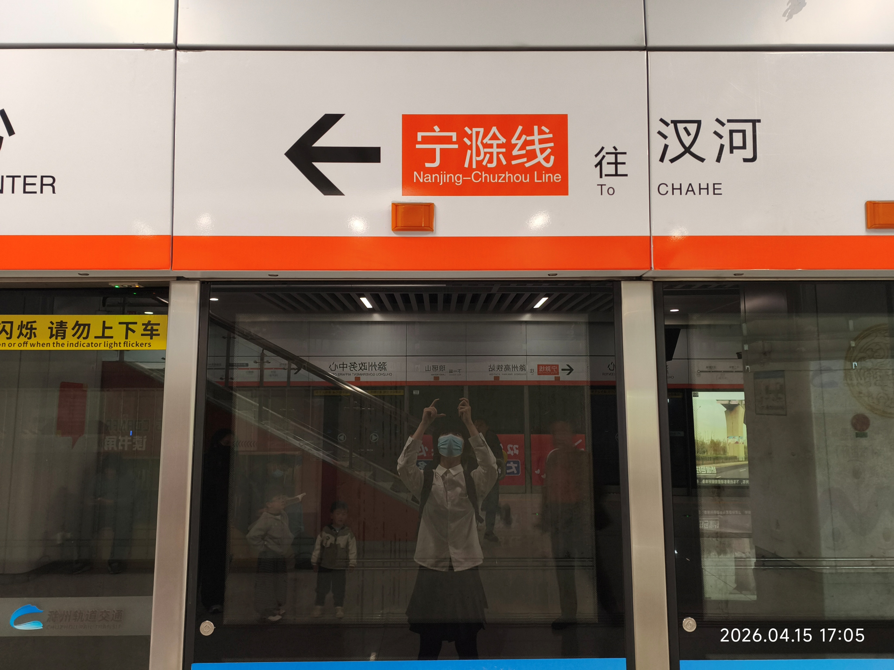
宁滁线
Nanjing-Chuzhou Line

