Slide 1
Indexek
… WHERE key = 22
Row
pointer
Key
22
22
Table
Index
Notes:
Indexes
Indexes are optional structures associated with tables. They can be created to improve the performance of data update and retrieval. An Oracle index provides a direct access path to a row of data.
Indexes can be created on one or more columns of a table. After an index is created, it is automatically maintained and used by the Oracle server. Updates to a table’s data, such as adding new rows, updating rows, or deleting rows, are automatically propagated to all relevant indexes with complete transparency to users.

Slide 2
B+ fa index
Index entry
Root
Branch
Index entry header
Leaf
Key column length
Key column value
ROWID
Notes:
B-Tree Index
Structure of a B-tree index
At the top of the index is the root, which contains entries that point to the next level in the index. At the next level are branch blocks, which in turn point to blocks at the next level in the index. At the lowest level are the leaf nodes, which contain the index entries that point to rows in the table. The leaf blocks are doubly linked to facilitate the scanning of the index in an ascending as well as descending order of key values.
Format of index leaf entries
An index entry is made up of the following components:
An entry header, which stores the number of columns and locking information
Key column length-value pairs, which define the size of a column in the key followed by the value for the column (The number of such pairs is a maximum of the number of columns in the index.)
ROWID of a row that contains the key values

Slide 3
Bitmap Indexek
Table
File 3
Block 10
Block 11
Index
Block 12
Start
ROWID
End
ROWID
Key
Bitmap
<Blue, 10.0.3, 12.8.3, 1000100100010010100>
<Green, 10.0.3, 12.8.3, 0001010000100100000>
<Red, 10.0.3, 12.8.3, 0100000011000001001>
<Yellow, 10.0.3, 12.8.3, 0010001000001000010>
Notes:
Bitmap Indexes
Bitmap indexes are more advantageous than B-tree indexes in certain situations:
When a table has millions of rows and the key columns have low cardinality—that is, there are very few distinct values for the column. For example, bitmap indexes may be preferable to B-tree indexes for the gender and marital status columns of a table containing passport records.
When queries often use a combination of multiple WHERE conditions involving the OR operator
When there is read-only or low update activity on the key columns
Structure of a bitmap index
A bitmap index is also organized as a B-tree, but the leaf node stores a bitmap for each key value instead of a list of ROWIDs. Each bit in the bitmap corresponds to a possible ROWID, and if the bit is set, it means that the row with the corresponding ROWID contains the key value.
As shown in the diagram, the leaf node of a bitmap index contains the following:
An entry header that contains the number of columns and lock information

Slide 4
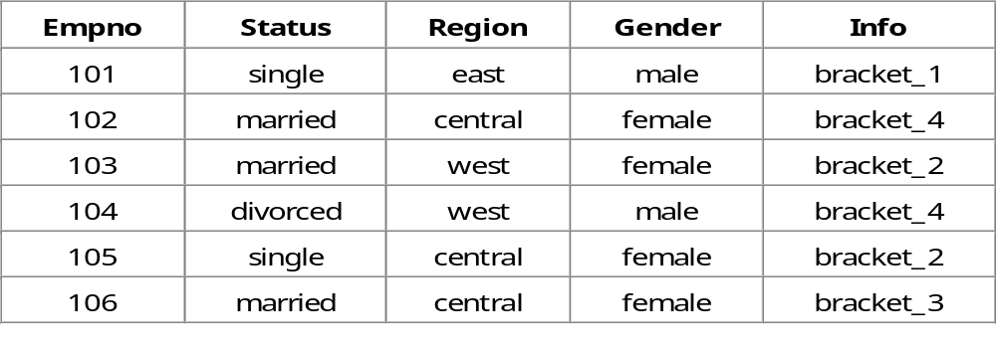
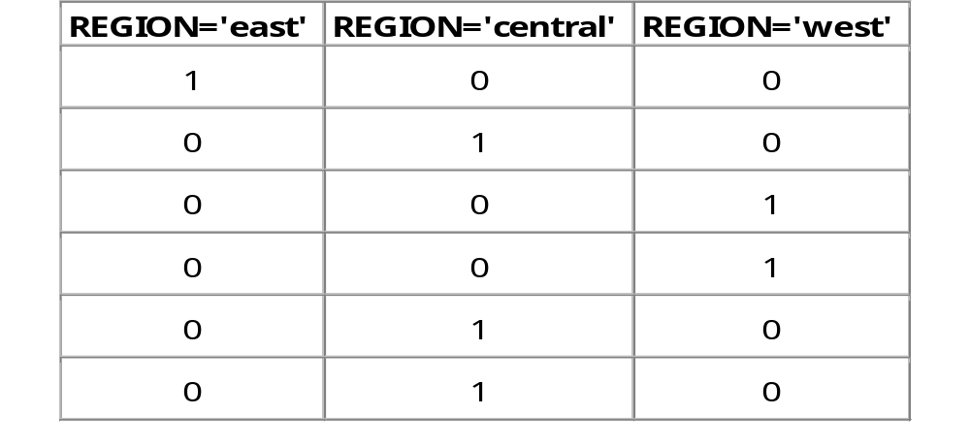
Bitmap Index

Slide 5
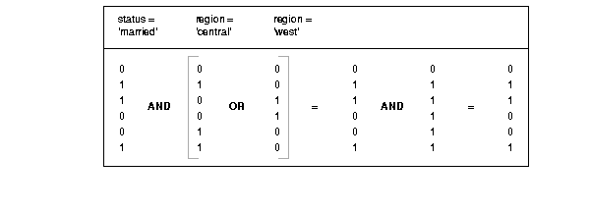
Bitmap Indexek használata
SELECT COUNT(*)
FROM CUSTOMER
WHERE MARITAL_STATUS = 'married‘
AND REGION IN ('central','west');

Slide 6
Tömörítsük a bitmap-eket
A bitvektorban az 1-esek ritkák, sokkal több a 0.
Szakaszhossz kódolás:
A 0-ákból álló, i hosszúságú szakaszok hosszát kódoljuk.
10000001000000000100010000000000001
1. Meghatározzuk, hogy az i binárisan ábrázolva hány
bitből áll: ez lesz a j szám.
2. Ezt unárisan ábrázoljuk: j-1 db 1-es majd egy 0.
3. Mögé írjuk i bináris értékét.

Slide 7
Tömörítsük a bitmap-eket
Példa: 100000000000001
13 db 0-ából álló szakasz
j = 4 -> unárisan: 1110
i binárisan: 1101
A szakasz kódolva: 11101101

Slide 8
Tömörítsük a bitmap-eket
i = 0 kódolva: 00
i=1 kódolva: 01
A záró 0-ákat nem tároljuk.
Visszafejtés:
Fejtsük vissza: 11101101001011 -> 13, 0, 3
Az eredeti: 0000000000000110001

