Slide 1
DANGKONG 피아노
소프트웨어실습1
2016314857 김규연
2016311739 김연재
2017.06.13

Slide 2
목차
1. 땅콩 피아노 소개
Overall
Design
2.1. Single Play
2.2. Multi Play
2.3. Song Practice
3. 후기

Slide 3
<땅콩이 자기소개>
이름 | 땅콩 피아노
취미 | 피아노 혼자 치기
좋아하는 것 | 친구랑 피아노 같이 치기
특기 | 곡 연주 하기

Slide 4
<땅콩이 패키지 구성>
piano
- 피아노 구성 -
main
single
multi
song
- 메뉴-
Play
Play
Practice
- 독주 모드-
- 합주 모드-
- 연주 모드-
server
- 합주 서버-

Slide 5
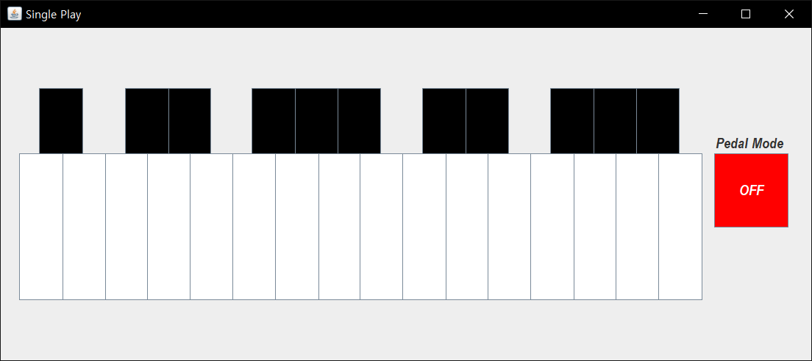

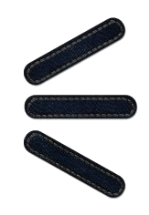
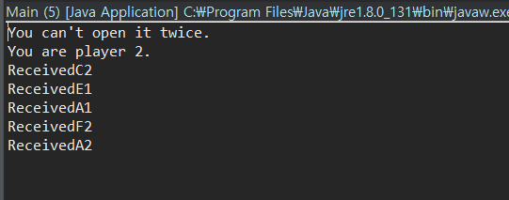

Main menu
해당 play mode 창이 이미 틀어져있는 상태에서, 또 틀어지는 상황을 방지했다.

Slide 6
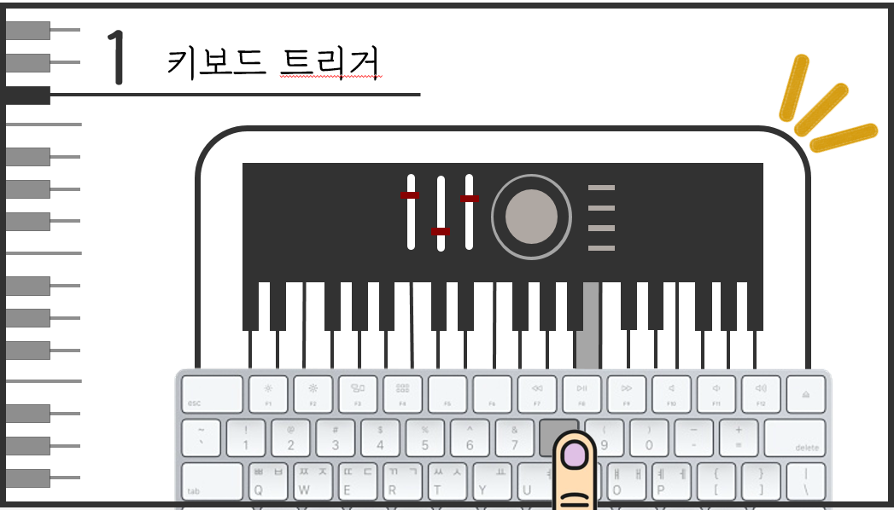
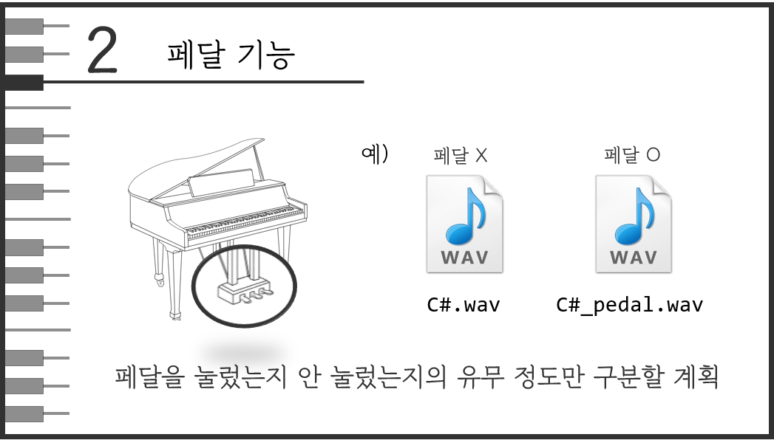
Single
Play

Slide 7

piano
- 피아노 패키지 구성 -
피아노 그 자체를 담고있는 패키지, 모든 play mode의 기반이 된다.
<Piano.java>
<Keyboard.java>
<Pedal.java>
<Keyboard.java>
<Key.java>
ArrayList < >

Slide 8
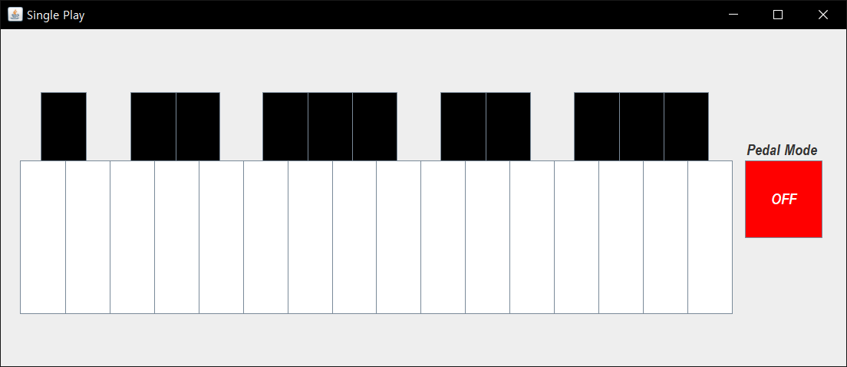
Piano
Keyboard
Key
Pedal

Slide 9
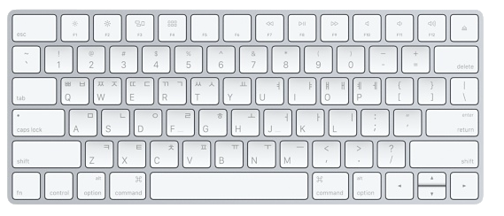
singlePlay
- 독주 -
건반을 마우스 또는 키보드로 누르면 소리가 난다.
도# 미b 파# 라b 시b
도 레 미 파 솔 라 시
시b 도# 미b 파# 라b 시b 페달
라 시 도 레 미 파 솔 라 시

Slide 10
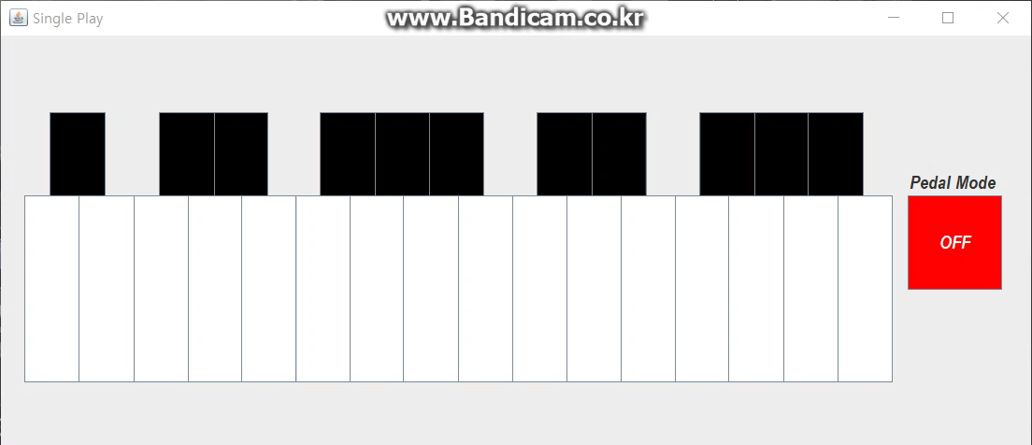
singlePlay
- 독주 -
페달을 클릭하거나, Enter 키를 누르면 페달 모드가 ON/OFF 로 바뀐다.
페달이 ON 상태라면, 페달이 걸린 피아노 소리가 난다.
눌린 키보드는 순간적으로 회색으로 바뀐다.

Slide 11
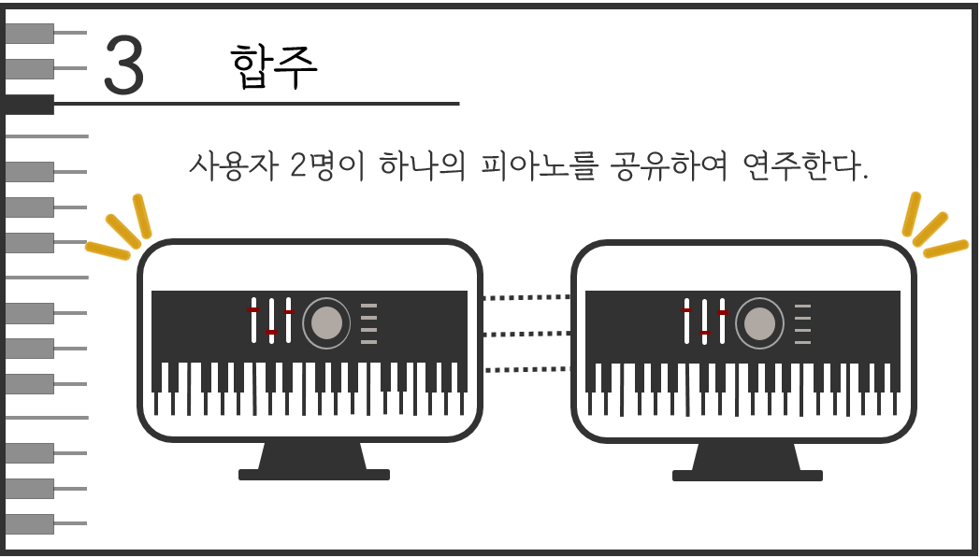
Multi
Play

Slide 12
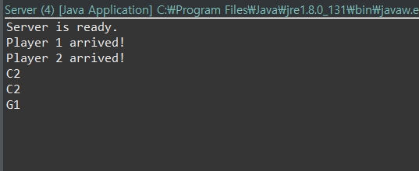
multiPlay
- 합주 -
서버를 틀고, 각자 다른 컴퓨터에서 player 두 명이 각각 접속하면, 합주가 가능하다.
서버의 콘솔창을 통해 접속 여부와, 오가는 음을 확인할 수 있다.
각 플레이어의 콘솔창에는 다른 플레이어에게서 받은 음을 확인할 수 있다.

Slide 13
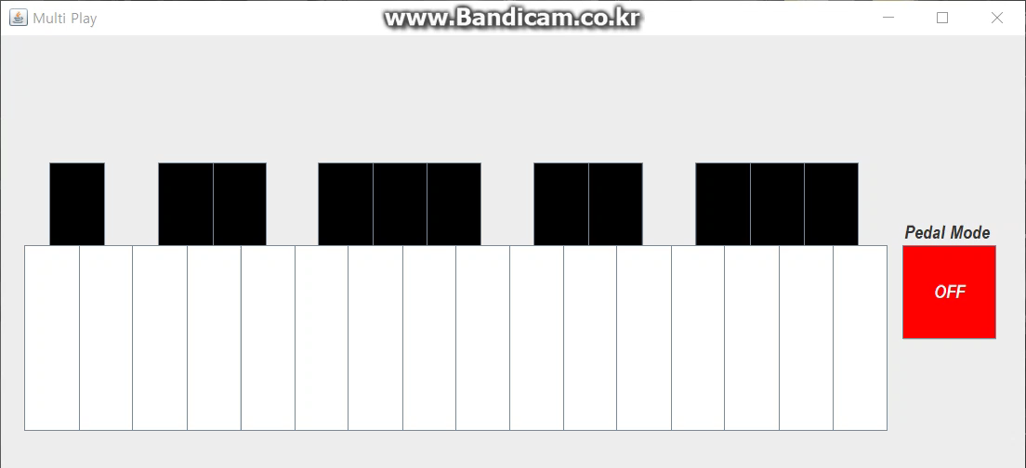
multiPlay
- 합주 -
다른 플레이어가 누른 건반은 빨강, 내가 누른 건반은 회색으로 표시된다.
다른 사람이 누른 음도 내 피아노에서 들린다.

Slide 14
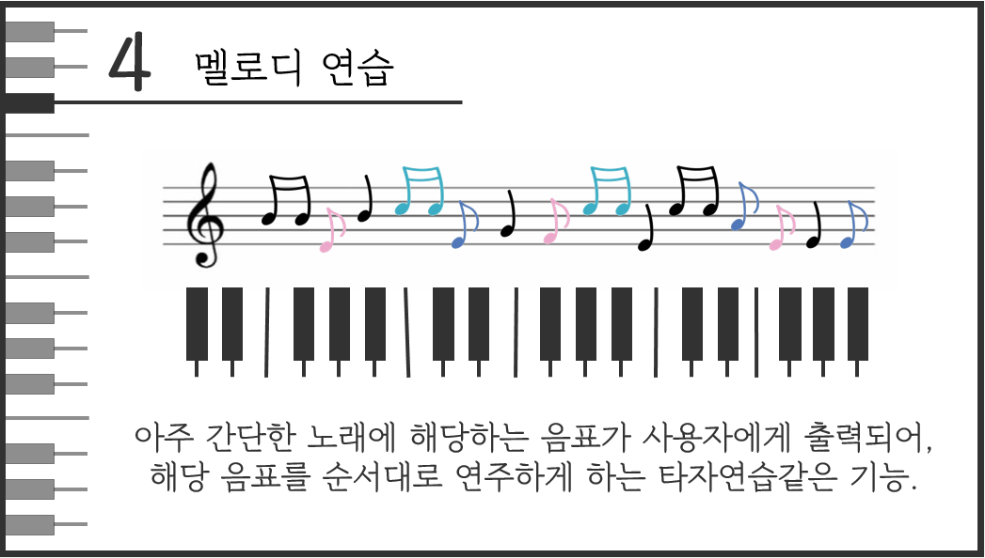
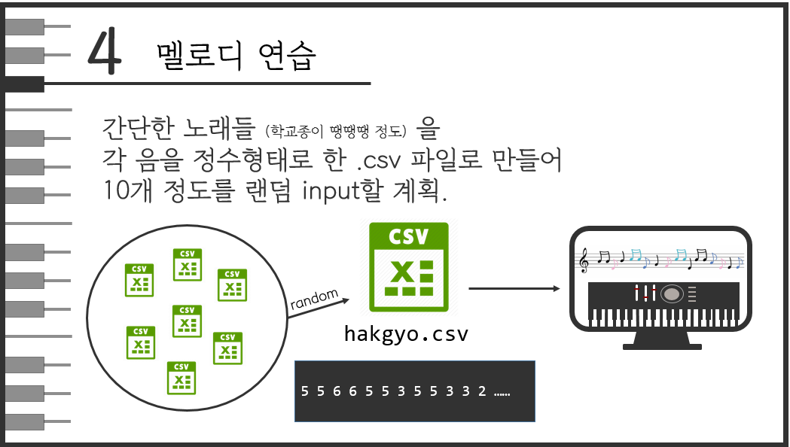
Song
Practice

Slide 15
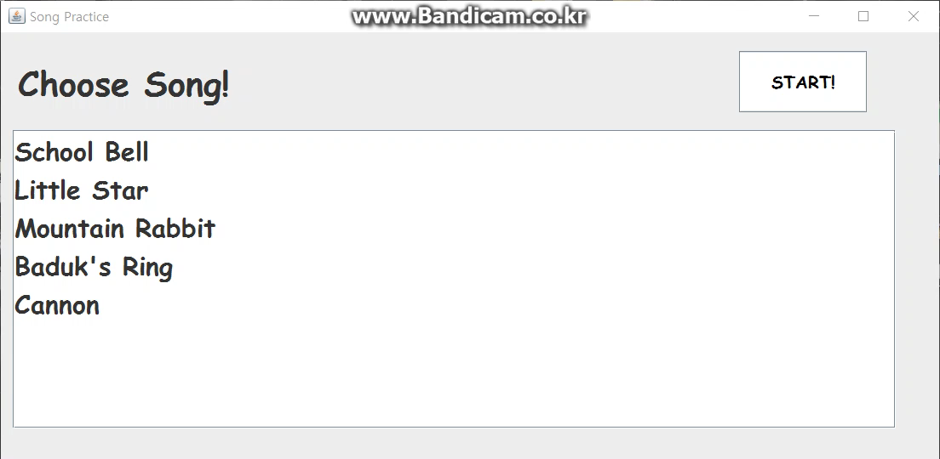
songPractice
- 노래 연습 -
여러가지 노래 목록 중에서 하나를 선택하여 연습할 수 있다.
(학교종, 작은별, 산토끼, 바둑이 방울, 캐논)
아무것도 선택하지 않았을 때의 예외처리도 했다.

Slide 16
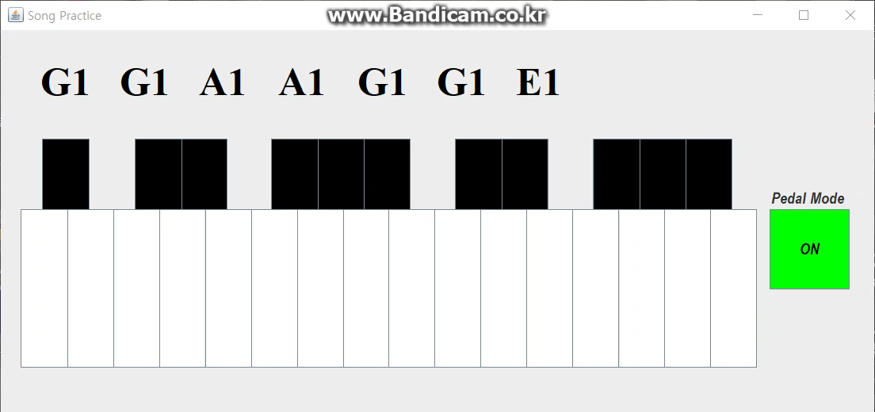
songPractice
- 노래 연습 -
연주해야하는 멜로디가 순서대로 출력된다.
바른 멜로디를 눌렀다면, 노란색으로 바뀐다.
곡을 끝내면 “END”가 출력된다.

Slide 17
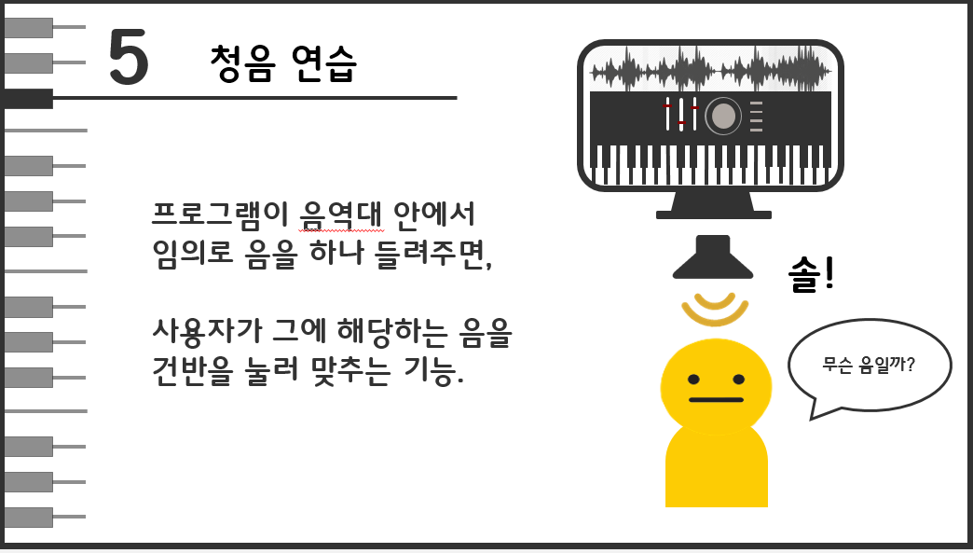
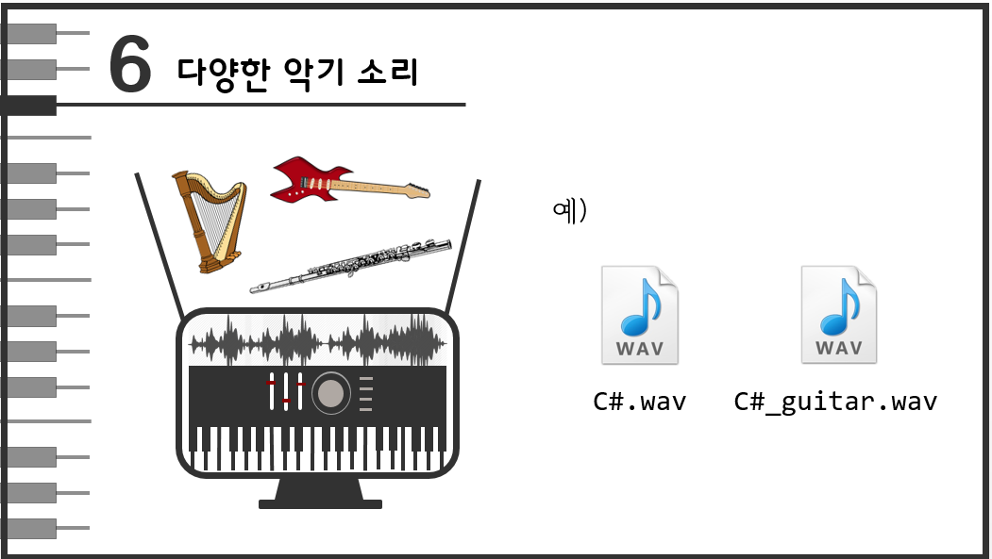
구현하지
못한 기능

Slide 18
후기
좋았다
처음으로 만들고 싶었던 프로그램을 만들어보았다.
아주 깔끔한 OOP 디자인!
만족스러운 결과물, 다양한 API를 써볼 수 있었다.
핵심적인 기능을 모두 구현할 수 있었다. 목표달성!
아쉬웠다
멀티플레이를 재실행하려면 서버를 껐다 켜야한다.

Slide 19
2017.06.13
By . 김규연 김연재
감사합니다

Slide 20
2017.06.13
By . 김규연 김연재
Appendix

Slide 21
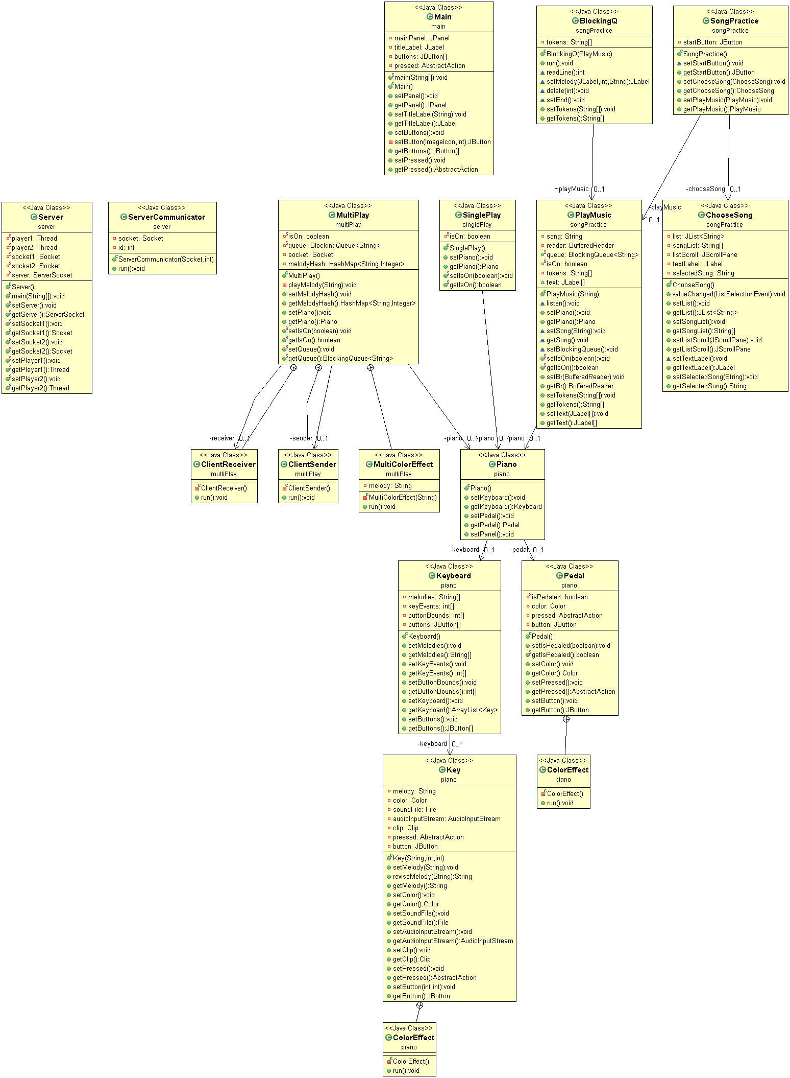

Slide 24
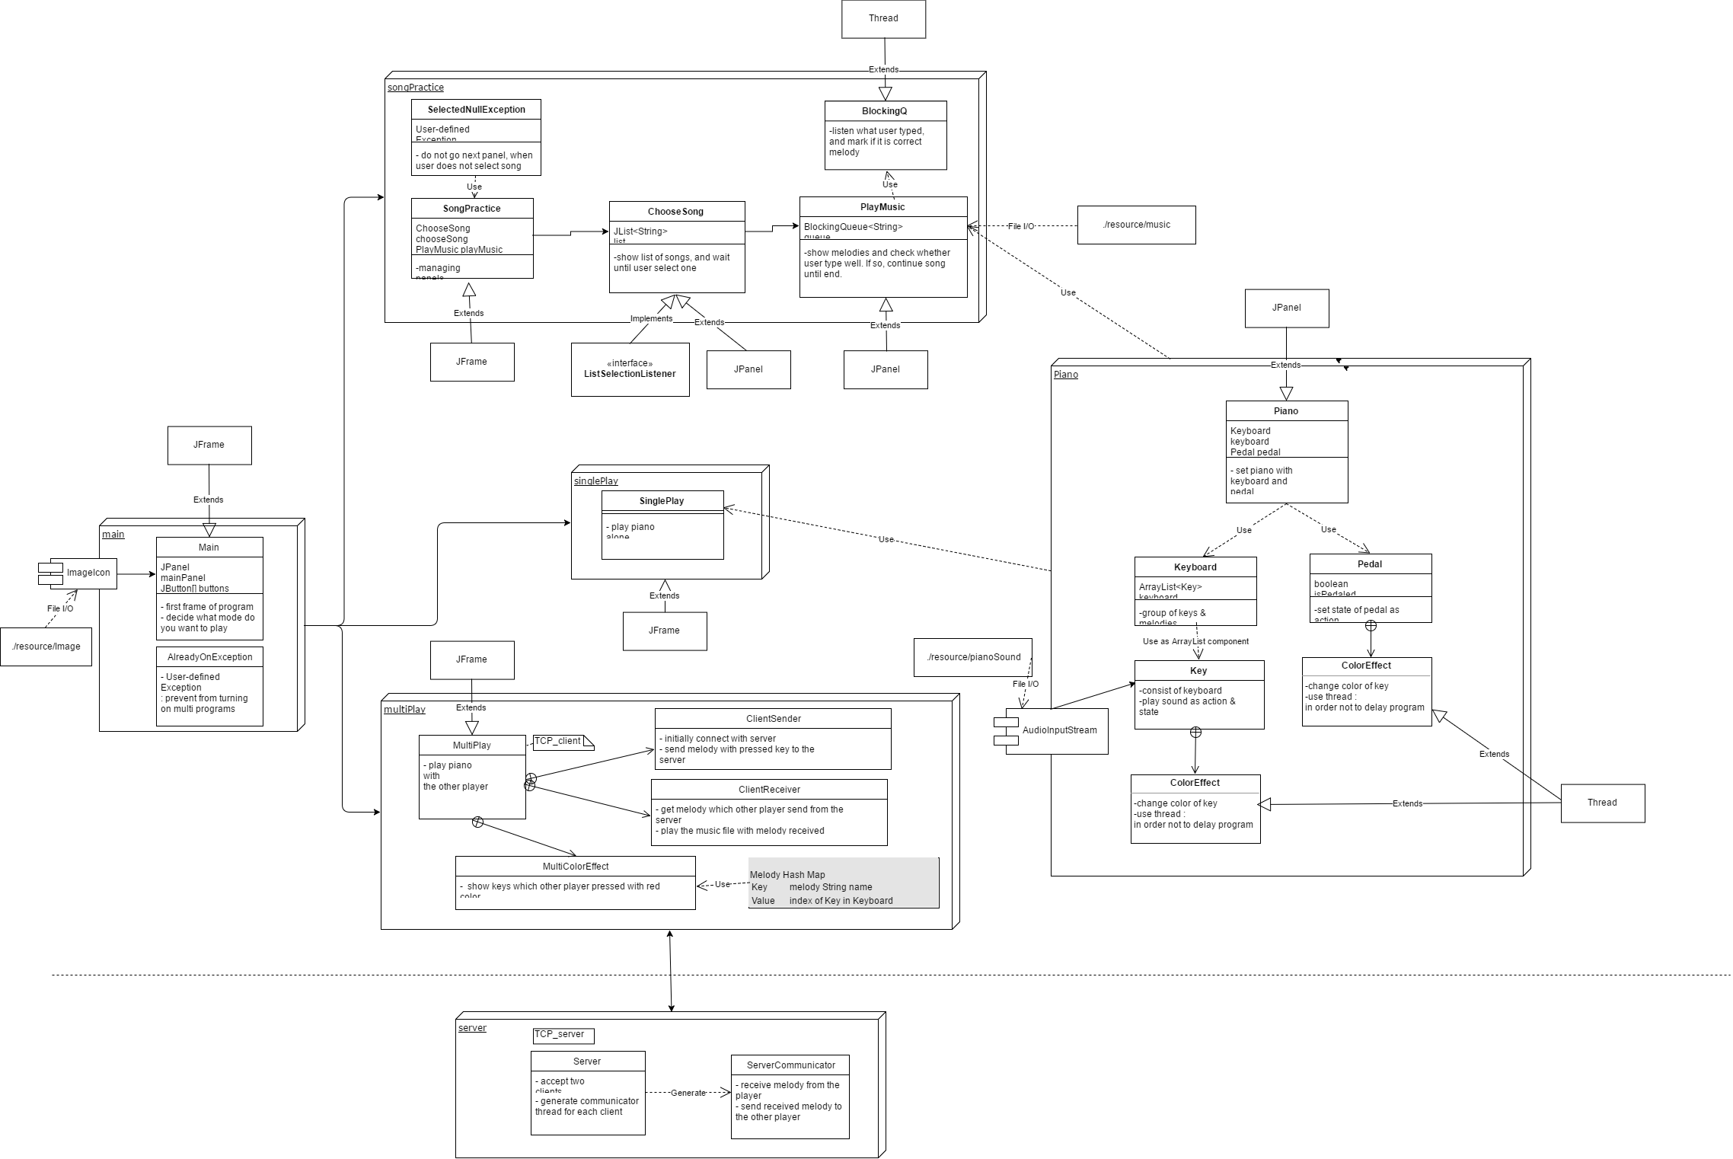

Slide 25
https://www.draw.io/?lightbox=1&highlight=0000ff&edit=_blank&layers=1&nav=1&title=Untitled%20Diagram.html#R7V1dd6M40v41ubQPEoiPy06me6dnu3ezk9l9d6%2F2YCPb7GDwAu4k%2B%2BtfSUgYJEGwjXC6h3SfxAjMVz1VelSqKt3ZD%2FuXP%2BXhYfc1i3ByB63o5c7%2B6Q5C4AYO%2BUNbXnkLCqyqZZvHEW87NTzF%2F8O8URx2jCNctA4ssywp40O7cZ2lKV6XrbYwz7Pn9mGbLGlf9RBusdLwtA4TtfX%2F4qjcVa0%2BdE%2FtP%2BN4uxNXJo9c7dmH4mD%2BJMUujLLnRpP98c5%2ByLOsrD7tXx5wQt%2BeeC%2FV9z517K1vLMdpOeQLdgCQhX3H3wDkO9Z6wc%2FwLUyO%2FGH3YZzymy1fxRv4hvMyJi%2FkQxJvU9JUZoc7%2Bz7kWwnekKvfF4dwHafb3%2Bi%2Bn%2FxTwxe2%2Byd4avmVvyzA2nbhgV5mfVxhulmJn8jevo%2FinMgzzuhFiuxIX%2Bb9JkvLJ35nDtnelfuEHk8%2B5tkxjTB9VKs6b%2FWu6cY628dr%2FjkJVzi5D9e%2Fb9kXHrIky8muNEvZ9cs8%2Bx2LxjtoW%2Byn3iMQQC%2B4iZOkceSG%2FfB7%2FBTu44Qi%2Fh84j8I0FLfOHw%2Fybd2FuEzIO8cvnYIGNXyI4uFsj8v8lRzCv4A44LjK2Tbffj7hF3q8bdfALvR5Y8h1Zluf%2BgQr8oEjayDKbBVlR6K%2Bj%2BRLbsKhQ0Dnbunn8FW0kus0d8yo%2FN5R6cA2LJGrwtJzNbC0wQiw9ABcWZYX2tD1IXLWC0eBZUFgkODHJHydwfa9g8312mCDGrBBHdgAMgE2pIItS7ePeUiku8Yz3L53uDkQteC2gMhTjVugM262CbyR55UBp4AMR4Tn8k2crLLnj6eGe9ZAduyyPP4feW9hQhvT6ANl1BQ9SVgUVMRNQJCXlb%2F%2Bk4p9icTmv8S%2Bl7hs7CJb%2F%2BL4qG6M3k3%2Fyyc3nx3zNe6gGWJsEOZbXHYcY%2BuF2JAR0ohItOU4Ccv4W%2Fs2dWLjV3jMYvIANUYI4Nq0TGZb1ePxbzV5vHwiybY5ssmq3oFyIoai%2BrEvBJbK5qYAVid4%2BiBnDlh6%2B34zYMl837oQWI6EUDglsFQ%2B9ge0WHqWejNg2ZKhkYn4YIvlSwh1JwSWhnvhnPT2M%2Bv63lkXAn4LVoHnK6QLuUjVDxBAE6TLHWDCTgaJiyIKix0TJ2jLeaiRuZVxqDmmePkykR1qHE7S6DqTSesQnCWzUydSkJsqh%2FUtoNmznHqTfwoKI3oWtueyvqXT6r1fOgzaXQKwLsWP2z5RINNqg%2BgRHq0Geh7jMM3mruV771qAPFoDQtYN7XBtjXq4YzjRFaTZ6oD%2Bq26upniO90nIBNEQbFPmTJq7OIm%2BhK8EEhQZJZGl2Lpv8mf2ZWbp%2BGuHriQ1LvTTl57oyfhlckzB%2BCheOqibvoRFWQMrScJDEa%2FYzdFD9kRf4%2FQ%2BK8tsL6DIn%2BpTB17GELjkwbERUuQNHJ3D0EYmuISn0lYxMxLF38SsyC%2BP5K3QE9GJO%2F65nj5pHnd%2FJK8zvUP3d4icylqxzUKBD3l%2FZRs6bXXm4tYgQLJleoPXNmiOatBo0%2FMuLvETaaf39JyH9IsZOd8mqcZ3cRThlFmrMizDVQ3qA7XwTAb0Ke%2BJqB5ol0qf94Fsg9M2%2BU8Pz4nxSMnzhTGDCCagfMZFORRPHTqqIqx2QQ8DlOMYwdMAcprEsuHoN9nDRL8nAmMj9Fb%2FtgAKHmwVD7ZGzqz7ecyKmHdseXWsJP%2BbiNhT%2BwitiH0TPYTqmVuQzU2cF5QsbfJwj8nfbEOfMc%2B2ZFtjUOhXIryOI3rs8y6kX91nbCvK6INmR7ojZASspC0HNl%2Fmhnuqp%2BmqOLCXqzNCs7WZEorqUFgLRWTC2jiqsfmQ5DiMXv%2BafnxZ4wNT3Zm7GOIuThAM5C6WEel7Wkv09wLniwhvSCcTkc0GDhQrdGd%2FYFYKf8NpZbzI6yT25pinRH2pFUupXaJhJCdrVsxWx7zVqTT7ao7jmsAdUqcQ9KPxtw0NaEh7Td4GzjvlfZ09%2BgGMD5JmCWqq2QSBNtTCNoICdeD0Z%2Fy6ysKcWp3f64%2BK0XnEUUjPfKj%2BzrbEtC1BHZNbPbZEByMz4yWkdmLzeGlsEevGSzoRmxgvAeRraUqBKeM4VB0HuTNyY6qtOJkRK0yj2Wi8G6OhG%2FZojQY00fWoiCJdz0w%2FjNIPR5pIQkCNvAO6aPfAhJ8eqfOJizVRgJg5YZjzpYeCLCpnCp3aY1aF3Br5Vc3g0PkH7mWpfjNQhSWerc4EVsc%2Fm6roIGdk2OOqU0MnwjubnglNj%2B2DYb2PEdPjqg7gD3kevn5htoebDmYpWKfEG7ixaFil2W6MZzfc86eEdHgRx42LlwERl%2FMI50oJI3i7EY6rekIWNGTj0GAihZZX7HGSRTGe54enhIomQ2lCY6DO2HB%2F2MwgDDII15EYhKcZvEzHIFSf1yrLEkyzcK24YIDAM0MY1yicP6EynVFQ%2FRkzQxhbwjdlCBpvReX%2F5J4FHi7CZ0Za7ojZCEwGkZsyA0%2BtEvL3Qk1ZbgTJZwf2lklLM1i3K8%2BhmYLVysFaWEvLCkTLI85j8jCUTNRR82p21uVpf52zyb3pWV2UTiepa%2BPlkZxEJYt7aMA88GXWEXhLGjrtWG5gAcsRSZ4TRNB7qvPKGLqa4HpHEOrQfRMQcuUU5EsT%2BgCyvKVvn36k4Gk%2FaO21vekApXo1RJC0hCkl1%2BrKMAjUfgcwWLpUqVxg2QggF2riyYHGiBupP6GJJv%2F4UhIdUof4DVVbJRkdVjV1za026ZiIa9GbadpvqeFIyuYNUbau2UMTyiYnvQI3WNoB%2BSHa4Tq%2BY0uMbrjuOeed2KS2qSPGp77CJrP3YETvgSNlvi2CgTwRWCZSVjx1tPiwy7ICU0SQ9nVjQw2%2BSsLXr0eaQ1lFlPPP88ym6aFHpcHvMwjLG5CcO%2FsfrpTwLWOwRA%2FZ9D%2FswzTcVlHeB8rb5kmISdEwMH7KiKvBV10NTzjB6xJHfzkmyTWZIzOtuJxWQE3qsza8BciFh8ZBhdZF0JFKMpuK8UyF34GTM4OezJiKAXXIZmpwpYR1UxM6CRuhBqofh%2BWm0qDsNKPD4S37SBWcMwWqFzRpFdPpymNBKzyR42kUA%2F9GwToT5khggxApZ3W2HZMhSzejoUOWY6RDUZ1hzYHqzC3McQtPqgG98HWdiK%2BhFrAHCfxyvxLlDmkJ5zOvZw3otMKEiDUNS3xPQ7MLBX9X%2BtF8NfzmFzVu86nM44bhEqGbCTtwtl4jWq%2BOep59zEcDWjPMZ05MMy9hLfPRSNgI89HkpRU7ojFC06ugDMphCkZ59LU3WqsqsGyS5zCm3z6mZZycGFJNiigGBq69MBsXc9DTUiMN9OQSquNgT%2FW4NjzzMzMyx4wCT57MUU1Q7YhpZ9FDA0AIVM%2FsPZ0NJkr4tyM%2B4kHE5L%2FVkbPxGNF4BOcyEy1ojDCTQHXfzsxkbAlrmIlWwiaYiTBJbZ%2BMSjc4WzllkXRWB2uzjC7ist5hYtOZa6fcMdLCuUv5emB1ysh9L8nfz2ecuaJQlctoTXqOOKWminuGao6E02g5k6Lb2zXd6j061HsmSFGguiKfupeKmlnRmP4iKcMWClncJD8mmGtojqDqwThlf4x0cPrKdbwqg6gJEyZsqDyb%2F8kwYQ%2FUejO01ldk3VyIhryLXbbN0jBprkbTLqWuiZEVn6vK%2F7COitUsGMB2%2FgeX5Ss37uGxzKhk6yt%2FyZg9GDF0fVA0rdchtcGRs5fLJPgRZXLFm%2BwK%2BPecpXv68VqdKYBg2QzSdy4NSL7qKiYX9xAzOzNM3oCJ3ydAeyyYXHMVozABPyJMvm8LDyyVW%2F8AQplN%2FNi6q1kn4wHefbiP6cB6Q6kw2byvfUCrXPYKrUQDnXCv4k3JoIhu4JR6mWrvz6rT9TNuKpm8dnHdjTXpL9Isa2bE%2BwEsddT7eX9I8B7TMYOio2Onj1l3rfQxx%2FeaagqW1kmJ5RzhkSxljbFeU%2Bl3lIgzkFrmSZllIk%2FiXK0OnP7zGNVbdZZ71MTfkWTvD%2BolO2LqDYjel6cJ%2FWDpBUFAjAby%2FHohgLPtu2WfdV6TyAATsLFWv2%2B1%2B%2F1bcDF%2FiIHpSBSfgIuJpR7%2FQCIREXm9Iqm8zLcRiWZSQr%2Bs7bysyqU8DEg0tzaSLSKmi8mQ6yqMJHO9ezpc0%2FQXitVn6p5eJ7GWmc0O6isc1Fzfzpq10CFjDA81gi7yAhQ5QeRgYG0WQF%2FJfkvHL1UZp3W23x9TIrSSyJUAZUcXYyIfNmwTh%2BtdDZwZN1PiRhdoqsONPKQeyaCowKk6kYcWXuYOZZwOxZcrgli2piiMbmRvqkPR1H9j9GWNKXvhITz0CcQKXDvaSudDT54RafXAArOYHX6OqHkStl5gdYqMB%2FK0TzUXejBpic6vYa91MhlZbgdCBYlf6fJuF4bYzAZIn9oteQ9cMHSRYzP2B2oqVN8p8RYda%2FDMhuRGhqTS1bMMyWRrAAKoequZX7EqXtpYEIFy4gMRqobxGqk2eDeOX8Id4ovuWq7ERJkzINUUdN1L55ig%2B8aZTHodoTq2%2FuVTtWayhI5xJ3s8Ua1NrN2K7HbdQFWZJqsaCKA6PjBQNnAkzeAinGYGhlZ37JoOtX3U3OnKjGmoQniB3YaG3Akb1Qd1aGCmMKtu1n0kRIgI8X4f7oQlIaFcwldO4htsK2Wra0OnNQU%2FYcVVYKt5P0tyFsKCK%2BGQE2rzB0cuwCoXoa2ri701ojFjO0VaXuOtEPNHmchncrK%2FjqhJYtq8ezpF0rERVawW%2FkXzJCZ0zAramrGAvr1sVkf1Lp0jrYEy9MxGlU5XAKka%2FBxawHL%2Fe8zKesRZraxuHV7I77tqrR%2FWvmAjF7rPaeyj46QFH%2FLQfTxbpT5nZygNGzV93GxYZrkugKZuO8htOzqaKyrcn64Eui960eNW47f6eeVzL9a7MN1WnvOE%2BcjFgkl9t27kTo5s9FJ77Nmh095CTOspZXnExtlVJSXmyYswH6fn2ZYw5alvqzuiq30Hkp3VD9mlcX1jIL5hnLXyLjWsMd3%2BFO7jhBqDn3HyDdOz6ojtlWsMWu1erSabN1neFNiacLu3ezLmXRNt6zhf09y5Y6EMCthxje1TD%2BibGGj39lncwk7TaTlSp%2BVa0hIMwwM1pZguVy6hZbRTGpAgNwE6RuI2bkdOqhkABMvADiCCtu06jog%2Bqf20kBEN8XMpg5HLYaEJV%2FoAtuphqUtKKCiZs2jHXGbOstqehAWBAnNRQBR4rn5tismyamvncHMWIGHh1%2FSWdiErWnRK%2BI%2BqpP2qNAB5obQyQEzZGatuFBeMtOV5VdRIzD1K8JonAK6ZALDHqRmPHCNoUgdG4zqutMNtb6Lx9jCX1oTDbSgvRmK5ozg%2FiVU478Qmuy5HZb2TTA4A6eVCS15USNW06WYHHJXtTbqo0EgqVUu3V6cqd94kOgVFbK%2Fw7cpl1YfqkNuehwi8%2FtMa1SB1Juk37tIwq0FyXTXXC97P%2FJqjTrKY1CDFQTyaBk0431yT1Xr9kkuXQUQSNJQzmVQIpJLeaRTCgojOFMEAuo5NKD1svYOFjazWYmKayhvT6YeIjjWsHx20zTtHRaYBv2zNvEu7BuBL9Ar50t0YBb%2BavPJdMgc0hI13DpfMrPDZE5iwIGrK9vqeBYAH%2FEu5OZTKci2gE7DpZ2S7nm%2F7aMIlCOsp3XkmbJ4Jm2fCftyZMFdKUa6d17eZCUMqd59koWHfaQcMEjq2BDBwHBcFlut4gWZ%2BcDrG5qq0dprlly34rl%2BLGiJlksiaKpPxXgpgBLJv8NJ1zP2AvCrPQr4PbUTQAlqnpe621t4JXY6u6saejCKPWTvFndAXDSRaqqxHOLwchi%2BF3k7oKnNVPiuFU7LEmCdaXsG0VQXShLEjFie5TUylq3qczcZU9pWoaFQPG11phnikQbUw5iSqJXsLoAOXrXmICyMSZEPuyFzNqKKpPulJZnUcv%2B3BJGbqPVGVSXzSo2nKdKQDBYrYLgM9kgLV5aXtTGLeezNW%2F%2FM%2B3JrWgIWUB%2BF4Gjezrr6%2FGchr1plnb%2BHzWrfW9C480I%2Bn9EFlzCyVZHdHemnS%2BNf2NeNfEehjfBFNIPzFf6CaUDVQ%2Bvtlr2OBrwmqQmnWyv5wjOLsc3o4lk9ljqlz6r0AGkBpKg9pM3Z0qcNmEK0OuQxn7PQVumyRy1FBPCj62Zsu%2BHVBrNayGmADj%2FAfC7anLRwH9Q7Dh%2Fa7p0LPtQcRLhuXFR69KfphzYKvffhaJ2FBU%2BjOh5FlOW27aSF4vSOoH2HCCvXnqL8NMJ3qo5F8BTaQbI9rLykOriujabvSWUHPWcfDl1oRTEHXTUY2TgBuFWyjvBK1Z%2FwOppy7BNtvu%2BGUjgHJUeZqyxec7ZeVT2tujKS8YjU24beHx393FMcT5CnNSspvdTHdzSBzjiFqkgfNvrWXexqJd7mSU09XBcjXqGXfEuwXq%2BV5%2BWQ8CP%2FtogJLSwrmoUrR0e2NHR%2FXhairldZgfyg7NzzrQpLlOlK%2Bohzlb1BzVU5FNbfoKIt7ieZa70pxAbGzSwfYPqGwBFEIgdvpsepC6dNj83mhqrNguDI3FVXtgadLC3Wt9kDIvbTQv%2Be%2BcSKTVFSNCHhgfekTkeJcrnrEtTIlp6rOm2Lr6LZvwh4AdQjSUTA0TuMyDpOEPso6S9Mqca8q%2BmcJ460r69eoNlqXGOVfOxApFaz4KAtUa1Ye7egO5ozA4RmBHTquIrM7IVALxDESAtV7Uwd%2Blf35tapQO1ug8SyQJ3E%2FT52h0Fsgz4TgVXduVRW9bBmMXcyKn8t1RIVlaRU%2BblsjyRTxqqXVkbzilbWpHMjcLNVXPVVHnuuVGjdOHQOrM42TY8Q4qc4GVva4FTU%2Bm6dxzBMC7RBRTzPrXLuFx15XTRW9vvYxsQHhnupWuiqYbu6IejEaU%2FRZqxPh4aYmZxs8Zn82JyOak7MXAtFiysxCIO%2Bj%2Fk7fKLx7ov%2FuImdbd1Hx%2FlH8dEl7yA%2FarMiRTjF4FI%2BkUbxvLx3oIw9Uv41lr6pvTy3lc1ucqVXAzCf%2FiWfux9l01WUVb5HvX4gzicZ7tnUjnIlX3MDZn%2BpFjd7E28grRU4iRNlTB6xLkzTVxWbkM5kUnMprW6MmTQrcKntZEOJIaEKV6bZieXYL0nwnsuH4%2B6Z7WfAlqvesCCPdsuCyajdhjtih%2F%2BojDmEU1eeGw7Lovorh2s8EOuTP1%2FAgDqooie45um%2BSUvRFNZHA9uJ98yasNXmn9V02TgiVozidah1ldT9QuWJPITXmSkskWv7cSu48tatH1gPapzKndwStlEUZ9HyZNqrX7rmbfzAMDbufOI0wxQvLUWWPYbGcTfJxlYV5NNadaeTeL131SsMuTxt14qPtFQSV9j5HwoUpn%2BNGiQTS5L7nqZxZO9fpmuDMmoUfJil03yTDxmaehR3u5ygd8aomwkWkTsmXh0HDM7ScN85ksnczvHZ1XxRog9e6Tgs2FhTbhuL6xDjm3VS7CGCwrFkp%2Bd0eZ5HRcJWkBDzH9l2AvMug5qP%2BqyBvSdptiwzziWkDYwX50ayMjPYep8Pz8LD7mkWYHvH%2F
URL of diagram >>

