Slide 1
NFL Play by Play Analysis
Project Team: Beverlyn Tucker, Gilbert Guyah, Kyle Welch

Slide 2
Data Set: NFL Play by Play 2009-2016
The NFL lacked any advanced statistical data that was available publicly, because of this the Sports Analytics Club from Carnegie Mellon created an R package, nflscrapR, that compiles NFL play by play data. Using the NFL’s API, the R package scrapes, cleans, parses, and output datasets, an example of this is the 2009-2016 NFL play by play dataset that was made available on Kaggle by the group from Carnegie Mellon. The dataset has 356,768 rows and over 100 columns. Each play is broken down into great detail containing information on the game situation, players involved, results, and advanced metrics such as expected point and win probability values.
Columns chosen:
Date WPA
No_Score_ProbGameID Opp_Field_Goal_ProbDrive Opp_Safety_Probqtr Opp_Touchdown_ProbSideofField Field_Goal_Probyrdln Safety_Probyrdline100 Touchdown_Probydstogo Home_WP_preydsnet
Away_WP_preposteam Home_WP_postDefensiveTeam Away_WP_postYards.Gained Win_ProbHomeTeam
AwayTeam Season

Slide 3
Goal
Predict team performance
Predict game and season outcomes
Analyze NFL Conference data (NFC, AFC)

Slide 4
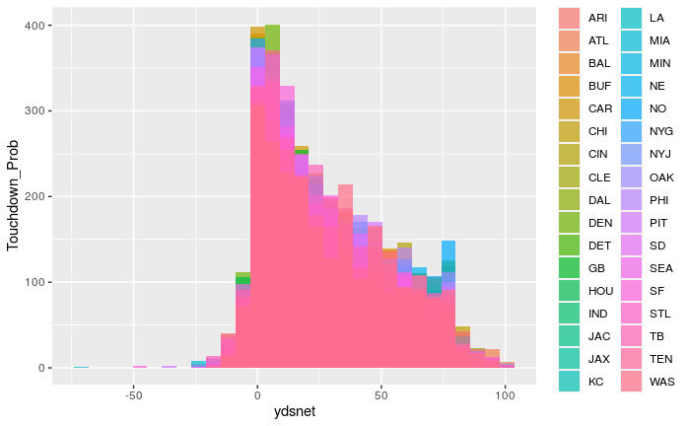
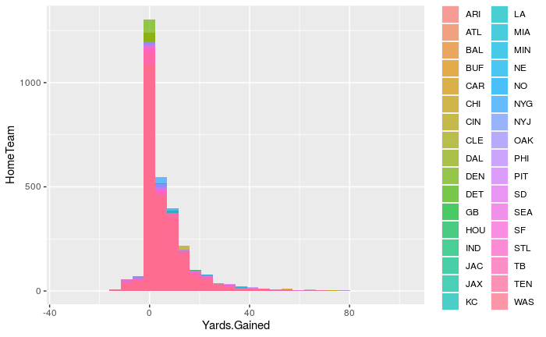
Histogram

Slide 5
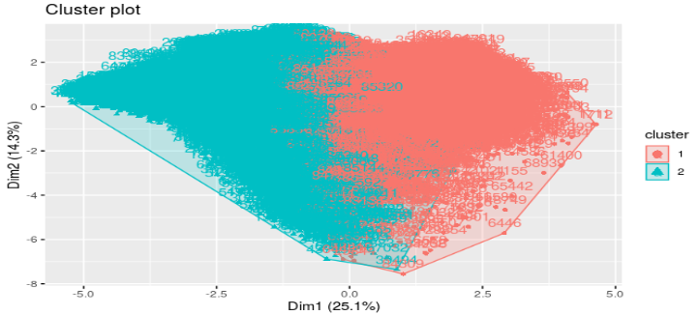
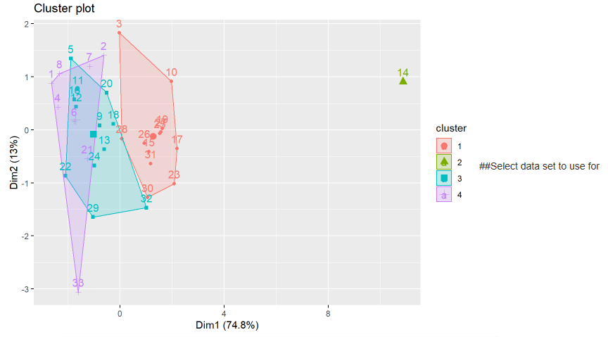
Cluster Plot ( Kmeans)
Within cluster sum of squares by cluster:
[1] 44884487 27634710
(between_SS / total_SS = 47.1 %)
Within cluster sum of squares by cluster:
[1] 37714273 0 29458239 14867557
(between_SS / total_SS = 94.5 %)

Slide 6
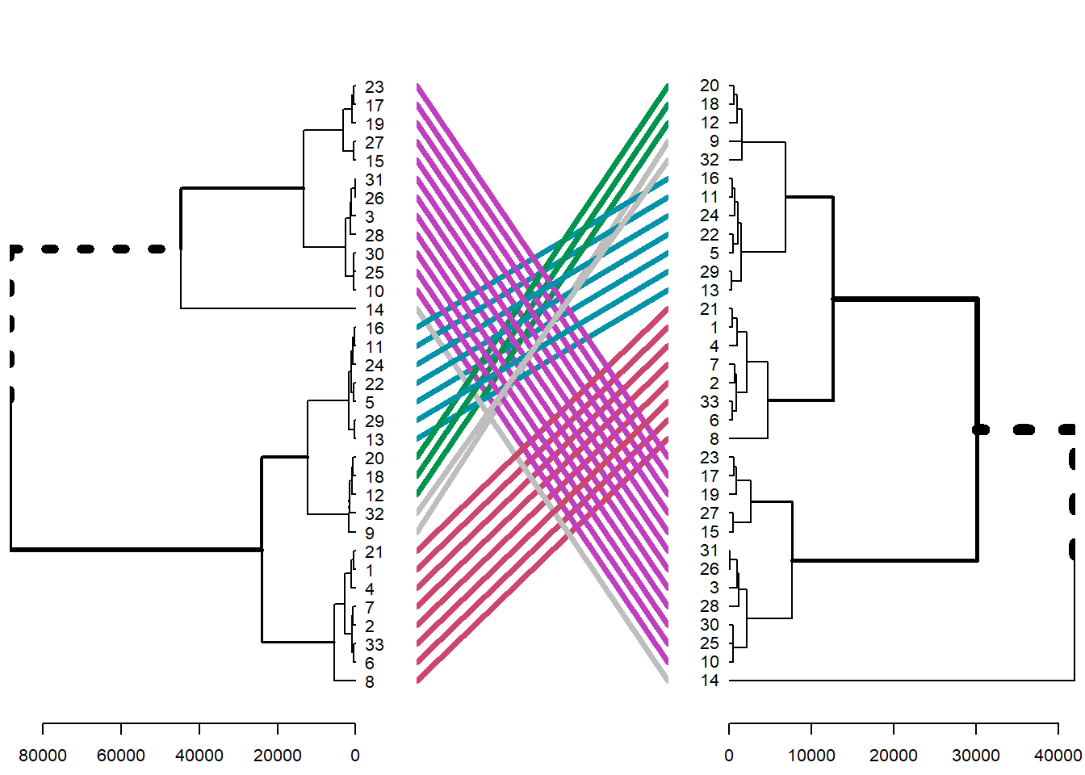
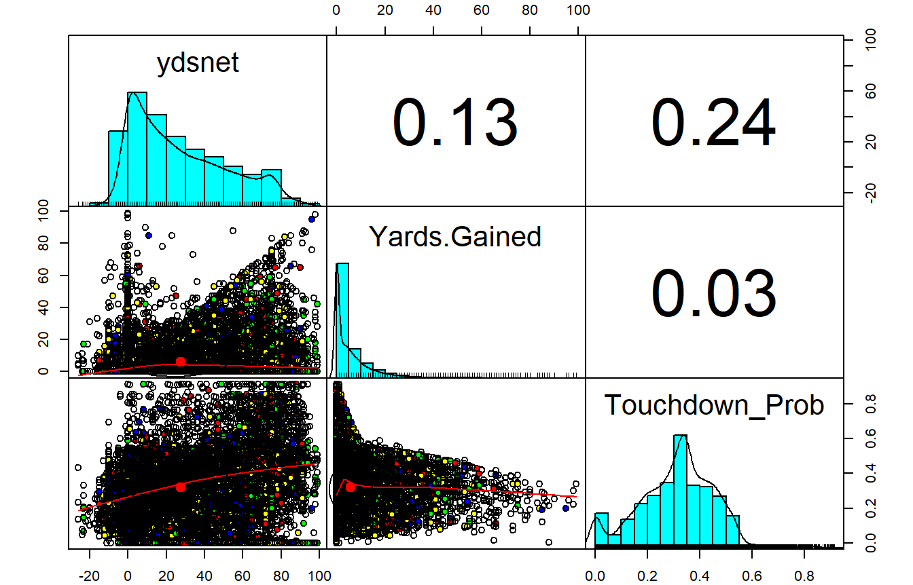
HC Model
Collinearity

Slide 7
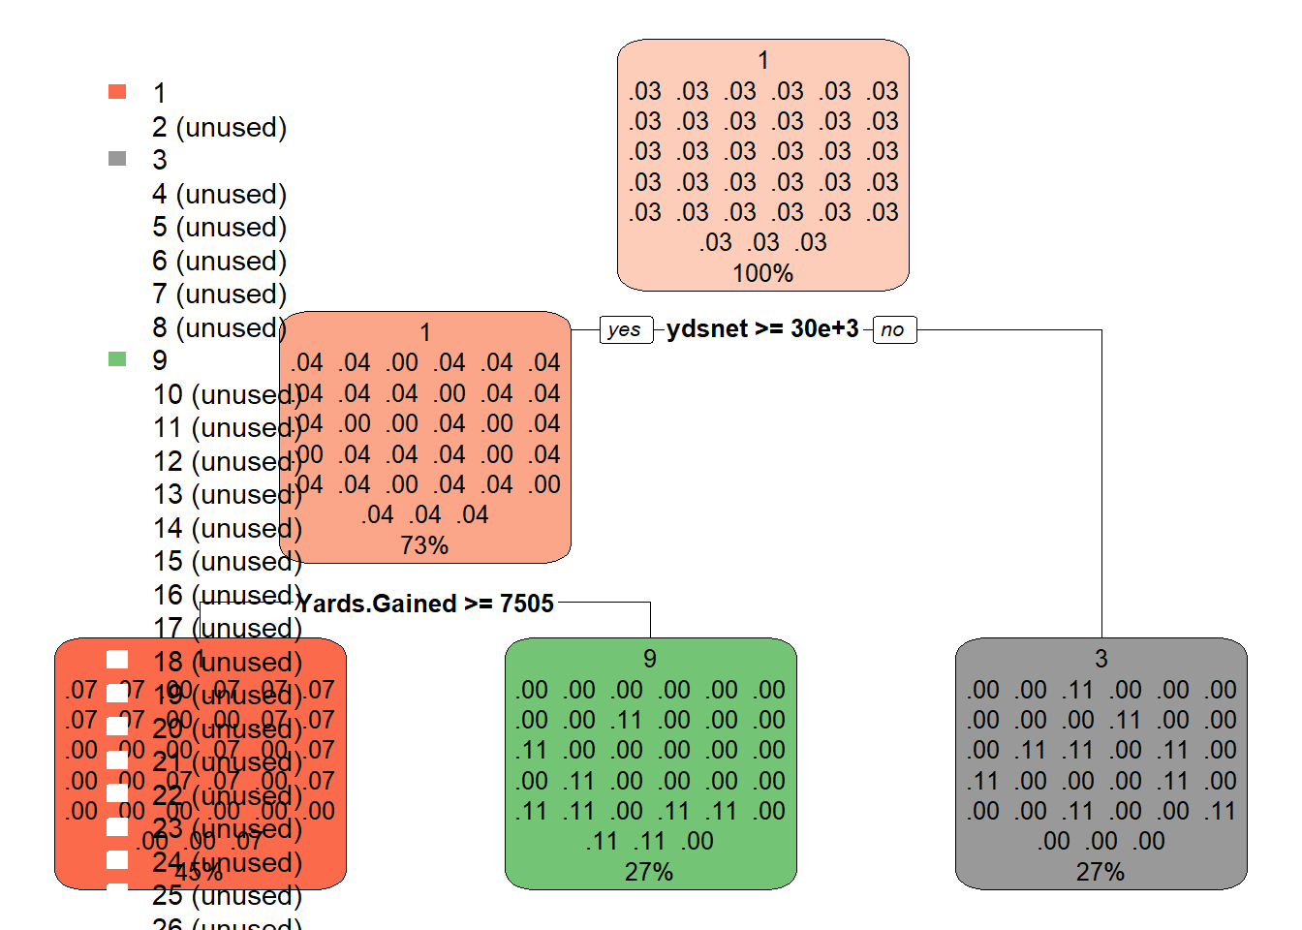
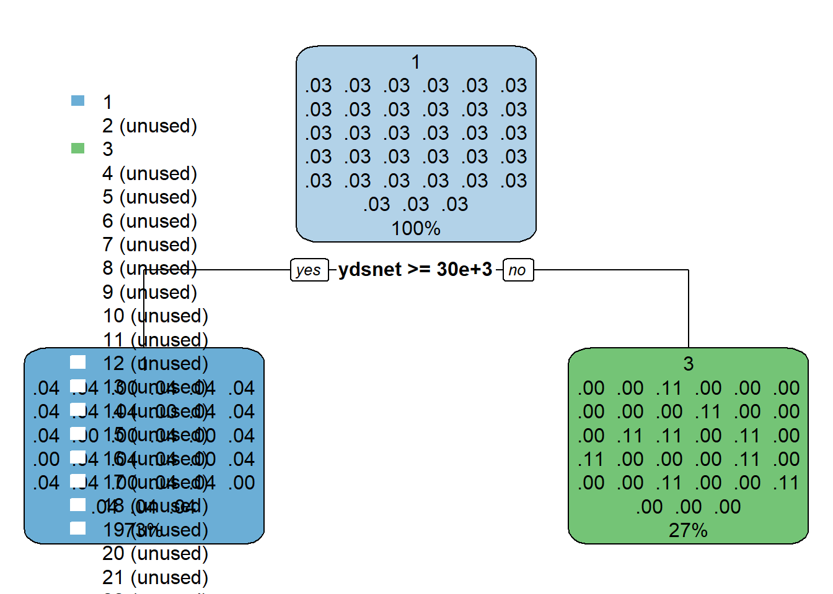
Decision Tree
Tuned
CP nsplit rel error xerror xstd
## 1 0.03125 0 1.0000 1.0312 0
## 2 0.01000 2 0.9375 1.0312 0
CP nsplit rel error xerror xstd
## 1 0.03125 0 1.00000 1.0312 0
## 2 0.01000 1 0.96875 1.0312 0

Slide 8




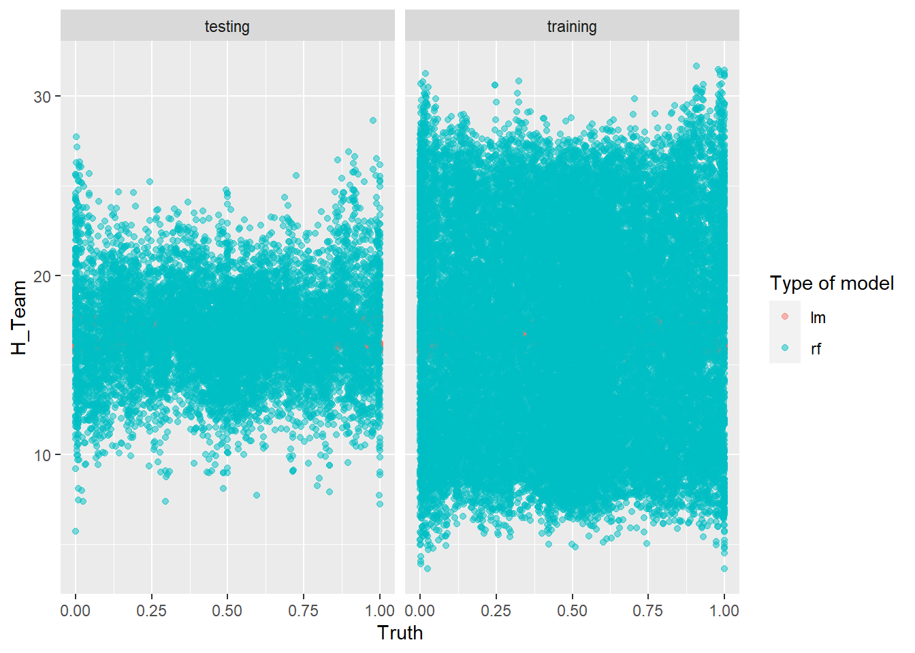
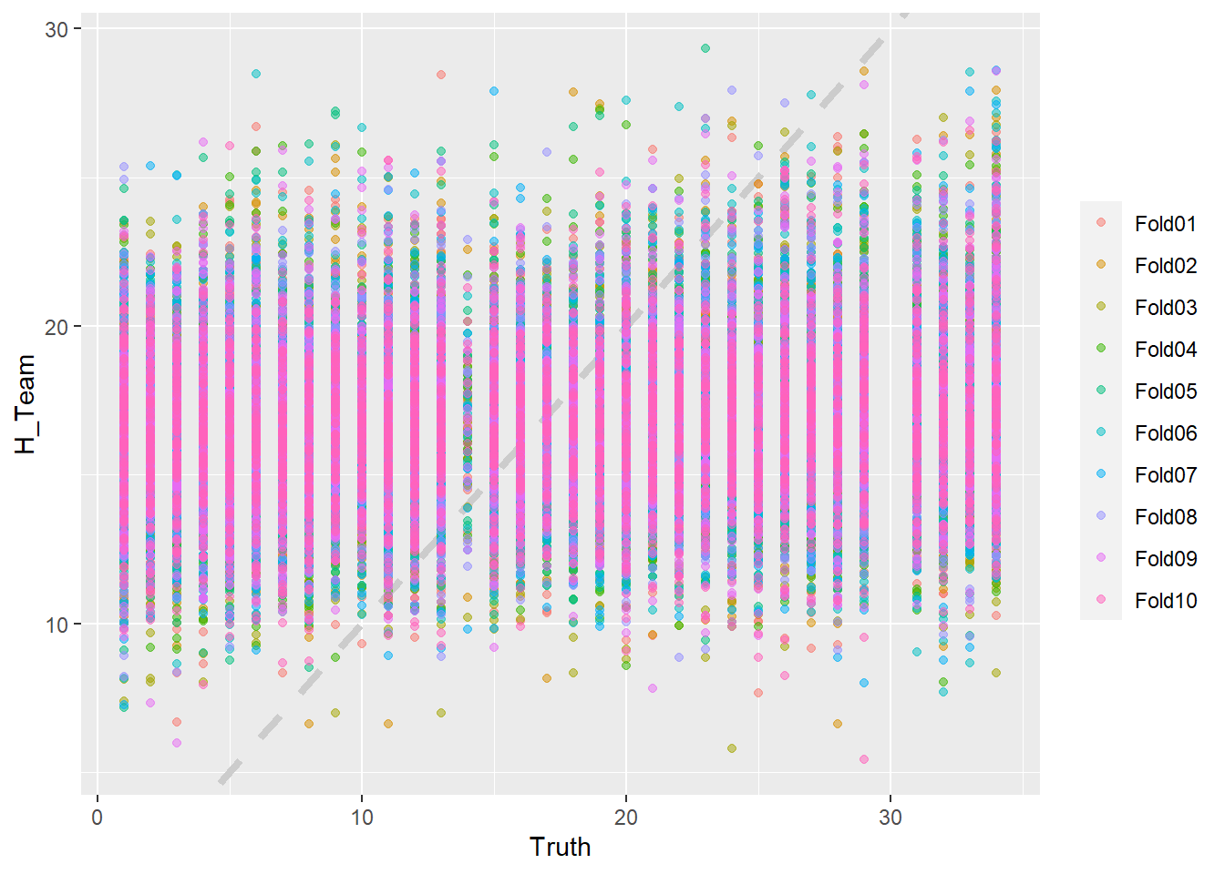
Linear & Random Forest Model

Slide 9
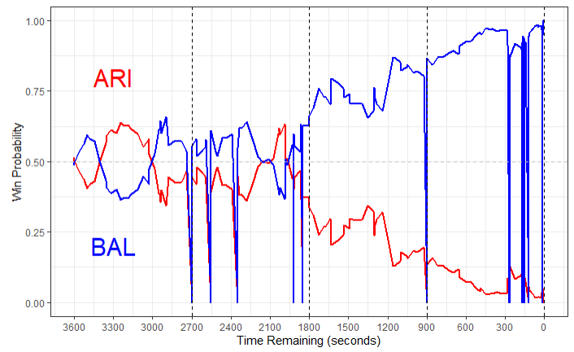
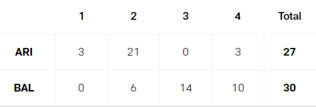
Team Probability Chart

Slide 10
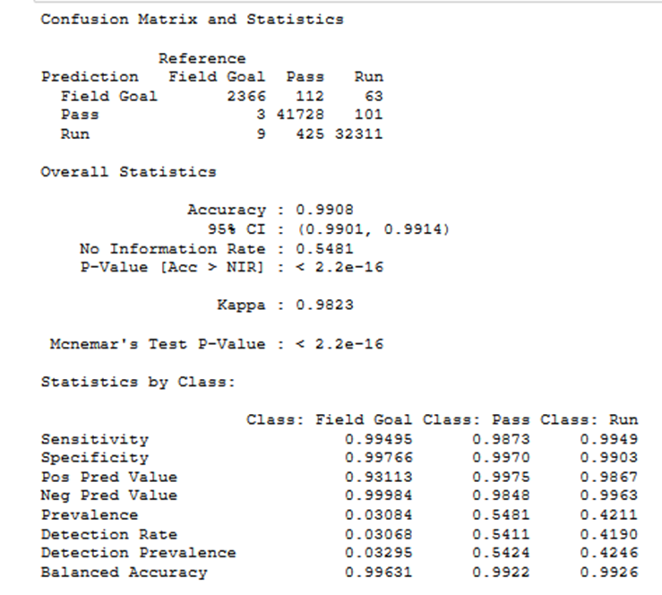
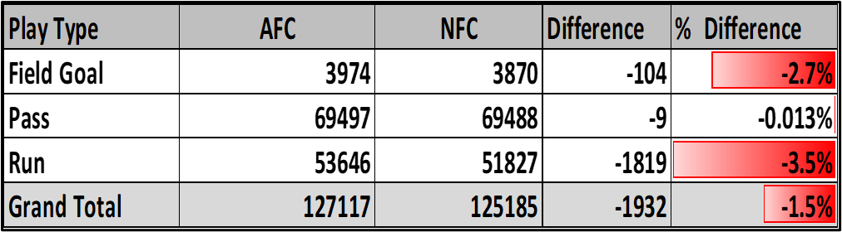
Model for Predicting Play Type
Accuracy Model
0. SVM
0. Random Forest
0. Naive Bayes
0.9908 Decision Tree
0. KNN

Slide 11
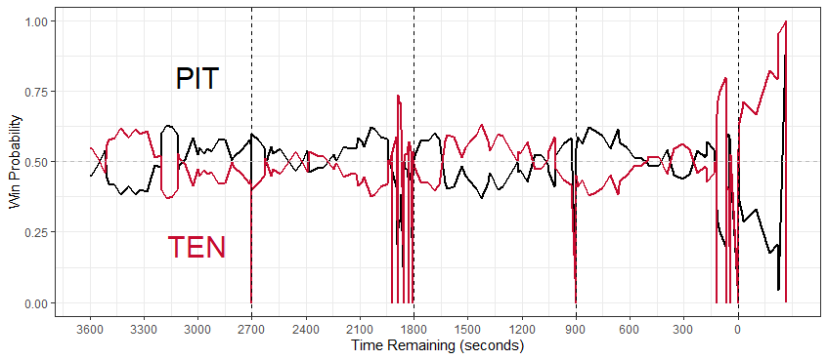
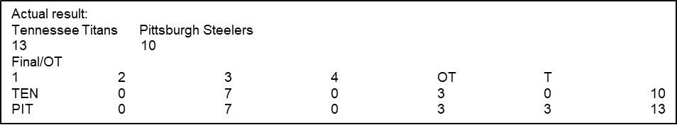
Win Probability Chart

Slide 12

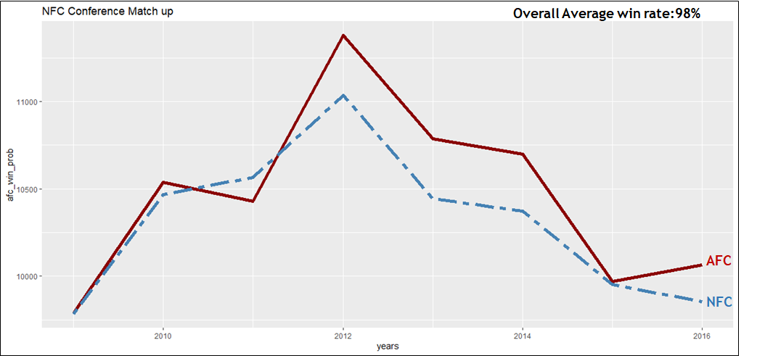

Slide 13
Conclusion
The objective of this project was to use NFL play by play data to train models and build predictions of NFL team performances and individual NFL game outcomes.
Using kNN, Decision Tree, Random Forest, and Linear Models we were able to develop high confidence predictions, the NFL game outcome model in particular was able to mirror some actual NFL to a high degree.
The sheer size of the data along with the amount of NAs from this unofficial data set caused long times dedicated to data cleaning and computer processing.
Another prediction we could model in the future include predicting the next play a team will run based on the time remaining in the game and their position on the field.

Slide 14
Questions?

