Slide 1
University of Computer Studies (Pakokku) TIC TAC TOE MULTIPLAYER GAME
Presented By - Group I

Slide 2
Members
No | Name | Roll No
1 | Mg Kyaw Zayya | 5CT – 12
2 | Mg Ye Kyaw Swar Aung | 5CT – 8
3 | Mg Hein Soe Win | 5CT – 14
4 | Mg Aung Pyae Phyoe | 5CT – 17
5 | Mg Kyaw Ko Ko Paing | 5CT – 10
6 | Mg Zin Min Thaw | 5CT – 3
7 | Mg Tin Ko Win | 5CT – 19

Slide 3
Outlines
Introduction
Remote Method Invocation(RMI)
Implementation of RMI
Project Implementation
Conclusion

Slide 4
Introduction
This project is chatting system.
To know about RMI (Remote Method Invocation).
To know about Remote Object Reference.
To know how chat application works.

Slide 5

Remote Method Invocation
is a Java API that provides a mechanism to create distributed application in java.
allows an object to invoke methods on an object running in another JVM.
provides remote communication between the applications using two objects stub and skeleton.
is an object whose method can be invoked from another JVM.

Slide 6
Stub
An object acts as gateway for the client side.
All the outgoing requests are routed through it.
When the caller invokes method on the stub object, it does the following tasks:
It initiates a connection with remote Virtual Machine (JVM).
It writes and transmits (marshals) the parameters to the remote Virtual Machine (JVM).
It waits for the result.
It reads (unmarshals) the return value or exception, and
It finally, returns the value to the caller.

Slide 7
Skeleton
An object acts as a gateway for the server side object.
All the incoming requests are routed through it.
receives the incoming request from stub.
delivers response to stub.
does the following tasks:
It reads the parameter for the remote method.
It invokes the method on the actual remote object, and
It writes and transmits (marshals) the result to the caller.

Slide 8
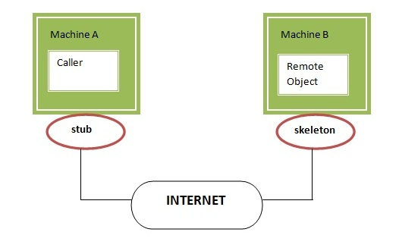

Slide 9
Implementation of RMI
If any application performs these tasks, it can be distributed application.
The appli2/29/2020cation need to locate the remote method.
It need to provide the communication with the remote objects, and
The application need to load the class definitions for the objects.
The RMI application have all these features, so it is called the distributed application.2/29/2020

Slide 10
Conclusion
World becoming village because of distributed system.
By using distributed system in financial trading system, our life will be more easier and no more pocket money.
Gamers are now professional because e-sport is more and more popular.

Slide 11
Any question?

