Slide 1

Developers are decision makers and paying customers
Why DX matters in product development and sales
Jarkko Moilanen (PhD, pursuing 2nd PhD)
Chief Development Officer, Platform of Trust
@Jarkko_Moilanen
+358 40 535 9066

Slide 2

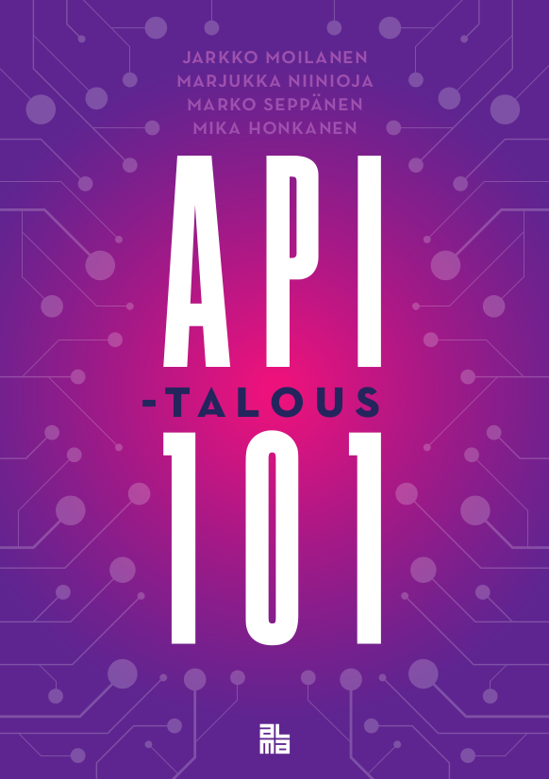
#100DaysDX 100daysdx.com 113 633 words of wisdom which is equivalent of a 378 page book.
2019
2019
2018
The biggest open resource on Developer eXperience so far.
DX Doctor – dxdoctor.net – Jarkko Moilanen @Jarkko_Moilanen

Slide 3
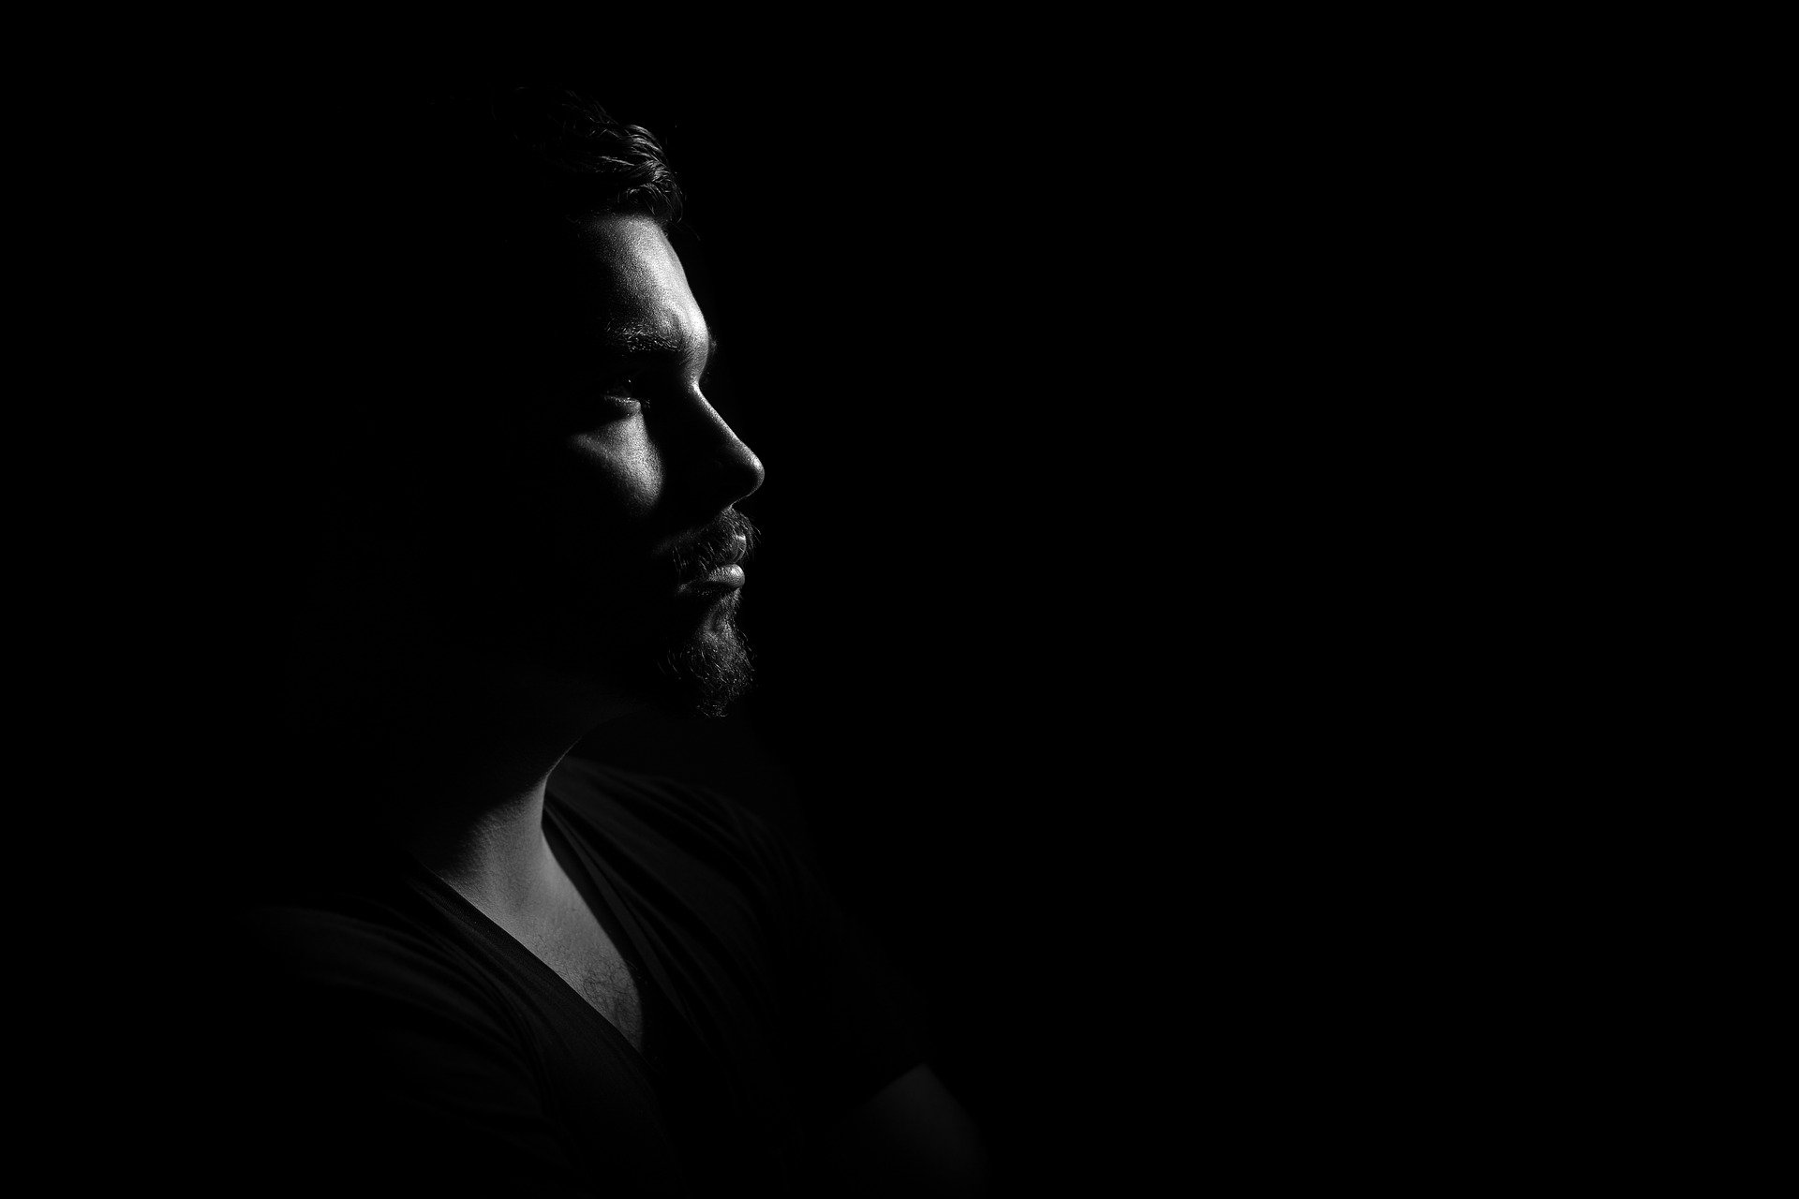
Developers have a lot of influence in technology purchases They have buying potential and can act as a wedge point to start selling into an organisation.
DX Doctor – dxdoctor.net – Jarkko Moilanen @Jarkko_Moilanen

Slide 4
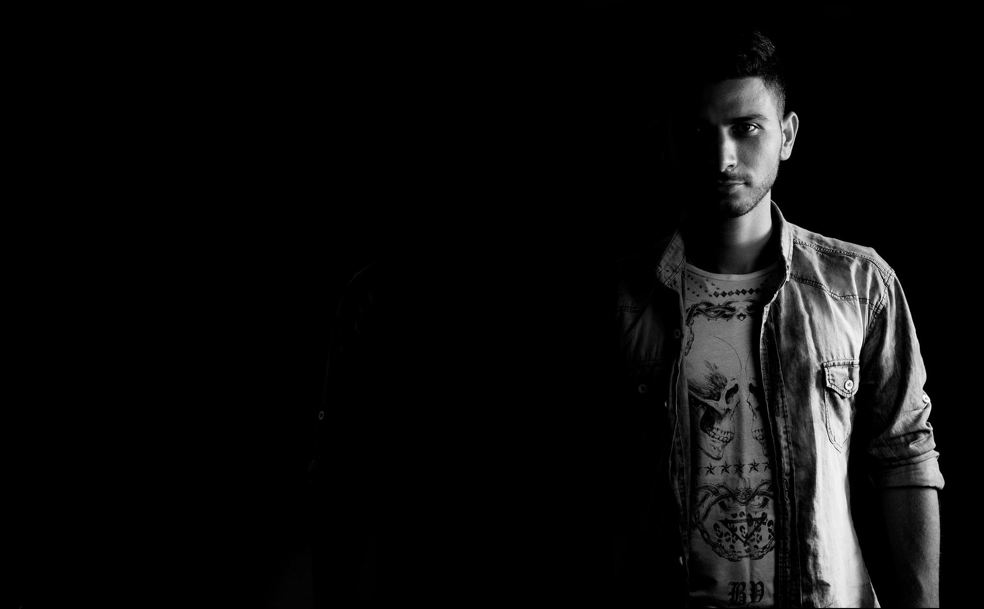
38% of the developers are in position to make purchases
Global developer population report 2019 . https://sdata.me/GlobalDevPop19
DX Doctor – dxdoctor.net – Jarkko Moilanen @Jarkko_Moilanen

Slide 5

18,9 Million active sw developers globally (45 Million by 2030) 12,9 Million professional sw developers
Global developer population report 2019 . https://sdata.me/GlobalDevPop19
DX Doctor – dxdoctor.net – Jarkko Moilanen @Jarkko_Moilanen

Slide 6

38% of professional developers is around 4 900 000 customers
Global Developer Population 2019 Community Edition
DX Doctor – dxdoctor.net – Jarkko Moilanen @Jarkko_Moilanen

Slide 7

45% are in a position to make recommendations 5 800 000 developers
Global Developer Population 2019 Community Edition
DX Doctor – dxdoctor.net – Jarkko Moilanen @Jarkko_Moilanen

Slide 8
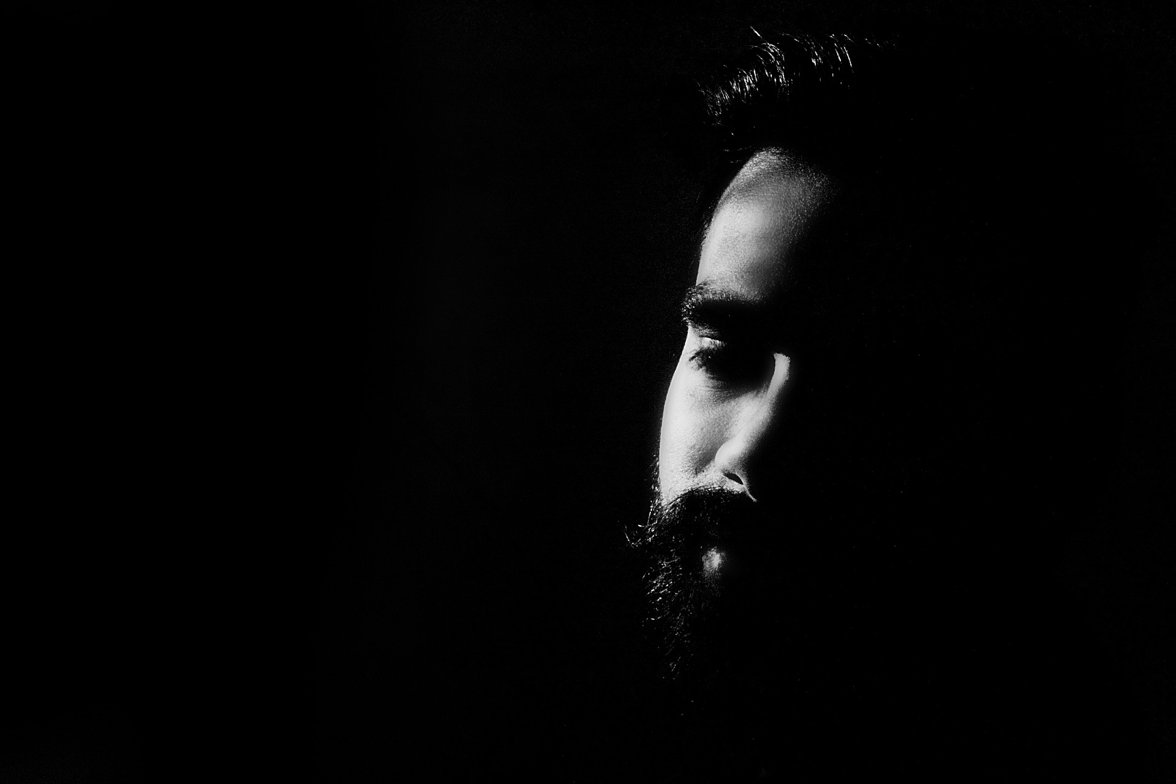
25% of developers can spend 10 000€+ without authorization
DX Doctor – dxdoctor.net – Jarkko Moilanen @Jarkko_Moilanen

Slide 9
B2D product strategy Make multiple compact services (with instant value + freemium) with relatively small annual costs (1k-2k€)
DX Doctor – dxdoctor.net – Jarkko Moilanen @Jarkko_Moilanen

Slide 10
Go to dxdoctor.net and follow #dxdoctor in social media
Jarkko Moilanen (PhD)
Chief Development Officer, Platform of Trust
@Jarkko_Moilanen
+358 40 535 9066

