Slide 1
What Kahneman's system theory has to do with Developer eXperience?
Jarkko Moilanen (PhD)
Chief Development Officer, Platform of Trust
@Jarkko_Moilanen
+358 40 535 9066

Slide 2

100 Days DX 100daysdx.com
100 articles on what is Developer eXperience.
The biggest open resource on Developer eXperience so far.
Economics of the Developer eXperience
Why DX matters in product development and sales
DX Doctor – dxdoctor.net – Jarkko Moilanen @Jarkko_Moilanen

Slide 3
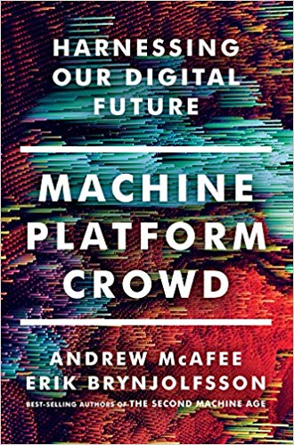
Developer eXperience,
Kahneman’s systems,
Cognitive ease/strain and
Flow experience
DX Doctor – dxdoctor.net – Jarkko Moilanen @Jarkko_Moilanen

Slide 4
Developer eXperience ”mindmap”
To understand developer experience, one must combine thoughts from multiple great scholars like Mihaly Csikszentmihalyi and Daniel Kahneman
Kuusinen, K. (2016). Are Software Developers Just Users of Development Tools? Assessing Developer Experience of a Graphical User Interface Designer. Human-Centered and Error-Resilient Systems Development, 215–233. doi:10.1007/978-3-319-44902-9_14
DX Doctor – dxdoctor.net – Jarkko Moilanen @Jarkko_Moilanen

Slide 5

When problems are routine and when under time constraint, System 1 kicks in.
fast,
instinctive,
”intuition”,
emotionally driven
System 2 is the more “analytical,” “deliberate” and “rational” side to the thinking process.
slow,
deliberate and conscious,
effortful,
controlled mental process,
rational thinking
Kahneman’s systems
DX Doctor – dxdoctor.net – Jarkko Moilanen @Jarkko_Moilanen

Slide 6
Cognitive ease or fluency is the measure of how easy it is for our brains to process information.
The Cognitive ease principle reveals that when people have to switch to the second system of thinking, causing cognitive strain, they become more vigilant and suspicious.
It results in a decrease in confidence, trust and pleasure involved in completing the mental action.
Cognitive ease
often discussed next to
Kahnemen’s systems
DX Doctor – dxdoctor.net – Jarkko Moilanen @Jarkko_Moilanen

Slide 7
“A state in which people are so involved in an activity that nothing else seems to matter; the experience is so enjoyable that people will continue to do it even at great cost, for the sheer sake of doing it.”
To accomplish tasks efficiently developer must be in flow state
Developer experience of tools such as APIs must enable flow state
Flow state
Mihaly Csikszentmihalyi
DX Doctor – dxdoctor.net – Jarkko Moilanen @Jarkko_Moilanen

Slide 8
Getting into the flow state
System 2
Cognitive strain
Reading, learning, collecting information to working memory.
Getting familiar with your API, how it is used
Working memory is a cognitive system with a limited capacity that is responsible for temporarily holding information available for processing
Takes 15-60 minutes
Developer (your customer)
DX Doctor – dxdoctor.net – Jarkko Moilanen @Jarkko_Moilanen

Slide 9
In the flow state
System 1
Cognitive ease
Completely involved in what we are doing
A sense of ecstasy
Great inner clarity
A sense of serenity
Timelessness
Whatever produces flow becomes its own reward
Developer (your customer)
DX Doctor – dxdoctor.net – Jarkko Moilanen @Jarkko_Moilanen

Slide 10
All the ”6 lines of code”, library-driven platforms and 3-steps guides with code examples to get started intend to…
reduce the need to use system 2 (rational, effortful, consumes more energy)
reduce the working memory burden of the developer (cognition related)
Reward as fast as possible (sense of control and enjoyment)
Utilize system 1 based fast decision making by offering easy way out of the problem
DX Doctor – dxdoctor.net – Jarkko Moilanen @Jarkko_Moilanen

Slide 11
As service provider you want to offer developer experience in which the
consumer operates as fast as possible in System 1
Results to snowball effect in Business to Developer marketing and sales
DX Doctor – dxdoctor.net – Jarkko Moilanen @Jarkko_Moilanen

Slide 12
What Kahneman's system theory has to do with Developer eXperience?
Jarkko Moilanen (PhD)
Chief Development Officer, Platform of Trust
@Jarkko_Moilanen
+358 40 535 9066

Slide 13
Available for API development and strategy consulting
+358 40 535 9066
dxdoctor.net/services

