Slide 1
Pareto principle and Developer eXperience – why should I care?
Jarkko Moilanen (PhD)
Chief Development Officer, Platform of Trust
@Jarkko_Moilanen
+358 40 535 9066

Slide 2
Continue discussion and participate
#dxdoctor
@Jarkko_Moilanen
DX Doctor – dxdoctor.net – Jarkko Moilanen @Jarkko_Moilanen

Slide 3
Goal
Understanding Pareto principle and its impact on the performance of our value stream – offering great API driven solutions with excellent developer experience
DX Doctor – dxdoctor.net – Jarkko Moilanen @Jarkko_Moilanen

Slide 4
80/20
Pareto principle, aka the law of the vital few, or the principle of factor sparsity
“universal truth” about the imbalance of inputs and outputs is
It is named after an Italian Economist Vilfredo Pareto who in 1906 noticed that 80% of the land in Italy was owned by 20% of the population. Pareto verified the principle with multiple tests around different contexts.
DX Doctor – dxdoctor.net – Jarkko Moilanen @Jarkko_Moilanen

Slide 5
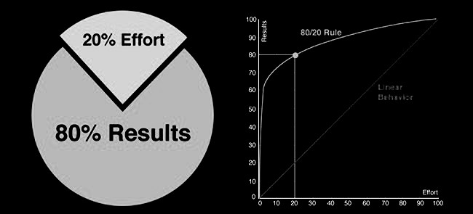
Pareto principle
also known as the 80/20 rule, the law of the vital few, or the principle of factor sparsity) states that, for many events, roughly
80% of the effects come from 20% of the causes.
https://en.wikipedia.org/wiki/Pareto_principle
DX Doctor – dxdoctor.net – Jarkko Moilanen @Jarkko_Moilanen

Slide 6
Examples from the IT industry
Microsoft observed that by fixing the top 20% of the most reported bugs, 80% of the bugs and crushes would be eliminate
The test team found 100% of the defects in 28% of the code, and 80% of the defects in 26% of the code.
P. Rooney. Microsoft’s ceo: 80-20 rule applies to bugs, not just features
http://www.crn.com/news/security/18821726/microsofts-ceo-80-20-rule-applies-to-bugs-not-just-features.htm;jsessionid=4y9xsrtocbwxlpvhrhueuw**.ecappj01,October 2002.
Gittens, M., Yong Kim, & Godwin, D. (n.d.). The Vital Few Versus the Trivial Many: Examining the Pareto Principle for Software.
29th Annual International Computer Software and Applications Conference (COMPSAC’05). doi:10.1109/compsac.2005.153
DX Doctor – dxdoctor.net – Jarkko Moilanen @Jarkko_Moilanen

Slide 7

Examples
80% of the bugs in software come from 20% of the features.
80% of the complexity in a given application comes from 20% of the code base.
Only 20% of a given feature set in an application is important to 80% of the users.
A given engineering team spends 80% of its time on 20% of the application.
You DONT want your API to be involved in the 20% of the features
You DONT want your API to be involved in the 20% code base
You WANT to enable that 20% of the features
You WANT to decrease the time needed with your API
DX Doctor – dxdoctor.net – Jarkko Moilanen @Jarkko_Moilanen

Slide 8
Pareto Chart Analysis
It doesn’t matter whether you are trying to optimize code, a business process, workflows, documentation practices, and so on.
Pareto chart analysis can be applied to any efforts for optimization.
DX Doctor – dxdoctor.net – Jarkko Moilanen @Jarkko_Moilanen

Slide 9




”inverse” Pareto principle
In learning how to use your API / platform, the learnign curve should be ”inverse” Pareto curve.
20% of resources probably enable 80% of the needs
DX Doctor – dxdoctor.net – Jarkko Moilanen @Jarkko_Moilanen

Slide 10

Information overflow
Find the relevant information from your developer portal
80% of the developers
need 20% of the content
DX Doctor – dxdoctor.net – Jarkko Moilanen @Jarkko_Moilanen

Slide 11

Example from real world - platform of trust
Data consuming
(app developer)
Data source
integration engineer
50%
50%
Both need different content and tools
DX Doctor – dxdoctor.net – Jarkko Moilanen @Jarkko_Moilanen

Slide 12
Example is platform of trust
Data consuming
(app developer)
40%
Knows Oauth by heart
become
20%
50%
Knows Oauth by heart
Has account
More experience
DX Doctor – dxdoctor.net – Jarkko Moilanen @Jarkko_Moilanen

Slide 13

How to offer needed 20% of the information so that consumers achieve 80% of their goals
Targeted getting started packages
Efficient search
Grouping related guides
Analyze how search is used to learn
Clear structure (and menu!)
Conventions - no need to learn
Keywords indicate and catch the eye
DX Doctor – dxdoctor.net – Jarkko Moilanen @Jarkko_Moilanen

Slide 14

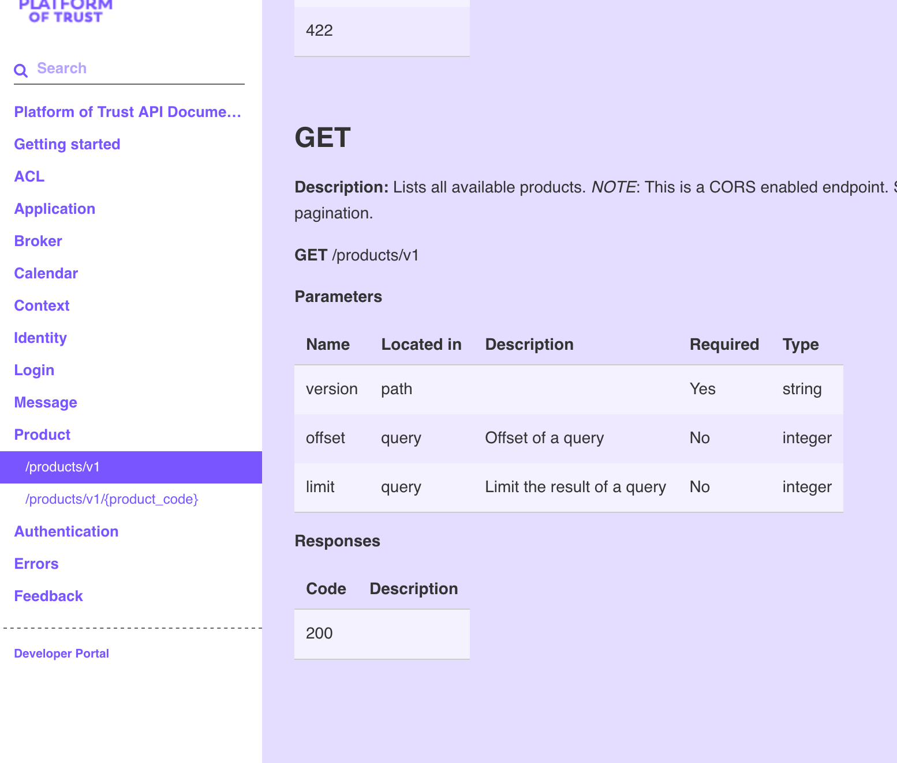
Example 1
Developer wants to list all products with API from Platform of Trust.
What information the developer needs?
Find the documentation
Product listing endpoint
How to call API with preferred programming language
What are the responses?
Take-away:
Reorder endpoints so that relevant for
the user’s work flow are close to each other. Use Pareto Chart Analysis
DX Doctor – dxdoctor.net – Jarkko Moilanen @Jarkko_Moilanen

Slide 15
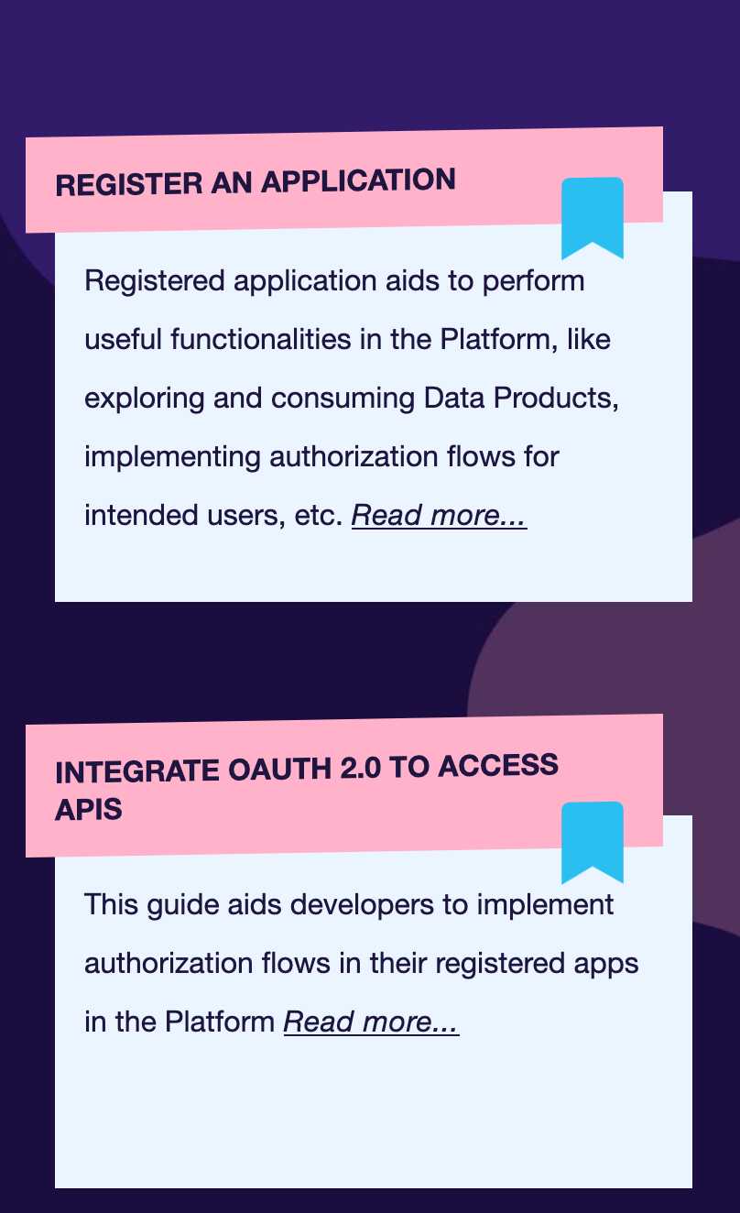
Take-away:
Reorder guides so that relevant for
the user’s work flow are close to each other. Use Pareto Chart Analysis
Example 2
Developer wants to register application to the platform
What information the developer needs?
Find the developer portal and guides
Howto guide on registering an application
Step by step guide with code examples (for API calls)
Most likely developer also needs to add auth to the application as well
DX Doctor – dxdoctor.net – Jarkko Moilanen @Jarkko_Moilanen

Slide 16
Example 3
Which APIs or endpoints should I optimize?
Optimize, performance, usability and reliability of the 20% of the endpoints, leave rest as is (waste of time and resources.
Example 4
We consider building a code library to enable more fluent DX for consumers. What APIs and endpoints should be included?
Most likely consumers need in 80% of the cases just 20% of your API capabilities. Bundle those logically.
DX Doctor – dxdoctor.net – Jarkko Moilanen @Jarkko_Moilanen

Slide 17
Pareto principle and Developer eXperience – why should I care?
Jarkko Moilanen (PhD)
Chief Development Officer, Platform of Trust
@Jarkko_Moilanen
+358 40 535 9066

Slide 18

100 Days DX 100daysdx.com
100 articles on what is Developer eXperience.
The biggest open resource on Developer eXperience so far.
Economics of the Developer eXperience
Why DX matters in product development and sales
DX Doctor – dxdoctor.net – Jarkko Moilanen @Jarkko_Moilanen

Slide 19
Available for API development and strategy consulting
+358 40 535 9066
dxdoctor.net/services

