Slide 1
Conway's law and Developer eXperience
Jarkko Moilanen (PhD)
Chief Development Officer, Platform of Trust
@Jarkko_Moilanen
+358 40 535 9066

Slide 2
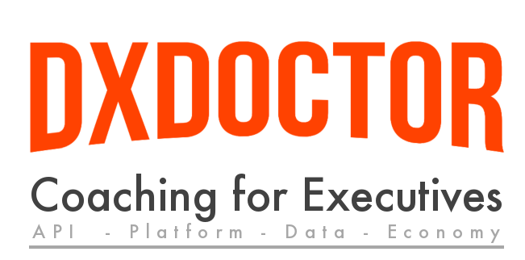
100 Days DX 100daysdx.com
100 articles on what is Developer eXperience.
The biggest open resource on Developer eXperience so far.
Executive level coaching packages
3 packages
26 Online video episodes
dxdoctor.net/services/
DX Doctor – dxdoctor.net – Jarkko Moilanen @Jarkko_Moilanen

Slide 3
Conway's law
organizations which design systems ... are constrained to produce designs which are copies of the communication structures of these organizations.
Conway, Melvin E. (April 1968). "How do Committees Invent?". http://www.melconway.com/research/committees.html
DX Doctor – dxdoctor.net – Jarkko Moilanen @Jarkko_Moilanen

Slide 4
Goal
Understanding Conway’s Law and its impact on the performance of our value stream – offering great API driven solutions with excellent developer experience
DX Doctor – dxdoctor.net – Jarkko Moilanen @Jarkko_Moilanen

Slide 5

Organisational structures
3 archetypes according to Dr. Roberto Fernandez
Functional-oriented organizations optimize for expertise, division of labor, or reducing cost. (Optimizing for Cost)
Market-oriented organizations optimize for responding quickly to customer needs. (Optimizing for speed)
Matrix-oriented organizations attempt to combine functional and market orientation.
Global Developer Population 2019 Community Edition
DX Doctor – dxdoctor.net – Jarkko Moilanen @Jarkko_Moilanen

Slide 6

Conway’s Law is why companies like Netflix, Spotify, and Amazon structure themselves around
small autonomous teams that
have a small part of the overall system
…Market-oriented
Global Developer Population 2019 Community Edition
DX Doctor – dxdoctor.net – Jarkko Moilanen @Jarkko_Moilanen

Slide 7

two-pizza rule
a team only as large as can be fed with two pizzas—usually about five to ten people.
It ensures the team has a clear, shared understanding of the system they are working on
It limits the growth rate of the product or service being worked on.
It decentralizes power and enables autonomy.
Leading a 2PT is a way for employees to gain some leadership experience in an environment where failure does not have catastrophic consequences.
DX Doctor – dxdoctor.net – Jarkko Moilanen @Jarkko_Moilanen

Slide 8
Fullstack teams
“Small teams are fast…and don’t get bogged down in so-called administrivia….Each group assigned to a particular business is completely responsible for it….The team scopes the fix, designs it, builds it, implements it and monitors its ongoing use.
This way, technology programmers and architects get direct feedback from the people who use their code or applications—in regular meetings and informal conversations.”
Larry Dignan
DX Doctor – dxdoctor.net – Jarkko Moilanen @Jarkko_Moilanen

Slide 9
Now lets turn our focus on APIs and developer experience
DX Doctor – dxdoctor.net – Jarkko Moilanen @Jarkko_Moilanen

Slide 10
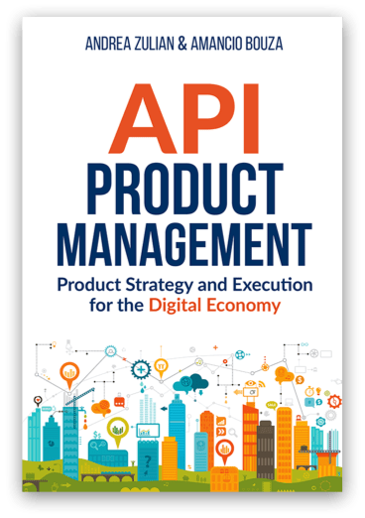
You have API as a product
Developers as primary customers.
Targeted to Business to Developer markets (B2D)
Primary consumers to interact with your product are developers
Developer eXperience becomes crucial ”sales” argument
Read more from http://api-as-a-product.com/
DX Doctor – dxdoctor.net – Jarkko Moilanen @Jarkko_Moilanen

Slide 11

Conway and API design
APIs are now more often created according to Design-First principle. Validate fit before committing
…
DX Doctor – dxdoctor.net – Jarkko Moilanen @Jarkko_Moilanen

Slide 12

Divide your services based on business capabilities, or domain instead of technical layers.
Don’t separate services or domains based on layers, because those are against the Conway’s law and set up to fail.
DX Doctor – dxdoctor.net – Jarkko Moilanen @Jarkko_Moilanen

Slide 13
When problems are routine and when under time constraint, System 1 kicks in.
fast,
instinctive,
”intuition”,
emotionally driven
System 2 is the more “analytical,” “deliberate” and “rational” side to the thinking process.
slow,
deliberate and conscious,
effortful,
controlled mental process,
rational thinking
Kahneman’s systems
DX Doctor – dxdoctor.net – Jarkko Moilanen @Jarkko_Moilanen

Slide 14
Cognitive ease or fluency is the measure of how easy it is for our brains to process information.
The Cognitive ease principle reveals that when people have to switch to the second system of thinking, causing cognitive strain, they become more vigilant and suspicious.
It results in a decrease in confidence, trust and pleasure involved in completing the mental action.
Cognitive ease
often discussed next to
Kahnemen’s systems
DX Doctor – dxdoctor.net – Jarkko Moilanen @Jarkko_Moilanen

Slide 15
“A state in which people are so involved in an activity that nothing else seems to matter; the experience is so enjoyable that people will continue to do it even at great cost, for the sheer sake of doing it.”
To accomplish tasks efficiently developer must be in flow state
Developer experience of tools such as APIs must enable flow state
Flow state
Mihaly Csikszentmihalyi
DX Doctor – dxdoctor.net – Jarkko Moilanen @Jarkko_Moilanen

Slide 16
Getting into the flow state
System 2
Cognitive strain
Reading, learning, collecting information to working memory.
Getting familiar with your API, how it is used
Working memory is a cognitive system with a limited capacity that is responsible for temporarily holding information available for processing
Takes 15-60 minutes
Developer (your customer)
DX Doctor – dxdoctor.net – Jarkko Moilanen @Jarkko_Moilanen

Slide 17
In the flow state
System 1
Cognitive ease
Completely involved in what we are doing
A sense of ecstasy
Great inner clarity
A sense of serenity
Timelessness
Whatever produces flow becomes its own reward
Developer (your customer)
DX Doctor – dxdoctor.net – Jarkko Moilanen @Jarkko_Moilanen

Slide 18
All the ”6 lines of code”, library-driven platforms and 3-steps guides with code examples to get started intend to…
reduce the need to use system 2 (rational, effortful, consumes more energy)
reduce the working memory burden of the developer (cognition related)
Reward as fast as possible (sense of control and enjoyment)
Utilize system 1 based fast decision making by offering easy way out of the problem
DX Doctor – dxdoctor.net – Jarkko Moilanen @Jarkko_Moilanen

Slide 19
As service provider you want to offer developer experience in which the
consumer operates as fast as possible in System 1
Results to snowball effect in Business to Developer marketing and sales
DX Doctor – dxdoctor.net – Jarkko Moilanen @Jarkko_Moilanen

Slide 20
Conway's law and Developer eXperience
Jarkko Moilanen (PhD)
Chief Development Officer, Platform of Trust
@Jarkko_Moilanen
+358 40 535 9066

Slide 21

Available for API development and strategy consulting
+358 40 535 9066
dxdoctor.net/services

