Slide 1
APIs as the Network multiplier explained - Dunbar’s number and Metcalfe’s Law
Jarkko Moilanen (PhD)
Chief Development Officer, Platform of Trust
@Jarkko_Moilanen
+358 40 535 9066

Slide 2
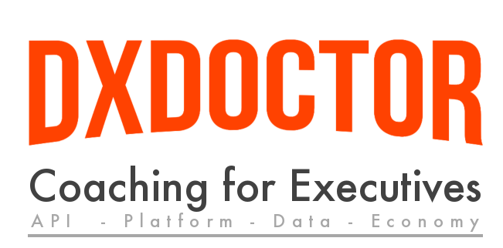
100 Days DX 100daysdx.com
100 articles on what is Developer eXperience.
The biggest open resource on Developer eXperience so far.
Executive level coaching packages
3 packages
26 Online video episodes
dxdoctor.net/services/
DX Doctor – dxdoctor.net – Jarkko Moilanen @Jarkko_Moilanen

Slide 3

The effect described in economics and business that an additional user of goods or services has on the value of that product to others.
When a network effect is present, the value of a product or service increases according to the number of others using it
Network Effect
DX Doctor – dxdoctor.net – Jarkko Moilanen @Jarkko_Moilanen

Slide 4
Network effect
Four laws have been proposed to provide more precise definitions and characterizations of network effect
network’s value V is dependent on its size n (the number of its nodes)
Sarnoff’s law:
V ∝ n
Odlyzko’s law:
V ∝ n log(n)
Reed’s law:
V ∝ 2^{n}
Metcalfe’s law:
V ∝ n²
Zhang, Xingzhou & Liu, Jing-Jie & Xu, Zhi-Wei. (2015). Tencent and Facebook Data Validate Metcalfe’s Law. Journal of Computer Science and Technology. 30. 246-251. 10.1007/s11390-015-1518-1.
DX Doctor – dxdoctor.net – Jarkko Moilanen @Jarkko_Moilanen

Slide 5
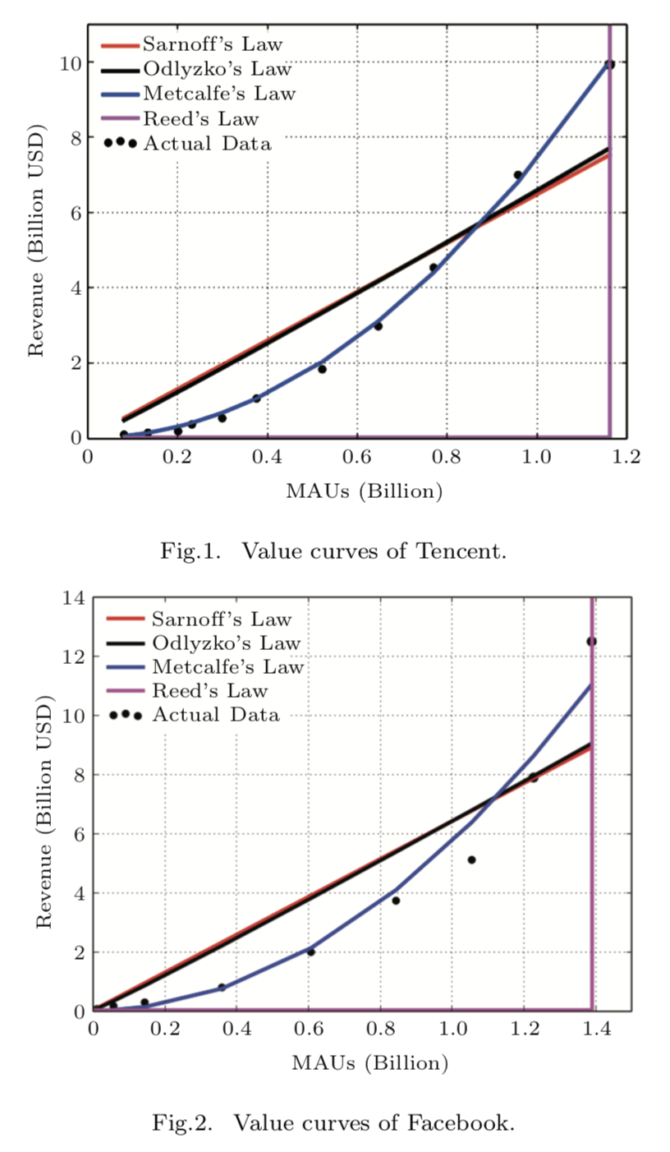
Tencent and Facebook
Value curves of Facebook
Value curves of Tencent
Zhang, Xingzhou & Liu, Jing-Jie & Xu, Zhi-Wei. (2015). Tencent and Facebook Data Validate Metcalfe’s Law. Journal of Computer Science and Technology. 30. 246-251. 10.1007/s11390-015-1518-1.
DX Doctor – dxdoctor.net – Jarkko Moilanen @Jarkko_Moilanen

Slide 6
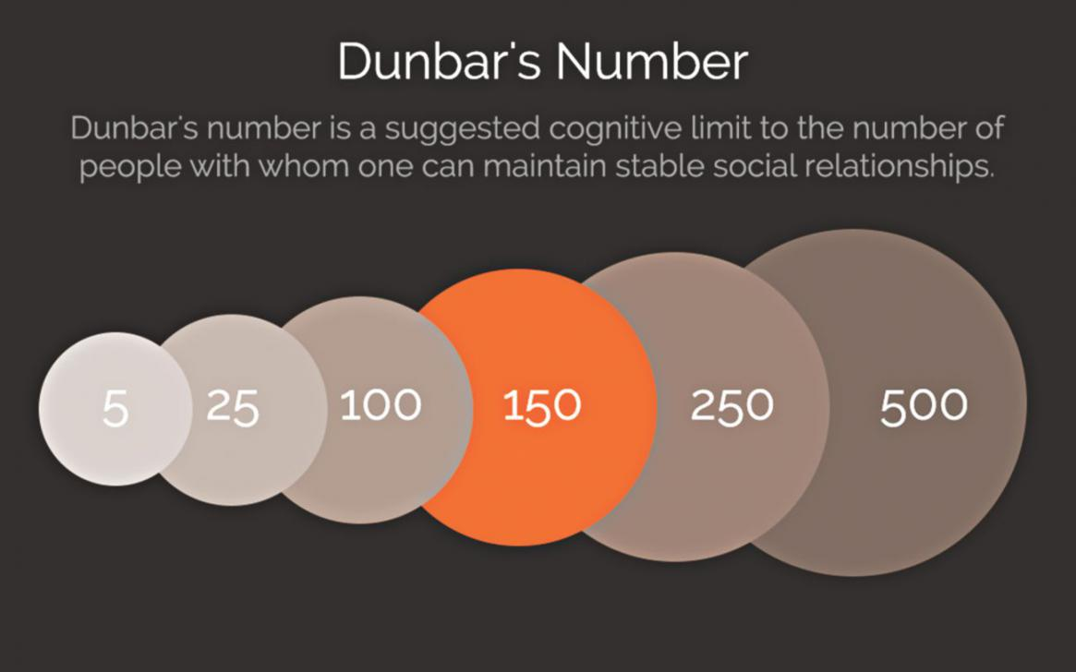
Dunbar’s Number
Dunbar's number is a suggested cognitive limit to the number of people with whom one can maintain stable social relationships—relationships in which an individual knows who each person is and how each person relates to every other person
5 always there for you
15- 25 Soul mates
50 for partying
150 personal network
DX Doctor – dxdoctor.net – Jarkko Moilanen @Jarkko_Moilanen

Slide 7
Ok, how is the above related to APIs?
DX Doctor – dxdoctor.net – Jarkko Moilanen @Jarkko_Moilanen

Slide 8

Developers are the enablers of the multiplier effect, where
APIs are the enabling concept that actually allow developers to do so.
DX Doctor – dxdoctor.net – Jarkko Moilanen @Jarkko_Moilanen

Slide 9
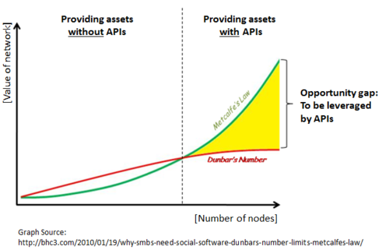
APIs are the multiplier
Without APIs at some point it will become very difficult to increase the value of the network. That is related to the integration efforts, which will not scale.
APIs are the enablers of scalability through the multiplier effect or Metcalfe’s law
DX Doctor – dxdoctor.net – Jarkko Moilanen @Jarkko_Moilanen

Slide 10
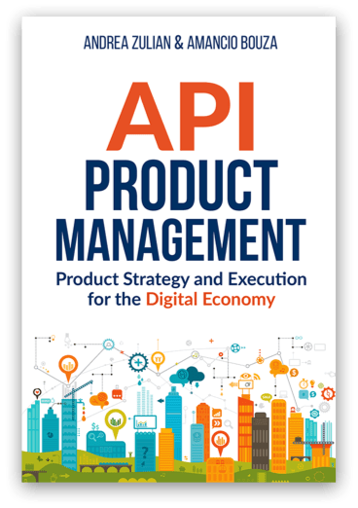
You have API as a product
Developers as primary customers.
Targeted to Business to Developer markets (B2D)
Primary consumers to interact with your product are developers
Self-service
Transparent pricing and plans
Uptodate documentation
Support, life cycle management
Read more from http://api-as-a-product.com/
DX Doctor – dxdoctor.net – Jarkko Moilanen @Jarkko_Moilanen

Slide 11
As service provider you want to offer developer experience in which the
consumer operates as fast as possible in System 1
Results to snowball effect in Business to Developer marketing and sales
DX Doctor – dxdoctor.net – Jarkko Moilanen @Jarkko_Moilanen

Slide 12
Network multiplier explained - Dunbar’s number and Metcalfe’s Law
Jarkko Moilanen (PhD)
Chief Development Officer, Platform of Trust
@Jarkko_Moilanen
+358 40 535 9066

Slide 13

Available for API development and strategy consulting
+358 40 535 9066
dxdoctor.net/services

