Slide 1
96% of the problems come from the system
Jarkko Moilanen (PhD)
Chief Development Officer, Platform of Trust
@Jarkko_Moilanen
+358 40 535 9066

Slide 2
Continue discussion and participate
#dxdoctor
@Jarkko_Moilanen
DX Doctor – dxdoctor.net – Jarkko Moilanen @Jarkko_Moilanen

Slide 3
To blame is human. The fix is to engineer
DX Doctor – dxdoctor.net – Jarkko Moilanen @Jarkko_Moilanen

Slide 4
Goal
Understanding Pareto principle and its impact on the performance of our value stream – offering great API driven solutions with excellent developer experience
DX Doctor – dxdoctor.net – Jarkko Moilanen @Jarkko_Moilanen

Slide 5

Nothing is perfect after 1st round
learn & improve
It has been shown that due to the complexity of work and the multiple influencing or latent factors that we cannot possibly eliminate the errors that humans make; we are hard wired.
no amount of training, incentives, observations or discipline will ever eliminate human error.
DX Doctor – dxdoctor.net – Jarkko Moilanen @Jarkko_Moilanen

Slide 6

It has been shown that due to the complexity of work and the multiple influencing or latent factors that we cannot possibly eliminate the errors that humans make; we are hard wired.
no amount of training, incentives, observations or discipline will ever eliminate human error.
Human error cannot be eliminated.
Make it safe to fail – easy recovery!
DX Doctor – dxdoctor.net – Jarkko Moilanen @Jarkko_Moilanen

Slide 7
Great ”error handling” developer experience
Try to prevent human errors by excellent design – but 0% failures is impossible
Nothing is perfect after 1st round – learn & improve
Make it safe to fail – easy recovery!
DX Doctor – dxdoctor.net – Jarkko Moilanen @Jarkko_Moilanen

Slide 8
Human error cannot be eliminated. It has been shown that due to the complexity of work and the multiple influencing or latent factors that we cannot possibly eliminate the errors that humans make; we are hard wired. This is why no amount of training, incentives, observations or discipline will ever eliminate human error.
DX Doctor – dxdoctor.net – Jarkko Moilanen @Jarkko_Moilanen

Slide 9
Examples from the IT industry
Microsoft observed that by fixing the top 20% of the most reported bugs, 80% of the bugs and crushes would be eliminate
The test team found 100% of the defects in 28% of the code, and 80% of the defects in 26% of the code.
P. Rooney. Microsoft’s ceo: 80-20 rule applies to bugs, not just features
http://www.crn.com/news/security/18821726/microsofts-ceo-80-20-rule-applies-to-bugs-not-just-features.htm;jsessionid=4y9xsrtocbwxlpvhrhueuw**.ecappj01,October 2002.
Gittens, M., Yong Kim, & Godwin, D. (n.d.). The Vital Few Versus the Trivial Many: Examining the Pareto Principle for Software.
29th Annual International Computer Software and Applications Conference (COMPSAC’05). doi:10.1109/compsac.2005.153
DX Doctor – dxdoctor.net – Jarkko Moilanen @Jarkko_Moilanen

Slide 10
Pareto Chart Analysis
It doesn’t matter whether you are trying to optimize code, a business process, workflows, documentation practices, and so on.
Pareto chart analysis can be applied to any efforts for optimization.
DX Doctor – dxdoctor.net – Jarkko Moilanen @Jarkko_Moilanen

Slide 11




”inverse” Pareto principle
In learning how to use your API / platform, the learnign curve should be ”inverse” Pareto curve.
20% of resources probably enable 80% of the needs
DX Doctor – dxdoctor.net – Jarkko Moilanen @Jarkko_Moilanen

Slide 12
Information overflow
Find the relevant information from your developer portal
80% of the developers
need 20% of the content
DX Doctor – dxdoctor.net – Jarkko Moilanen @Jarkko_Moilanen

Slide 13

Example from real world - platform of trust
Data consuming
(app developer)
Data source
integration engineer
50%
50%
Both need different content and tools
DX Doctor – dxdoctor.net – Jarkko Moilanen @Jarkko_Moilanen

Slide 14
Example is platform of trust
Data consuming
(app developer)
40%
Knows Oauth by heart
become
20%
50%
Knows Oauth by heart
Has account
More experience
DX Doctor – dxdoctor.net – Jarkko Moilanen @Jarkko_Moilanen

Slide 15

How to offer needed 20% of the information so that consumers achieve 80% of their goals
Targeted getting started packages
Efficient search
Grouping related guides
Analyze how search is used to learn
Clear structure (and menu!)
Conventions - no need to learn
Keywords indicate and catch the eye
DX Doctor – dxdoctor.net – Jarkko Moilanen @Jarkko_Moilanen

Slide 16

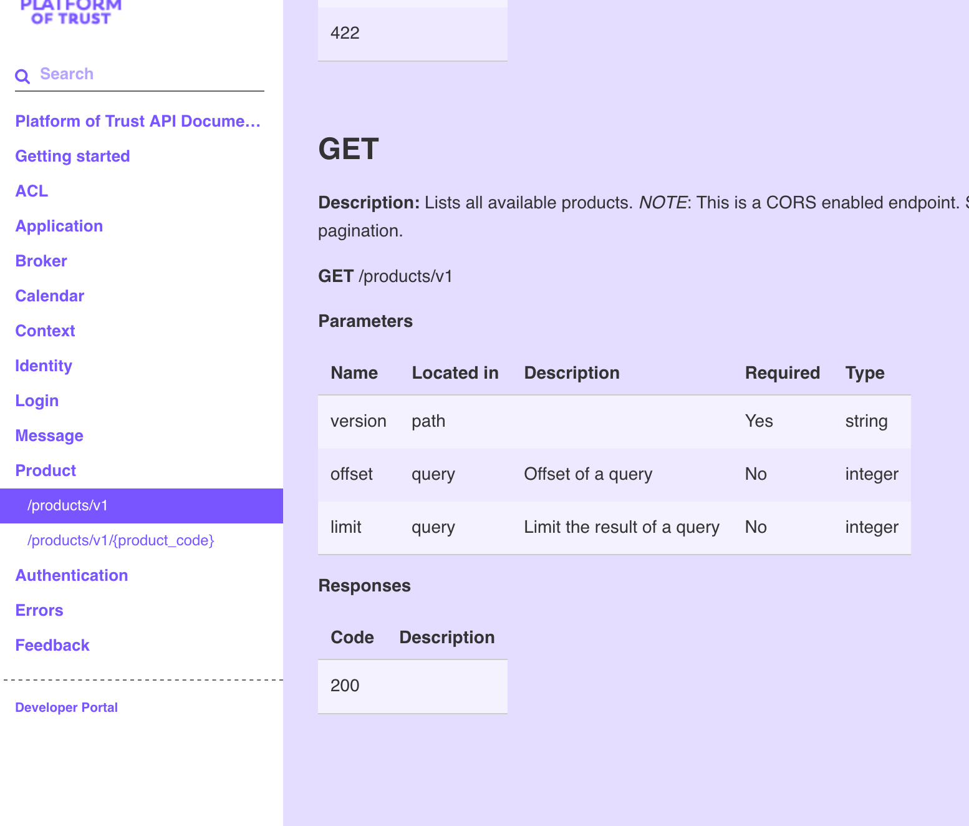
Example 1
Developer wants to list all products with API from Platform of Trust.
What information the developer needs?
Find the documentation
Product listing endpoint
How to call API with preferred programming language
What are the responses?
Take-away:
Reorder endpoints so that relevant for
the user’s work flow are close to each other. Use Pareto Chart Analysis
DX Doctor – dxdoctor.net – Jarkko Moilanen @Jarkko_Moilanen

Slide 17
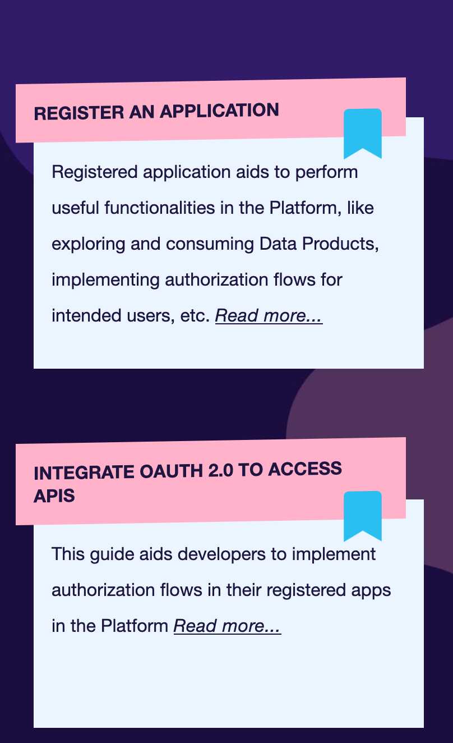
Take-away:
Reorder guides so that relevant for
the user’s work flow are close to each other. Use Pareto Chart Analysis
Example 2
Developer wants to register application to the platform
What information the developer needs?
Find the developer portal and guides
Howto guide on registering an application
Step by step guide with code examples (for API calls)
Most likely developer also needs to add auth to the application as well
DX Doctor – dxdoctor.net – Jarkko Moilanen @Jarkko_Moilanen

Slide 18
Example 3
Which APIs or endpoints should I optimize?
Optimize, performance, usability and reliability of the 20% of the endpoints, leave rest as is (waste of time and resources.
Example 4
We consider building a code library to enable more fluent DX for consumers. What APIs and endpoints should be included?
Most likely consumers need in 80% of the cases just 20% of your API capabilities. Bundle those logically.
DX Doctor – dxdoctor.net – Jarkko Moilanen @Jarkko_Moilanen

Slide 19
Pareto principle and Developer eXperience – why should I care?
Jarkko Moilanen (PhD)
Chief Development Officer, Platform of Trust
@Jarkko_Moilanen
+358 40 535 9066

Slide 20

100 Days DX 100daysdx.com
100 articles on what is Developer eXperience.
The biggest open resource on Developer eXperience so far.
Economics of the Developer eXperience
Why DX matters in product development and sales
DX Doctor – dxdoctor.net – Jarkko Moilanen @Jarkko_Moilanen

Slide 21
Available for API development and strategy consulting
+358 40 535 9066
dxdoctor.net/services

