Slide 1
Things nobody told you about developer experience (DX)
Jarkko Moilanen (PhD)
@Jarkko_Moilanen
+358 40 535 9066

Slide 2

Aim of the DX is to help developers (customers) to be more productive
DX Doctor – dxdoctor.net – Jarkko Moilanen @Jarkko_Moilanen

Slide 3
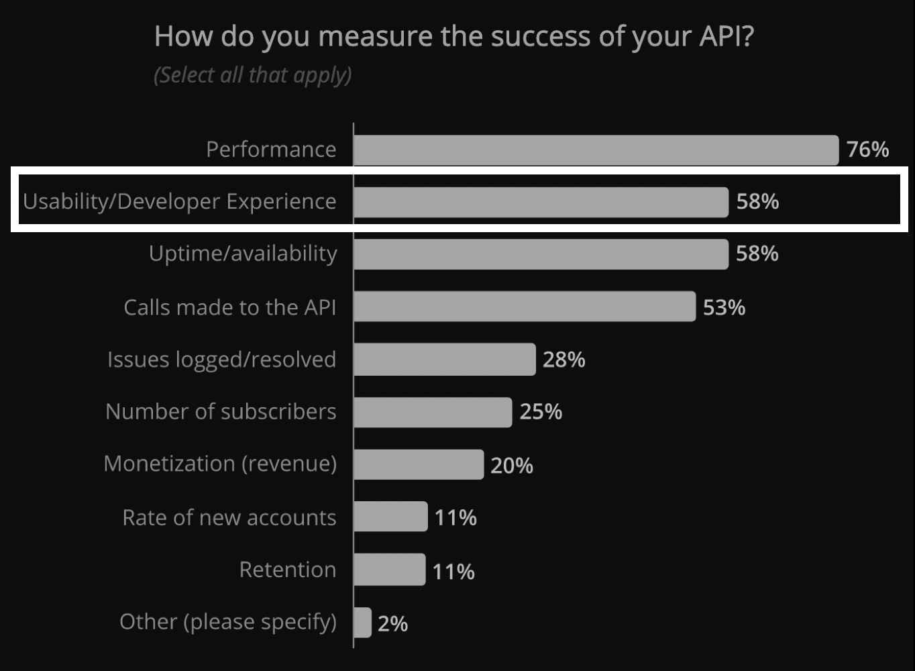
Services are consumed via APIs Performance and usability are defining successful API program DX as key aspect in winning competition
State of API 2019 report. https://smartbear.com/resources/ebooks/the-state-of-api-2019-report/
DX Doctor – dxdoctor.net – Jarkko Moilanen @Jarkko_Moilanen

Slide 4
Developer eXperience End results of a great process
Product provides instant value
Consider libraries (if platform-ish)
Onboarding is self-service based
Easy to read and informative (API) documentation
Low learning curve – fast 1st positive experience
1/2
DX Doctor – dxdoctor.net – Jarkko Moilanen @Jarkko_Moilanen

Slide 5
Developer eXperience End results of a great process
Offers space and time for learning (freemium)
Sample apps (open source)
Supports developer’s work flow(Postman -Rethink need for console)
Supports architecture trends (events driven)
CLI tools for automation and testing
2/2
DX Doctor – dxdoctor.net – Jarkko Moilanen @Jarkko_Moilanen

Slide 6
But what is developer experience?
”you need to have up-to-date API docs, developer portal, some code snippets, code libraries…”
DX Doctor – dxdoctor.net – Jarkko Moilanen @Jarkko_Moilanen

Slide 7
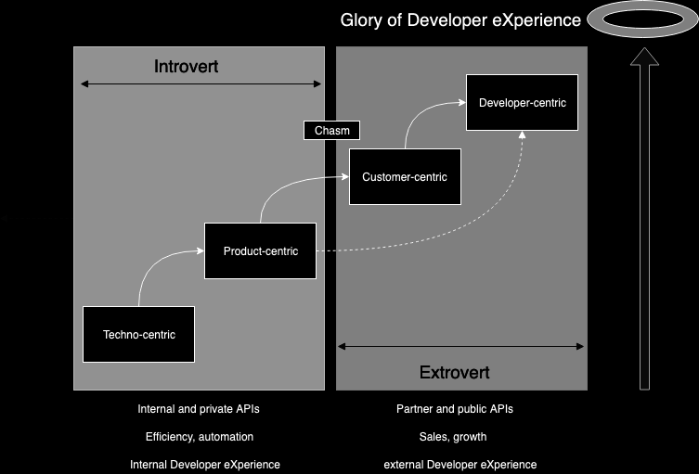
Internal and external developer experience Crossing the chasm is easier if you build APIs like they would become public in the future (Bezos Mandate)
DX Doctor – dxdoctor.net – Jarkko Moilanen @Jarkko_Moilanen

Slide 8
2/3 of the DX is other than tools and services. You control the remaining 1/3
Fagerholm, Fabian, and Jürgen Münch. "Developer experience: Concept and definition." Proceedings of the International Conference on Software and System Process. IEEE Press, 2012.
DX Doctor – dxdoctor.net – Jarkko Moilanen @Jarkko_Moilanen

Slide 9
DX Doctor – dxdoctor.net – Jarkko Moilanen @Jarkko_Moilanen

Slide 10


100 Days DX 100daysdx.com 113 633 words of wisdom which is equivalent of a 378 page book.
2019
2019
2018
The biggest open resource on Developer eXperience so far.
DX Doctor – dxdoctor.net – Jarkko Moilanen @Jarkko_Moilanen

Slide 11
dxdoctor.net #dxdoctor 100daysdx.com #100DaysDX
Jarkko Moilanen (PhD)
@Jarkko_Moilanen
+358 40 535 9066

