Slide 1
Emerging Drag-and-drop Developer profile and developer experience
Jarkko Moilanen (PhD)
Chief Development Officer, Platform of Trust
@Jarkko_Moilanen
+358 40 535 9066

Slide 2

100 Days DX 100daysdx.com
100 articles on what is Developer eXperience.
The biggest open resource on Developer eXperience so far.
Economics of the Developer eXperience
Why DX matters in product development and sales
DX Doctor – dxdoctor.net – Jarkko Moilanen @Jarkko_Moilanen

Slide 3

We are 5x too slow
Market demand for mobile app development services will grow at least five times faster than the professional capacity to deliver them.
Gartner
DX Doctor – dxdoctor.net – Jarkko Moilanen @Jarkko_Moilanen

Slide 4
DX Doctor – dxdoctor.net – Jarkko Moilanen @Jarkko_Moilanen

Slide 5
DX Doctor – dxdoctor.net – Jarkko Moilanen @Jarkko_Moilanen

Slide 6

Needs
More developers creating apps
Constant lack of
Hard and long training
Not all are capable
Faster time to market
Fierce competition
First one grabs the most revenue
Not all apps needs to be complex
DX Doctor – dxdoctor.net – Jarkko Moilanen @Jarkko_Moilanen

Slide 7
2025
I need a simple app to do one thing
…and eventually give up because of lacking ”;”
DX Doctor – dxdoctor.net – Jarkko Moilanen @Jarkko_Moilanen

Slide 8
2025
I need a simple app to do one thing
Learn how APIs work
Setup development stack
Have security problems (avoid stack overflow copy-paste effect)
Learn programming in depth
Learn how to deploy to Azure, AWS, Heroku, etc
Debug my crappy code 80% of my time
…and eventually give up because of lacking ”;”
DX Doctor – dxdoctor.net – Jarkko Moilanen @Jarkko_Moilanen

Slide 9

No-code/low-code platforms
allows programmers and non-programmers to create application software through graphical user interfaces and configuration instead of traditional computer programming.
No code platforms are accessible to any end-business user while low-code platforms require developers with knowledge of coding languages who can work within a platform's constraints to streamline the development process.
DX Doctor – dxdoctor.net – Jarkko Moilanen @Jarkko_Moilanen

Slide 10

Mostly no-code, used by ”all”, for layman use
Offers low-code for advanced features, hobby developers+
Simple everyday automations
Used by developers, kids, teachers, marketing people, basicly ”all”
Global Developer Population 2019 Community Edition
DX Doctor – dxdoctor.net – Jarkko Moilanen @Jarkko_Moilanen

Slide 11
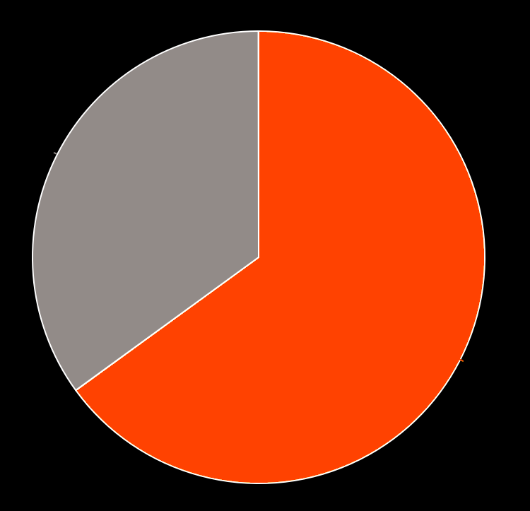
“By 2024, low-code application development will be responsible for more than
65% of application development activity.”
35%
65%
Gartner, Magic Quadrant for Enterprise Low Code Application Platforms, 8 August 2019, [Paul Vincent, Kimihiko Iijima, Jason Wong, Mark Driver Yefim Natis Name(s)],
DX Doctor – dxdoctor.net – Jarkko Moilanen @Jarkko_Moilanen

Slide 12
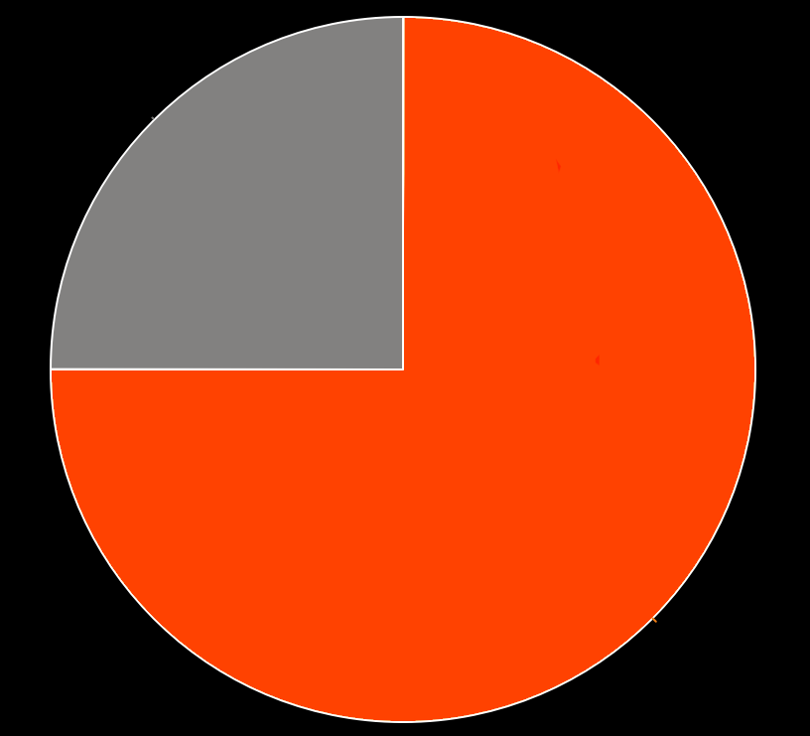
”By 2024, three-quarters of large enterprises will be using at least four low-code development tools for both IT application development and citizen development initiatives.”
25%
75%
Gartner, Magic Quadrant for Enterprise Low Code Application Platforms, 8 August 2019, [Paul Vincent, Kimihiko Iijima, Jason Wong, Mark Driver Yefim Natis Name(s)],
DX Doctor – dxdoctor.net – Jarkko Moilanen @Jarkko_Moilanen

Slide 13
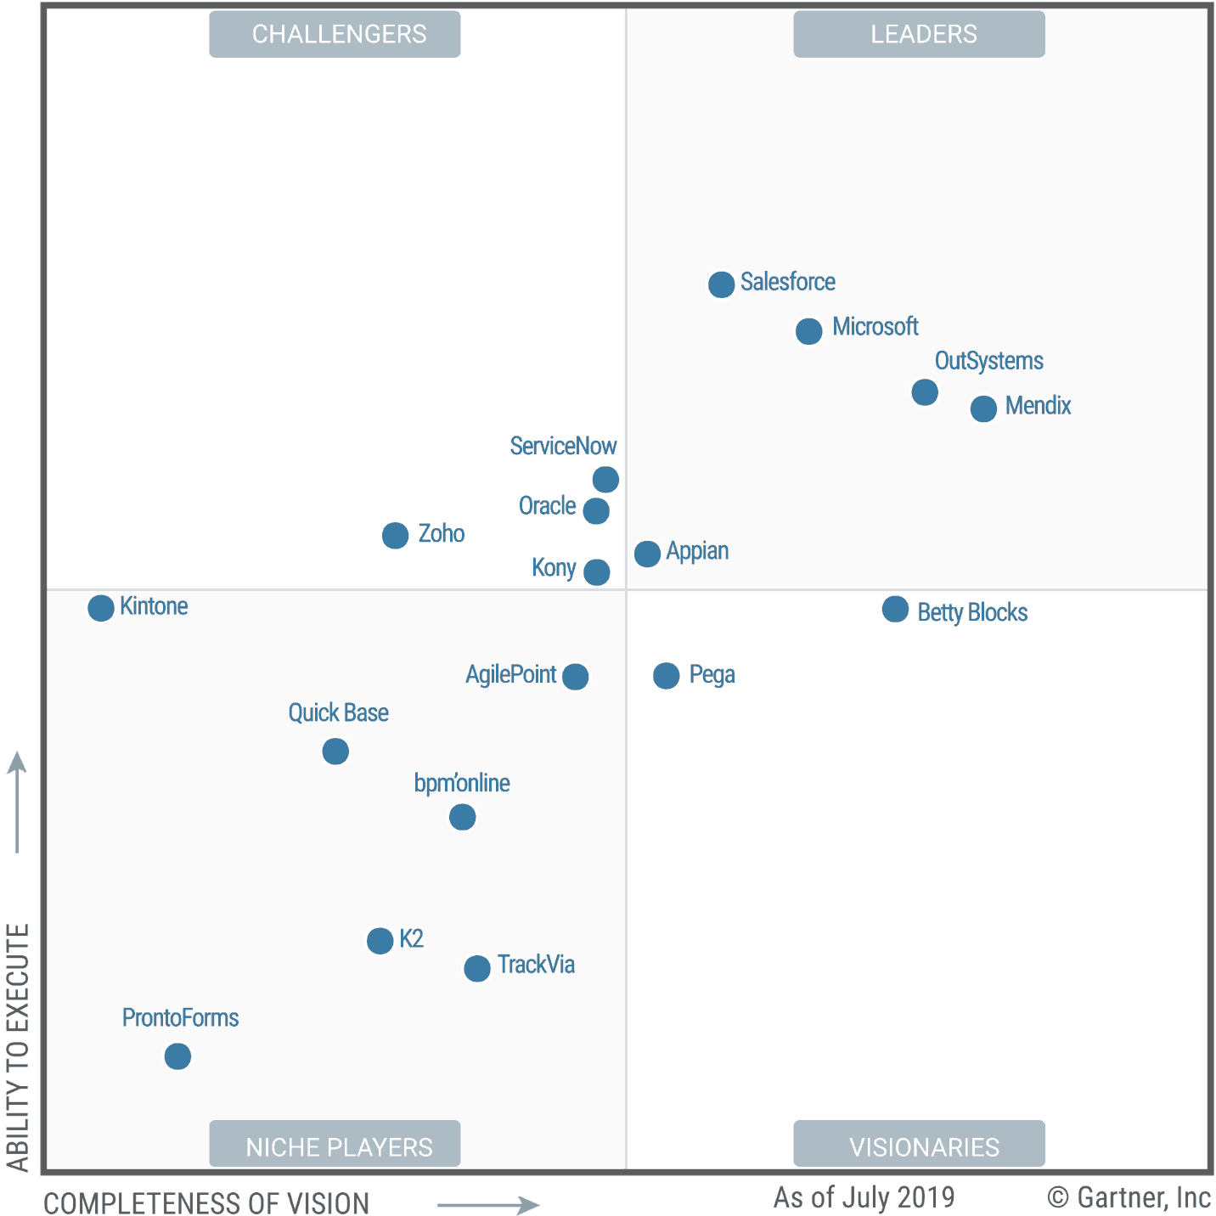
Gartner 2019 Magic Quadrant for Enterprise Low Code Application Platforms
Huge players involved – piggyback their growth
DX Doctor – dxdoctor.net – Jarkko Moilanen @Jarkko_Moilanen

Slide 14

2018 Salesforce acquired MuleSoft for 6,5$ Billion
2019 Salesforce acquired Tableau for 15,3$ Billion
79% of Salesforce customers use apps made with low-code platform to boost business
Low-code approach
Data centricity
Cloud-based architecture
Cross-platform support
Drag-and-drop (or point-and-click) tools
Flexibility
The lightning platform
Global Developer Population 2019 Community Edition
DX Doctor – dxdoctor.net – Jarkko Moilanen @Jarkko_Moilanen

Slide 15
What it means?
Huge amount of more developers, not just ”hard core developers”.
Apps are created faster.
We might see a lot of crappy applications
DX Doctor – dxdoctor.net – Jarkko Moilanen @Jarkko_Moilanen

Slide 16

Complexity of an app
About 19 Million developer world wide
Developers
Citizen
Developers
About 500+ Million world wide
Available population
DX Doctor – dxdoctor.net – Jarkko Moilanen @Jarkko_Moilanen

Slide 17
Speed of development
About 500+ Million world wide
8x
Citizen
Developers
Low-code platforms
No-code platforms
faster
About 19 Million developers world wide
Developers
APIs
Code libraries
Traditional IDEs
Available population
DX Doctor – dxdoctor.net – Jarkko Moilanen @Jarkko_Moilanen

Slide 18

So far developers have been building tools for other developers
Open source code
Code libraries
APIs
This will continue, but focus of tools is divided
Now developers build app tools for layman use
DX Doctor – dxdoctor.net – Jarkko Moilanen @Jarkko_Moilanen

Slide 19
Open source
Glue period
1990
2000
2010
2025
traditional application or
framework APIs
DX Doctor – dxdoctor.net – Jarkko Moilanen @Jarkko_Moilanen

Slide 20
Web APIs
Lego period
Open source
Glue period
1990
2000
2010
2025
traditional application or
framework APIs
Fielding’s REST
dissertation
DX Doctor – dxdoctor.net – Jarkko Moilanen @Jarkko_Moilanen

Slide 21
Code Libraries
Component period
Web APIs
Lego period
Open source
Glue period
1990
2000
2010
2025
traditional application or
framework APIs
Fielding’s REST
dissertation
NPM established
DX Doctor – dxdoctor.net – Jarkko Moilanen @Jarkko_Moilanen

Slide 22
Drag & drop period
No-Code / Low-Code
Code Libraries
Component period
Web APIs
Lego period
Open source
Glue period
1990
2000
2010
2025
traditional application or
framework APIs
Fielding’s REST
dissertation
NPM established
65% of application development activity driven
by low-code platforms
DX Doctor – dxdoctor.net – Jarkko Moilanen @Jarkko_Moilanen

Slide 23
You have 4 years time
”Old-school DX”
Old-school DX is how we now understand DX. It will not vanish, but the position will change
65%
Skills
35%
”No-Code / low-code DX”
2020
Time
2024
DX Doctor – dxdoctor.net – Jarkko Moilanen @Jarkko_Moilanen

Slide 24
What it means DX wise?
Ease of use becomes more important
GUI signifigance rise – CLI drops
Drag-and-drop
Basic level programming skills courses for staff
Users are not traditional developers
Not fiddling with ”invented here” code
Reuse - ready-made functions, components, recipes become more important
DX Doctor – dxdoctor.net – Jarkko Moilanen @Jarkko_Moilanen

Slide 25
What it means for company?
Drag-and-drop DX
Traditional DX
Traditional DX is important
Enables tools development in no/low-code platforms
Build feed for low-code platforms
Piggyback the giants
Become trusted data provider (remember that data is corner stone of for example Salesforce approach)
Start building own low-code solution on top of your platform
Different kind of DX and marketing, different audience
App
App
Low-code platforms
Traditional DX
Platform of Trust
DX Doctor – dxdoctor.net – Jarkko Moilanen @Jarkko_Moilanen

Slide 26
Emerging Drag-and-drop Developer profile and developer experience
Jarkko Moilanen (PhD)
Chief Development Officer, Platform of Trust
@Jarkko_Moilanen
+358 40 535 9066

Slide 27
Available for API development and strategy consulting
+358 40 535 9066
dxdoctor.net/services

