Slide 1

Developers are decision makers and paying customers
Why DX matters in product development and sales
Jarkko Moilanen (PhD, pursuing 2nd PhD)
Chief Development Officer, Platform of Trust
@Jarkko_Moilanen
+358 40 535 9066

Slide 2
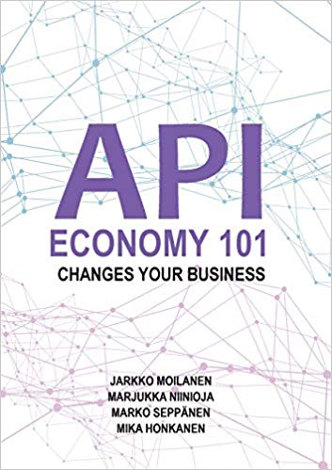
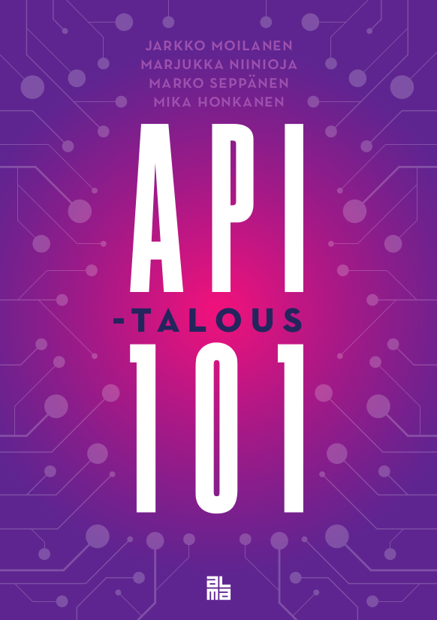
100 Days DX 100daysdx.com 113 633 words of wisdom which is equivalent of a 378 page book.
2019
2019
2018
The biggest open resource on Developer eXperience so far.
DX Doctor – dxdoctor.net – Jarkko Moilanen @Jarkko_Moilanen

Slide 3

Developers have a lot of influence in technology purchases They have buying potential and can act as a wedge point to start selling into an organisation.
DX Doctor – dxdoctor.net – Jarkko Moilanen @Jarkko_Moilanen

Slide 4

38% of the developers are in position to make purchases
Global developer population report 2019 . https://sdata.me/GlobalDevPop19
DX Doctor – dxdoctor.net – Jarkko Moilanen @Jarkko_Moilanen

Slide 5

18,9 Million active sw developers globally (45 Million by 2030) 12,9 Million professional sw developers
Global developer population report 2019 . https://sdata.me/GlobalDevPop19
DX Doctor – dxdoctor.net – Jarkko Moilanen @Jarkko_Moilanen

Slide 6

38% of professional developers is around 4 900 000 customers
Global Developer Population 2019 Community Edition
DX Doctor – dxdoctor.net – Jarkko Moilanen @Jarkko_Moilanen

Slide 7

45% are in a position to make recommendations 5 800 000 developers
Global Developer Population 2019 Community Edition
DX Doctor – dxdoctor.net – Jarkko Moilanen @Jarkko_Moilanen

Slide 8

25% of developers can spend 10 000€+ without authorization
DX Doctor – dxdoctor.net – Jarkko Moilanen @Jarkko_Moilanen

Slide 9
B2D product strategy Make multiple compact services (with instant value + freemium) with relatively small annual costs (1k-2k€)
DX Doctor – dxdoctor.net – Jarkko Moilanen @Jarkko_Moilanen

Slide 10
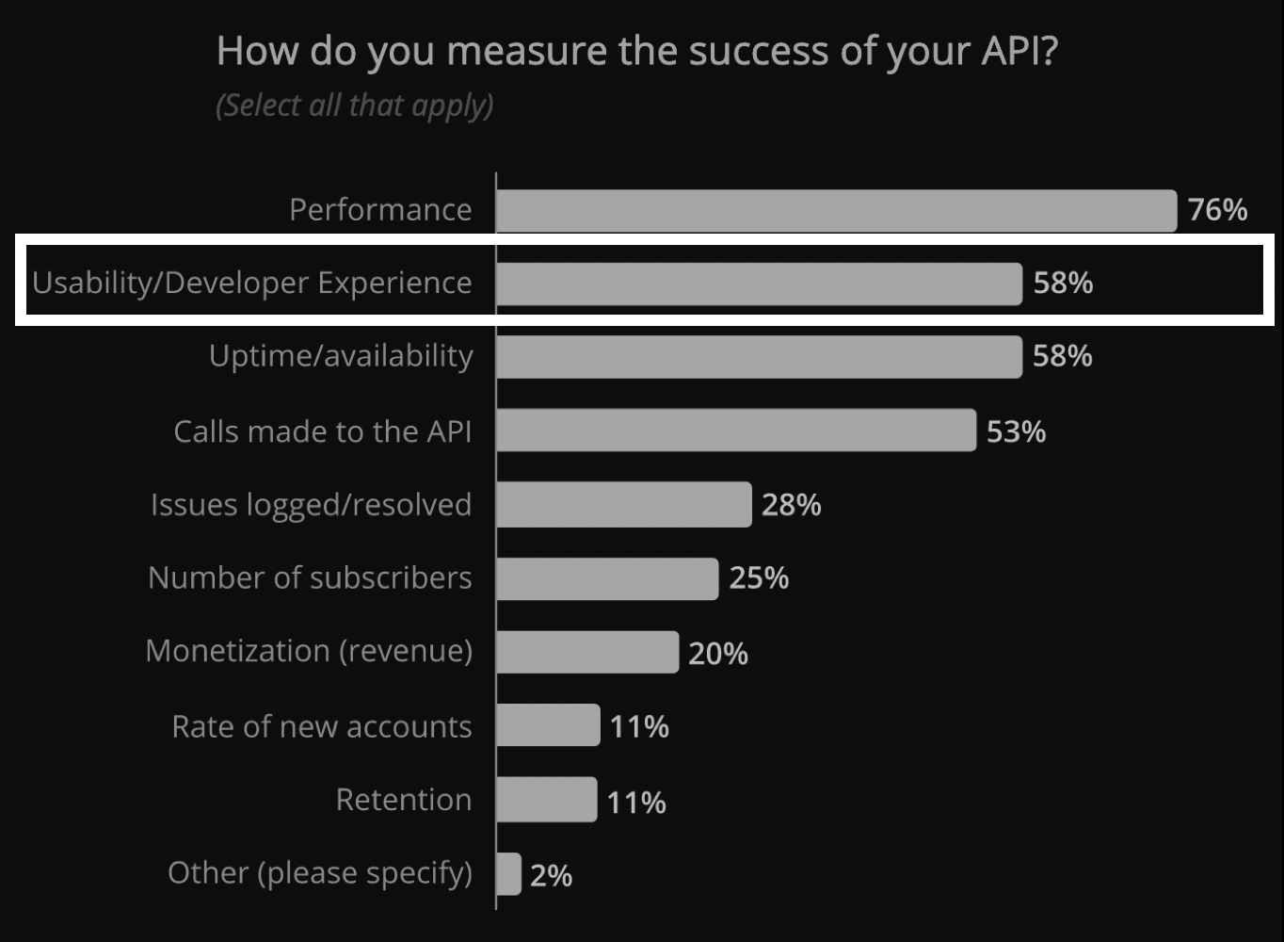
Services are consumed via APIs Performance and usability are defining successful API program DX as key aspect in winning competition
State of API 2019 report. https://smartbear.com/resources/ebooks/the-state-of-api-2019-report/
DX Doctor – dxdoctor.net – Jarkko Moilanen @Jarkko_Moilanen

Slide 11
But what is developer experience?
DX Doctor – dxdoctor.net – Jarkko Moilanen @Jarkko_Moilanen

Slide 12
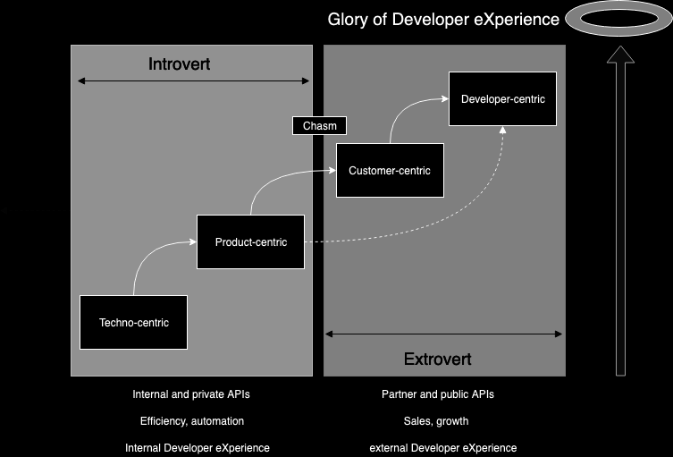
Crossing the chasm is easier if you build APIs like they would become public in the future (Bezos Mandate)
DX Doctor – dxdoctor.net – Jarkko Moilanen @Jarkko_Moilanen

Slide 13
2/3 of the DX is other than tools and services. You control the remaining 1/3
Fagerholm, Fabian, and Jürgen Münch. "Developer experience: Concept and definition." Proceedings of the International Conference on Software and System Process. IEEE Press, 2012.
DX Doctor – dxdoctor.net – Jarkko Moilanen @Jarkko_Moilanen

Slide 14
DX Doctor – dxdoctor.net – Jarkko Moilanen @Jarkko_Moilanen

Slide 15
Developer eXperience End results of a great process
Product provides instant value
Consider libraries (if platform-ish)
Onboarding is self-service based
Easy to read and informative (API) documentation
Low learning curve – fast 1st positive experience
1/2
DX Doctor – dxdoctor.net – Jarkko Moilanen @Jarkko_Moilanen

Slide 16
Developer eXperience End results of a great process
Offers space and time for learning (freemium)
Sample apps (open source)
Supports developer’s tool stack (Postman -Rethink need for console)
Supports architecture trends (events driven)
CLI tool for automation and testing
2/2
DX Doctor – dxdoctor.net – Jarkko Moilanen @Jarkko_Moilanen

Slide 17
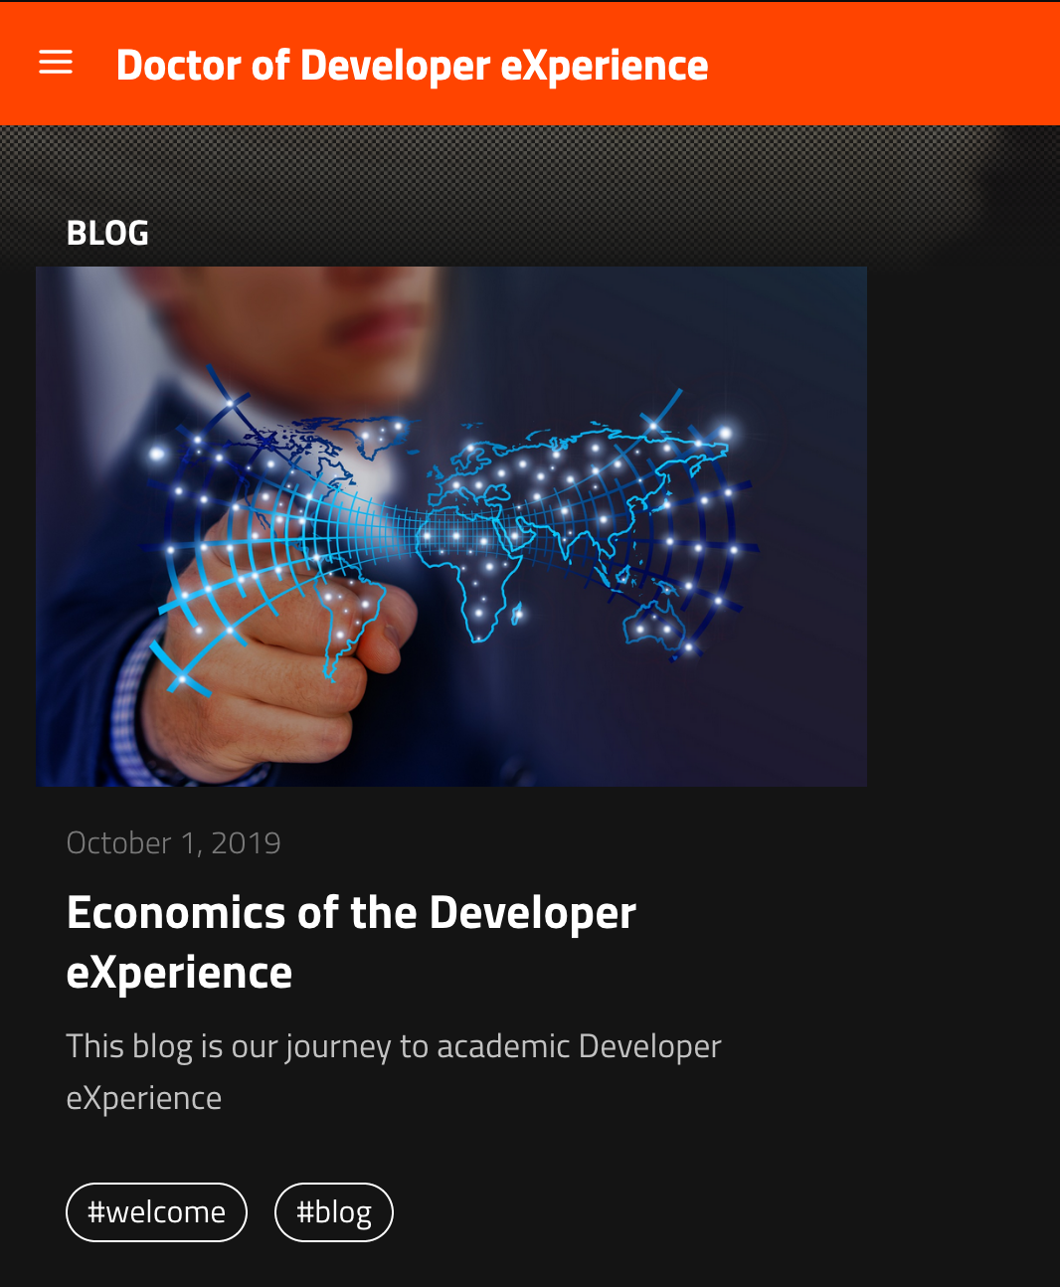
dxdoctor.net #dxdoctor 100daysdx.com #100DaysDX
Jarkko Moilanen (PhD)
Chief Development Officer, Platform of Trust
@Jarkko_Moilanen
+358 40 535 9066

