Slide 1

Object Oriented Programming Lecture 00: Course Information
Department of Computer Science and Information Engineering
Shuo-Han Chen (陳碩漢), shchen@ntut.edu.tw
The Sixth Teaching Building 327
M 15:10 - 16:00 & F 10:10 - 12:00

Slide 2

Course Information
Object Oriented Programming
Course Time and Place
Lecture (3 Hours)
Monday 15:10 - 16:00
Friday 10:10 - 12:00
The Sixth Teaching Building 327
Midterm & Final involve both hand-written and computer-based exams
Check the Announcement beforehand
Course Website: http://140.124.183.78/gitlab/109000000/oop2022f
You need to connect to School VPN to access the website
Course Website
2

Slide 3
Prerequisites
Addend & Interact
Familiar with C or Taken 程設 (一) & (二)
Do not be afraid of English
Read the text book
And, of course, willing to learn C++
3

Slide 4
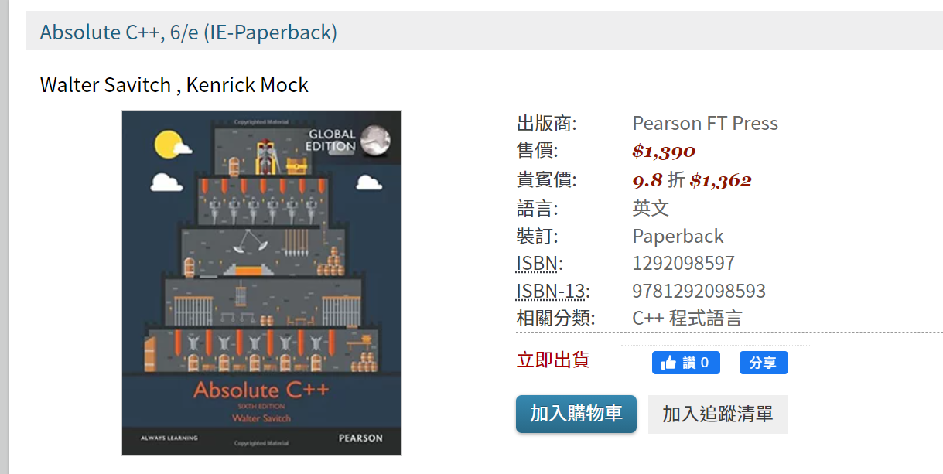
The book we are using
We will assign reading chapter every week.
It would be very helpful if you can get one
4

Slide 5

Course Grading Policy
Participance as Bonus: Less than 5 %
Assignment: 30 %
Weekly or Biweekly
HW that requires PDF report -> submit to i 學園
HW that requires code -> Git push to our Gitlab website
Accounts will be created by this Sunday – If you have no student ID, we will assign one
Midterm Exam: 35 %
Final Exams: 35 %
50 minutes of hand-written exams - Physical
3 hour of computer-based exams - Online
Do the survey and mark your calendar before 09/23 24:00!
https://forms.gle/L38sTYVMKY5qQKne7
If you do, you will get +1 bonus on the final grade
If you do not, you will get -3 points bonus on the final grade
Exam Time Survey
5

Slide 6
Course Schedule
Due to national holidays, there will be no class on Oct. 10, Oct. 31, and Jan. 2.
W | Date | Lecture | Readings | Homework
1 | Sept. 12, 16 | Lec01: Introduction & Environment Setup | Chapter 1
2 | Sept. 19, 23 | Lec02: Flow of Control |  | HW 00
3 | Sept. 26, 30 | Lec03: Function Basics / Exception Handling
4 | Oct. 3, 7 | Lec04: String
5 | Oct. 10, 14 | National Day / Lec05: Pointer
6 | Oct. 17, 21 | Lec06: Parameters and Overloading
7 | Oct. 24, 28 | Lec07: Structures and Classes
8 | Oct. 31, Nov. 4 | No class / Lec08: Constructors and Other Tools
9 | Nov.7, 11 | Physical Hand-Written Midterm / Online Computer-based Midterm
10 | Nov. 14, 18 | Lec09: Operator Overloading, Friends, and References
11 | Nov. 21, 25 | Lec10: Inheritance
12 | Nov. 28, Dec. 2 | Lec11: Inheritance
13 | Dec. 5, 9 | Lec12: Polymorphism and Virtual Functions
14 | Dec. 12, 16 | Lec14: Standard Template Library
15 | Dec. 19, 23 | Lec15: Templates
16 | Dec. 26, 30 | Physical Hand-Written Final / Lec16: Streams and File I/O / Namespace
17 | Jan. 2, 6 | No class / Online Computer-based Final
18 | Jan. 9, 13 | No class & Let’s you guys to get prepared for other finals
6

Slide 7
Object-Oriented Programming (OOP)
OOP is a program design philosophy
Modularization
Reusability
The key idea is
To describe the real world accurately as a collection of objects that interact
Everything in OOP is self sustainable objects, which include
States (data)
Behaviors (methods)
Procedural Programming | Object-Oriented Programming
Functions | Objects
Top down Approach | Bottom up approach
C | C++, Java, Python, C#
Notes:
Instead of referring to a certain programming language, OOP is actually a program design philosophy that emphasizes
Modularization: where the application can be decomposed into modules
Reusability: where an application can be composed from existing and new modules
And the key idea of OOP is to describe the real world accurately as a collection of objects that interact with each other
Therefore, everything in OOP is self sustainable objects, which include States also know as data and Behaviors which is known as methods
In the past, C is known as a type of Procedural Programming language
Which is mostly implemented as a set of functions with top down approach
On the other hand, OOP is implemented as a set of objects in a bottom up approach

Slide 8
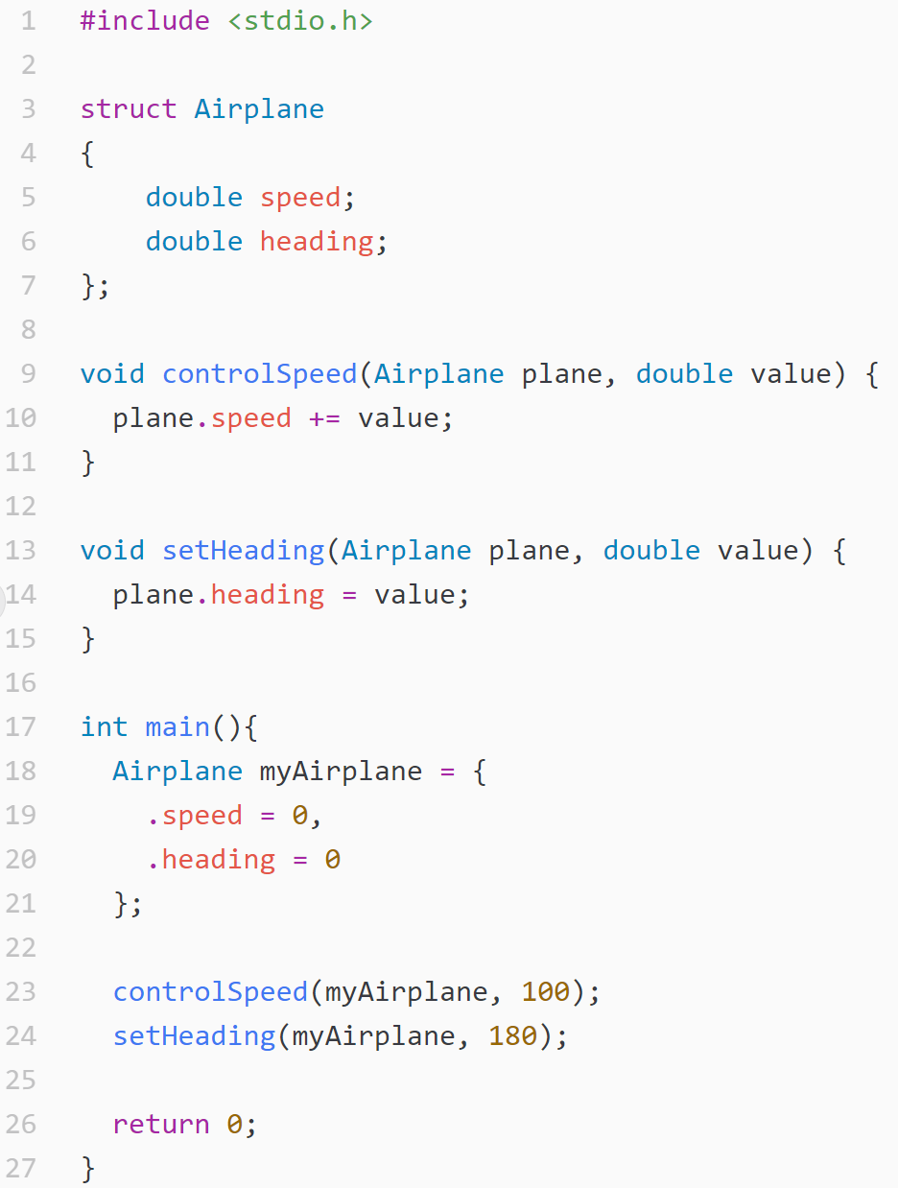
If you’re still unsure about the differences
Example: We are writing a program to control toy airplane
Procedural Programming – function-based
In this example, you need to control the airplane by functions

Slide 9
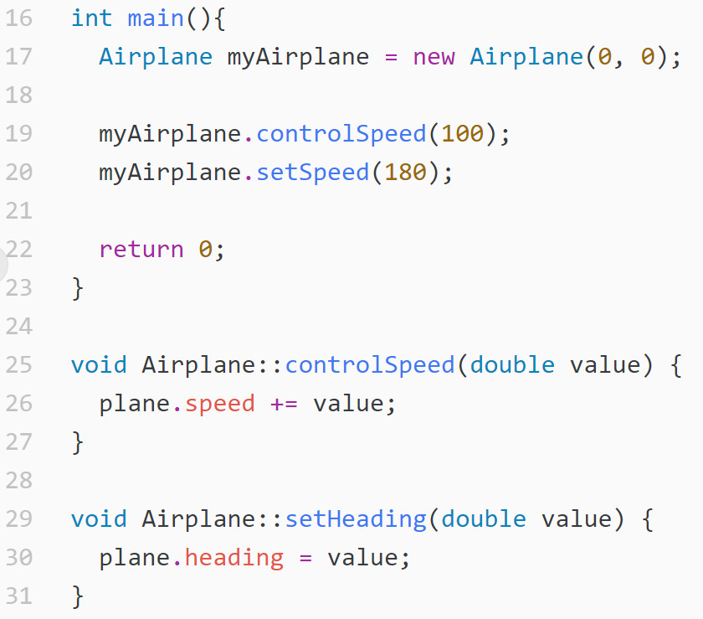
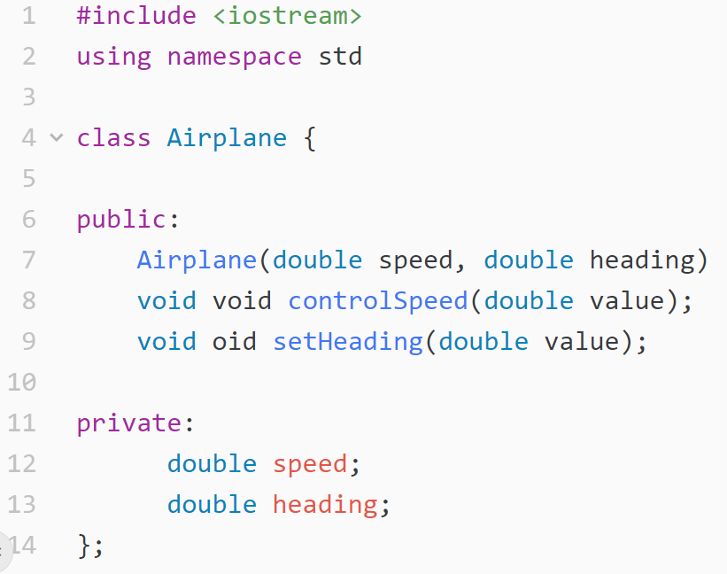
If you’re still unsure about the differences (Cont'd)
But in object-oriented programming, the state and functions are encapsulated into an object (class)

Slide 10
Main Features of OOP
OOP generally supports
Classes
Objects
Encapsulation
Inheritance
Polymorphism
Notes:
OOP usually supports
Classes
Objects
Encapsulation
Inheritance
Polymorphism

Slide 11
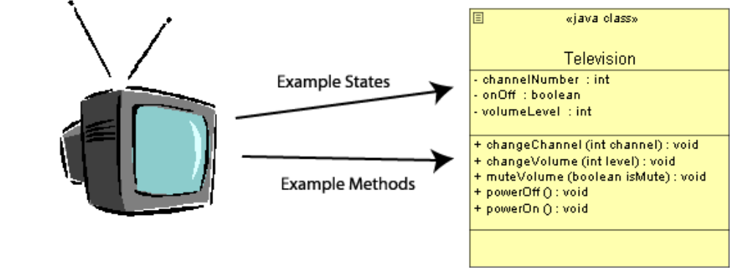
Classes
Represent the structure of objects with
State (Data) are the states that the object has
Behavior (Methods) are the ways in which the object can be interacted with
Class should
Represent a clear concept - Such as the concept of a television
Provide a well-defined interface - Such as the remote control of the television
Be complete and well-documented - TV should have a plug and a manual

Slide 12
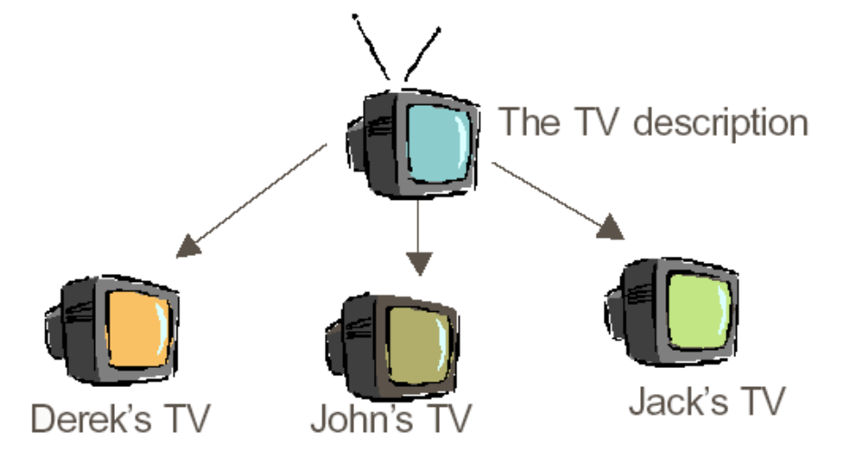
Objects
An instance of a class
If a class is the description of a concept
An object is the realization of the description in calss
To create an independent distinguishable entities – TVs can be on/off independently
Each with its own individual identity – Each TV has different serial number

Slide 13
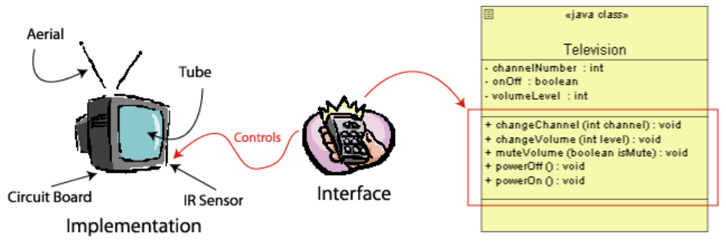
Encapsulation
Use to hide the mechanics of the object
Allow the actual implementation of the object to be hidden
In plain
Users don't need to understand how the object works
All Users need to understand is the interface that is provided for us

Slide 14
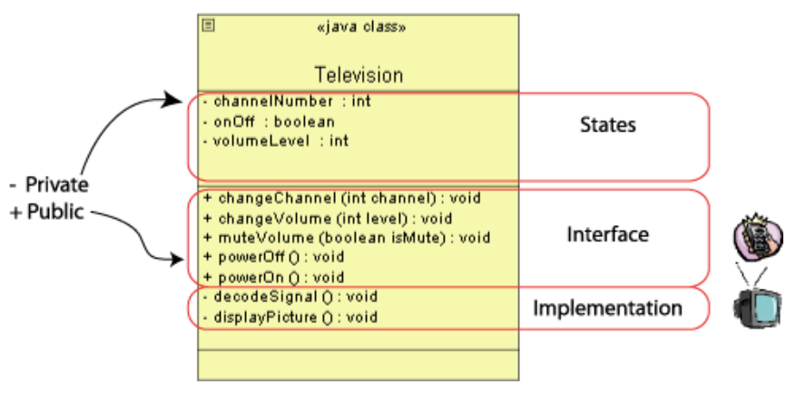
Encapsulation (Cont’d)
The implementation of interface are implemented as methods
Public methods: Interface seen by users
Private methods: Implementation used by other methods in the same class
Encapsulation can be thought as data-hiding
Users or other programmers only need to know the interface
Programmer can change the implementation, but need not notify the user

Slide 15
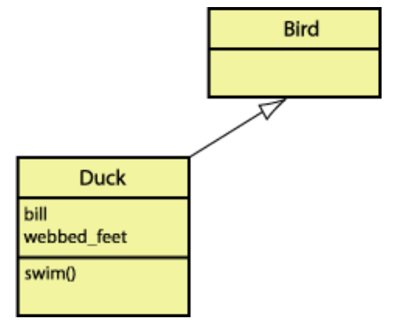
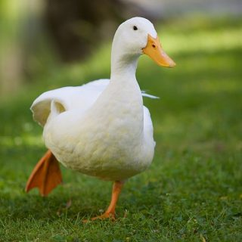
Inheritance
Provide a compact representation of descriptions that share some commonalities
OOP allows us to group the commonalities and create classes that can describe their differences from other classes.
Ex. What is a duck?
A bird that swims, with webbed feet, and a yellow bill
A duck is a special type of bird

Slide 16
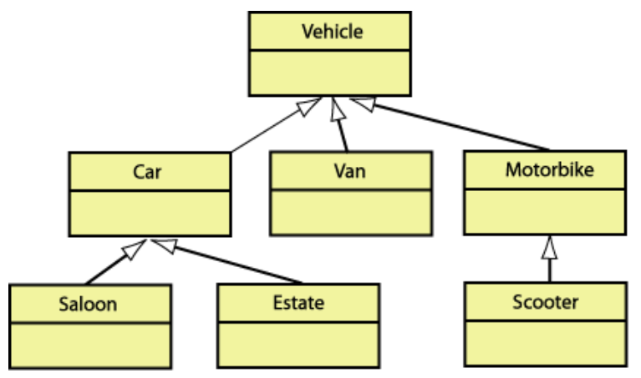
Inheritance (Cont’d)
An example of organizing different
vehicles via their differences
Car inherits from Vehicle
Saloon inherits from Car
…
Child class inherits all the data and
methods of the parent class
Car class inherits the methods of the vehicle class
– engineStart(), gearChange(), lightsOn()
Car class inherits the data of the vehicle class
– isEngineOn, isLightsOn, numberOfWheels
Base / Parent Class
Derived / Child Class

Slide 17
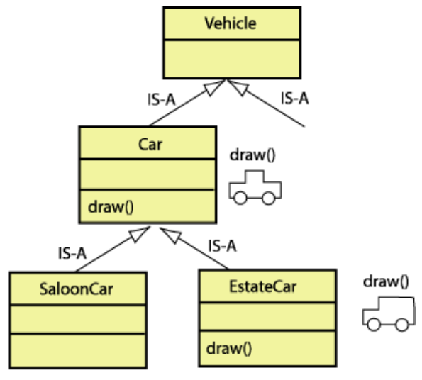
Polymorphism
Polymorphism means "multiple forms“ of the same method
Exact same method name can behave differently in derived classes
Same method name can be used in the same class with slightly different parameters
Two forms of polymorphism, over-riding and over-loading

Slide 18
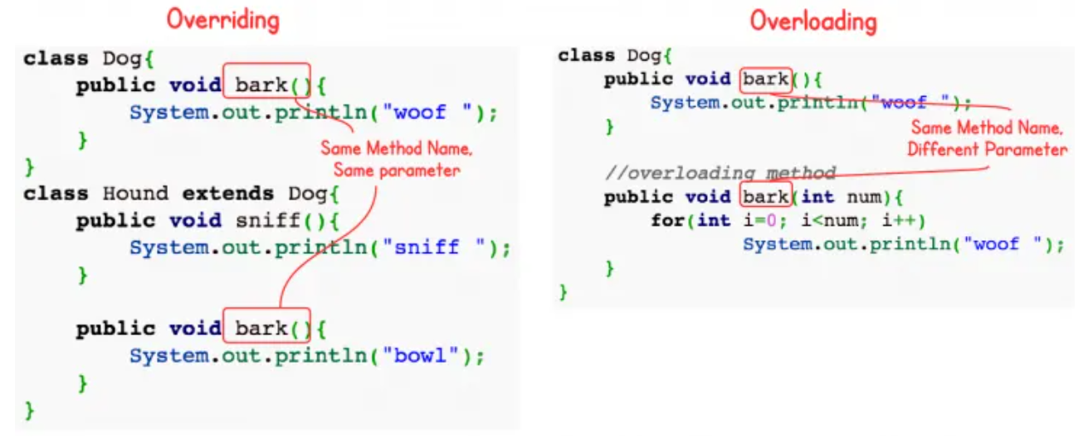
Polymorphism (Cont’d)
Difference between over-riding and over-loading

Slide 19

Class-related messages will be available on MS teams
Link:
https://teams.microsoft.com/l/team/19%3aqG1lyoshUHpaaIPvLlJcH_Fv_WXdkvtC27BEdLYc_0M1%40thread.tacv2/conversations?groupId=d27dcbf4-2e7d-45e8-bd82-c243a8183a63&tenantId=dfb5e216-2b8a-4b32-b1cb-e786a1095218
Access Code:
go4k75s
Do the survey and mark your calendar to get 1 points bonus

