Slide 1

Object Oriented Programming Lecture 01: Flow of Control
Department of Computer Science and Information Engineering
Shuo-Han Chen (陳碩漢), shchen@ntut.edu.tw
Pioneer International R&D Building - 401
M 15:10 - 16:00 & F 10:10 - 12:00

Slide 2
Course Schedule
Due to national holidays, there will be no class on Oct. 10, Oct. 31, and Jan. 2.
W | Date | Lecture | Readings | Homework
1 | Sept. 12, 16 | Lec01: Introduction & Environment Setup | Chapter 1
2 | Sept. 19, 23 | Lec02: Flow of Control |  | HW 00
3 | Sept. 26, 30 | Lec03: Function Basics / Exception Handling
4 | Oct. 3, 7 | Lec04: String
5 | Oct. 10, 14 | National Day / Lec05: Pointer
6 | Oct. 17, 21 | Lec06: Parameters and Overloading
7 | Oct. 24, 28 | Lec07: Structures and Classes
8 | Oct. 31, Nov. 4 | No class / Lec08: Constructors and Other Tools
9 | Nov.7, 11 | Physical Hand-Written Midterm / Online Computer-based Midterm
10 | Nov. 14, 18 | Lec09: Operator Overloading, Friends, and References
11 | Nov. 21, 25 | Lec10: Inheritance
12 | Nov. 28, Dec. 2 | Lec11: Inheritance
13 | Dec. 5, 9 | Lec12: Polymorphism and Virtual Functions
14 | Dec. 12, 16 | Lec14: Standard Template Library
15 | Dec. 19, 23 | Lec15: Templates
16 | Dec. 26, 30 | Physical Hand-Written Final / Lec16: Streams and File I/O / Namespace
17 | Jan. 2, 6 | No class / Online Computer-based Final
18 | Jan. 9, 13 | No class & Let’s you guys to get prepared for other finals
2

Slide 3
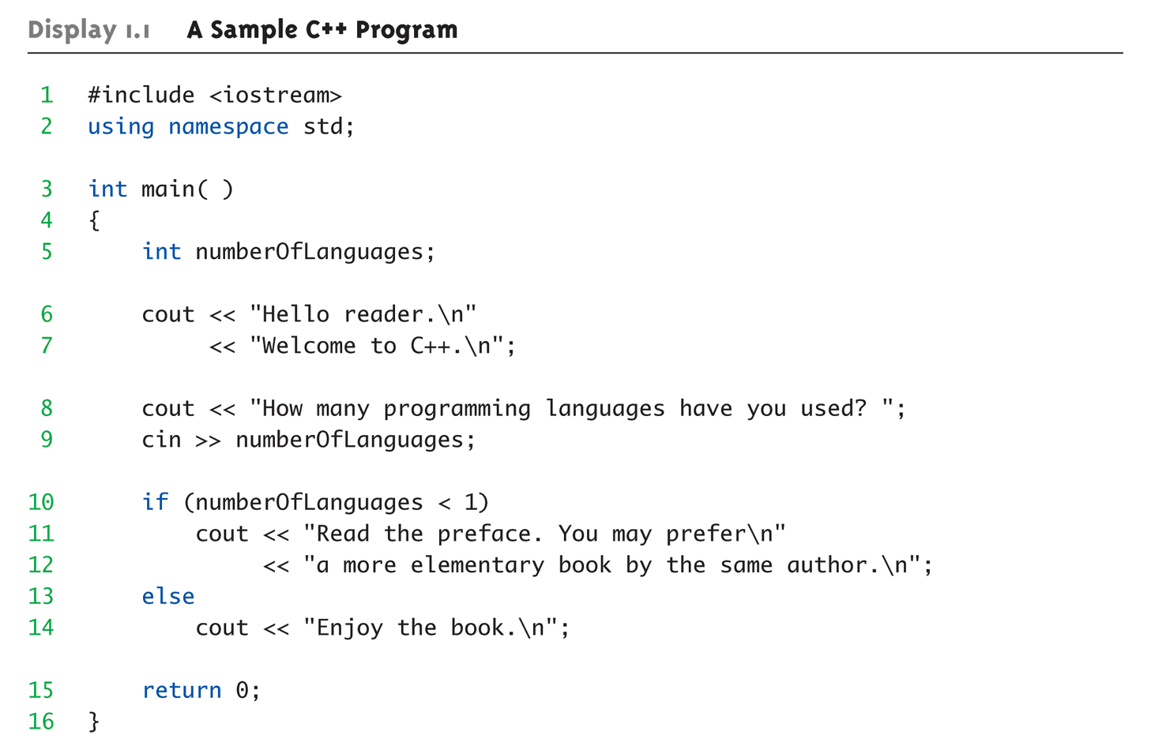
Console I/O (Text book 57 – 64)
In C++, the printf and scanf are replaced with cin & cout
Part of the iostream library and std namespace
When you do output
cout <<
When you do input
cin >>
Direction : To where you want the content to be
You can put variable in cin/cout directly, without
scanf(“%i”, number);
printf(“%i”, number);

Slide 4
Namespace (Text book 521 – 540)
Namespace is a collection of name definition
ex. Function / class / variable
Namespace is used to isolate function/class with the same name but has different functions
Std contains all definition from all standard library
The way we use it
Includes entire standard library of name definitions
#include <iostream> using namespace std;
Can specify just the objects we want
#include <iostream>
using std::cin; using std::cout;

Slide 5
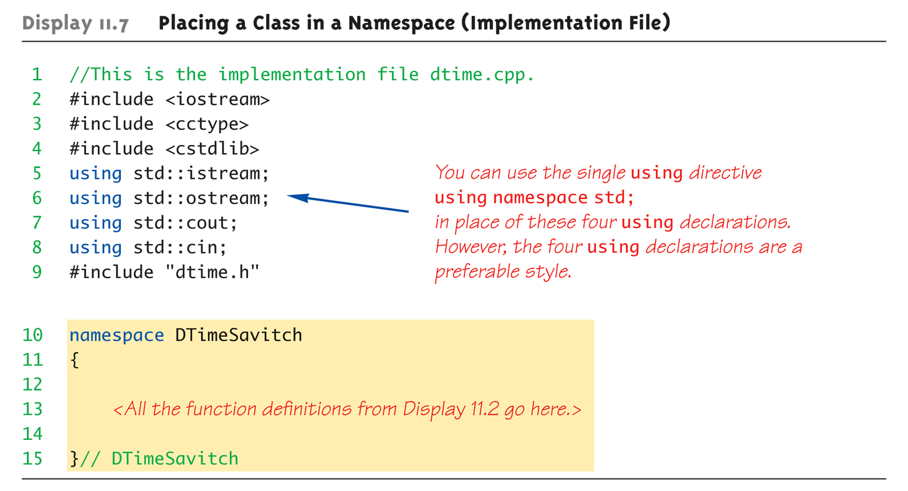
Namespace (Text book 521 – 540)

Slide 6
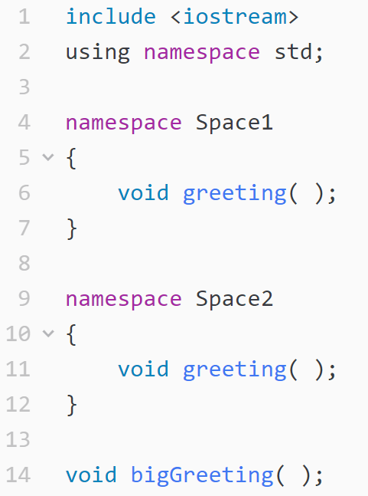
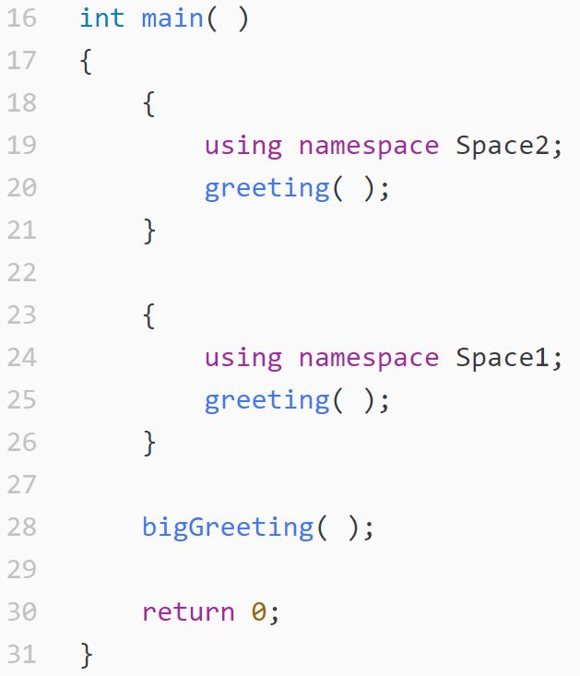
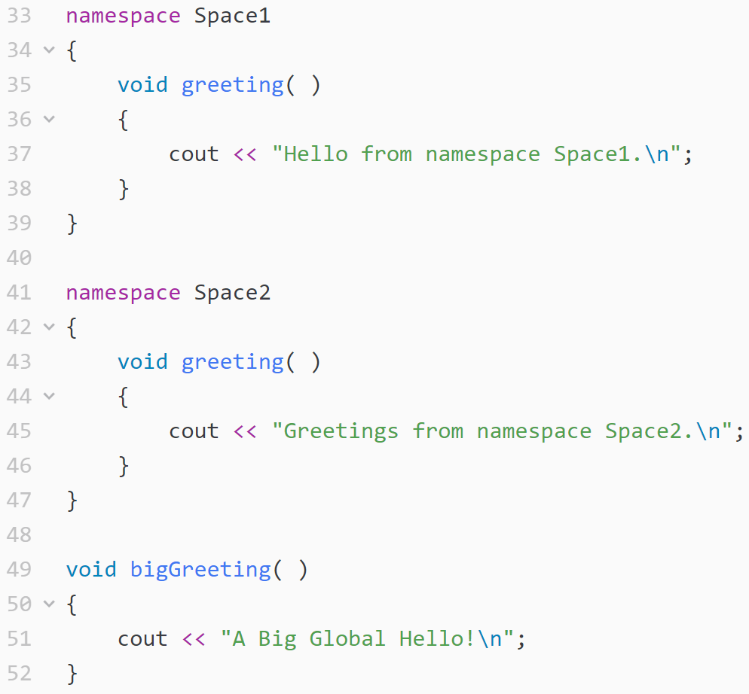
Namespace (Text book 521 – 540)
Multiple namespace in one code project is allowed
You can also define namespaces of your own

Slide 7
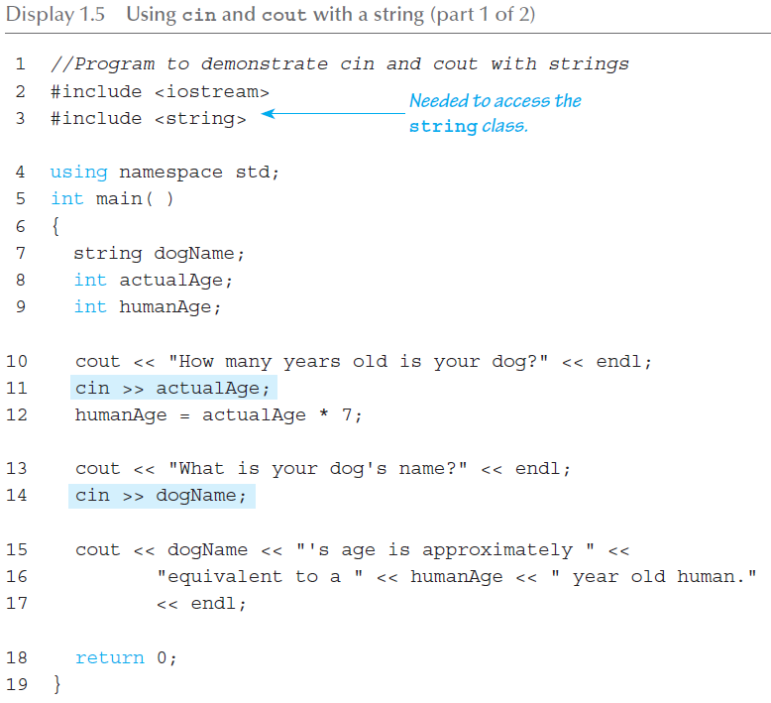
String
We have less trouble now when dealing with stream
Part of the string library and std namespace
You do cout and cin directly
We can also mess the string with some operators / methods
+=
+
==
.length() / .compare()

Slide 8
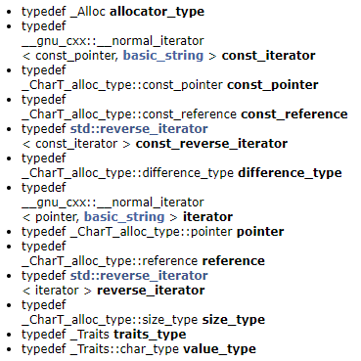
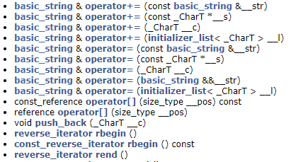
How does that become possible ?
Functions
As we already discussed, C++ enable objects to have
State (Data)
Behavior (Functions)
See the implementation of string here https://gcc.gnu.org/onlinedocs/gcc-4.6.2/libstdc++/api/a00259.html
https://gcc.gnu.org/onlinedocs/gcc-4.6.2/libstdc++/api/a00770_source.html
Data

Slide 9
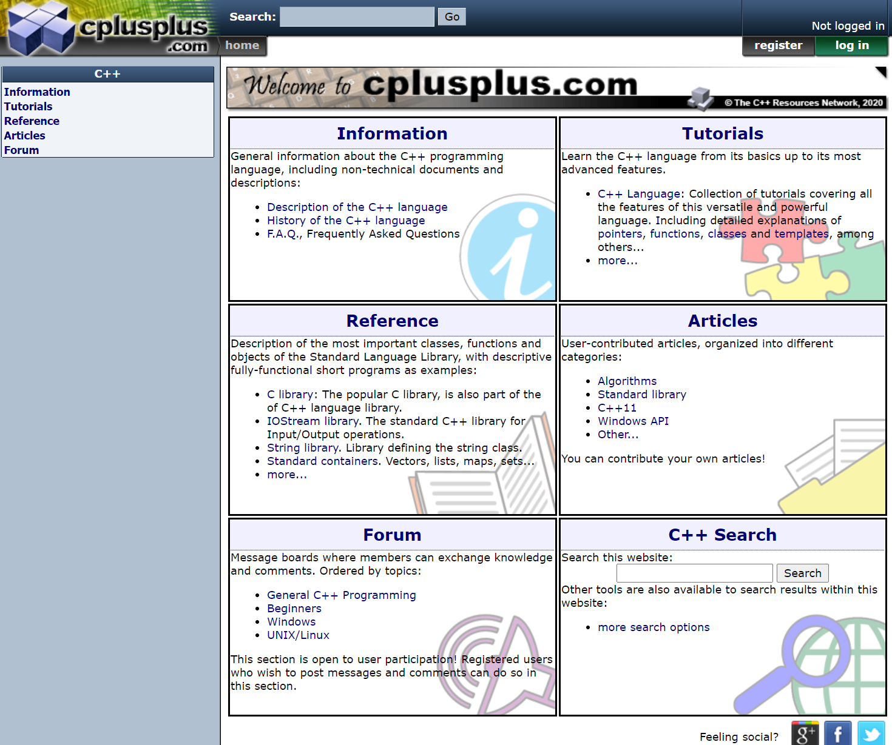
Try this out
http://cplusplus.com/
Will be very helpful in your future homework

Slide 10
How we are going to solve this problem ?
In this course, we follow the steps of
“How To Solve It” (數學家George Pólya)
瞭解問題(understanding the problem)
Find the number of continuous upper case in a string
規劃解法(devising a plan)
先個別檢查字母的大小寫
用 0 1 代表
找出把所有的 0 的長度印出來
依規劃解題 (carrying out the plan)
大小寫檢查 isUpper()
型態 String, int, vector
回顧(looking back)

Slide 11
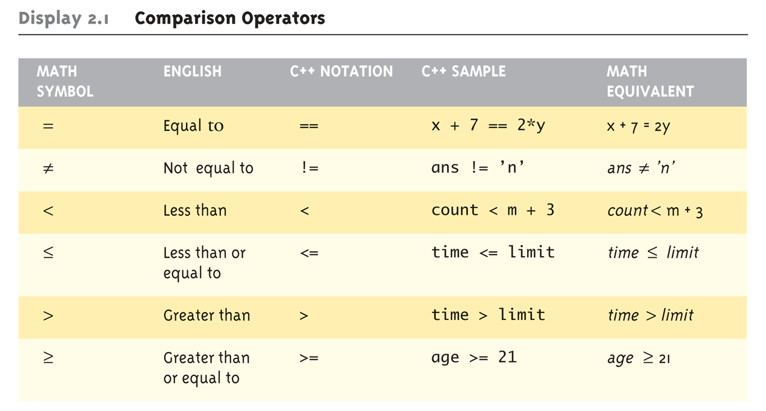
Assuming you’re familiar with the following
Comparison Operators
Logical Operators
Logical AND (&&)
Logical OR (||)

Slide 12
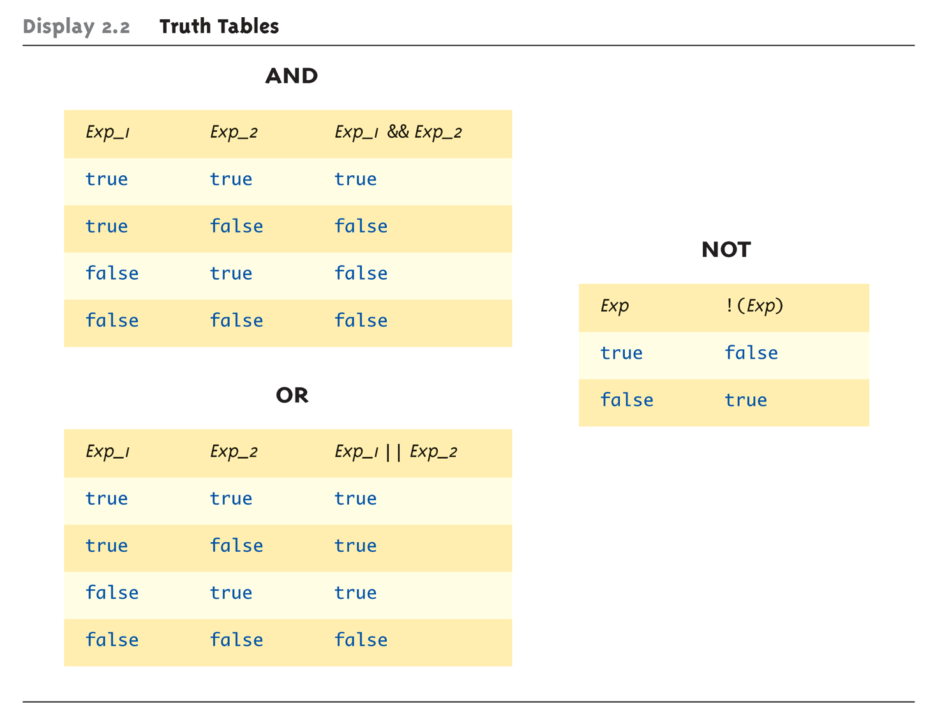
Assuming you’re familiar with the following
Truth Table

Slide 13
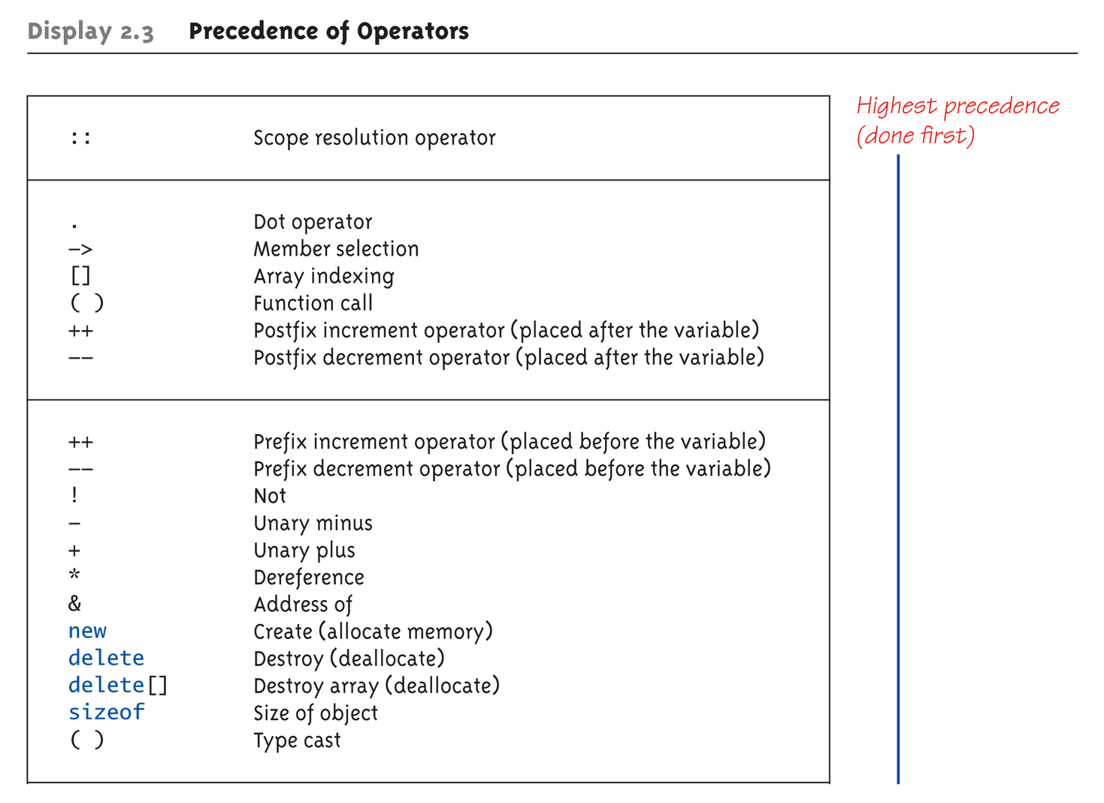
Precedence of Operators

Slide 14
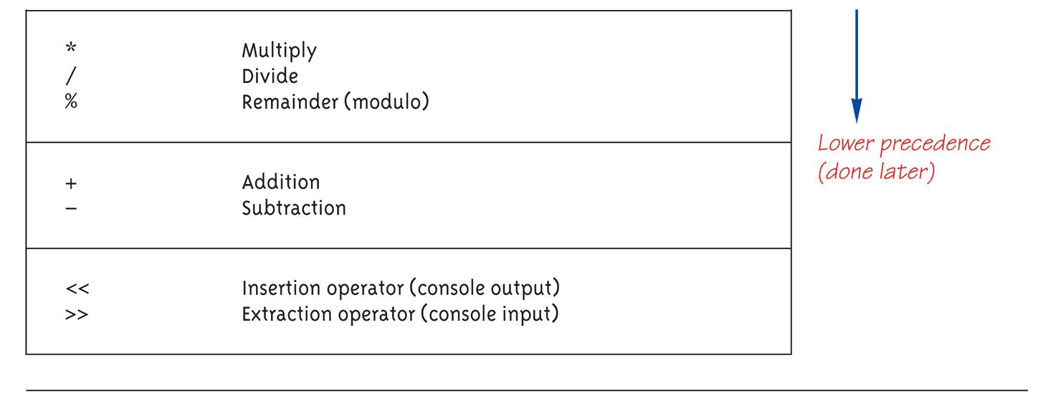
Precedence of Operators (Cont’d)

Slide 15
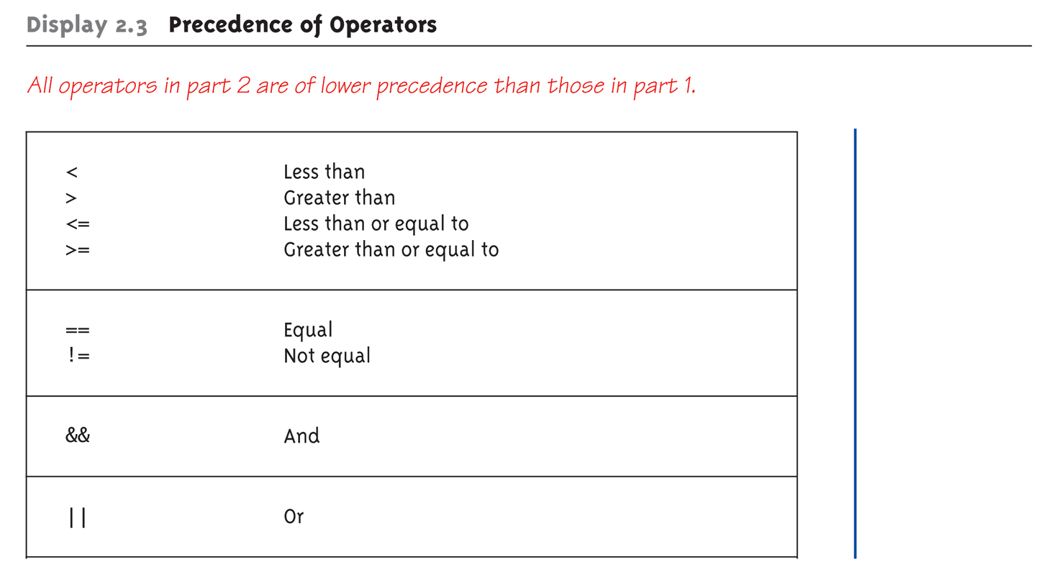
Precedence of Operators (Cont’d)

Slide 16
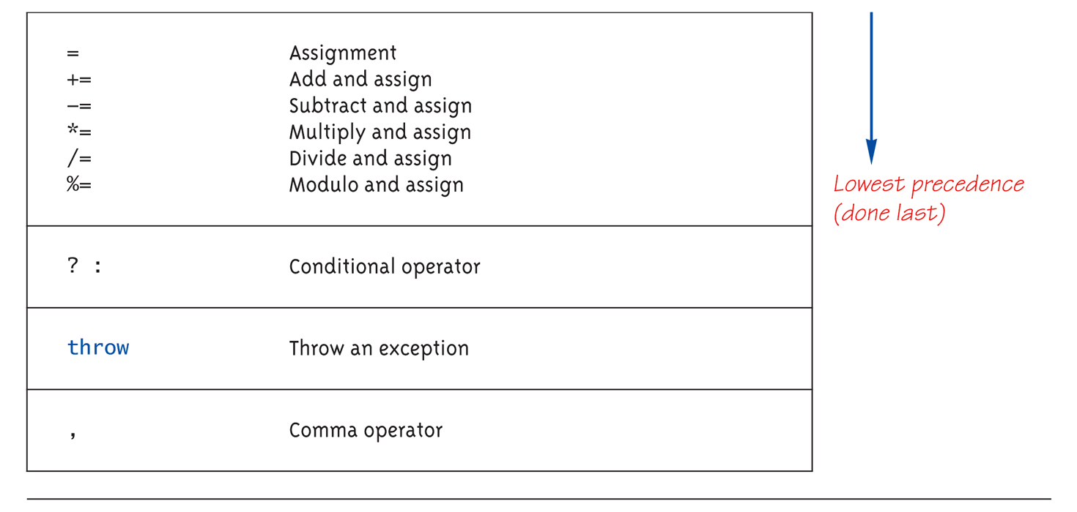
Precedence of Operators (Cont’d)

Slide 17
Precedence Examples
Arithmetic before logical
x + 1 > 2 || x + 1 < -3 means:
(x + 1) > 2 || (x + 1) < -3
Short-circuit evaluation
(x >= 0) && (y > 1)
Be careful with increment operators!
(x > 1) && (y++)
Integers as boolean values
All non-zero values → true
Zero value → false

Slide 18
Precedence Examples
Some cases
cout<<( 6 != 5 ) <<"\n";
cout<<( 5 + 3 > 4 )<<"\n";
cout<<( 5 + ( 3 > 4 ))<< "\n";
cout<<( 0 || 1 && 0 ) <<"\n";
cout<<( !0 || 0 && 0 ) <<"\n";
cout<<( 3 + 4 * 7 / 12 % 5 ) <<"\n";
Notes:
1
1
5
0
1
5

Slide 19
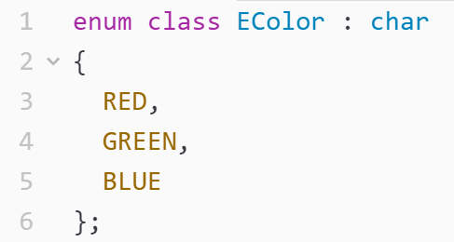
Strong Enum
C++11 introduces strong enums or enum classes
Does not act like an integer
Avoid using enums as integer
Avoid name confliction
Can be assigned to types other than integer

Slide 20
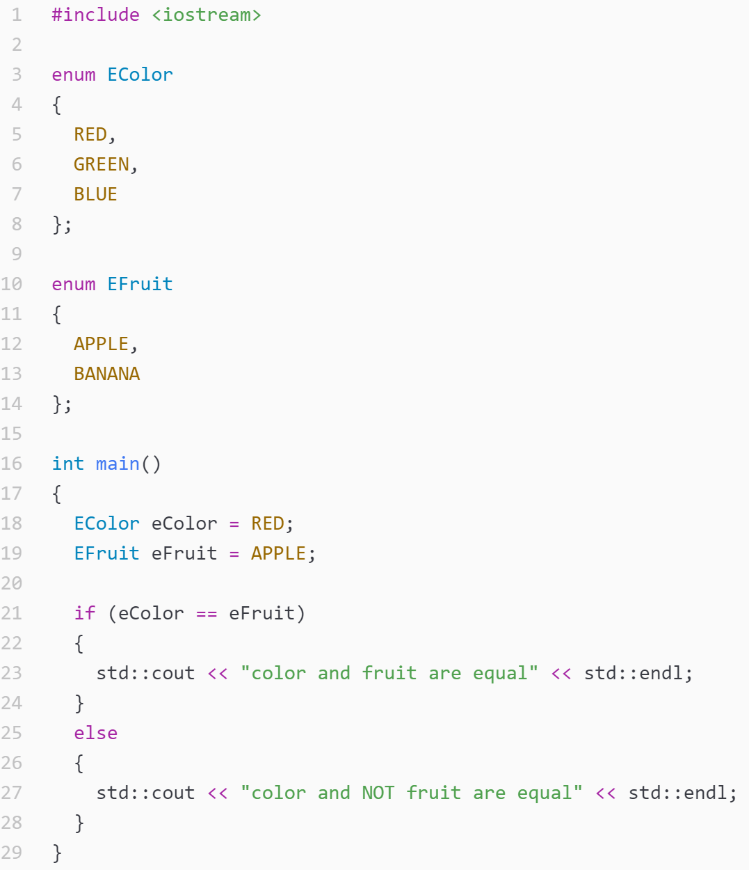
Enum (C)
Legal

Slide 21
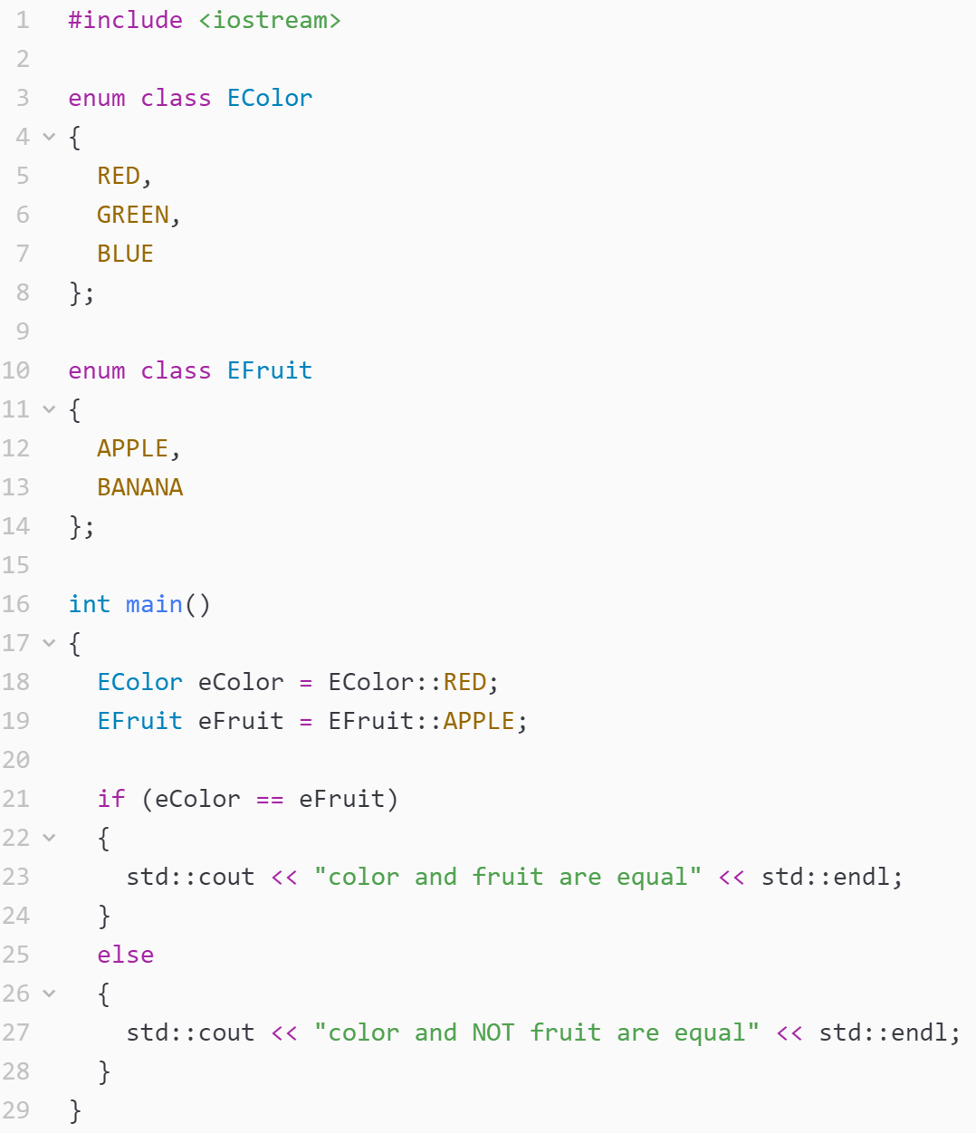
Strong Enum
Illegal

Slide 22
Simple File I/O
We can use cin to read from a file in a manner very similar to reading from the keyboard
Add at the top
#include <fstream> using namespace std;
You can then declare an input stream
ifstream inputStream;
Next you must connect the inputStream variable to a text file on the disk.
inputStream.open("filename.txt");
The “filename.txt” is the pathname to a file in the current directory

Slide 23
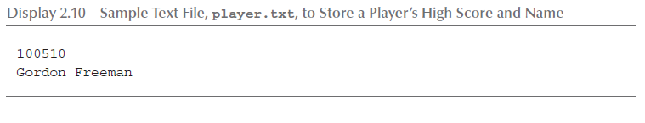
Simple File I/O
Use
inputStream >> var;
The result is the same as using cin >> var except the input is coming from the text file and not the keyboard
When done with the file close it with
inputStream.close();
Example : Consider a text file named player.txt with the following text

Slide 24
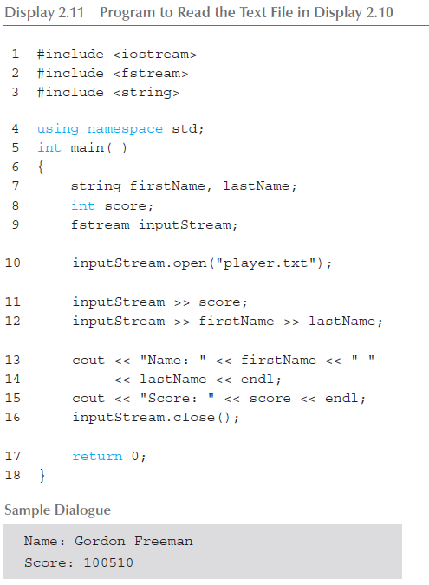
Simple File I/O

Slide 25
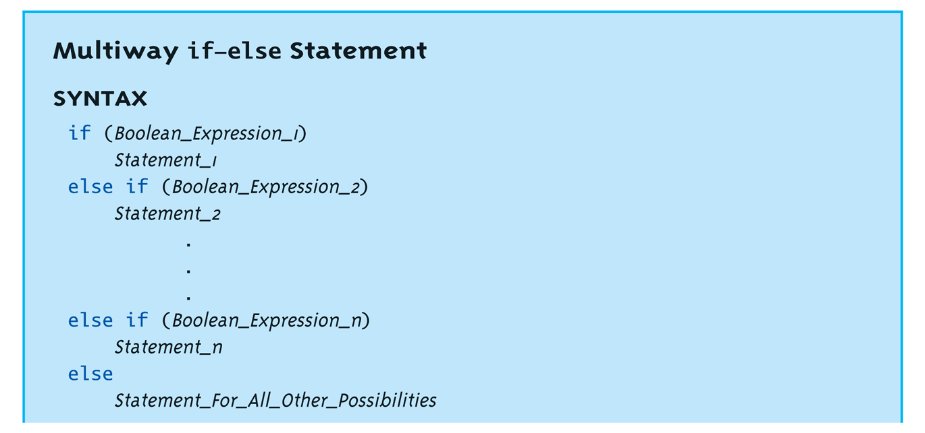
Recap : if - else

Slide 26
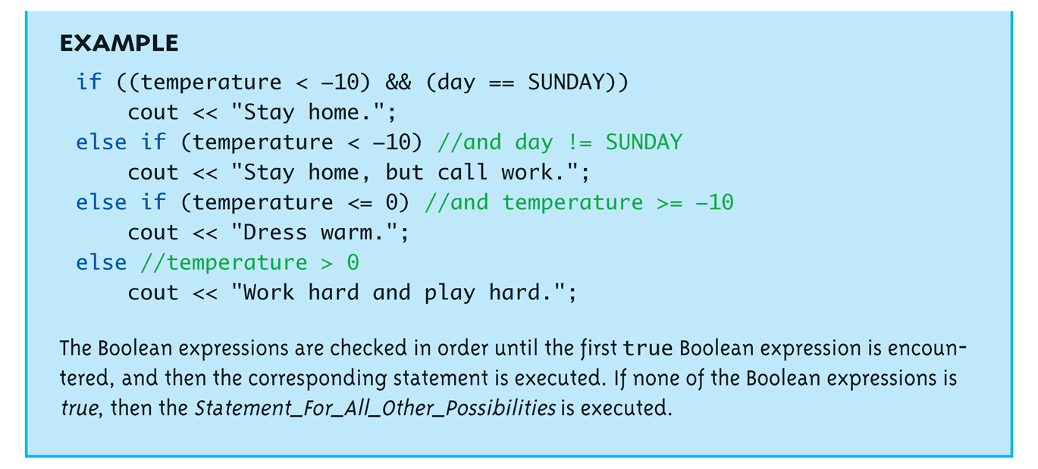
Recap : if - else

Slide 27
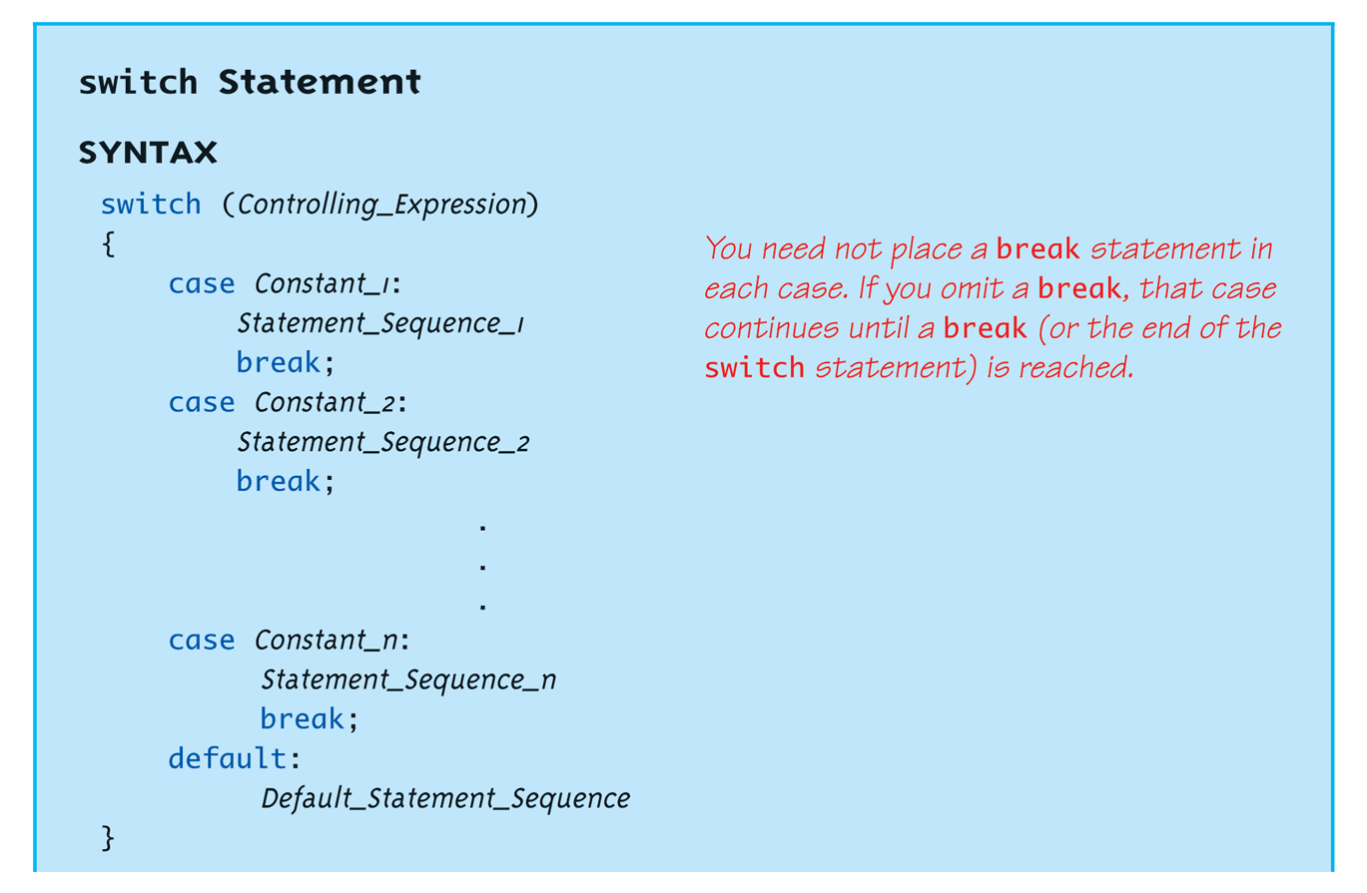
Recap : switch

Slide 28
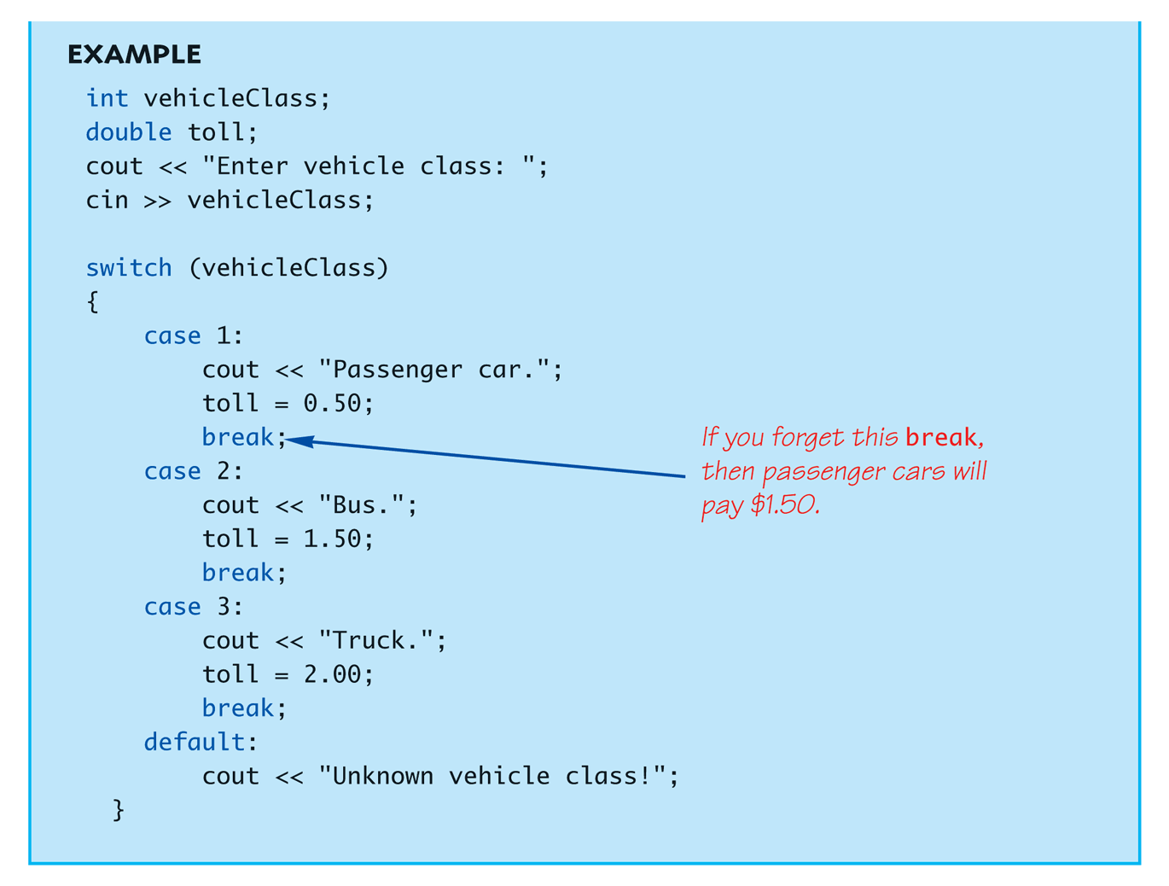
Recap : switch

Slide 29
Recap : Loops
3 Types of loops in C++
while
Most flexible
No "restrictions"
do-while
Least flexible
Always executes loop body at least once
for
Natural "counting" loop

Slide 30
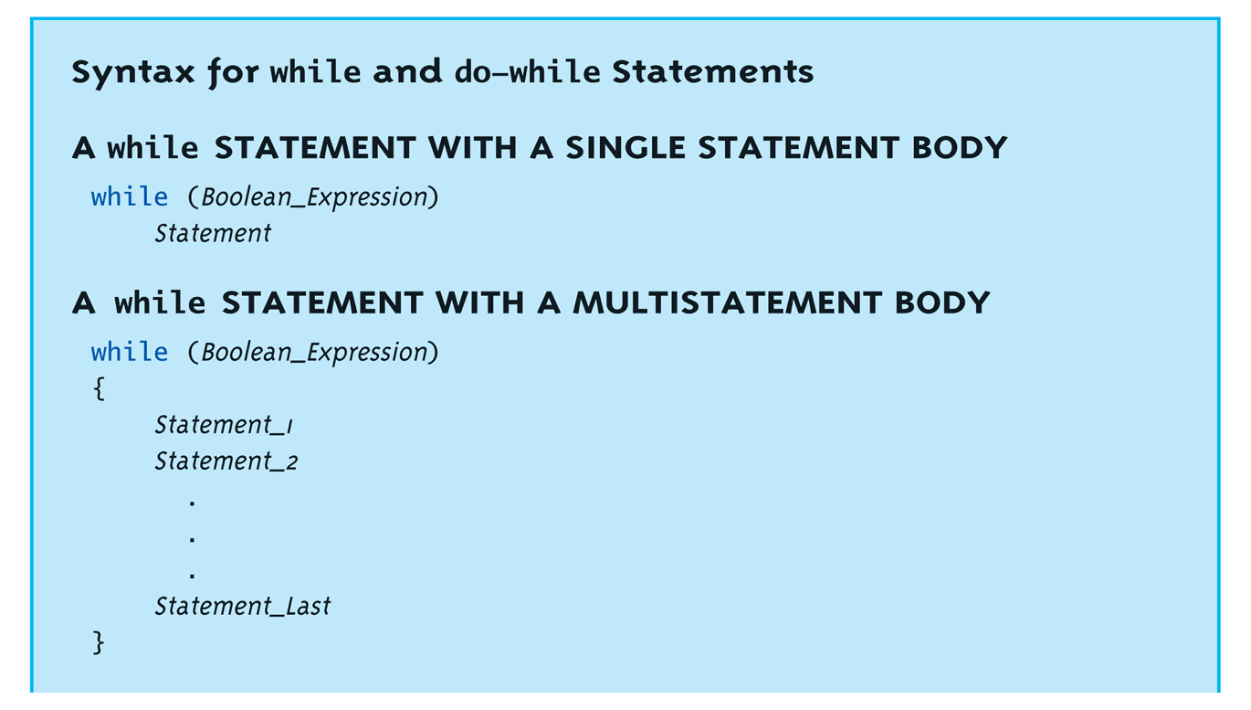
Recap : Loops

Slide 31
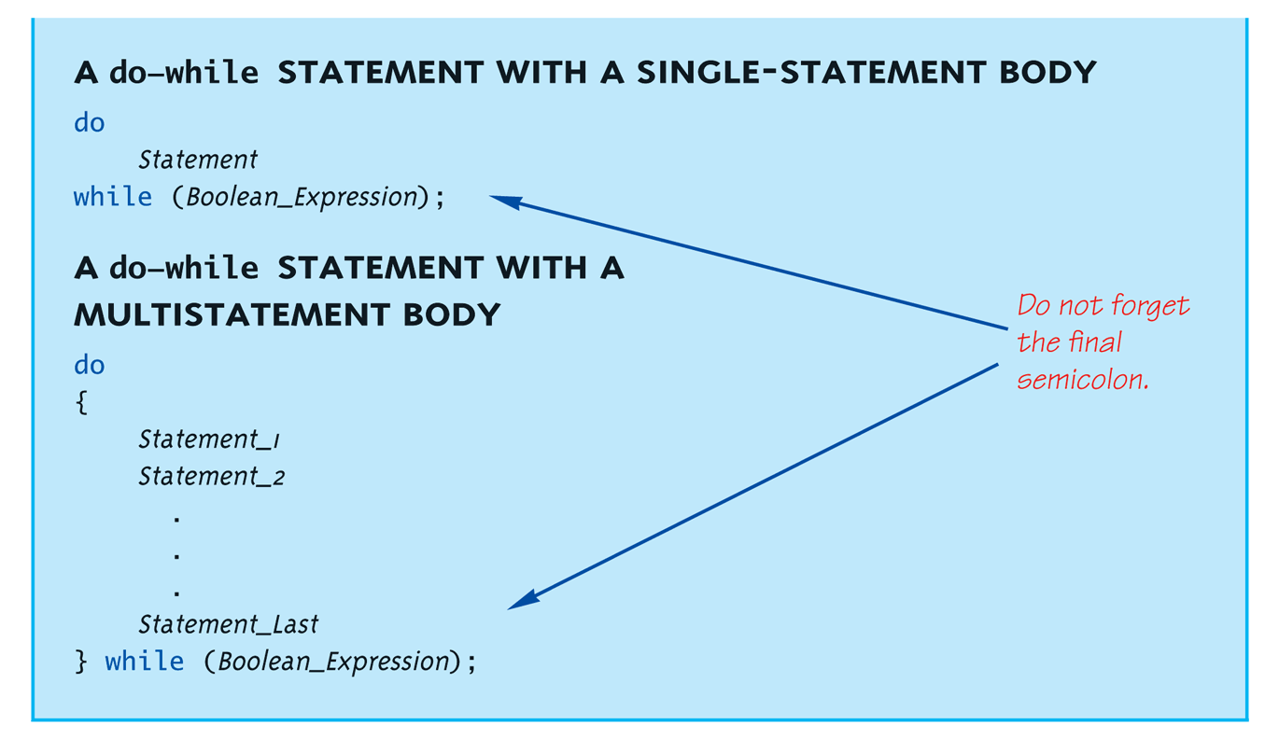
Recap : Loops

Slide 32
Recap : Loops
for (count=0;count<3;count++) { cout << "Hi "; // Loop Body }
How many times does loop body execute?
Initialization, loop condition and update all "built into" the for-loop structure!
A natural "counting" loop

Slide 33
Summary
Console I/O
Namespace in C++
Char array become String Class
4 steps in solving programming problem
Simple File I/O
Recap
Comparator
If-else
switch
Loops

Slide 34


Q & A
Thank you for your attention.
Class-related messages will be available on MS teams
Access Code:
go4k75s
Exam Time Survey
before 09/23 24:00!

