Slide 1

Object Oriented Programming Code Coverage (gcovr)
Department of Computer Science and Information Engineering
Shuo-Han Chen (陳碩漢), shchen@ntut.edu.tw
Pioneer International R&D Building - 401
M 15:10 - 16:00 & F 10:10 - 12:00

Slide 2
What’s Code Coverage? (1/3)
When you finish implement your code, you will write some test case to test your code work correctly or not.
How many test should I implement?
2

Slide 3
What’s Code Coverage? (2/3)
You should write the test cases, that test can coverage your code as much as you can.
Code coverage is a percentage measure of the degree to which the source code of a program is executed when a particular test suite is run. (Definition in Wikipedia).
3

Slide 4
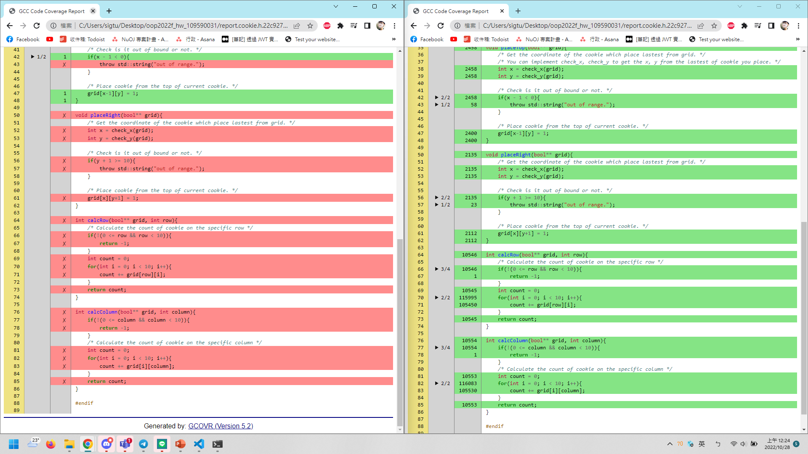
What’s Code Coverage? (3/3)
Nope :(
Nice :)
4

Slide 5
gcovr / install
A code coverage tool based on python.
Simply install it on apt-get.
sudo apt-get remove gcovr && sudo apt-get install python3-pip && pip3 install gcovr

Slide 6
gcovr / compile binary file
Add some compiler flag to compile binary file.
You should compile the ut_main.cpp in your test with following flags, simply copy it and add to your makefile.
g++ -std=c++11 test/ut_main.cpp -o bin/ut_all_gcovr -lgtest -pthread --coverage -fkeep-inline-functions -fno-inline -fno-inline-small-functions -fno-default-inline -g -O0
It will generate ut_main.gcno if it finish compile.

Slide 7
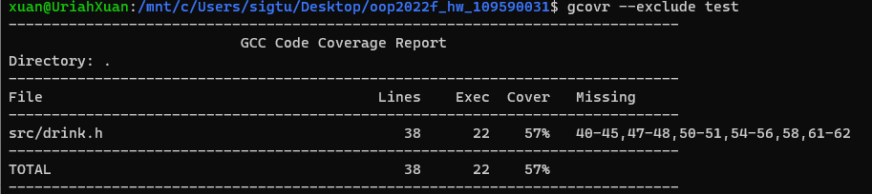
gcovr / execute
Execute the binary file you generate for code coverage test.
./bin/ut_all_gcovr
It will generate ut_main.gcda if it can work successfully.
Use following command to test your code coverage.
python3.8 –m

Slide 8
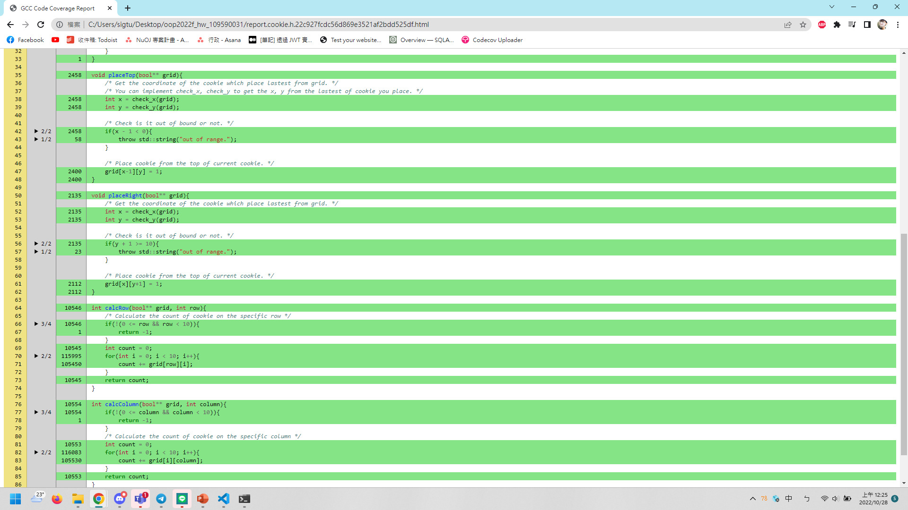
gcovr / generate HTML report
Use following command to test coverage, also generate HTML report.
Python3.8 –m gcovr --exclude test --html-details report.html
Remember to clean the file you generated.
rm -rf bin *.gcov *.gcda *.gcno *.html *.css

Slide 9

Q & A
Thank you for your attention.

