Slide 1

Tech Analysis

Slide 2
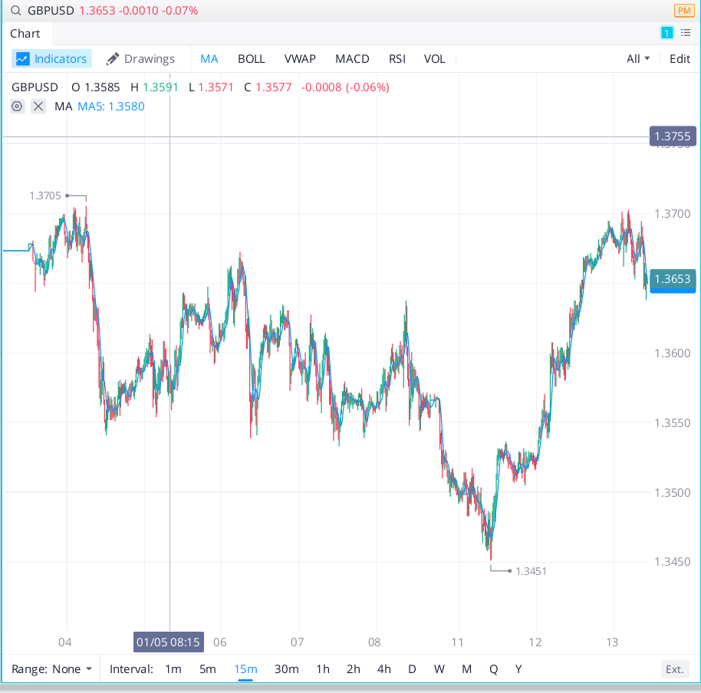
1/13
Negative strong momentum for GBPUSD. Also reached 3M highs, due for a correction. In terms of fundamentals, Brexit is driving up the cost to export and lockdowns are still being enforced.
Trade:
Short 100,000 shares. Stop loss at 1.36.

Slide 3
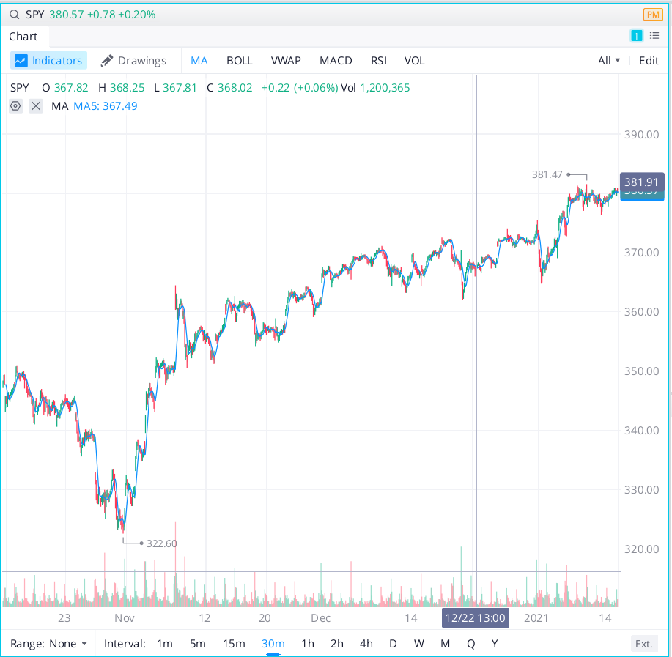
1/14
Upward trend. Weak, positive momentum. Fundamentals: Biden’s stimulus package will be revealed tonight but it should include more payments, extended unemployment benefits, and tax credits.
Trade: 500 shares at $380.47 each. Stop loss at $378.17.

Slide 4
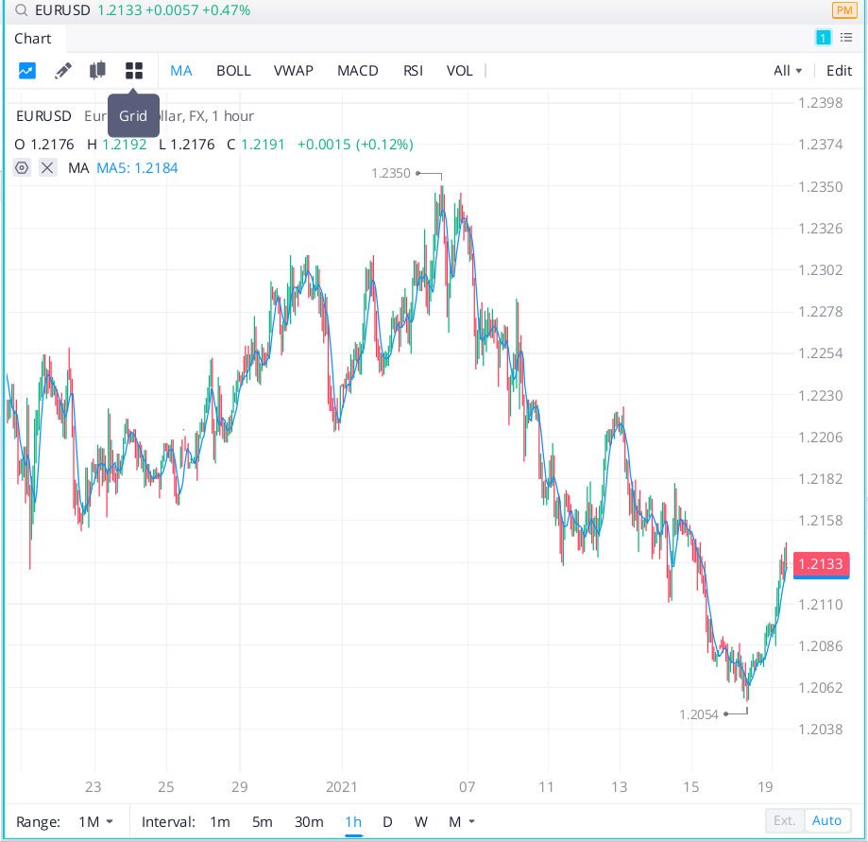
1/19
Overall momentum downward, but recently hit monthly lows. Short term strong positive momentum. In terms of fundamentals, EU set to unveil plan to strengthen international presence of Euro.
Trade: Buy 100,000 shares EURUSD at 1.211. Stop loss: 1.2057. Take profit: 1.2230.

Slide 5
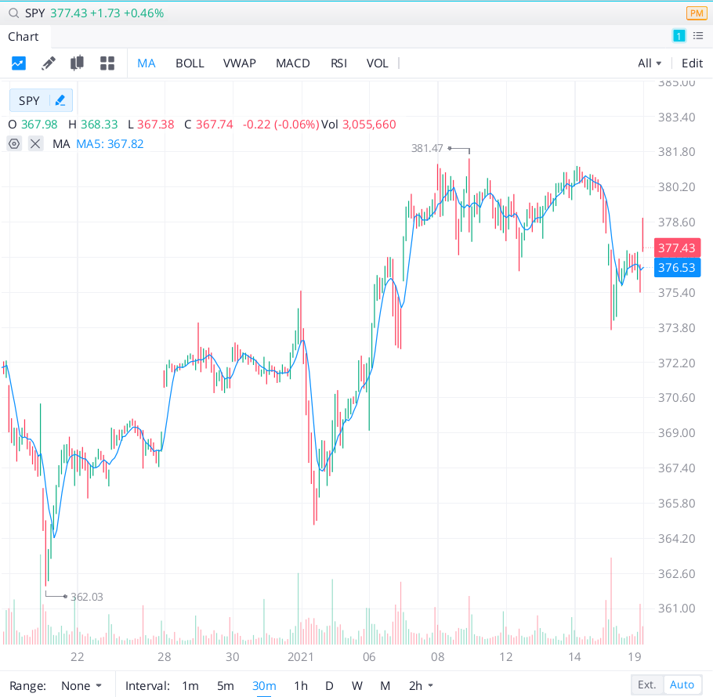
1/19
Try previous trade again. Evidence that SPY will continue moving upward:
- Strong positive momentum.
- In terms of fundamentals, Yellen strongly advocating for stimulus package, bringing low interest rates into the argument. Tone for new administration is focusing on economic recovery.
Trade: Buy 800 shares SPY at 378.77. Stop loss 375.50.

Slide 6
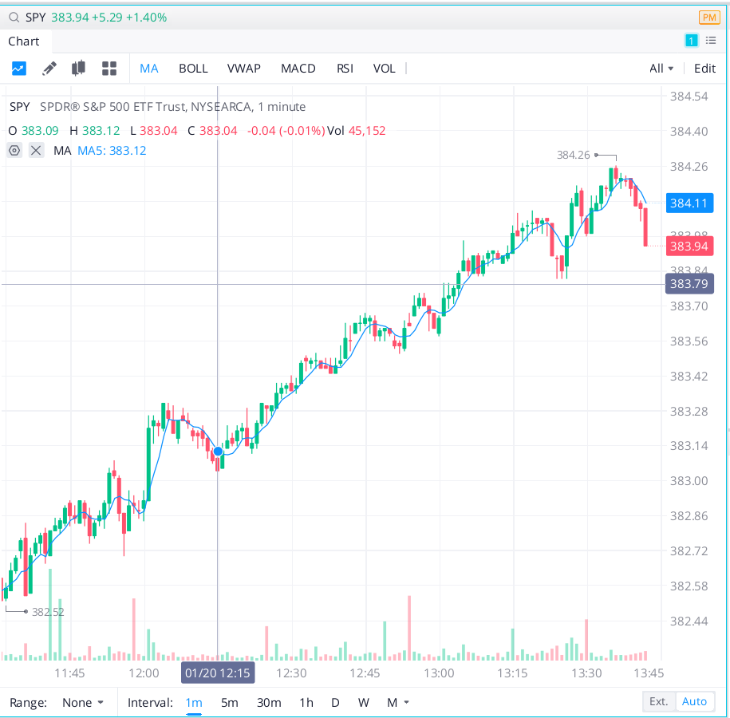
1/20
Upward momentum slowing as shown by flattening line. Reached all time highs.
Trade: close SPY positions.

Slide 7
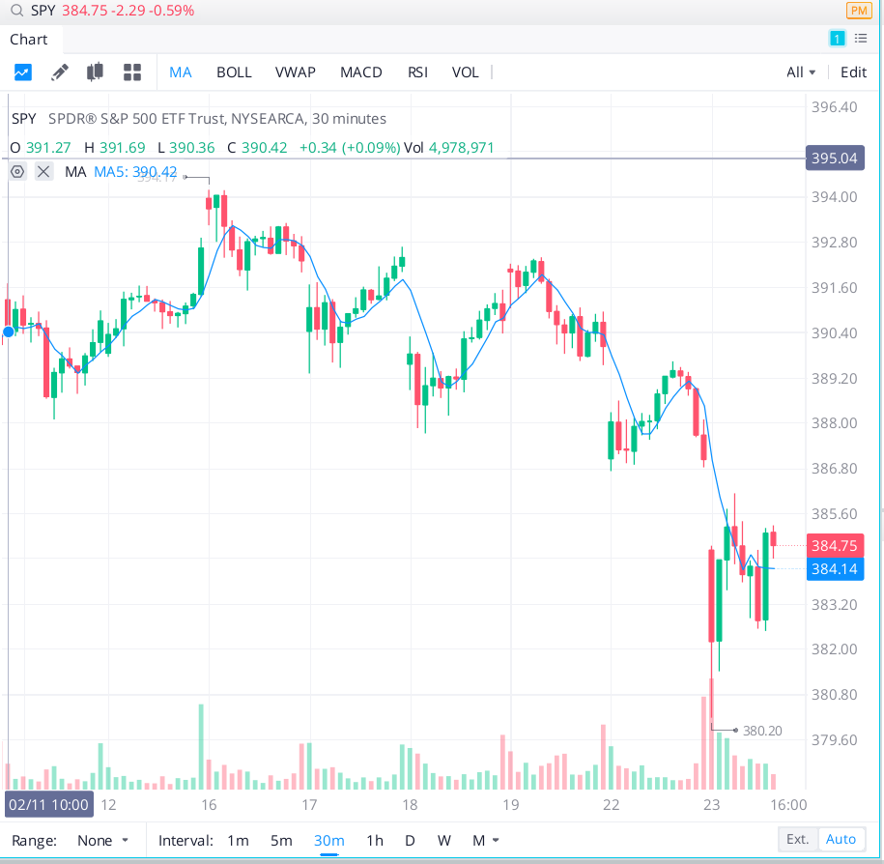
2/23
Downward momentum slowing as shown by flattening line.
Trade: close negative SPY positions.

Slide 8
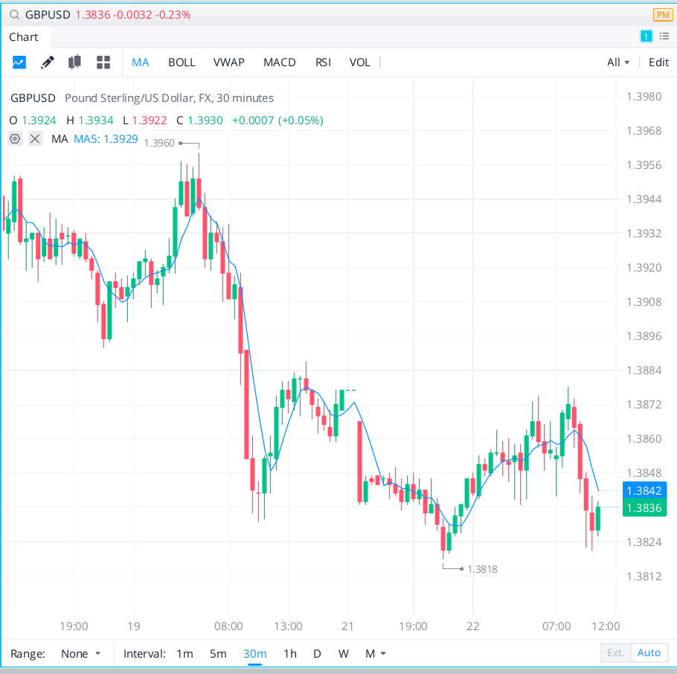
3/22
Overall momentum downward. In terms of fundamentals, EU ready to halt vaccine shipments to UK. EU and UK relations deteriorating quickly. Astra vaccine no longer appears to be safe to people in Europe.
Trade: Sell 100,000 shares GBPUSD at 1.3837. Stop loss: 1.3864. Take profit: 1.3830.

Slide 9
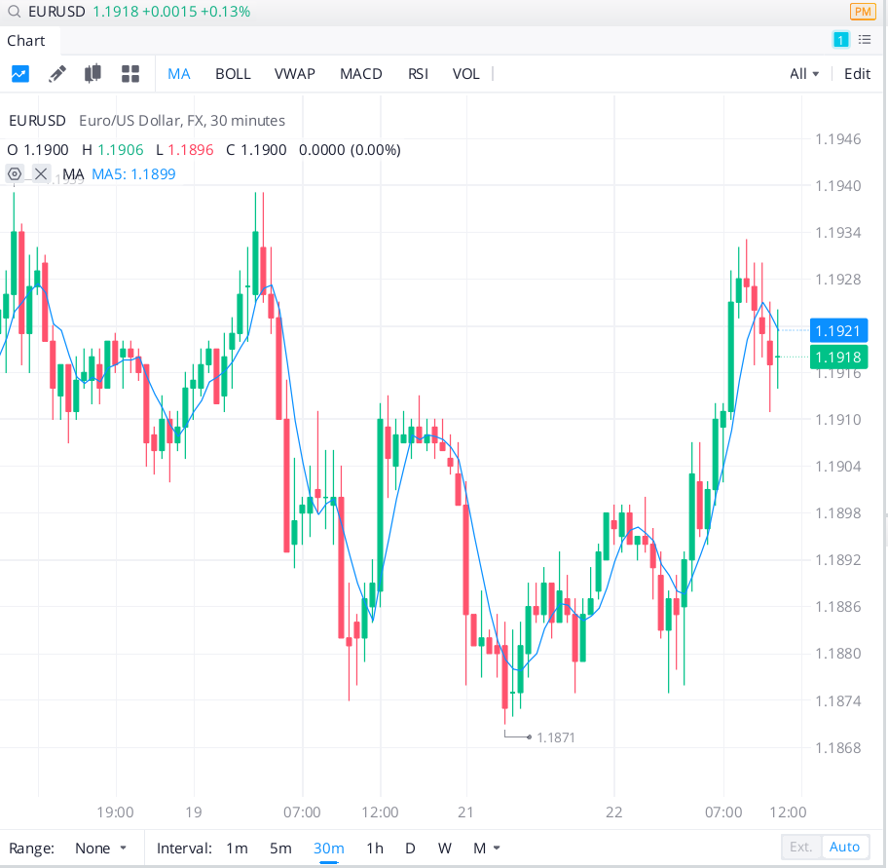
3/22
Short term momentum downward.
Trade: Sell 100,000 shares EURUSD at 1.1918. Stop loss: 1.1986. Take profit: 1.1871.

Slide 10
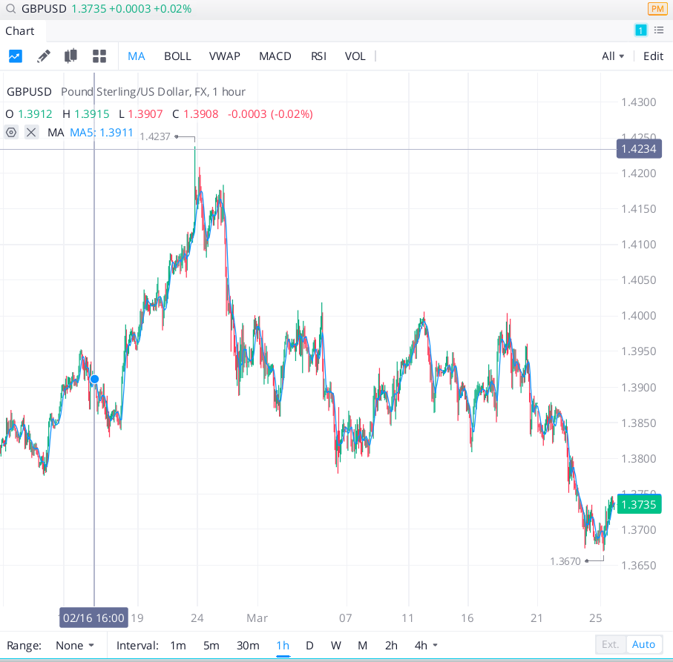
3/23
Trading flat. In terms of fundamentals: EU and UK seem to have reached agreement on vaccine distribution.
Exit the GBP and EUR trades.

Slide 11
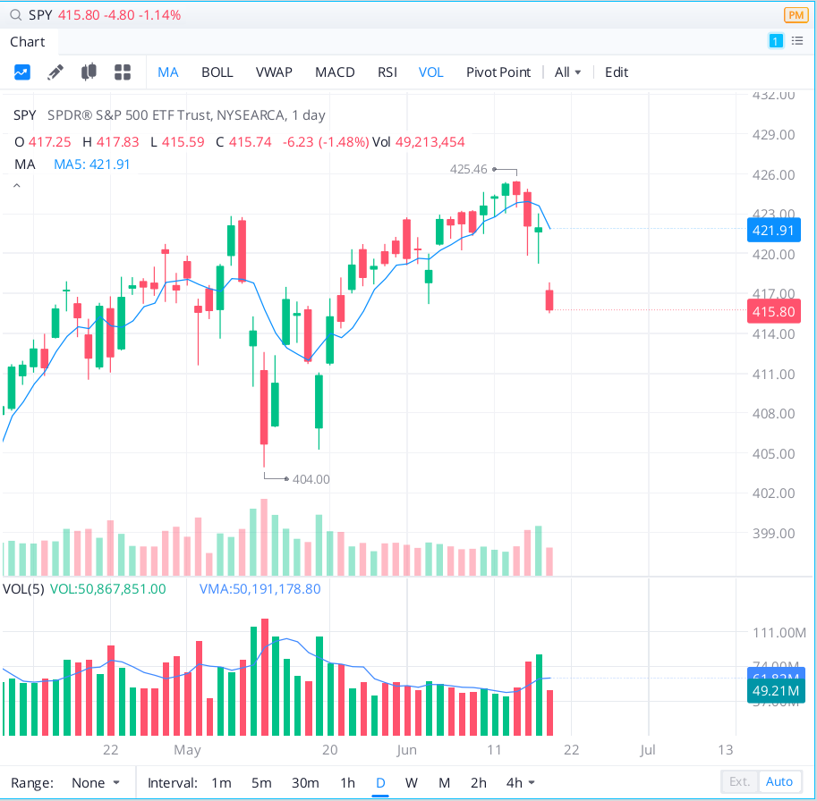
6/18
Reflation trade coming to an end. Sold 500 shares at 420.86, another 500 at 419.70.
Close positions at 415.80. Slowly rising again from support level.

