Slide 1
C FUNCTIONS
-independent routine which do a specific task(s)-

Slide 2
C FUNCTIONS
Some definition: A function is a named, independent section of C code that performs a specific task and optionally returns a value to the calling program or/and receives values(s) from the calling program.
Basically there are two categories of function:
  Predefined functions: available in C / C++ standard library such as stdio.h, math.h, string.h etc.
  User-defined functions: functions that programmers create for specialized tasks such as graphic and multimedia libraries, implementation extensions or dependent etc.

Slide 3
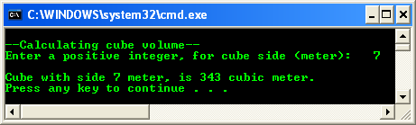
C FUNCTIONS
Let try a simple program example that using a simple user defined function,

Slide 4
C FUNCTIONS
The following statement call cube() function, bringing along the value assigned to the fInput variable.
    fAnswer = cube(fInput);
When this statement is executed, program jump to the cube() function definition.
After the execution completed, the cube() function returns to the caller program (main()), assigning the returned value, fCubeVolume to fAnswer variable for further processing (if any).
In this program the scanf() and print() are examples of the standard predefined functions.

Slide 5
C FUNCTIONS
Basically a function has the following characteristics:
  Named with unique name .
  Performs a specific task - Task is a discrete job that the program must perform as part of its overall operation, such as sending a line of text to the printer, sorting an array into numerical order, or calculating a cube root, etc.
  Independent - A function can perform its task without interference from or interfering with other parts of the program.
  May receive values from the calling program (caller) - Calling program can pass values to function for processing whether directly or indirectly (by reference).
  May return a value to the calling program – the called function may pass something back to the calling program.

Slide 6
C FUNCTIONS
Function Mechanism
C program does not execute the statements in a function until the function is called.
When it is called, the program can send information to the function in the form of one or more arguments although it is not a mandatory.
Argument is a program data needed by the function to perform its task.
When the function finished processing, program returns to the same location which called the function.

Slide 7
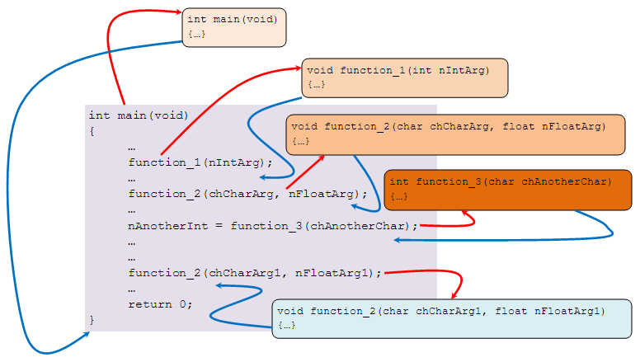
C FUNCTIONS
The following figure illustrates function calls (also the memory’s stack record activation – construction & destruction.

Slide 8
C FUNCTIONS
Function can be called as many times as needed as shown for function_2(…).
Can be called in any order provided that it has been declared (as a prototype) and defined.

Slide 9
C FUNCTIONS
Function Definition
Is the actual function body, which contains the code that will be executed as shown below (previous example).
int cube(int fCubeSide)
{
// local scope (local to this function)
// only effective in this function 'body'
int fCubeVolume;
// calculate volume
fCubeVolume = fCubeSide * fCubeSide * fCubeSide;
// return the result to caller
return fCubeVolume;
}

Slide 10
C FUNCTIONS
First line of a function definition is called the function header, should be identical to the function prototype, except the semicolon.
Although the argument variable names (fCubeSide in this case) were optional in the prototype, they must be included in the function header.
Function body, containing the statements, which the function will perform, should begin with an opening brace and end with a closing brace.
If the function returns data type is anything other than void (nothing to be returned), a return statement should be included, returning a value matching the return data type (int in this case).

Slide 11
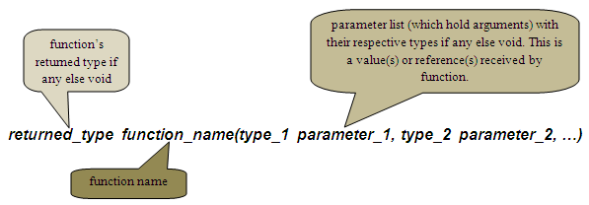
C FUNCTIONS
The Function header
The first line of every function definition is called function header. It has 3 components, as shown below,
Function return type - Specifies the data type that the function should returns to the caller program. Can be any of C data types: char, float, int, long, double, pointers etc. If there is no return value, specify a return type of void. For example,
  int calculate_yield(…) // returns an int type
  float mark(…) // returns a float type
  void calculate_interest(…) // returns nothing

Slide 12
C FUNCTIONS
Function name - Can have any name as long as the rules for C / C++ variable names are followed and must be unique.
Parameter list - Many functions use arguments, the value passed to the function when it is called. A function needs to know the data type of each argument. Argument type is provided in the function header by the parameter list. Parameter list acts as a placeholder.

Slide 13
C FUNCTIONS
For each argument that is passed to the function, the parameter list must contain one entry, which specifies the type and the name.
For example,
    void myfunction(int x, float y, char z)
    void yourfunction(float myfloat, char mychar)
    int ourfunction(long size)
The first line specifies a function with three arguments: type int named x, type float named y and type char named z.
Some functions take no arguments, so the parameter list should be void or empty such as,
    long thefunction(void)
    void testfunct(void)
    int zerofunct()

Slide 14
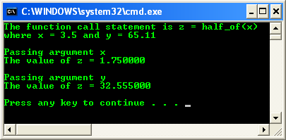
C FUNCTIONS
Parameter is an entry in a function header. It serves as a placeholder for an argument. It is fixed, that is, do not change during execution.
The argument is an actual value passed to the function by the caller program. Each time a function is called, it can be passed with different arguments.
A function must be passed with the same number and type of arguments each time it is called, but the argument values can be different.
Function example: parameter and argument

Slide 15
C FUNCTIONS
The Function Body
Enclosed in curly braces, immediately follows the function header.
Real work in the program is done here.
When a function is called execution begins at the start of the function body and terminates (returns to the calling program) when a return statement is encountered or when execution reaches the closing braces (}).
Variable declaration can be made within the body of a function.
Which are called local variables. The scope, that is the visibility and validity of the variables are local.
Local variables are the variables apply only to that particular function, are distinct from other variables of the same name (if any) declared elsewhere in the program outside the function.
It is declared, initialized and use like any other variable.
Outside of any functions, those variables are called global variables.

Slide 16
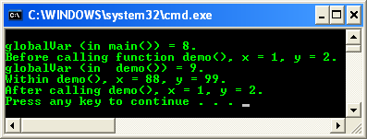
C FUNCTIONS
Function program example: local and global variable
The function parameters are considered to be variable declarations.
Function prototype normally placed before main() and your function definition after main() as shown below.
For C++, the standard said that we must include the prototype but not for C.

Slide 17
C FUNCTIONS
#include … /* function prototype */ int funct1(int); int main() { /* function call */ int y = funct1(3); … } /* Function definition */ int funct1(int x) {…}
But it is OK if we directly declare and define the function before main() as shown below.
#include … /* declare and define */ int funct1(int x) { … } int main() { /* function call */ int y = funct1(3); … }
Three rules govern the use of variables in functions:
To use a variable in a function, we must declare it in the function header or the function body.
For a function to obtain a value from the calling program (caller), the value must be passed as an argument (the actual value).
For a calling program (caller) to obtain a value from function, the value must be explicitly returned from the called function (callee).

Slide 18
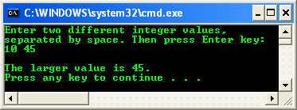
C FUNCTIONS
The Function Statements
Any statements can be included within a function, however a function may not contain the definition of another function.
For examples: if statements, loop, assignments etc are valid statements.
Returning a Value
A function may or may not return a value.
If function does not return a value, then the function return type is said to be of type void.
To return a value from a function, use return keyword, followed by C expression.
The value is passed back to the caller.
The return value must match the return data type.
A function can contain multiple return statements.
Program example: multiple return statement

Slide 19
C FUNCTIONS
The Function Prototype
Must be included for each function that will be defined, (required by Standards for C++ but optional for C) if not directly defined before main().
In most cases it is recommended to include a function prototype in your C program to avoid ambiguity.
Identical to the function header, with semicolon (;) added at the end.
Function prototype includes information about the function’s return type, name and parameters’ list and type.
The general form of the function prototype is shown below,
function_return_type function_name(type parameter1, type parameter2,…, type parameterN)
An example of function prototype,
  long cube(long);

Slide 20
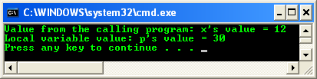
C FUNCTIONS
Passing Arguments to a Function
In order function to interact with another functions or codes, the function passes arguments.
The called function receives the values passed to it and stores them in its parameters.
List them in parentheses following the function name.
Program example: passing arguments

Slide 21

C FUNCTIONS
The number of arguments and the type of each argument must match the parameters in the function header and prototype.
If the function takes multiple arguments, the arguments listed in the function call are assigned to the function parameters in order.
The first argument to the first parameter, the second argument to the second parameter and so on as illustrated below.
Basically, there are two ways how we can pass something to function parameters,
  Passing by value.
  Passing by reference using array and pointer.

Slide 22

C FUNCTIONS
Macros and Inline Functions
If the same sequence of steps or instructions is required in several different places in a program, you will normally write a function for the steps and call the function whenever these steps are required. But this involves time overhead.
Also can place the actual sequence of steps wherever they are needed in the program, but this increase the program size and memory required to store the program. Also need retyping process or copying a block of program.
Use function if the sequence of steps is long. If small, use macros or inline function, to eliminate the need for retyping and time overhead.
Macros
Need #define compiler directive. For example, to obtain just the area of a triangle, we could create a macro,

Slide 23
C FUNCTIONS
Then, we can use it anywhere in the program e.g.,
  printf("\nArea = %f\n", area(4.0, 6.0));
Example for finding an average of 4 numbers (a, b, c and d),
  #define avg(x, y) (x + y)/2.0
Then in the program we can define something like this,
  avg1 = avg(avg(a, b), avg(c, d))
Doing the substitution,
  avg4 = ((a + b)/2.0 + (c + d)/2.0) / 2.0
The drawback: nesting of macros may result in code that difficult to read.

Slide 24
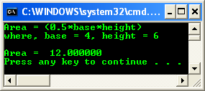
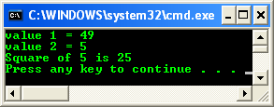
C FUNCTIONS
Program example: macro
Inline Function
Is preferred alternative to the macro since it provides most of the features of the macro without its disadvantages.
Same as macro, the compiler will substitute the code for the inline function wherever the function is called in the program.
Inline function is a true function whereas a macro is not.
The best time to use inline functions is when:
  There is a time critical function
  That is called often
  And is respectfully small
Use keyword __inline which is placed before the function.
Program example: inline function

Slide 25
C FUNCTIONS
Header Files and Functions
Header files contain numerous frequently used functions that programmers can use without having to write codes for them.
Programmers can also write their own declarations and functions and store them in header files which they can include in any program that may require them (these are called user-defined header file which contains user defined functions).
Standard Header File
To simplify and reduce program development time and cycle, C provides numerous predefined functions.
These functions are normally defined for most frequently used routines.
These functions are stored in what are known as standard library which consist of header files (with extension .h, .hh etc).
In the wider scope, each header file stores functions, macros, enum, structures (struct) , types etc. that are related to a particular application or task.

Slide 26
C FUNCTIONS
We need to know which functions that are going to use, how to write the syntax to call the functions and which header files to be included in your program.
Before any function contained in a header file can be used, you have to include the header file in your program. You do this by writing,
  #include <header_filename.h>
This is called preprocessor directive, normally placed at the top of your program.
You should be familiar with these preprocessor directives, encountered many times in the program examples previously discussed.

Slide 27
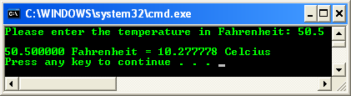
C FUNCTIONS
Using Predefined Functions from Header File
Complete information about the functions and the header file normally provided by the compiler’s documentation.
For your quick reference: C standard library reference.
User-defined Header Files
We can define program segments (including functions) and store them in files.
Then, we can include these files just like any standard header file in our programs.
Program example: user defined function

Slide 28
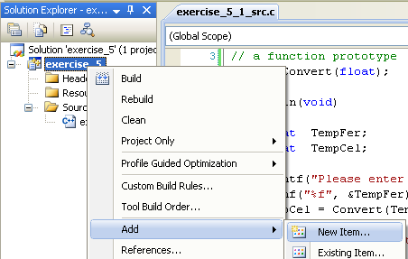
C FUNCTIONS
Next, let convert the user defined function to header file.
Step: Add new header file to the existing project.

Slide 29
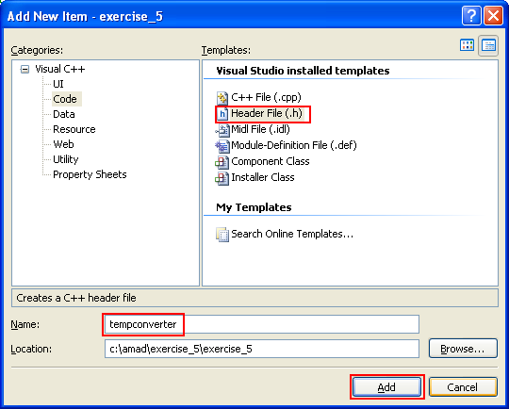
C FUNCTIONS
Step: Put the header file name.

Slide 30
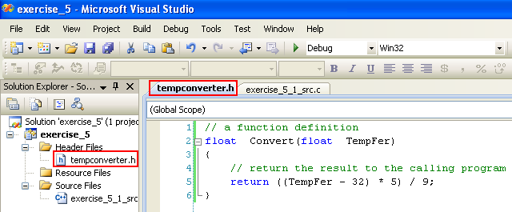
C FUNCTIONS
Step: Cut the function definition from the source file and paste it into the header file.
// a function definition
float Convert(float TempFer)
{
// return the result to the calling program
return ((TempFer - 32) * 5) / 9;
}

Slide 31
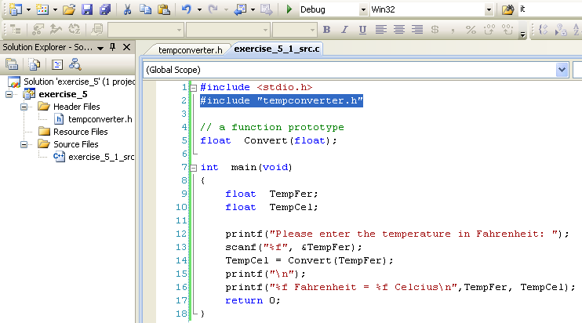
C FUNCTIONS
Step: Next, include the header file at the top, just after the #include <stdio.h>.
Use double quotes because the header file is under the project folder/sub folder instead of the default or VC++ ..\include sub folder.
#include "tempconverter.h"

Slide 32
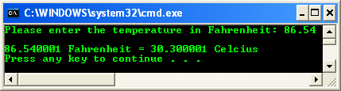
C FUNCTIONS
Step: Re-build and re-run the project.
Next, we are going to use < > instead of " ".
To accomplish this, we need to put the header file under the VC++ include folder/sub folder.

Slide 33
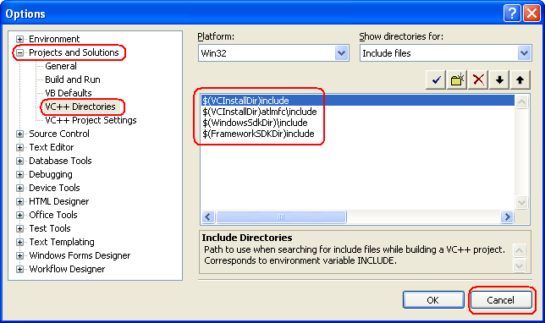
C FUNCTIONS
The VC++ include sub folder can be found in VC++ Directories Options settings.
Step: Select Tools menu > Select Options sub-menu.

Slide 34
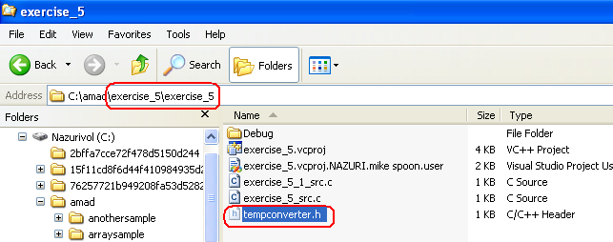
C FUNCTIONS
Step: When you have found your VC++ include sub folder, copy the header file (tempconverter.h) into the VC++ include sub folder.
Step: The header file can be found under the project folder/sub folder.

Slide 35
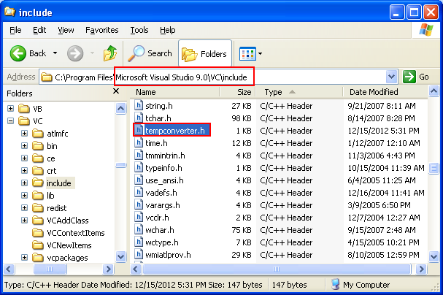
C FUNCTIONS

Slide 36
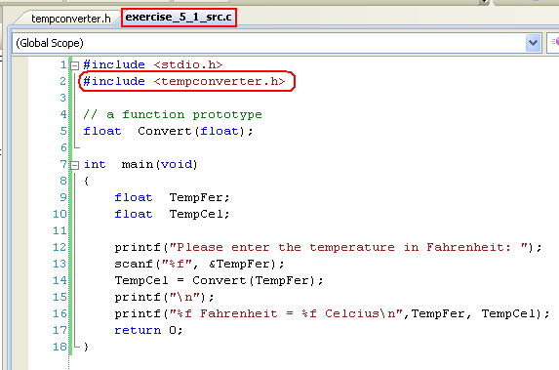
C FUNCTIONS
Step: Now, change the double quotes (" ") to less-than-greater-than brackets (< >) brackets.
#include <tempconverter.h>

Slide 37
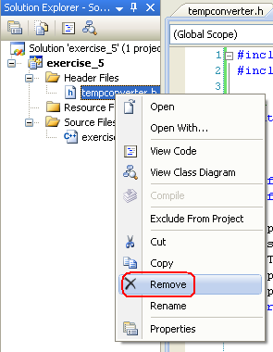
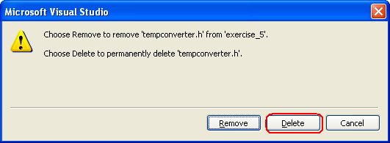
C FUNCTIONS
Step: Then, we can delete the header file in the project.

Slide 38

C FUNCTIONS
Step: Re-build and re-run the project.

Slide 39
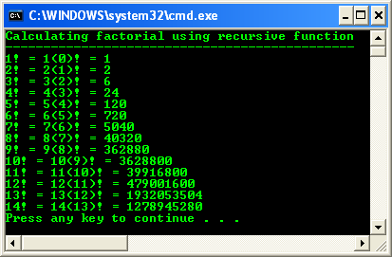
C FUNCTIONS
Recursive Function
We cannot define function within function, but we can call the same function within that function.
A recursive function is a function that calls itself either directly or indirectly through another function.
Classic example for recursive function is factorial, which used in mathematics.
Program example: recursive function

Slide 40

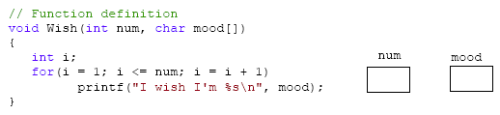

C FUNCTIONS
Passing an array to a function
What are the output and the content of num & mood variables after program execution was completed?
#include <stdio.h>
// function prototype
void Wish(int, char[ ]);
void main(void)
{
Wish(5, "Happy");
}

Slide 41
Standard output (cout)
On most program environments, the standard output by default is the screen, and the C++ stream object defined to access it is cout.
For formatted output operations, cout is used together with the insertion operator, which is written as << (i.e., two "less than" signs).
cout << "Output sentence"; // prints Output sentence on screen
cout << 120; // prints number 120 on screen
cout << x; // prints the value of x on screen
cout << "Hello"; // prints Hello cout << Hello; // prints the content of variable Hello
cout << "This " << " is a " << "single C++ statement"; cout << "I am " << age << " years old and my zipcode is " << zipcode; cout << "First sentence.\n"; cout << "Second sentence.\nThird sentence."; cout << "First sentence." << endl; cout << "Second sentence." << endl;

Slide 42
Standard input (cin)
In most program environments, the standard input by default is the keyboard, and the C++ stream object defined to access it is cin.
For formatted input operations, cin is used together with the extraction operator, which is written as >> (i.e., two "greater than" signs). This operator is then followed by the variable where the extracted data is stored. For example:
int age; cin >> age; // i/o example #include <iostream> using namespace std; Int main () { int i; cout << "Please enter an integer value: "; cin >> i; cout << "The value you entered is " << i; cout << " and its double is " << i*2 << ".\n"; return 0; }

Slide 43
Standard input (cin)
Extractions on cin can also be chained to request more than one datum in a single statement:
The extraction operator can be used on cin to get strings of characters in the same way as with fundamental data types:
cin >> a >> b;
string mystring;
cin >> mystring;

Slide 44
Standard input (cin)
However, cin extraction always considers spaces (whitespaces, tabs, new-line...) as terminating the value being extracted, and thus extracting a string means to always extract a single word, not a phrase or an entire sentence.
To get an entire line from cin, there exists a function, called getline, that takes the stream (cin) as first argument, and the string variable as second. For example:
// cin with strings
#include <iostream>
#include <string>
using namespace std;
int main ()
{
string mystr;
cout << "What's your name? ";
getline (cin, mystr);
cout << "Hello " << mystr << ".\n";
cout << "What is your favorite team? ";
getline (cin, mystr);
cout << "I like " << mystr << " too!\n";
return 0;
}

Slide 45
stringstream
The standard header <sstream> defines a type called stringstream that allows a string to be treated as a stream, and thus allowing extraction or insertion operations from/to strings in the same way as they are performed on cin and cout. This feature is most useful to convert strings to numerical values and vice versa. For example, in order to extract an integer from a string we can write:
This declares a string with initialized to a value of "1204", and a variable of type int. Then, the third line uses this variable to extract from a stringstream constructed from the string. This piece of code stores the numerical value 1204 in the variable called myint.
string mystr ("1204");
int myint;
stringstream(mystr) >> myint;

Slide 46
stringstream
// stringstreams
#include <iostream>
#include <string>
#include <sstream>
using namespace std;
int main ()
{
string mystr;
float price=0;
int quantity=0;
cout << "Enter price: ";
getline (cin,mystr);
stringstream(mystr) >> price;
cout << "Enter quantity: ";
getline (cin,mystr);
stringstream(mystr) >> quantity;
cout << "Total price: " << price*quantity << endl;
return 0;
}
In this example, we acquire numeric values from the standard input indirectly: Instead of extracting numeric values directly from cin, we get lines from it into a string object (mystr), and then we extract the values from this string into the variables price and quantity. Once these are numerical values, arithmetic operations can be performed on them, such as multiplying them to obtain a total price.

