Slide 1
POINTERS
Point to here, point to there, point to that, point to this, and point to nothing!
well, they are just memory addresses!!??

Slide 2
POINTERS
When declaring a variable, the compiler sets aside memory storage with a unique address to store that variable.
The compiler associates that address with the variable’s name.
When the program uses the variable name, it automatically accesses a proper memory location.
No need to concern which address.
But we can manipulate the memory address by using pointers.
Let say we declare a variable named nRate of type integer and assign an initial value as follows,
    int nRate = 10;

Slide 3
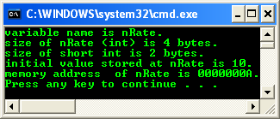
POINTERS
#include <stdio.h>
void main(void)
{
int nRate = 10;
printf("variable name is nRate.\n");
// or sizeof(int)
printf("size of nRate (int) is %d bytes.\n", sizeof(nRate));
printf("size of short int is %d bytes.\n", sizeof(short int));
printf("initial value stored at nRate is %d.\n", nRate);
printf("memory address of nRate is %p.\n", nRate);
}

Slide 4
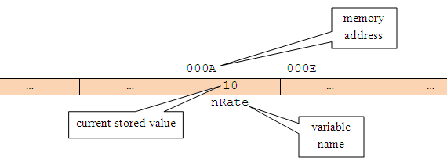
POINTERS
The variable is stored at specific memory address and can be depicted as follows,

Slide 5
POINTERS
The variable scope is local to the main() function.
The memory allocation is from the main() function's stack.
The nRate memory address (or any other variable) is a number, so can be treated like any other number in C.
Using %p, the address is in hexadecimal format.
Hence, if a variable’s memory address is 'known', we can create a second variable for storing the memory address.
From the previous example, let declare another variable, named pTonRate to hold the address of nRate variable.

Slide 6
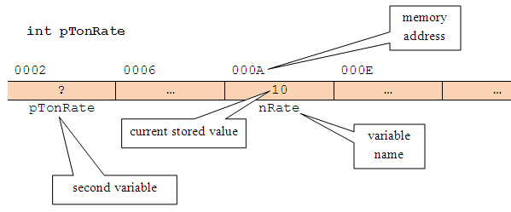
POINTERS
At the beginning, pTonRate is uninitialized.
So, storage has been allocated for pTonRate, but its initial value is undetermined, as shown below,

Slide 7
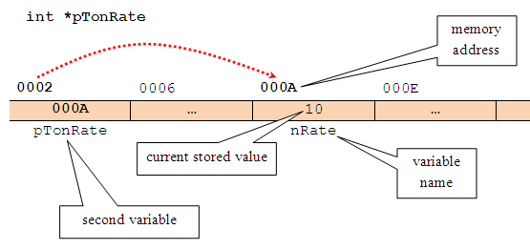
POINTERS
Let store the nRate's memory address, in pTonRate variable.
So, pTonRate now holds the nRate's memory address, where the actual data (10) is stored.
Finally, in C vocabulary, pTonRate is pointing to nRate or is said a pointer to nRate and can be illustrated as follows,

Slide 8
POINTERS
So, the pointer variable declaration becomes something like this,
    int *pTonRate;
In other word, the pTonRate variable holds the memory address of nRate and is therefore a pointer to nRate.
The asterisk (*) is used to show that is it the pointer variable instead of normal variable.
Definition: A pointer is a variable that holds memory address of another variable, where, the actual data is stored.

Slide 9
POINTERS
By using pointers, it is an efficient way of accessing and manipulating data.
Very useful for dynamic memory management, as we know memory, registers and cache are scarce resource in computer system.
Every computer system, there are fixed and limited amount of memory for temporary data storage and processing.
There are loading and unloading data into and from, moving data from and to different locations of the memory, including the cache and the processors’ registers for temporary data storage and processing.
The loading and unloading need an efficient memory management.
Some of the memory portion also used for shared data to further optimizes the utilization.
This shared data access (read/write) depends heavily on the pointers manipulation.
Without moving/loading/unloading data to/from different locations in memory, we can use pointers to point to different locations.

Slide 10
POINTERS
Pointers and Simple Variables
A pointer is a numeric variable and like other variables, must be declared and initialized before it can be used.
The following is a general form for declaring a pointer variable,
  type_of_stored_data * pointer_variable_name;
For example,
  char* chName;
  int * nTypeOfCar;
  float *fValue;
type_of_stored_data is any valid pointer base type such as char, int, float or other valid C derived types such as array and struct.
It indicates the type of the variable’s data to which the pointer is pointed to.
The pointer_variable_name follows the same rules as other C variable naming convention and must be unique.

Slide 11
POINTERS
From the pointer declaration examples, in the first line, the declaration tells us that chName is a pointer to a variable of type char.
The asterisk (*) is called indirection operator, and it indicates that chName is a pointer to type char and not a normal variable of type char.
Note the position of the *, it is valid for all the three positions.
Pointers can be declared along with non pointer variables as shown below,
// chFirstName and chSecondName both are pointers to
// type char while chInitial is normal char type variable
char *chFirstName, *chSecondName, chInitial;
// fValue is a pointer to type float, and fPercent
// is an ordinary float type variable.
float *fValue, fPercent;

Slide 12
POINTERS
Initializing Pointers
Once a pointer is declared, we must initialize it.
This makes the pointer pointing to something.
Don’t make it point to nothing; it is dangerous.
Uninitialized pointers will not cause a compiler error, but using an uninitialized pointer could result in unpredictable and potentially disastrous outcomes.
Until pointer holds an address of a variable, it isn’t useful.
C uses two pointer operators,
  Indirection operator (*) – asterisk symbol, has been explained previously.
  Address-of-operator (&) – ampersand symbol, means return the address of…
When & operator is placed before the name of a variable, it will returns the memory address of the variable instead of stored value.

Slide 13
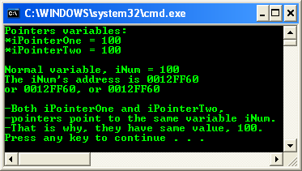
POINTERS
Using Pointers
Only the addition and subtraction operations are permitted in pointer's expression.
As with any variable, a pointer may be used on the right hand side of an assignment statement to assign its value to another pointer as shown in the following example.
Program example: using pointers

Slide 14
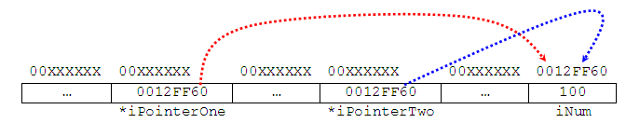
POINTERS
The situation can be illustrated as shown below. The memory address should be different for different run/system.
Take note the difference between memory address and the actual data value, which stored at the memory address.
Do not worry about the address, which are determined and provided by the system.
From the previous example, we can:
  Access the variable's content by using the variable name (iNum) and is called direct access.
  Access the variable's content by using a pointer to the variable (*iPointerOne or *iPointerTwo) and is called indirect access or indirection.

Slide 15
POINTERS
As a conclusion, if a pointer named pPointerVar of type int has been initialized to point to a variable named iNumVar, the following are true,
  // declare a pointer variable named pPointerVar, where the
  // data stored pointed to by pPointerVar is int type
  int * pPointerVar;
  // assign the iNumVar's address to pPointerVar pointer variable
  pPointerVar = &iNumVar;
* pPointerVar and iNumVar both refer to the contents of iNumVar (that is, whatever data value stored there).
pPointerVar and &iNumVar refer to the address of iNumVar (the pPointerVar only hold the address of variable iNumVar not the actual data value).
So, a pointer name without the indirection operator (*) accesses the pointer value itself, which is of course, the address of the variable pointed to.

Slide 16
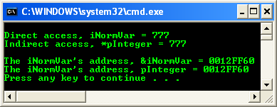
POINTERS
Program example: using pointers operator
The address displayed for variable iNormVar may be different on your system because different computer will have different specification.

Slide 17
POINTERS
For pointer arithmetic operation, only two arithmetic operations, that is addition and subtraction available. For example,
  int iAge = 35;
Hence, C reserved storage for the variable iAge and store the value 35 in it.
Let say, C has stored this value at the memory address 1000, then we declare a pointer variable named pPointerToAge that point to the iAge variable.
Then, after the following expressions have been executed,
  int * pPointerToAge;
  pPointerToAge = &iAge;
  pPointerToAge++;
The content of the pointer then becomes 1004 instead of 1001 (integer value takes 4 bytes so C add 4 to the pointer).

