Slide 1

STRUCT, TYPEDEF, ENUM & UNION
In this session we will learn struct and union types, typedef and enum

Slide 2
STRUCT, TYPEDEF, ENUM & UNION
Structure (struct)
With array, we can only declare one data type per array.
For different data type, we need another array declaration.
It is single type aggregate data type.
Struct overcomes this problem by declaring composite data types which can consist different types.
A structure is a collection of related data items stored in one place and can be referenced by more than one names.
These data items are different basic data types. So, the number of bytes required to store them may also vary.
A structure type is a user-defined composite type.
It is composed of fields or members which can be different types.

Slide 3
STRUCT, TYPEDEF, ENUM & UNION
In C++, a struct is same as a class except that its members are public by default.
In order to use a structure, we must first declare a structure template.
The variables in a structure are called elements or members.
In C, you must explicitly use the struct keyword to declare a structure however in C++, this is unnecessary, once the type has been defined.
You have the option of declaring variables when the structure type is defined by placing one or more comma-separated variable names between the closing brace and the semicolon.

Slide 4
STRUCT, TYPEDEF, ENUM & UNION
Structure variables can be initialized. The initialization for each variable must be enclosed in braces.
Both structure types and variables follow the same scope as normal variables, as do all identifiers.
If you define a structure within a function, then you can only use it within that function.
Likewise if you define a structure outside of any function then it can be used in any place throughout your program.
Example, to store and process a student’s record with the elements chIdNum (identification number), chName, chGender and nAge, we can declare the following structure,
      struct student {
      char chIdNum[5];
      char chName[10];
      char chGender;
      int nAge;
      };
tag

Slide 5
STRUCT, TYPEDEF, ENUM & UNION
Here, struct is a keyword that tells the compiler that a structure template is being declared and student is a tag that identifies its data structure.
Tag is not a variable; it is a label for the structure’s template.
Note that there is a semicolon after the closing curly brace.
A structure tag simply a label for the structure’s template but you name the structure tag using the same rules for naming variables.

Slide 6
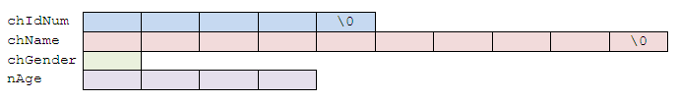
STRUCT, TYPEDEF, ENUM & UNION
The previous sample template for the structure can be illustrated as follow (note the different data sizes),

Slide 7
STRUCT, TYPEDEF, ENUM & UNION
Define, declare and initialize
Compiler will not reserve memory for a structure until it is declared.
A structure declaration names a type and specifies a sequence of variable values called 'members' or 'fields' of the structure that can have different types.
An optional identifier, called a 'tag', gives the name of the structure type and can be used in subsequent references to the structure type.
A variable of that structure type holds the entire sequence defined by that type.
Declaring structure variables can be done in the following way,
  struct MyEmployee // defines a structure variable named EmpData
  { char chName[20];
  int nIdNum;
  long nDepatment;
  } EmpData;

Slide 8
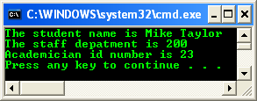
STRUCT, TYPEDEF, ENUM & UNION
The struct MyEmployee structure has three members: chName, nIdNum, and nDepatment.
The chName member is a 20-element array, and nIdNum and nDepatment are simple members with int and long types, respectively.
The identifier MyEmployee is the structure identifier.
Then we can declare variables of type struct MyEmployee like the following,
  struct MyEmployee student, staff, academician;
Struct basic example

Slide 9
STRUCT, TYPEDEF, ENUM & UNION
Another example, anonymous struct (struct without tag),
  Struct /* defines an anonymous struct and a */
  { /* structure variable named area */
  float fwidth, flength;
  } area;
The area structure has two members with float type, fwidth and flength.
The structure type has no tag and is therefore is unnamed or anonymous.
The nested structures, called anonymous structures allows you to declare a structure variable within another structure without giving it a name.
However, C++ does not allow anonymous structures.
You can access the members of an anonymous structure as if they were members in the containing structure.

Slide 10
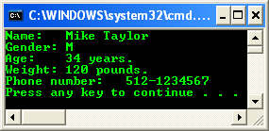
STRUCT, TYPEDEF, ENUM & UNION
Anonymous structure example

Slide 11
STRUCT, TYPEDEF, ENUM & UNION
Anonymous structures can be useful when the tag named is not needed.
This is the case when one declaration defines all structure instances.
Embedded or nested structures are often anonymous. For example,
  struct MyCube{
  struct /* anonymous structure */
  {
  int width, length;
  } area;
  int height;
  } CubeData;
Nested structures can also be accessed as though they were declared at the file-scope level.

Slide 12
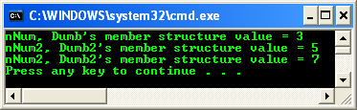
STRUCT, TYPEDEF, ENUM & UNION
Nested structure example

Slide 13
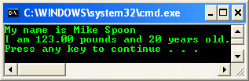
STRUCT, TYPEDEF, ENUM & UNION
Optionally, we can declare variables when the structure type is defined by placing one or more comma-separated variable names between the closing brace and the semicolon.
Structure variables can be initialized.
The initialization for each variable must be enclosed in braces.
Define & declare structure example

Slide 14
STRUCT, TYPEDEF, ENUM & UNION
Arrays of Structures
Suppose you would like to store and manipulate the record of 100 students.
It would be tedious and unproductive to create 100 different student array variables and work with them individually.
It would be much easier to create an array of student structures.
Structures of the same type can be grouped together into an array.
We can declare an array of structures just like we declare a normal array variable.
e.g., for 100 student records, we can declare a structure like the following,
  struct student{
  int nIdNum, nAge;
  char chName[80];
  char chGender;
  }studRecord[100];

Slide 15
STRUCT, TYPEDEF, ENUM & UNION
Or something like the following statements,
  struct student{
  int nIdNum, nAge;
  char chName[80];
  char chGender;
  };
And later in our program we can declare something like this,
  struct student studRecord[100];
This statement declares 100 variables of type struct student.

Slide 16
STRUCT, TYPEDEF, ENUM & UNION
As in arrays, we can use a subscript to reference a particular student record.
For example, to print the name of the seventh student, we could write the following statement,
  printf("%\n", studRecord[6].chName;
Example of initializing all the student names to blanks and their ages to 0, we could do this simply by using for loop as shown below,
  for(i=0; i<100; i++)
  {
  studRecord[i].chName = " ";
  studRecord[i].nAge = 0;
  }

Slide 17
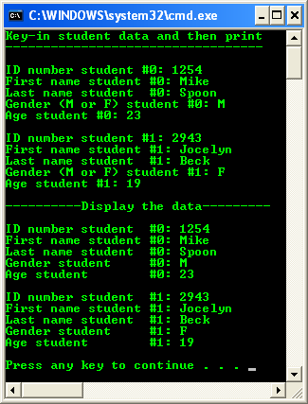
STRUCT, TYPEDEF, ENUM & UNION
Array of structure program example

Slide 18
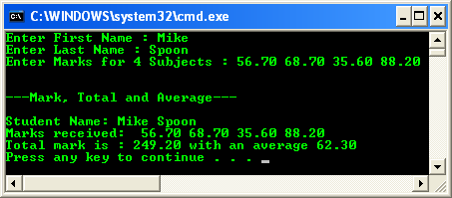
STRUCT, TYPEDEF, ENUM & UNION
Example demonstrates structure containing arrays

Slide 19
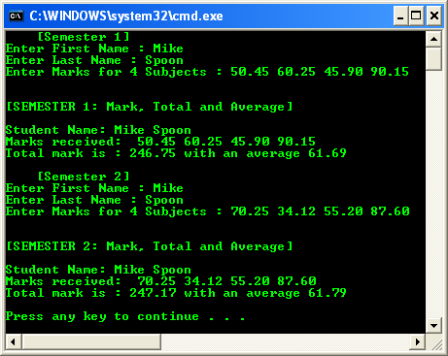
STRUCT, TYPEDEF, ENUM & UNION
Example demonstrates array of structure that containing arrays
So, take note on the difference between an array of structure and structure containing array.

