Slide 1
Visual Studio C++
-IDE & Compilers-

Slide 2
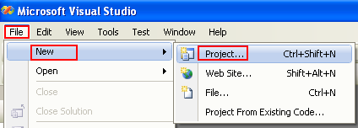
Using VC++ (2013)
In this session we will learn how to use VC++ to build a sample C program.
We assume VC++ (Visual Studio) was successfully installed.
Step: Launch VC++.
Step: Click File menu > New sub-menu > select Project… sub-menu.

Slide 3
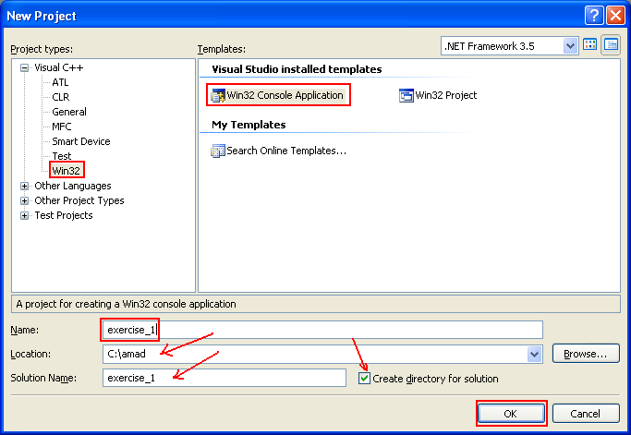
Using VC++
Step: select Win32 for the Project types > select Win32 Console Application for Templates.
Step: Enter the project Name > click OK button.
We just keep other settings to default.

Slide 4
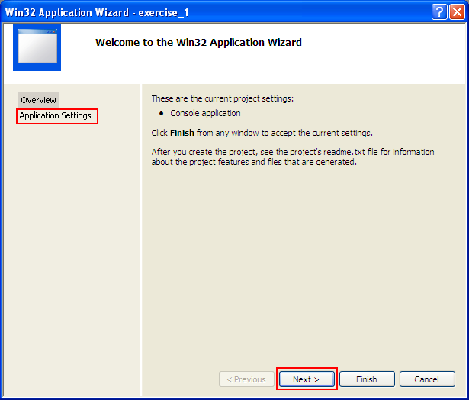
Using VC++
Step: select Application Settings (or Next > button).

Slide 5
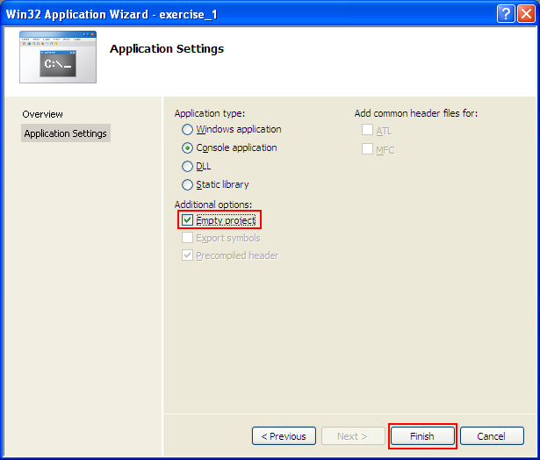
Using VC++
Step: select Empty project for Additional options > click Finish button.
Other settings set to default because we just want an empty Win32 console mode application.

Slide 6
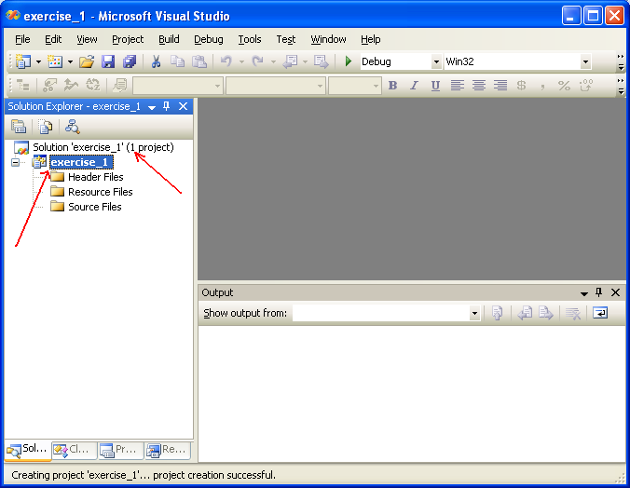
Using VC++
Now, on the left pane we have one solution and in it we have one project that we just created.
First project creation will create the first solution automatically.
At this stage we just having an empty project.

Slide 7
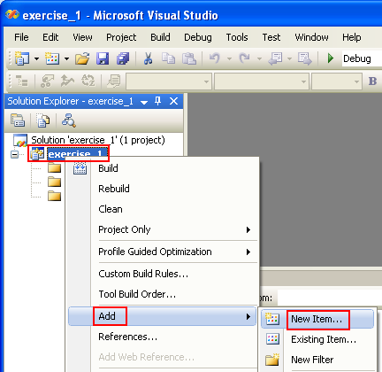
Using VC++
Step: select the project root folder > right-click mouse > select Add sub-menu > select New Item… sub-menu.
We are going to add C a source file to the project.

Slide 8
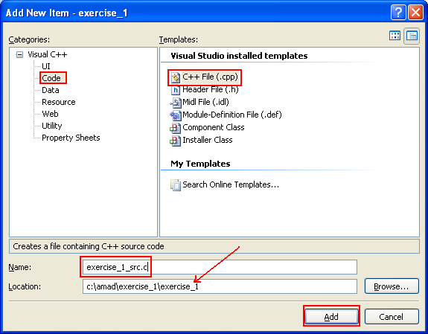
Using VC++
Step: select Code for Categories > select C++ File (.cpp) for Templates.
Step: put the source file name with .c extension for the Name.
Step: change the Location if needed > click Add button.
If we do not put the .c extension, the file will be defaulted to .cpp which is C++ source file.
For C source code portability, we need to put .c manually in VC++.

Slide 9
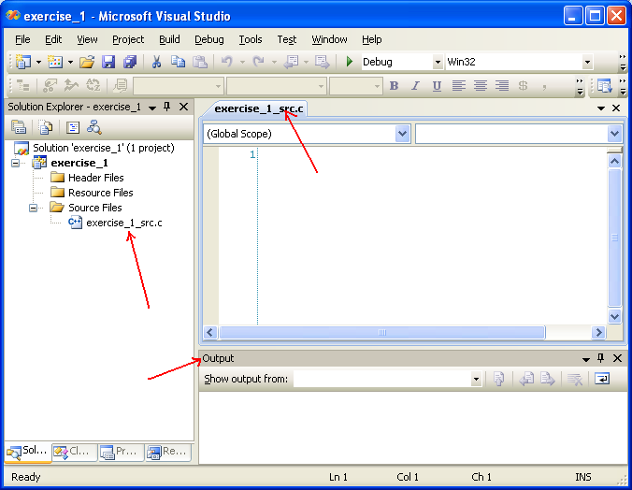
Using VC++
Now we have an empty C source file on the right pane.
If the file is not opened, just double-click the file link on the left pane.

Slide 10
Using VC++
Step: Copy and paste the following C source code to the source file.
#include <stdio.h>
int main(void)
{
int i, p;
float x;
char name[50];
printf("Key-in an integer, float and a string\n");
scanf_s(“%d%d%f%s",&p, &i, &x, name);
printf("p = %i\n", p);
return 0;
}

Slide 11
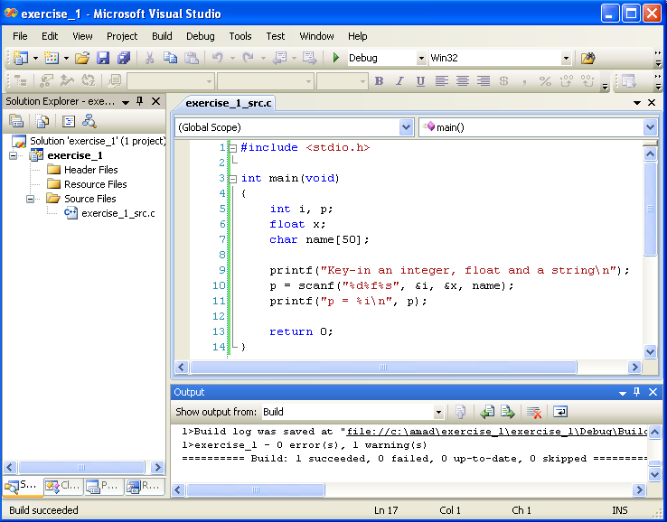
Using VC++
Now the C source file has source code in it.
We are ready to build (compile and link) the project.

Slide 12
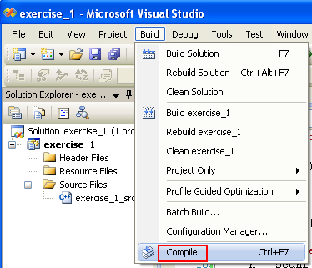
Using VC++
Step: select Build menu > select Compile sub-menu.

Slide 13
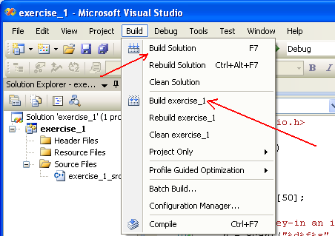
Using VC++
Optionally, we can directly build the solution (Build Solution sub-menu) or we can just build the project (Build exercise_1 in this case).
Both steps will compile and link the needed files.
However in this case we only have 1 solution and in it we only have 1 project and in it we only have 1 C source file!
There can be more than 1 solution and in 1 solution there can be more projects and in every projects there can be 100s or 1000s files!!!

Slide 14
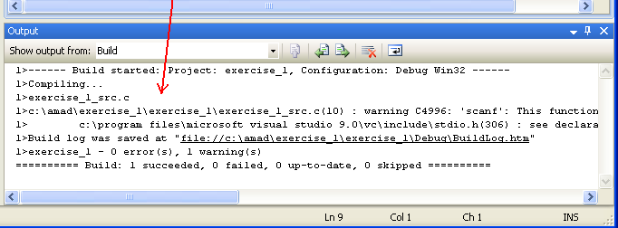
Using VC++
The output of the compiling process can be seen in the Output window.
You can invoke the Output windows by clicking View menu and selecting Output sub-menu (or Alt + 2) – VS 2013.
We have to make sure there is no error (optionally and/or warning) else the project/program cannot be run.

Slide 15
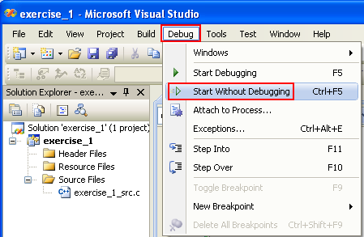
Using VC++
Provided there is no error during the building, we are ready to run the program.
Step: click Debug menu > select Start Without Debugging sub-menu.
We are not going to debug this program but just to run it.
So we choose Start Without Debugging instead of Start Debugging.

Slide 16
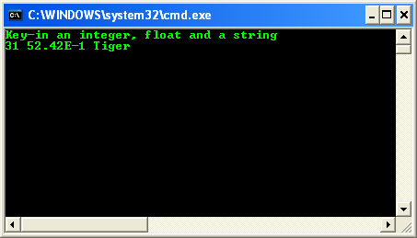
Using VC++
Now the console windows launched, ready to accept our input.
Step: For the purpose of learning, key-in “3 31 52.42E-1 Tiger" and press Enter key. Of course without the double quotes.
A space (whitespace) terminate C statement and in this case terminate an input.

Slide 17
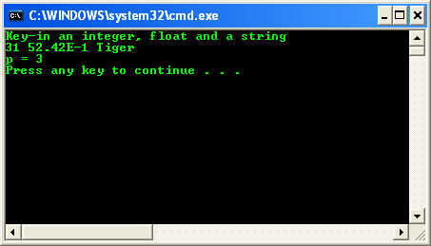
Using VC++
What this program does is:
Prompt user for inputs, assigns to p the value 3, to i the value 31, to x the value 5.242, and name contains the string "Tiger" and print p’s value.

Slide 18
Using VC++
Step: Replace the previous C source code with the following.
Step: re-build and re-run the project key-in 31 52.42E-1 Tiger and press Enter key
The details can be depicted as shown below.
#include <stdio.h>
int main(void)
{
int i, p;
float x;
char name[50];
printf("Key-in an integer, float and a string\n");
scanf_s("%d%d%f%s",&p, &i, &x, name);
printf("p = %i, i = %i, x = %f, name = %s\n", p, i, x, name);
return 0;
}
assigns to p the value 3, to i the value 31, to x the value 5.242, and name contains the string "Tiger".

Slide 19
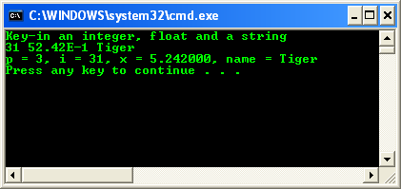
Using VC++
The following is a sample output.
assigns to p the value 3, to i the value 31, to x the value 5.242, and name contains the string "Tiger".

Slide 20
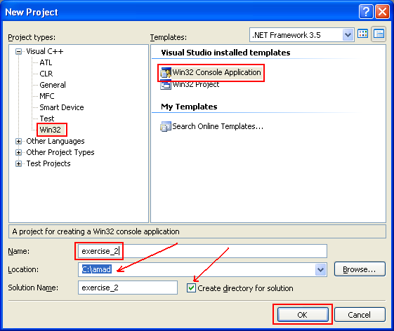
Using VC++
In the following steps, we are going to use the default extension .cpp and then 'force' compiler to compile the program as C code.
Step: Close the previous Solution: select File menu > select Close Solution.
Step: Create new empty Win32 console mode application project as done previously.

Slide 21
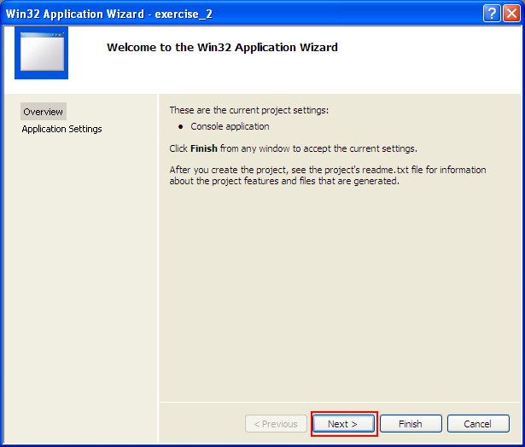
Using VC++
Step: click Application Settings or click Next > button.

Slide 22

Using VC++
Step: select Empty project tick box > click Finish button.
Left other settings as default.

Slide 23
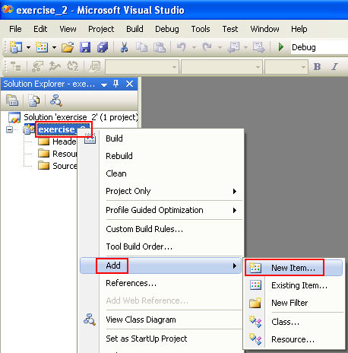
Using VC++
Step: add the source file. Select the project root folder > right-click mouse > select Add sub-menu > select New Item sub-menu.

Slide 24
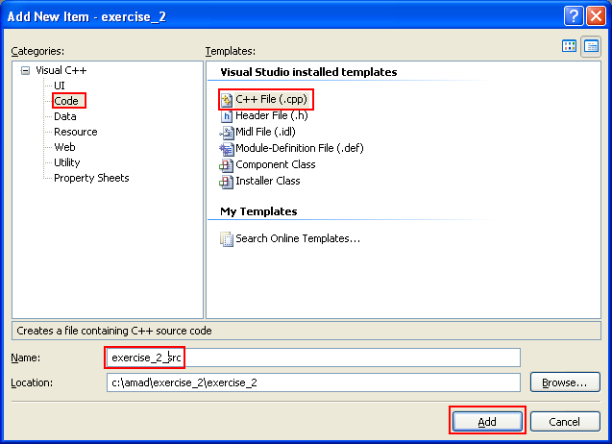
Using VC++
Step: However in this step we are not adding the .c extension (VC++ will add .cpp by default)

Slide 25
Using VC++
Step: Copy and paste the following C source code.
#include <stdio.h>
int main(void)
{
printf("%%#x:\t%#x\n", 141);
printf("%%g:\t%g\n", 5.1234567);
printf("%%07d:\t%07d\n", 123);
printf("%%+d:\t%+d\n", 456);
printf("%%-7d:\t%-7d,%%-5d:\t%-5d,\n", 33, 44);
printf("%%7s:\t%7s\n", "123456");
printf("%%s:\t%s\n", "my name");
printf("%%4f:\t%4f\n", 41.1234);
printf("%%8.5f:\t%8.5f\n", 1323.2346);
printf("%%.3f:\t%.3f\n", 15.4321);
printf("%%hd:\t%hd\n", 7);
printf("%%ld:\t%ld\n", 9);
printf("%%Lg:\t%Lg\n", 45.23456123);
return 0;
}

Slide 26
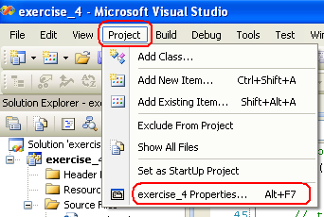
Using VC++
In order to force this C source code built as C code we need to tell compiler to do so for this project.
Step: select Project menu > select your_project_name Properties… sub-menu.

Slide 27
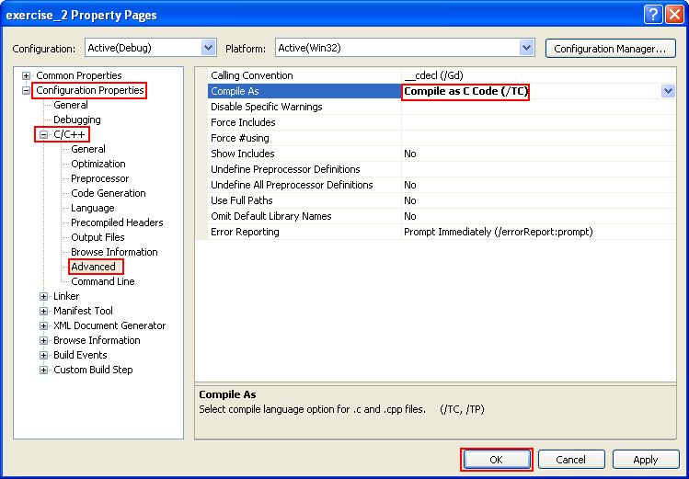
Using VC++
Step: expand the Configuration Properties folder > expand the C/C++ sub-folder > select Advanced link from the left pane.
Step: on the right pane, for Compile As option, select Compile as C Code (/TC) > click OK button.

Slide 28
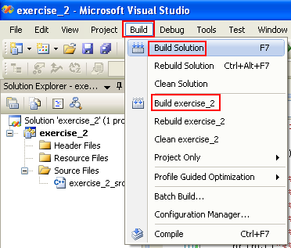
Using VC++
Step: Build the program as done previously. Make sure there is no error.

Slide 29
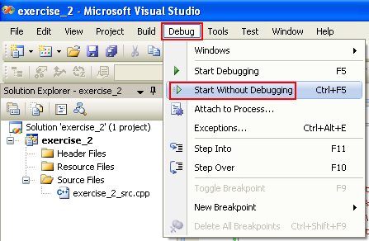
Using VC++
Step: run the program as done previously.

Slide 30
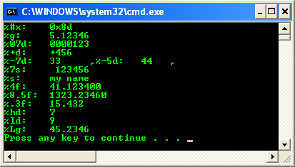
Using VC++
The following shows a sample output.

Slide 31
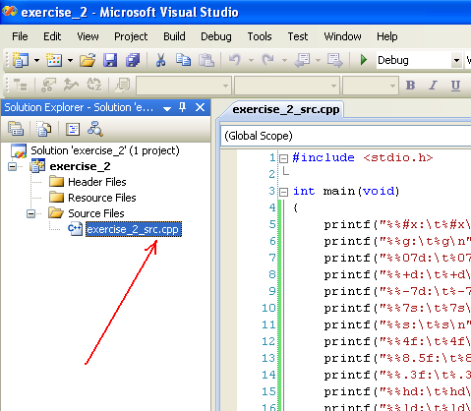
Using VC++
Compared to the previous example, the source file extension is .cpp instead of .c.
However, through the project settings we tell VC++ to build this C source code as C.

