Slide 1
C Program Controls -controlling the program execution flow: selection, repetition and branching-

Slide 2
PROGRAM CONTROL
Program begins execution at the main() function.
Statements within the main() function are then executed from top-down style, line-by-line.
However, this order is rarely encountered in real C program.
The order of the execution within the main() body may be branched.
Changing the order in which statements are executed is called program control.
Accomplished by using program control statements.
So we can control the program flows.

Slide 3
PROGRAM CONTROL
There are three types of program controls:
  Sequence control structure.
  Selection structures such as if, if-else, nested if, if-if-else, if-else-if and switch-case-break.
  Repetition (loop) such as for, while and do-while.
Certain C functions and keywords also can be used to control the program flows.

Slide 4
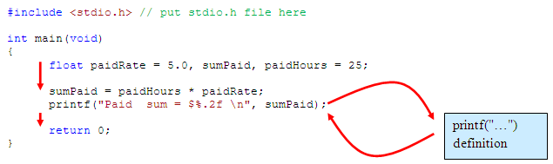
PROGRAM CONTROL
Take a look at the following example
Jump/branch to printf()
Back to main() from printf()

Slide 5
PROGRAM CONTROL
float paidRate = 5.0, sumPaid, paidHours = 25; | S1
sumPaid = paidHours * paidRate; | S2
printf("Paid sum = $%.2f \n", sumPaid); | S3
return 0; | S4
One entry point and one exit point.
Conceptually, a control structure like this means a sequence execution.

Slide 6
PROGRAM CONTROL
Selection Control Structure
Program need to select from the options given for execution.
At least 2 options, can be more than 2.
Option selected based on the condition evaluation result: TRUE or FALSE.

Slide 7
PROGRAM CONTROL
Selection: if, if-else, if-else-if
Starting from the most basic if syntax,
if (condition) | if (condition)
statement; | { statements;}
next_statement; | next_statement;
(condition) is evaluated. If TRUE (non-zero) the statement is executed. If FALSE (zero) the next_statement following the if statement block is executed. So, during the execution, based on some condition, some codes were skipped.

Slide 8
PROGRAM CONTROL
For example: if (hours > 70) hours = hours + 100; printf("Less hours, no bonus!\n");
If hours is less than or equal to 70, its value will remain unchanged and the printf() will be executed. If it exceeds 70, its value will be increased by 100.
if(jobCode == '1') { carAllowance = 100.00; housingAllowance = 500.00; entertainmentAllowance = 300.00; } printf("Not qualified for car, housing and entertainment allowances!");
The three statements enclosed in the curly braces { } will only be executed if jobCode is equal to '1', else the printf() will be executed.

Slide 9
PROGRAM CONTROL
if (condition) | if (condition)
statement_1; | { a block of statements;}
else | else
statement_2; | { a block of statements;}
next_statement; | next_statement;
Explanation: The (condition) is evaluated. If it evaluates to non-zero (TRUE), statement_1 is executed, otherwise, if it evaluates to zero (FALSE), statement_2 is executed. They are mutually exclusive, meaning, either statement_1 is executed or statement_2, but not both. statements_1 and statements_2 can be a block of codes and must be put in curly braces.

Slide 10
PROGRAM CONTROL
For example: if(myCode == '1') rate = 7.20; else rate = 12.50;
If myCode is equal to '1', the rate is 7.20 else, if myCode is not equal to '1' the rate is 12.50.
Equal/not equal (=) is not a value comparison, but a character comparison!!!

Slide 11
PROGRAM CONTROL
The if-else constructs can be nested (placed one within another) to any depth.
General forms: if-if-else and if-else-if.
The if-if-else constructs has the following form (3 level of depth example),
if(condition_1)
if(condition_2)
if(condition_3)
statement_4;
else
statement_3;
else
statement_2;
else
statement_1;
next_statement;

Slide 12
PROGRAM CONTROL
In this nested form, condition_1 is evaluated. If it is zero (FALSE), statement_1 is executed and the entire nested if statement is terminated.
If non-zero (TRUE), control goes to the second if (within the first if) and condition_2 is evaluated.
If it is zero (FALSE), statement_2 is executed; if not, control goes to the third if (within the second if) and condition_3 is evaluated.
If it is zero (FALSE), statement_3 is executed; if not, statement_4 is executed. The statement_4 (inner most) will only be executed if all the if statement are TRUE.
Again, only one of the statements is executed other will be skipped.
If the else is used together with if, always match an else with the nearest if before the else.
statements_x can be a block of codes and must be put in curly braces.
Program example: nested if-else

Slide 13
PROGRAM CONTROL
The if-else-if statement has the following form (3 levels example).
if(condition_1)
statement_1;
else if (condition_2)
statement_2;
else if(condition_3)
statement_3;
else
statement_4;
next_statement;

Slide 14
PROGRAM CONTROL
condition_1 is first evaluated. If it is non zero (TRUE), statement_1 is executed and the whole statement terminated and the execution is continue on the next_statement.
If condition_1 is zero (FALSE), control passes to the next else-if and condition_2 is evaluated.
If it is non zero (TRUE), statement_2 is executed and the whole system is terminated. If it is zero (FALSE), the next else-if is tested.
If condition_3 is non zero (TRUE), statement_3 is executed; if not, statement_4 is executed.
Note that only one of the statements will be executed, others will be skipped.
statement_x can be a block of statement and must be put in curly braces.

Slide 15
PROGRAM CONTROL
If mark is less than 40 then grade 'F' will be displayed; if it is greater than or equal to 40 but less than 50, then grade 'E' is displayed.
The test continues for grades 'D', 'C', and 'B'.
Finally, if mark is greater than or equal to 80, then grade 'A' is displayed.

Slide 16
PROGRAM CONTROL
Selection: The switch-case-break
The most flexible selection program control.
Enables the program to execute different statements based on an condition or expression that can have more than two values.
Also called multiple choice statements.
The if statement were limited to evaluating an expression that could have only two logical values: TRUE or FALSE.
If more than two values, have to use nested if.
The switch statement makes such nesting unnecessary.
Used together with case and break.

Slide 17
PROGRAM CONTROL
The switch constructs has the following form:
switch(condition)
{
case template_1 : statement(s);
break;
case template_2 : statement(s);
break;
case template_3 : statement(s);
break;
…
…
case template_n : statement(s);
break;
default : statement(s);
}
next_statement;

Slide 18
PROGRAM CONTROL
Evaluates the (condition) and compares its value with the templates following each case label.
If a match is found between (condition) and one of the templates, execution is transferred to the statement(s) that follows the case label.
If no match is found, execution is transferred to the statement(s) following the optional default label.
If no match is found and there is no default label, execution passes to the first statement following the switch statement closing brace which is the next_statement.
To ensure that only the statements associated with the matching template are executed, include a break keyword where needed, which terminates the entire switch statement.
The statement(s) can be a block of code in curly braces.

Slide 19
PROGRAM CONTROL
The statement sequence for case may also be NULL or empty.
The program would display,
B stands for Blue colour! | If the value entered at the prompt is B;
You have chosen 'G', 'R' or 'Y' G stands for Green, R for Red and Y for Yellow! | If the value entered at the prompt is G or R or Y;
The initial not a chosen colour! | If there is no matching characters.
It is useful for multiple cases that need the same processing sequence.

Slide 20
PROGRAM CONTROL
The break statement may be omitted to allow the execution to continue to the next cases.
The switch-case-break without break program example
It will display the message "Choice number 1!" if nChoice == 1.
It will display the message "Choice number 2!" if nChoice == 2.
It will display both the messages "Choice number 3!" and "Choice number 4!" if nChoice == 3.
It will display the "Invalid choice!" if it has any other value.
The switch-case construct can also be nested.

Slide 21
PROGRAM CONTROL
The differences between nested if and switch:
  The switch-case permits the execution of more than one alternatives (by not placing break) whereas the if statement does not. In other words, alternatives in an if statement are mutually exclusive whereas they may or may not be in the case of a switch-case.
  A switch can only perform equality tests involving integer (or character) constants, whereas the if statement allows more general comparison involving other data types as well.
When there are more than 3 or 4 conditions, use the switch-case-break statement rather than a long nested if statement.
When there are multiple options to choose from.
When test condition only use integer (or character) constants.

Slide 22
PROGRAM CONTROL
for loop is a very flexible construct.
Can use the decrementing counter instead of incrementing. For example,
    for (nCount = 100; nCount > 0; nCount--)
Can use counter other than 1, for example 3,
    for(nCount = 0; nCount < 1000; nCount += 3)
initial_value can be omitted if the test variable has been initialized beforehand.
However the semicolon must still be there. For example,
    nCount=1;
    for( ; nCount < 1000; nCount ++)

Slide 23
PROGRAM CONTROL
The initial_value can be any valid C expression, the expression is executed once when the for statement is first reached. For example,
  nCount =1;
  for(printf("Now sorting the array…"); nCount < 1000; nCount ++)
The increment/decrement expression can be omitted as long as the counter variable is updated within the body of the for statement.
The semicolon still must be included. For example,
  for(nCount =0; nCount < 100; )
  printf("%d", nCount ++);

Slide 24
PROGRAM CONTROL
The condition(s) expression that terminates the loop can be any valid C expression.
As long as it evaluates as TRUE (non zero), the for statement continues to execute.
Logical operators can be used to construct more complex condition(s) expressions. For example,
for(nCount =0; nCount < 1000 && name[nCount] != 0; nCount ++)
  printf("%d", name[nCount]);
for(nCount = 0; nCount < 1000 && list[nCount];)
  printf("%d", list[nCount ++]);

Slide 25
PROGRAM CONTROL
The for statement(s) can be followed by a null (empty) statement, so that task is done in the for loop itself.
Null statement consists of a semicolon alone on a line. For example,
for(count = 0; count < 20000; count++)
      ;
This statement provides a pause (delay) of 20,000 milliseconds.

Slide 26
PROGRAM CONTROL
An expression can be created by separating two sub expressions with the comma operator, and are evaluated (in left-to-right order), and the entire expression evaluates to the value of the right sub expression.
Each part of the for statement can be made to perform multiple duties. For example,
  "We have two arrays with 1000 elements each, named a[ ] and b[ ]. Then we want to copy the contents of a[ ] to b[ ] in the reverse order, so, after the copy operation, the array content should be…"
  b[0], b[1], b[2],… and a[999], a[998], a[997],… and so on.
sample coding is,
  for(iRow = 0, jColumn = 999; iRow < 1000; iRow ++, jColumn--)
  b[jColumn] = a[iRow];

Slide 27
PROGRAM CONTROL
Another examples of the for statements,
  nSum = 0;
  for(iRow = 1; iRow <=20; iRow++)
  nSum = nSum + iRow;
  printf("\n Sum of the first 20 natural numbers = ");
  printf("Sum = %d", nSum);
The above program segment will compute and display the sum of the first 20 natural numbers.
The above example can be re-written as,
  for(iNum = 1, nSum = 0; iNum <= 20; iNum++)
    nSum = nSum + iNum;
  printf("Sum of the first 20 natural numbers = %d", nSum);
Take note that the initialization part has two statements separated by a comma (,).

Slide 28
PROGRAM CONTROL
Another example,
for(iNum = 2, nSum=0, nSum2 = 0; iNum <= 20; iNum = iNum + 2)
{
nSum = nSum + iNum;
nSum2 = nSum2 + iNum * iNum;
}
printf("Sum of the first 20 even natural numbers = %d\n", nSum);
printf("Sum of the square for the first 20 even natural numbers = %d", nSum2);
In this example, the for statement is a compound or block statement.
Note that, the initial value in the initialization part doesn’t have to be zero and the increment value unnecessarily needs to be 1.

Slide 29
PROGRAM CONTROL
We can also create an infinite or never-ending loop by omitting all the expressions or by using a non-zero constant for condition(s) as shown in the following two code snippets,
  for( ; ; )
  printf("This is an infinite loop\n");
or
  for( ; 1 ; )
  printf("This is an infinite loop\n");
In both cases, the message "This is an infinite loop" will be printed repeatedly, indefinitely.
All the repetition constructs discussed so far can be nested to any degree.

Slide 30
PROGRAM CONTROL
Repetition: The while loop
Executes a block of statements as long as a specified condition is TRUE.
The general while loop construct,
while (condition)
statement(s);
next_statement;
The (condition) may be any valid C expression. The statement(s) may be either a single or a compound (a block of code) C statement. When while statement encountered, the following events occur: The (condition) is evaluated. If (condition) evaluates to FALSE (zero), the while loop terminates and execution passes to the next_statement. If (condition) evaluates as TRUE (non zero), the C statement(s) is executed. Then, the execution returns to step number 1 until condition becomes FALSE.

Slide 31
PROGRAM CONTROL
The while statement flow chart is shown below.
Start
Evaluate condition
T
Execute statement(s)
F
Stop

Slide 32
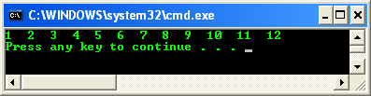
PROGRAM CONTROL
A simple example
// simple while loop example
#include <stdio.h>
int main(void)
{
int nCalculate = 1;
// set the while condition
while(nCalculate <= 12)
{
// print
printf("%d ", nCalculate);
// increment by 1, repeats
nCalculate++;
}
// a newline
printf("\n");
return 0;
}

Slide 33
PROGRAM CONTROL
The same task that can be performed using the for statement.
But, while statement does not contain an initialization section, the program must explicitly initialize any variables beforehand.
As conclusion, while statement is essentially a for statement without the initialization and increment components.
The syntax comparison between for and while,
for( ; condition; ) | vs | while(condition)

Slide 34
PROGRAM CONTROL
Repetition: The do-while loop
Executes a block of statements as long as a specified condition is true at least once.
Test the condition at the end of the loop rather than at the beginning, as demonstrated by the for and while loops.
The do-while loop construct is,
do
statement(s);
while (condition)
next_statement;
(condition) can be any valid C expression. statement(s) can be either a single or compound (a block of code) C statement. When the program encounter the do-while loop, the following events occur: The statement(s) are executed. The (condition) is evaluated. If it is TRUE, execution returns to step number 1. If it is FALSE, the loop terminates and the next_statement is executed. This means the statement(s) in the do-while will be executed at least once.

Slide 35
PROGRAM CONTROL
A flow chart for the do-while loop
The statement(s) are always executed at least once.
for and while loops evaluate the condition at the start of the loop, so the associated statements are not executed if the condition is initially FALSE.
Start
Execute statement(s)
Evaluate condition
T
F
Stop

Slide 36
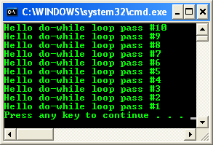
PROGRAM CONTROL

Slide 37
PROGRAM CONTROL
Other Program Controls
continue keyword
continue keyword forces the next iteration to take place immediately, skipping any instructions that may follow it.
The continue statement can only be used inside a loop (for, do-while and while) and not inside a switch-case selection.
When executed, it transfers control to the condition (the expression part) in a while or do-while loop, and to the increment expression in a for loop.
Unlike the break statement, continue does not force the termination of a loop, it merely transfers control to the next iteration.

Slide 38
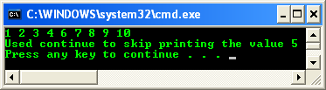
PROGRAM CONTROL
Consider the
// using the continue in for structure
#include <stdio.h>
int main(void)
{
int iNum;
for(iNum = 1; iNum <= 10; iNum++)
{
// skip remaining code in loop only if iNum == 5
if(iNum == 5)
continue;
printf("%d ", iNum);
}
printf("\nUsed continue to skip printing the value 5\n");
return 0;
}

Slide 39
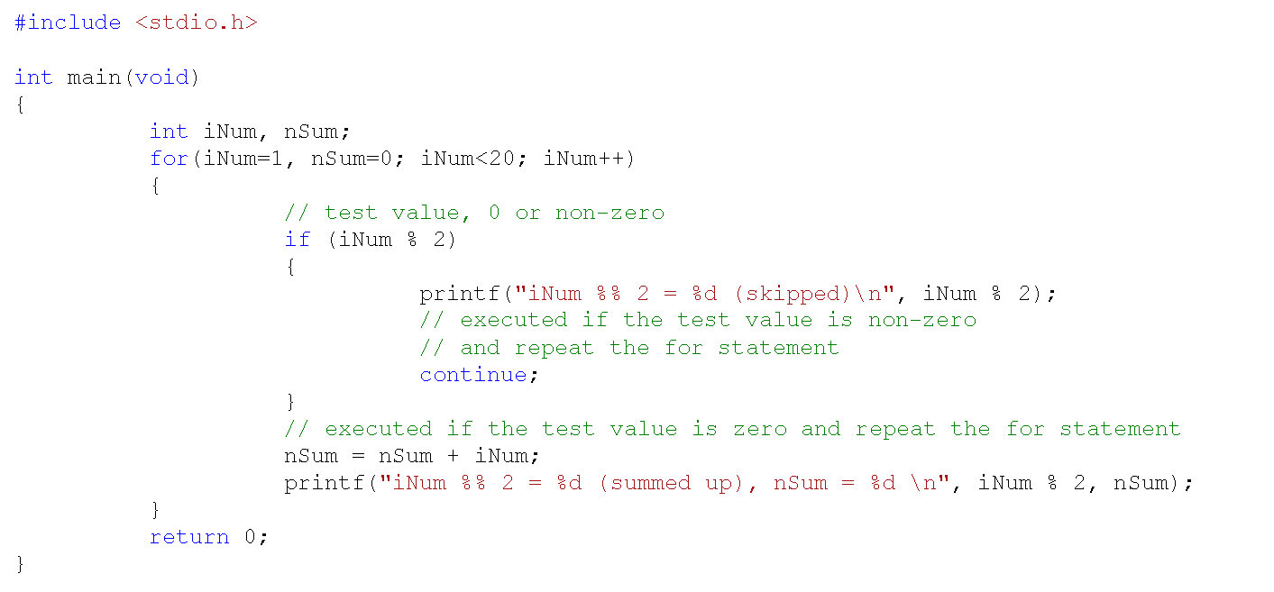
PROGRAM CONTROL
Next consider the following continue keyword example,

Slide 40
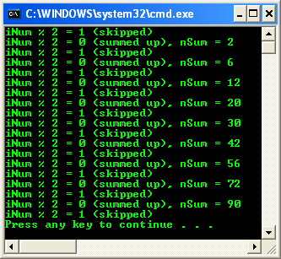
PROGRAM CONTROL
This loop sums up the even numbers 2, 4, 6, ... and stores the value in the nSum variable.
If the expression iNum % 2 (the remainder when iNum is divided by 2) yields a non-zero value (i.e., if iNum is odd), the continue statement is executed and the iteration repeated (iNum incremented and tested).

Slide 41
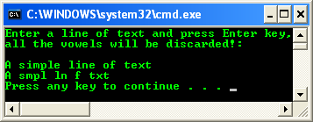
PROGRAM CONTROL
If it yields a zero value (i.e., if iNum is even), the statement nSum = nSum + iNum; is executed and the iteration continued.
When a continue statement executes, the next iteration of the enclosing loop begins.
The enclosing loop means the statements between the continue statement and the end of the loop are not executed.
Try another continue example

Slide 42
PROGRAM CONTROL
goto keyword
The goto statement is one of C unconditional jump or branching.
When program execution encounters a goto statement, execution immediately jumps, or branches, to the location specified by the goto statement.
The statement is unconditional because execution always branches when a goto statement is came across, the branching does not depend on any condition.
A goto statement and its target label must be located in the same function, although they can be in different blocks.
Use goto to transfer execution both into and out of loop.
However, using goto statement strongly not recommended.
Always use other C branching statements.
When program execution branches with a goto statement, no record is kept of where the execution is coming from.

Slide 43
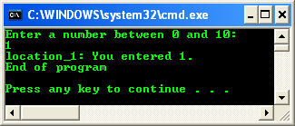
PROGRAM CONTROL
Try the following C goto keyword program example

Slide 44
PROGRAM CONTROL
exit() function
exit() function normally used when a program want to terminate at any time.
The exit() function terminates program execution and returns control to the Operating System.
The syntax of the exit() function is,
    exit(status);
Status | Description
0 (zero) | The program terminated normally.
1 (or non-zero) | Indicates that the program terminated with some sort of error. The return value is usually ignored.

Slide 45
PROGRAM CONTROL
We must include the header file stdlib.h (cstdlib if used in C++ code).
This header file also defines two symbolic constants for use as arguments to the exit() function, such as,
    #define EXIT_SUCCESS 0
    #define EXIT_FAILURE 1
Then we can call the function like the following,
    exit(EXIT_SUCCESS);
  Or
    exit(EXIT_FAILURE);

Slide 46
PROGRAM CONTROL
system() function
The system() function, enables the execution of OS command from the C running program.
Can be quite useful, for example, enabling the program to do a directory listing or formatting a disk without exiting the program.
Must include the header file stdlib.h. The syntax is,
  system("command");
The command can be either a string constant or a pointer to a string.

Slide 47
PROGRAM CONTROL
For example, using an argument with the system() function,
  char *command = "dir";
  system(command);
After the OS command is executed, the program continues at the location immediately following the system() call.
If the command passed to the system() function is not a valid OS command, a bad command or file name error message is displayed before returning to the program.
The command can also be any executable or batch file to be run.

Slide 48
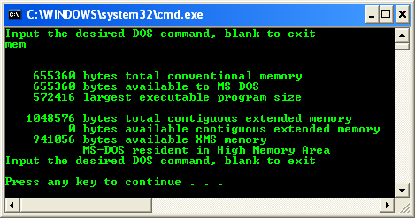
PROGRAM CONTROL
Try the following system() program example

Slide 49
PROGRAM CONTROL
return keyword
The return statement has a form,
  return expression;
The action is to terminate execution of the current function and pass the value contained in the expression (if any) to the function that invoked it.
The value returned must be of the same type or convertible to the same type as the function's return type (type casting).
More than one return statement may be placed in a function.
The execution of the first return statement in the function automatically terminates the function.

Slide 50
PROGRAM CONTROL
The main() function has a default type int since it returns the value 0 (an integer) to the environment.
A function of type void will not have the expression part following the keyword return.
Instead, in this case, we may drop the entire return statement altogether.
If a function calls another function before it is defined, then a prototype for it must be included in the calling function.
This gives information to the compiler to look for the called function (callee).

Slide 51
PROGRAM CONTROL
Callee
printf(“…“) definition
Caller
#include <stdio.h>
int main(void)
{
  int nNum = 20;
  printf("Initial value of the nNum variable is %d", nNum);
  return 0;
}

Slide 52
PROGRAM CONTROL
#include <stdio.h>
// prototype
void DisplayInteger(int);
void main(void)
{
  int nNum = 30;
  DisplayInteger(nNum);
}
void DisplayInteger(int iNum)
{
  printf("The integer is %d\n", iNum);
}
Caller
Callee

