Slide 1
C++
and Object Oriented Programming (OOP)

Slide 2
New in C++
General | OOP
input / output Strings, booleans function calls (by reference) Templates STL (standard template library) Containers (vectors, maps etc.) Algorithms (sort, find etc.) memory allocation (malloc vs new) Threads (Parallel programming) Exceptions (Error catching) | Classes and Objects Encapsulation Inheritance Polymorphism RAII (Memory leaks) Iterators Smart pointers

Slide 3
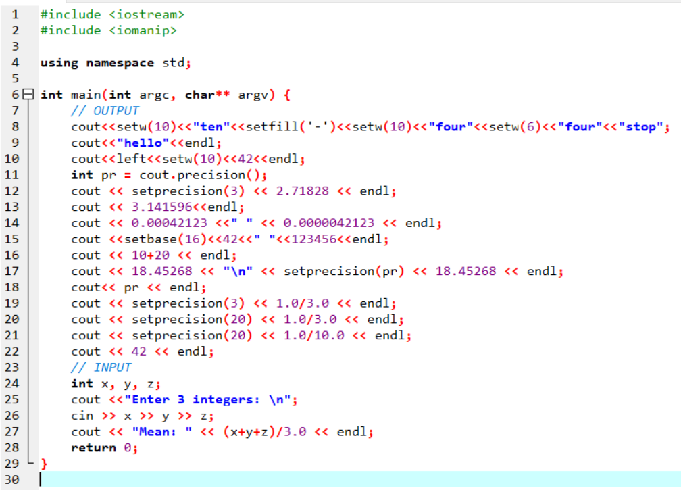
Console I/O
cin >>
cout <<
setw
setprecision
setbase

Slide 4
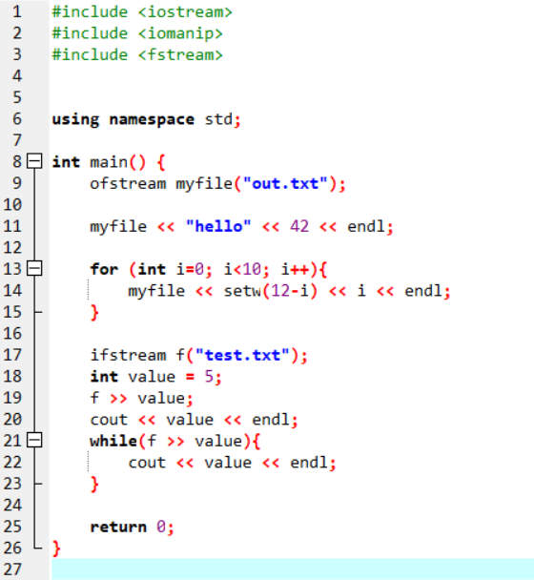
File I/O
Input from file
f >>
Output to file
f <<

Slide 5
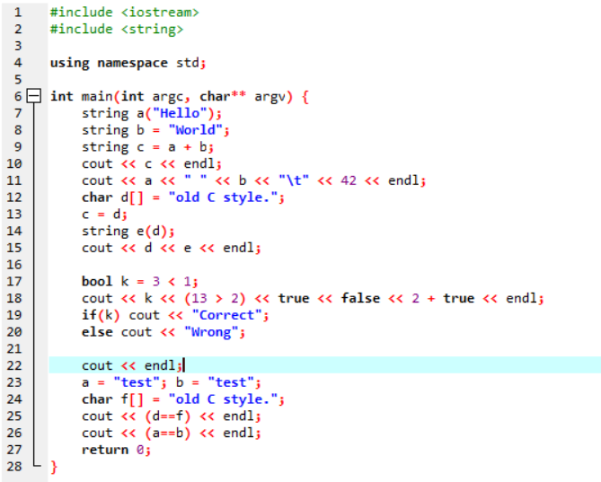
New types: String, Boolean

Slide 6
Swap algorithm
temp = a
a = b
b = temp
Hands on: Write a function [void exchange(int,int)] that accepts two integers and swaps their values. In main() declare int x=5, y =3. Call exchange(x,y) and then cout x and y, to check that x=3 and y=5.
[Don’t use swap(x, y) - swap is the name of a function of the standard library]

Slide 7
References
A reference is an alias to a variable.
int a = 5;
int &x = a;
x is an alias (pseudonym) of a.
Used in functions when we want to:
return multiple values
make changes to the original variables
send large arrays / objects

Slide 8
Call by reference
void somefunction(int &x){
x = 42;
}
int main(){
int a = 23;
somefunction(a);
// a is now 42
}
Any change in x inside the function, will reflect to variable a in main.
int &x = a
x is an alias of a

Slide 9
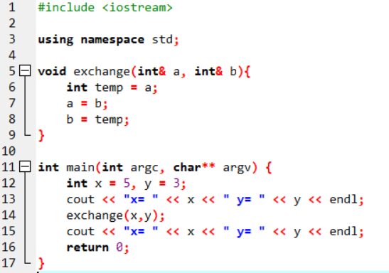
Swapping
But…
What if we want to swap double’s?
long int’s? unsigned int’s?
Templates for the rescue!!

Slide 10
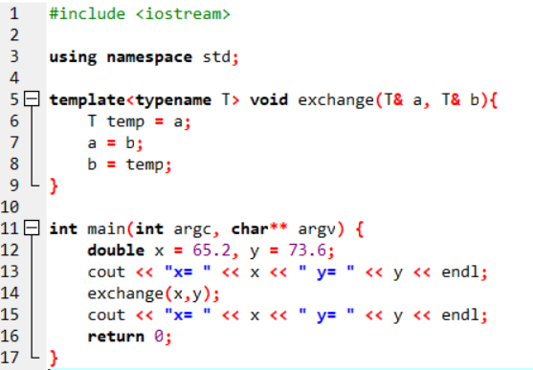
Template function
T can be any type: int, double, long int, unsigned int, char, unsigned char, etc.
It can even be a custom type defined by us (a class)

Slide 11
STL (Standard Template Library)
Containers | Algoriithms | Other stuff
Vector Map Set Deque List etc | Sort Find binary_search Count Shuffle etc | Iterators Functors

Slide 12
Vector (1)
Replaces C arrays
Is actually an array, with many extras
Dynamically allocated
Resizable
Knows its size
Can be send to and returned by a function
We can use algorithms like sort(), shuffle() etc.
Can be safe (if we let it!)

Slide 13
Vector (2)
Declaration / initialization examples:
vector<int> a; // zero sized vector
vector<int> a(n); // n elements
vector<int> a(n, v) // n elements, all initialized to v
Usage:
a[0] = 42;
int x = a[1];
just like an array!
Can actually be any type

Slide 14
Exercise
In main() create a vector of 100 random integers in the range [1..1000]
Write a function that sorts an array of ints (bubble sort, merge sort etc.) and call it from main(), sending the vector by reference.
Write a function that prints the elements of the (sorted) vector to a file.

