Slide 1
INTRODUCING
Coinbase — Your Hosted Bitcoin Wallet
TOTAL BALANCE
RECENT TRANSACTIONS
$1,240.00
Received from Alex
+0.50 BTC
3.42 BTC
Sent to Merchant
−0.12 BTC
Received from Jane
+1.00 BTC
Send
Receive
Sent to Exchange
−0.80 BTC

Slide 2



BITCOIN
A new kind of money
Instant
International
No Fees
Transactions confirm in seconds, anywhere on earth
No borders, no exchange rates, no intermediaries
Zero transaction cost versus 3% for cards or wire fees

Slide 3

GLOBAL ADOPTION
Bitcoin is everywhere — concentrated where it matters

Slide 4
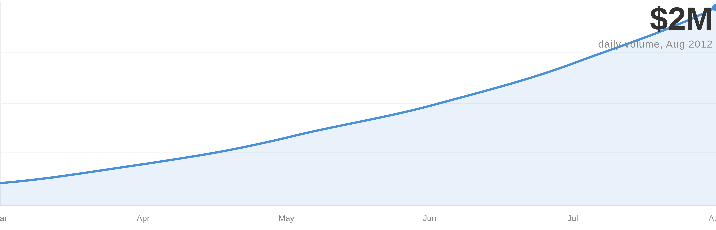
TRANSACTION VOLUME
Bitcoin processes $2M per day
Mar → Aug 2012 — consistently upward
$2M
daily volume, Aug 2012

Slide 5
International PaymentsVirtual GoodsGamesRemittanceMicro-transactionsDeveloping WorldE-CommercePeer-to-PeerDigital CommerceBorderlessGlobal TransfersOpen Marketplace
USE CASES
Real users. Real money. Real categories.

Slide 6
THE PROBLEM
Bitcoin is powerful but unusable
CURRENT REALITY
WHAT PEOPLE NEED
Desktop Clients & Terminals
Simple. Mobile. Web.
$ bitcoin-cli sendtoaddress \ 1A1zP1eP5QGefi2DM PTfedCe5vkAgj 0.1$ bitcoin-cli getbalance 3.42000000$ _
Send 0.10 BTC to Alex →
Recipient address or email
Amount in USD or BTC
Works from a browser. No installation. No keys to manage. Any device, any person.
Configuration files. Private keys. Command-line parameters. No normal person can use this.

Slide 7
THE SOLUTION
Coinbase — Bitcoin for everyone
DASHBOARD
SEND
HISTORY
Coinbase
Dashboard · Send · History
Send Bitcoin
Transaction History
YOUR BALANCE
TO
Received from Alex
+0.50
$1,240.00
friend@example.com
Aug 12
3.42 BTC
AMOUNT (BTC)
Sent to Merchant
−0.12
0.10
Aug 11
Send Bitcoin
Receive
Received · Jane
+1.00
NOTE (OPTIONAL)
Aug 9
For dinner
Sent · Exchange
Received · Alex
+0.50 BTC
Aug 7
−0.80
Sent · Merchant
−0.12 BTC
Send 0.10 BTC →
Received · Jane
+1.00 BTC

Slide 8
POSITIONING
Coinbase is to Bitcoinwhat iTunes was to MP3
The consumer-friendly layer that makes a powerful but raw technology accessible to everyone

Slide 9
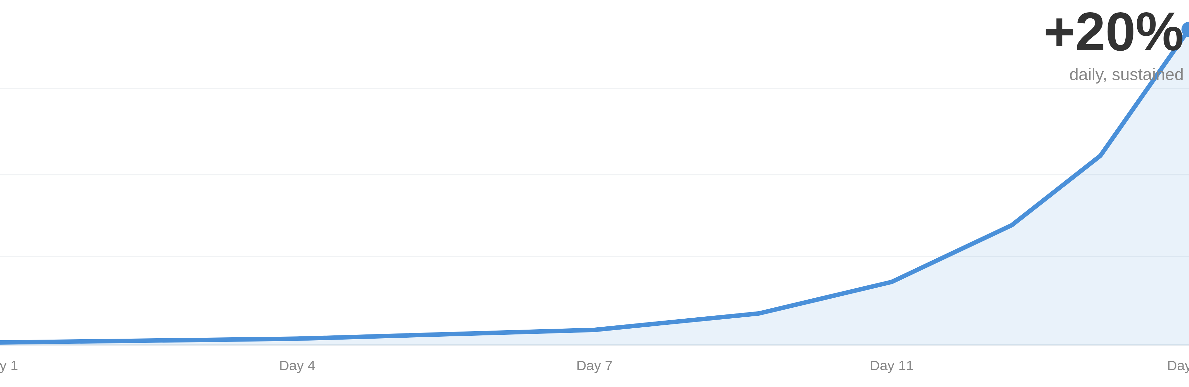
TRACTION — USER GROWTH
20% daily signup growth
Zero to thousands in two weeks
+20%
daily, sustained

Slide 10
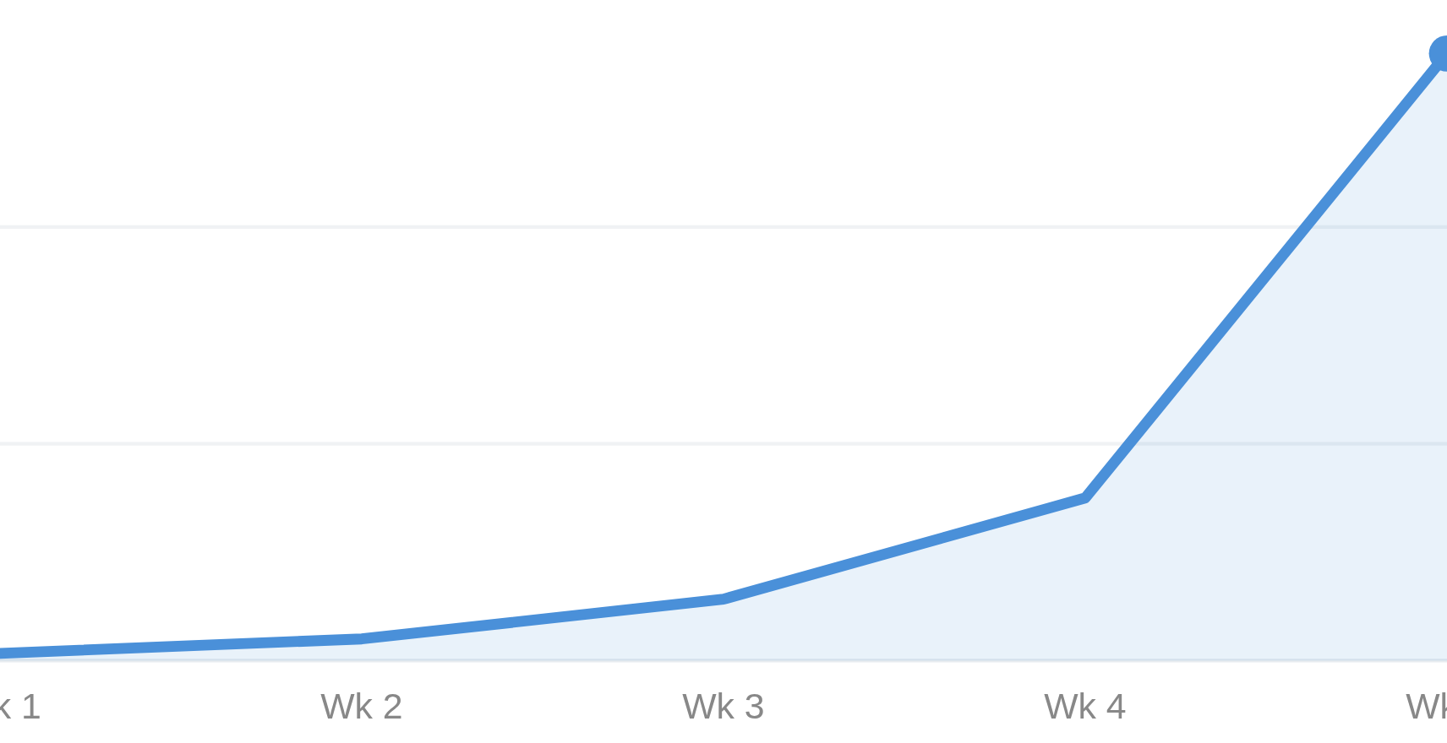
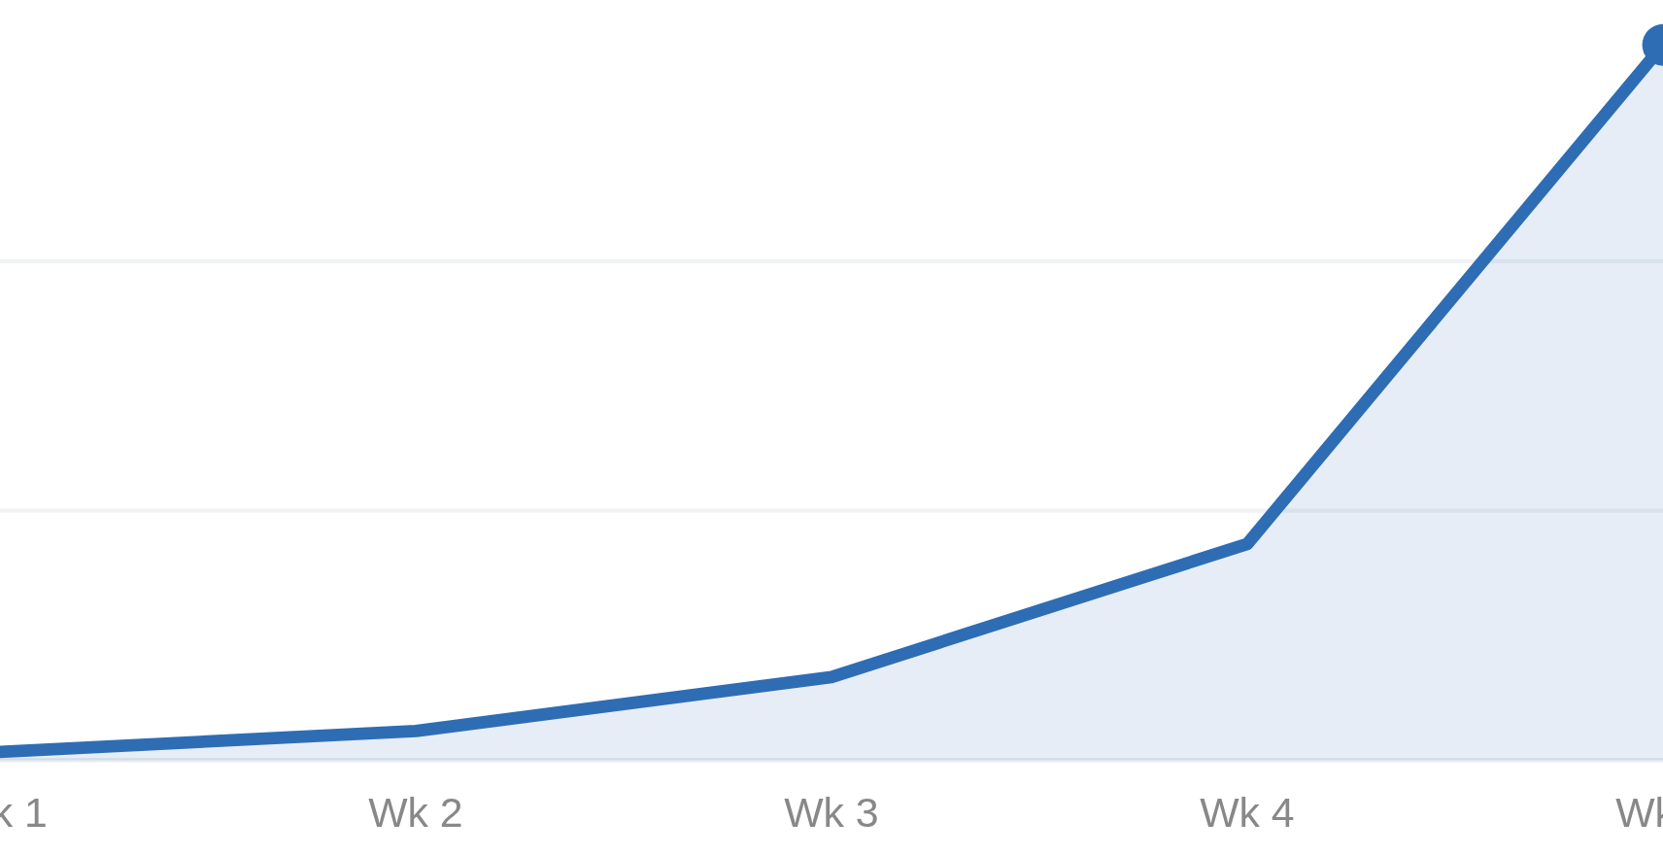
TRACTION — TRANSACTION VOLUME
$65,000 in 5 weeks
Real money moving — not just signups
USD VOLUME
BTC VOLUME
$65,000
~1,000 BTC

Slide 11
Coinbase
Your hosted Bitcoin wallet — Bitcoin for everyone
Get early access
coinbase.com

