Slide 1
Programowanie w języku Julia
Katarzyna Rycerz

Slide 2
References
Getting Started with Julia Programming Ivo Balbaert,
Julia High Performance Avik Sengupta -mam w wersji papierowej
Mastering Julia Malcolm Sherringhton
Julia’s authors responses at stackoverflow.com
http://julialang.org/learning/
Tutorial at juliabox.com

Slide 3
Two Language Problem
People love dynamic environments
for data analysis and exploration
but dynamism and performance are at odds
Two language problem: the need to prototype with one slow dynamic language and rewrite with a fast static language to obtain the final product
A standard compromise:
high-level logic in convenient, dynamic language (Matlab, Python, R)
performance-critical code in static, low-level language (C, C++, Fortran)

Slide 4
Julia - Introduction
First released in February 2012 at MIT
Open source
Small amount of C/C++ code, Lisp and Scheme
Much of the core is written in Julia
the standard library is written in Julia itself, including primitive operations like integer arithmetic
google “julia source” -> “base” or “examples”
Often compared with Python, R, MATLAB

Slide 5
Why Julia?
http://julialang.org/blog/2012/02/why-we-created-julia
speed of C
dynamism of Ruby
familiar mathematical notation (Matlab)
usable for general programming as Python,
easy for statistics as R,
natural for string processing as Perl,
powerful for linear algebra as Matlab,
good at gluing programs together as the shell.
simple to learn, keeping the most serious hackers happy ☺

Slide 6
Static type systems
there are rules for determining the type of every expression in a program.
the types of expressions dictate the behavior of the program.
a program that doesn't admit a consistent type to be determined for every expression will not compile.
Examples: C, C++,Java

Slide 7
Static typing
/* C code */
int num, sum; // explicit declaration
num = 5; // now use the variables
sum = 10;
sum = sum + num;
Java

Slide 8
Dynamic typing
do not have rules for assigning types to expressions:
types are implied by the way data flows through the program as it executes.
expressions can potentially produce values of any type at all
Examples: Python, JavaScript, Ruby

Slide 9
Dynamic typing
/* Python code */
my_variable = 10
while my_variable > 0:
i = foo(my_variable)
if i<100:
my_variable++
else
my_varaible = (my_variable + i) / 10
// spelling mistake not detected, new variable made !

Slide 10
Type inference
a feature present in some strongly statically typed languages
automatic deduction of the data type of an expression in a programming language
characteristic of functional programming languages in general
Example: Scala

Slide 11
Type inference in Julia
Julia is dynamically typed
Julia's compiler does type inference in different way:
it is not necessary for every expression to have an inferable type.
The compiler tries to predict the types of expressions to generate more efficient machine code.
if it can't determine the type of an expression, just emits generic code that will work anyway, using run-time type information.
For the most part in Julia, type inference is just an optimization :
your code will work the same way with or without it
with successful type inference, it will run a lot faster.

Slide 12
Just in Time compiler
compilation done during execution of a program – at run time – rather than prior to execution
Julia uses Low Level Virtual Machine (LLVM)
the first time a Julia function is run, it is parsed and the types are inferred
then, LLVM code is generated by the JIT compiler, which is then optimized and compiled down to native code.
the second time a Julia function is run, the native code already generated is called
Conclusion: the second time you call a function with arguments of a specific type, it takes much less time to run than the first time.

Slide 13
Julia: watch for performance !
Carefully thinking in terms of the types of variables is useful in avoiding performance bottlenecks.
E.g. adding type annotations to variables updated in the inner loop of a critical region of code helps the JIT compiler remove some type checking
Its good to know Julia performance tips: once you understand how Julia works, it’s easy to write code that’s nearly as fast as C
General advice:
first write an easy version that works.
Then, if necessary, improve the performance of that version by profiling it and then fixing performance bottlenecks

Slide 14
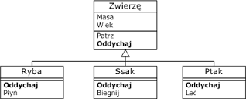
OO polymorfizm - reminder
abstract class Animal {
abstract String talk();
}
class Cat extends Animal {
String talk() {
return "Meow!";
}
}
class Dog extends Animal {
String talk() {
return "Woof!";
}
}
void letsHear(final Animal a) {
println(a.talk());
}
int main() {
letsHear(new Cat());
letsHear(new Dog());
}

Slide 15
OO polymorphism vs Multiple dispatch
In a typical OO language an object type (class) owns certain methods (functions), object.method(arg1, arg2)
Depending on the type of object, the runtime system will dispatch to different method definitions.
Traditional OO programming corresponds to single dispatch: the runtime chooses method based on the type of the first argument only.
In Julia, the same call would be spelled differently:
method(object, arg1, arg2)
In Julia the runtime chooses method based on the types of all the arguments.
a good fit for mathematical programming, where it is unnatural for the first argument to “own” an operation
Dynamics (at runtime) multiple dispatch different from C++ static overloading (at compile time)

Slide 16
Multiple Dispatch
The ability to define function behavior across many combinations of argument types
Efficiently picking the optimal method for all of a function’s arguments from many method definitions
Having defined:
f(n, m) = "base case"
f(n::Number, m::Number) = "n and m are both numbers"
f(n::Number, m) = "n is a number"
f(n, m::Number) = "m is a number"
f(n::Integer, m::Integer) = "n and m are both integers“
f(1.5, 2) returns “n and m are both numbers”
f(1, "bar") returns “n is a number”
f(1, 2) returns “n and m are both integers”
f("foo", [1,2]) returns “base case”

Slide 17
Multiple dispatch: How it works in Julia? (1/2)
The compiler will generate a separate version of the function each time it is called with arguments of a new type.
A concrete version of a function for a specific combination of argument types is called a method in Julia.
To define a new method for a function (also called overloading), just use the same function name but different argument types (different signature).
A list of all the methods is stored in a virtual method table (vtable) on the function itself;

Slide 18
Multiple dispatch: How it works in Julia? (2/2)
methods do not belong to a particular type.
when a function is called, Julia will do a lookup in that vtable at runtime to find which concrete method it should call based on the types of all its arguments;
in contrast to object-oriented (OO) languages, vtable is stored in the function, and not in the type (or class).
In Julia a function belongs to multiple types i.e. a function is specialized/overloaded for different types.

Slide 19
Summary: why Julia is fast ?
Intelligent type inference engine deduces the type from the data
JIT compiler generates specialized versions of functions for each data type
Multiple dispatch mechanism efficiently picks the optimal method for all of a function’s arguments

Slide 20
User-defined types
User-defined types are as fast and compact as built-ins.
Example
type Point
x::Float64
y::Float64
z::Float64
End
user-defined type is composed of a set of named fields with an optional type annotation
similar to a struct in C or a class without methods in Java
No functions belonging to the type
Julia uses func(object, args) instead of object.func(args)
the data and functions are separated
methods cannot be tied to a single type, because multiple dispatch connects them with different types.
when adding a new method for a type, you don’t have to change the code of the type itself (more flexible)

Slide 21
Metaprogramming
“code is data and data is code“.
every piece of the program code is internally represented as an ordinary Julia data structure, also called an expression.
homoiconics:
program code is a data structure accessible from the language itself,
the program can transform and even generate the new code
Inspired by Lisp solution, where code and data are just lists

Slide 22
Homoiconics - example
Examples
julia> prog = "1 + 1”
Julia> ex1 = parse(prog)
julia> dump(ex2)
Expr
head: Symbol call
args: Array{Any}((3,))
1: Symbol +
2: Int64 1
3: Int64 1
typ: Any
julia> dump(:(2+3))
Expr
head: Symbol call
args: Array{Any}((3,))
1: Symbol +
2: Int64 2
3: Int64 3
typ: Any
definition of the type Expr in
type Expr
head::Symbol
# identifying the kind of expression
args::Array{Any,1}
# the expression arguments are stored in an array
Typ
#the expression result type, which may be annotated by the user or inferred by the compiler
End
“:” operator (also called the quote operator) means to treat its argument as data, not as code.
dump() function presents the abstract syntax tree for its argument

Slide 23
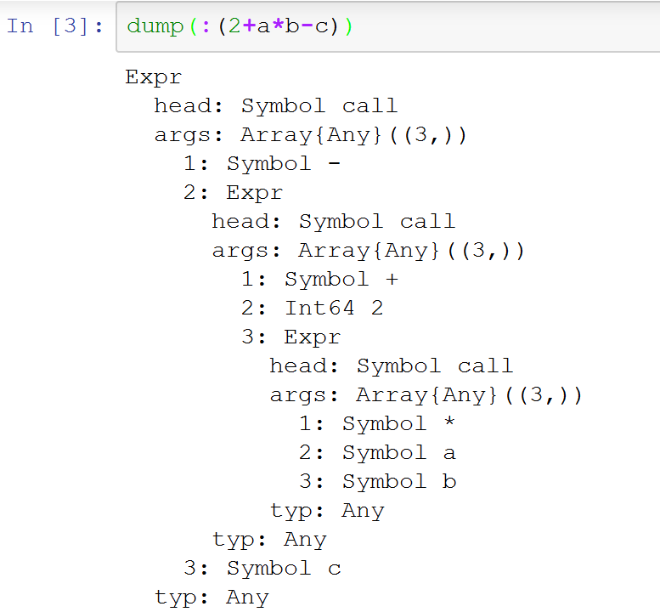
Abstract syntax tree in Julia expr
Syntax tree for 2+a*b-c
Julia expression
-
+
c
2
*
a
b

Slide 24
Shell capabilities
Instead of immediately running the command, backticks (e..g `echo hello`) create a Cmd object to represent the command.
Cmd object can be used to connect the command to others via pipes, run it, and read or write to it.
Julia does not capture its output of the command (unless asked).
the output by default goes to stdout (like libc‘s system call).
the command is never run with a shell
Julia parses the command syntax directly
interpolating variables
splitting on words
shell quoting syntax.
Command run as Julia‘s immediate child process (fork and exec calls).

Slide 25
Visualisation
Several packages exist to plot data and visualize data relations:
Plots
different plotting packages under a single API
Winston
offers easy 2D MATLAB-like plotting
PyPlot
a Julia interface to the Matplotlib plotting library from Python
works with no overhead through the PyCall package
Gadfly
provides ggplot2-like (a plotting system for R) package using data-driven documents
very useful for statistical graphs
publication quality
Examples https://juliaplots.github.io/ecosystem/

Slide 26
Parallel and distributed computing 1/2
environment based on message passing between multiple processes
can execute on the same machine or on remote machines
cluster managers (in-build localManager, SSHManager)
actual coding happens on a higher level than receiving and sending messages between processes
communication in Julia is generally “one-sided”,
one needs to explicitly manage only one process in a two-process operation.
send and receive operations are simulated by higher-level operations that look like function calls.

Slide 27
Parallel and distributed computing 2/2
remote calls and remote references
give a certain worker a function with arguments to execute with remotecall and fetch the result
parallel loops and maps
nheads = @parallel (+) for i=1:200000000
Int(rand(Bool))
End
shared Arrays
use system shared memory to map the same array across many processes
each process has access to the entire array
distributed arrays
very large array (or arrays) can be distributed, so that each process works in parallel on a different part of the array.
multi-threading (Experimental, from v0.5)

Slide 28
Julia standard library
written in Julia
broad range of functionalities:
regular expressions,
working with dates and times,
a package manager,
internationalization and Unicode,
linear algebra,
complex numbers,
specialized mathematical functions,
statistics,
I/O and networking,
Fast Fourier Transformations (FFT),
parallel computing,
macros,
reflection

Slide 29
Calling other languages
PyCall package for directly calling Python functions
mature libraries for numerical computing written in C and Fortran.
“no boilerplate” philosophy:
functions can be called directly from Julia without any “glue” code, code generation, or compilation even from the interactive prompt.
julia> t = ccall( (:clock, "libc"), Int32, ())
2292761
julia> t
2292761
julia> typeof(ans) Int32

Slide 30
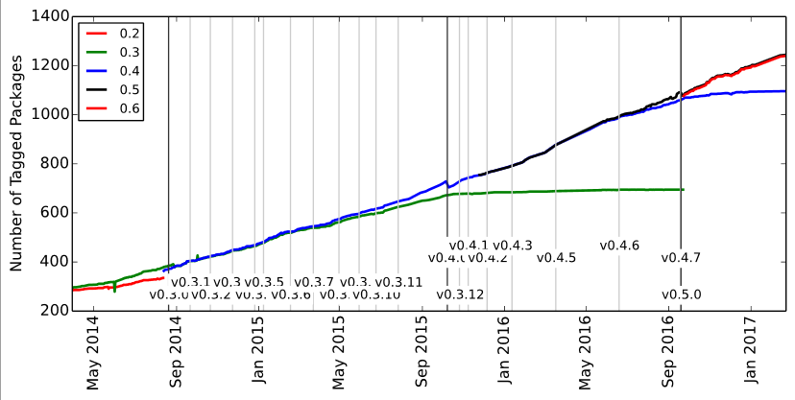
Julia Package Ecosystem Pulse
Total number of packages by Julia version
from (http://pkg.julialang.org/pulse.html)
See also http://pkg.julialang.org/

Slide 31
Juno IDE
built on Atom (text editor provided by Github)
consists of both Julia and Atom packages
Julia-specific enhancements to Atom:
syntax highlighting,
a plot pane,
integration with Julia's debugger (Gallium),
a console for running code

Slide 32
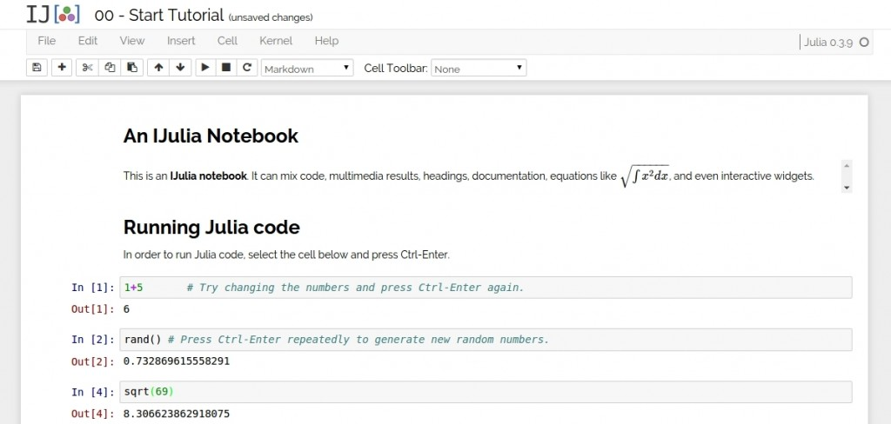
Web tool IJulia/Jupiter
Jupiter is a browser-based graphical notebook
code, formatted text, math, and multimedia in a single document
Julia-language backend (IJulia ) allows to interact with the Julia language using Jupyter/IPython's

Slide 33
JuliaBox
run Julia from the browser on the cloud
don’t have to download any software
Jupiter available on google cloud platform
beta version
free, but limited usage
https://juliabox.com

Slide 34
Community
http://julialang.org/community/

Slide 35
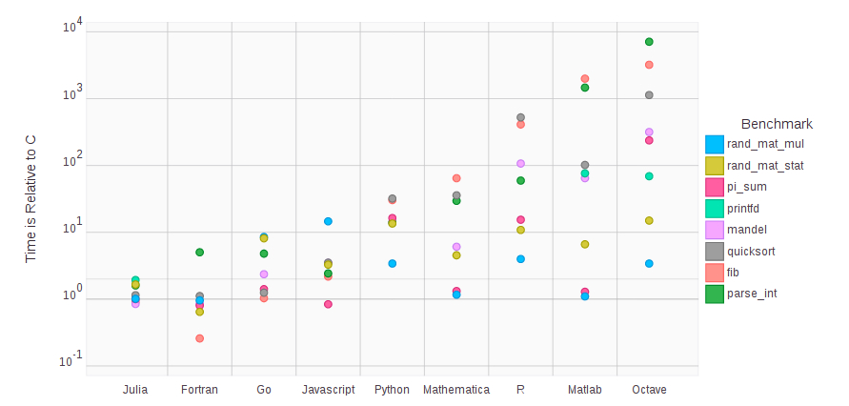
Performance slide

Slide 36
http://julialang.org/

Slide 37
Zasady zaliczania
Na każdym laboratorium będą zadane zadania za max 20 pkt.
W sumie będzie można uzyskać 100 pkt.
Do zaliczenia potrzebny jest wkład co najmniej 4 różnych tematów lab.
Za oddanie zadań później niż na zadane zajęcia będzie odejmowane 2 pkt na 2 tygodnie.
Ocena będzie wystawiona zgodnie z regulaminem studiów:
Od 91% bardzo dobry (5.0);
Od 81% plus dobry (4.5);
Od 71% dobry (4.0);
Od 61 % plus dostateczny (3.5);
Od 50 % dostateczny (3.0);
poniżej 50% niedostateczny (2.0).

Slide 38
Zadanie
Zadanie za pierwsze 5 pkt na pierwsze lab
Założyć konto na https://juliabox.com
Przeglądnąć i uruchomić przykłady z https://juliabyexample.helpmanual.io/ z sekcji:
Simple functions
Arrays
Loops and map
Packages and including of Files
przygotować implementację dowolnego algorytmu (np.. z przedmiotu algorytmy i struktury danych) w Julii.
Implementacje należy zademonstrować na lab za pomocą juliabox
Powinien to być prosty algorytm zawierający użycie:
dowolnej pętli,
dowolnej tablicy,
utworzenie i wywołanie funkcji.
Przykłady: sito Erastotenesa, sortowanie bąbelkowe
Strona z algorytmami: http://www.algorytm.org/algorytmy/

