Slide 1

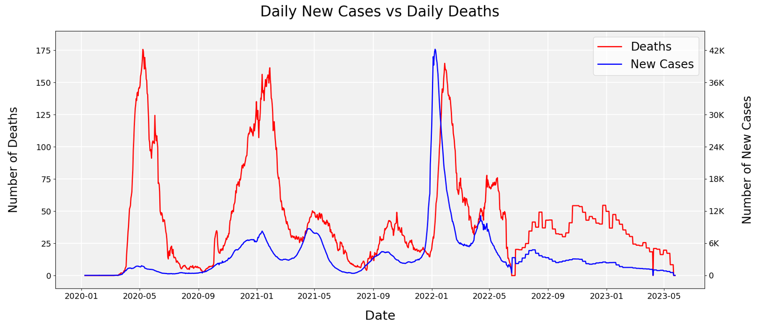
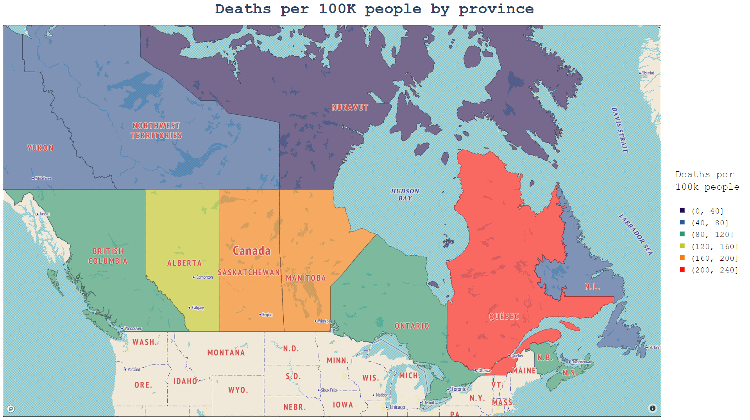
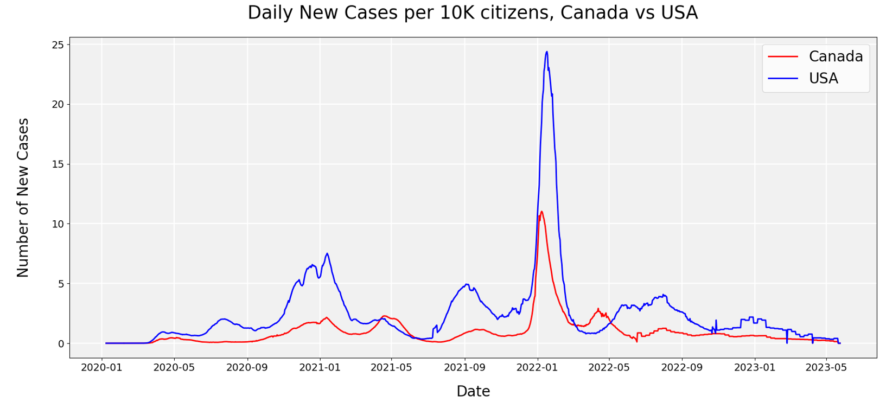
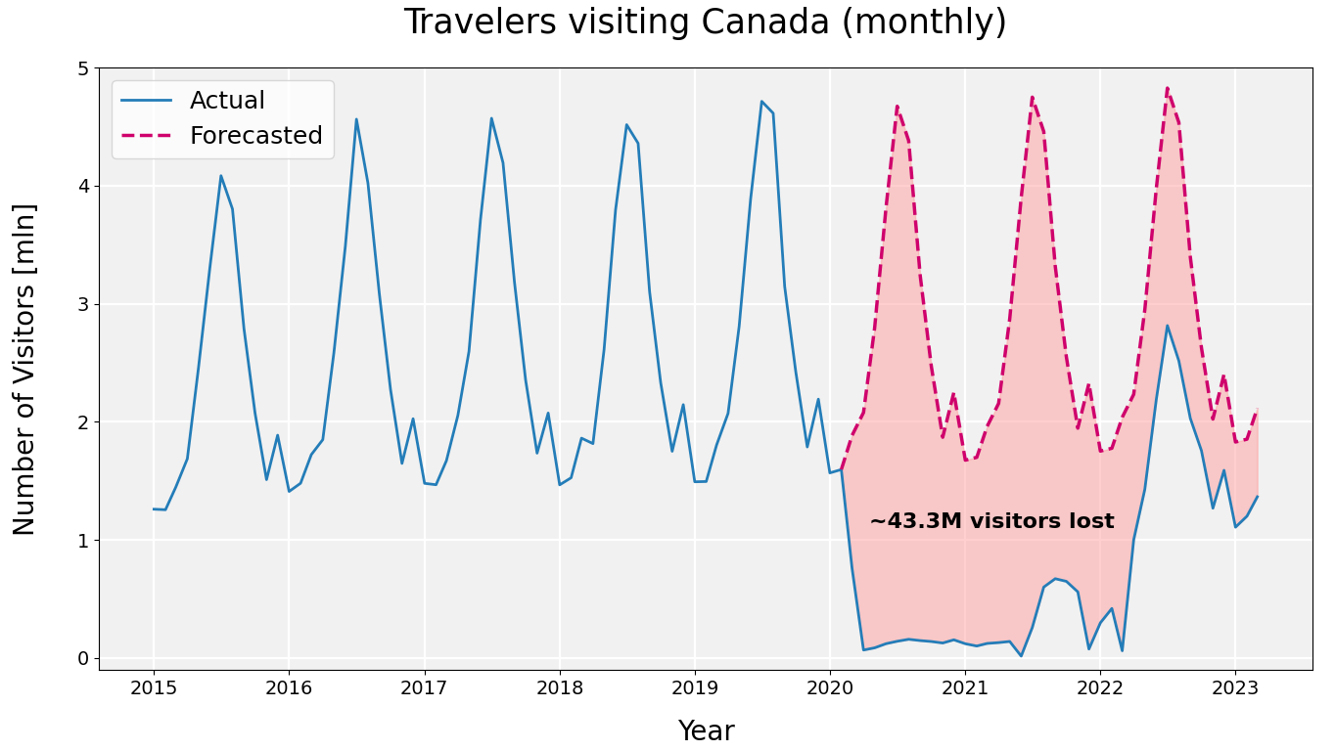
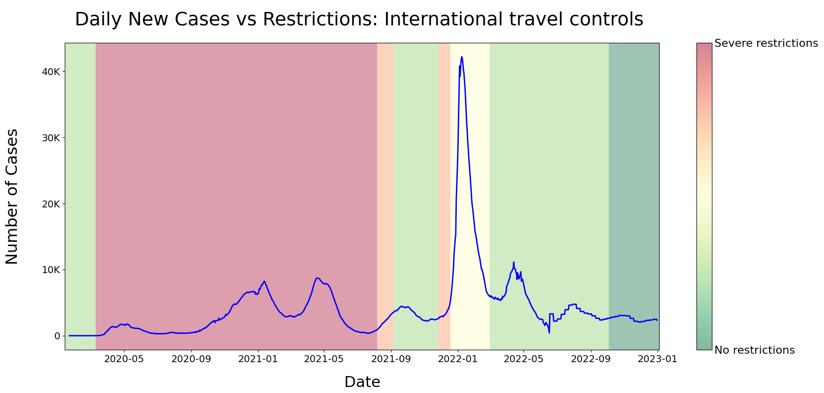
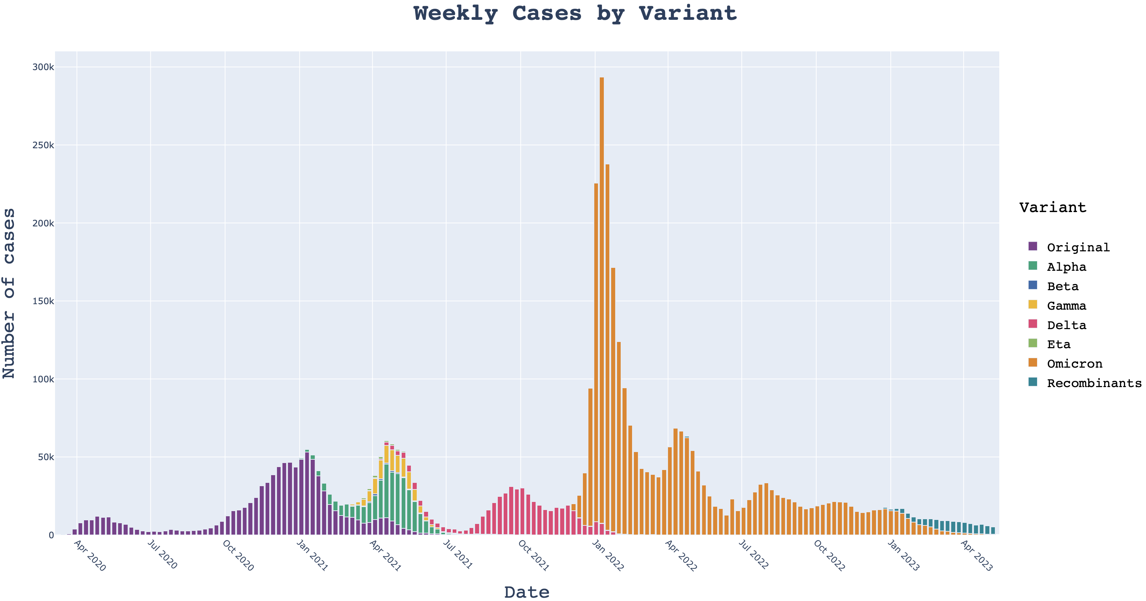
COVID-19 in Canada
Krzysztof Zakrzewski & Dawid Jamka
The initial high case-fatality rate for COVID-19 in Canada has gradually reduced starting from 2021 due to increasing vaccination coverage. Since Summer 2022, the fatality rate has spiked again to an alarming level. This phenomenon can be partially explained by the population not following vaccination with booster shots.
The severity of the COVID-19 was visibly varying across Canadian provinces. The most impacted region was Quebec, with Montreal as its most populated city.
The municipality is a reason why Quebec statistics stand out – until the middle of May 2020, Montreal accounted for 64% of the entire province’s death toll.
Second and third most populated provinces in Canada are Ontario and British Columba. Their example shows that the existence of large population centres is not enough to explain why COVID-19 in Quebec was so severe. What makes Montreal stand out is its systemic poverty and inequality.
The timeline of subsequent waves in Canada and the USA was similar. Peaks in the observed number of new cases in the USA are more pronounced and have brought significantly more infections per citizen.
International travel restrictions impacted Canadian tourism drastically but turned out to be the most effective preventive measure. Out of eight distinct categories highlighted by COVID-19 Government Response Tracker it achieved the lowest correlation with a number of new cases to come in the next ten days.
The pandemic timeline in Canada can be separated into distinct phases based on the most dominant COVID-19 variant. One exception could be seen around the Spring of 2021 when each of Alpha, Gamma and the original strain contributed considerably to the total number of cases.

