Slide 1
Can a Learning Orientation Reduce In-Group Bias?
Kaylee Billstone, Paulina Brown, Jaqueline Marroquin, Christiana Ozuna, Kirsten Richards, Kennedy Zapalac

Slide 2
Introduction
Notes:
Kaylee

Slide 3

Introduction
In-group bias: the preferential treatment of people with whom you share a common identity
Importance: Can lead to detrimental outcomes for out-group members
Our aims
Analyze participants’ responses for signs of in-group bias
Determine if a social orientation priming can influence participants’ responses
Determine if gender is important when considering social dynamics too

Slide 4
Data
Notes:
Paulina

Slide 5

Data Source
Study conducted by the Department of Psychology at Northwestern University
Participants: 124 white adults (55.65% female, mean age = 34.61)
Recruitment: Amazon’s Mechanical Turk (MTurk)
Method: Survey through Qualtrics
Purpose: investigate the impact of social orientation on in-group bias
Notes:
Originally there were 217 participants, but this was before removing people who only answered the first few questions of the survey.

Slide 6
Data Variables
Independent:
Learning/performance orientation
In-group/out-group stranger
Dependent:
Pronoun usage and sentiment expressed in letter of support
Perspective taking (5 items)
Empathetic concern (1 item)
Altruism (dictator game)
Potential Covariates:
Age
Gender
Trait-level learning/performance orientation (8 items each)
Notes:
Explain the survey flow.
Participants were randomly primed with a learning or performance orientation by reflecting on a time when they tried to get to know someone new or by reflecting on a time when they tried to get someone new to like them.
Participants were randomly assigned to read a first-person account from an in-group (white) or out-group (black) stranger who just went through a breakup.
Then they wrote a letter of support to this stranger and answered a series of questions about how easily they were able to understand this stranger’s perspective, the amount of empathy they felt, and given the opportunity to share their compensation with the stranger.

Slide 7

Data Cleaning
Created consistent, easy to work with variable names and data
Missing data: removed blank and mostly blank surveys
Textual analysis: extract word frequency, sentiment, and pronoun usage from letter of support
Data quality: reviewed quality checks, including an attention check and question that asked participants if they would like their responses to be excluded
Potentially untrustworthy data!
Notes:
Reformatted variable names
Removed unused variables
Removed previous categorical encoding
Created columns indicating participant’s condition (in-group/out-group and priming received)
Cleaned dictator game free response (additional text and typos)
Converted data types as needed
Calculate average scores on scales with multiple items
Remove blank and mostly blank surveys, review quality checks, and remove additional responses if necessary
Extract word frequency, sentiment, and pronoun usage from letters of support

Slide 8
Exploratory Data Analysis

Slide 9
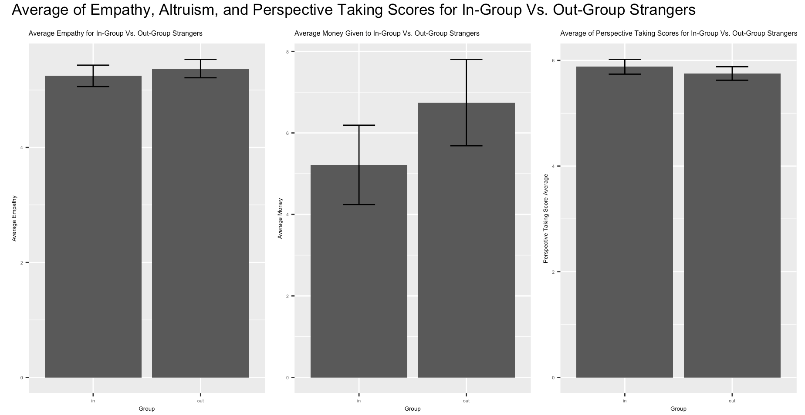
In-Group vs. Out-Group Survey Responses
There doesn’t seem to be a difference in the participant’s ability to understand the perspective of, their empathy for or the altruism exhibited towards out-group members
Maybe this difference is concealed by the priming received.
Notes:
Christiana
Perspective taking - how well participants could adopt the perspective of the person they read about
Although we see no difference when we separate by in and out group, there may be an underlying difference between differently primed groups

Slide 10
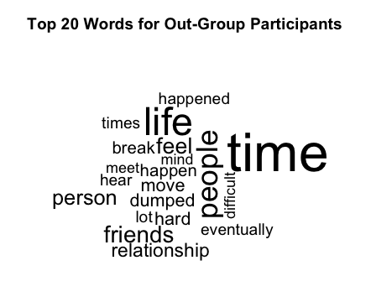
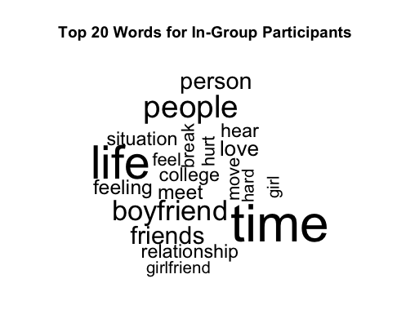
In-Group Vs. Out-Group Letter of Support
Letter of support similar across groups
Notes:
Christiana
The letter of support is similar across groups, evidenced by the similar frequent words.
Point out similar words
Also, this increases our confidence that participants were paying attention when taking the survey because the words in their letter of support appear related to the account they read in which someone shared about a breakup

Slide 11
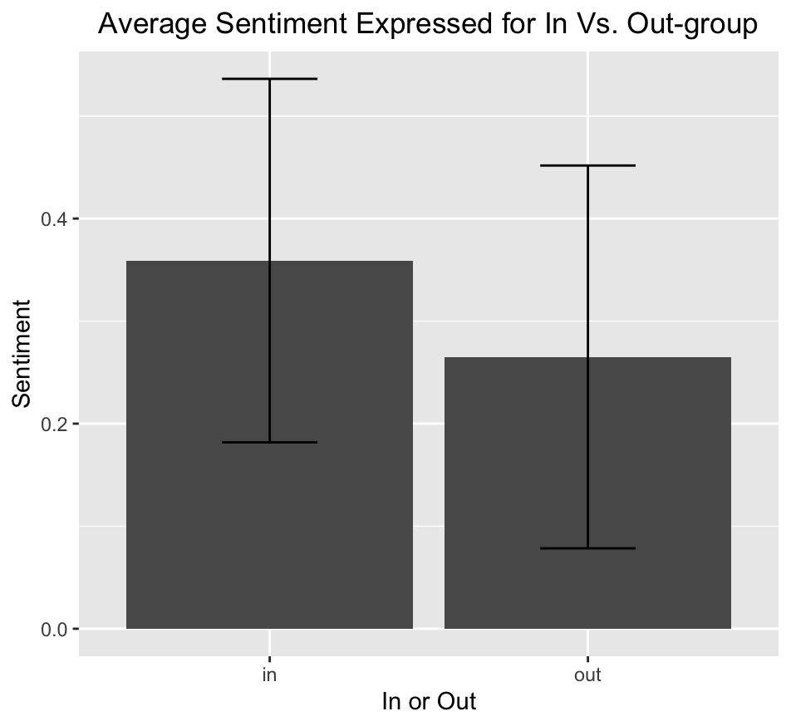
In-Group Vs. Out-Group Letter of Support
There doesn’t appear to be a significant difference in the usage of positive and negative words in a letter of support to an in- or out-group member
Notes:
Christiana
Explain how ‘afinn’ gives positive and negative values to words
Note how the sentiment is positive in both plots

Slide 12
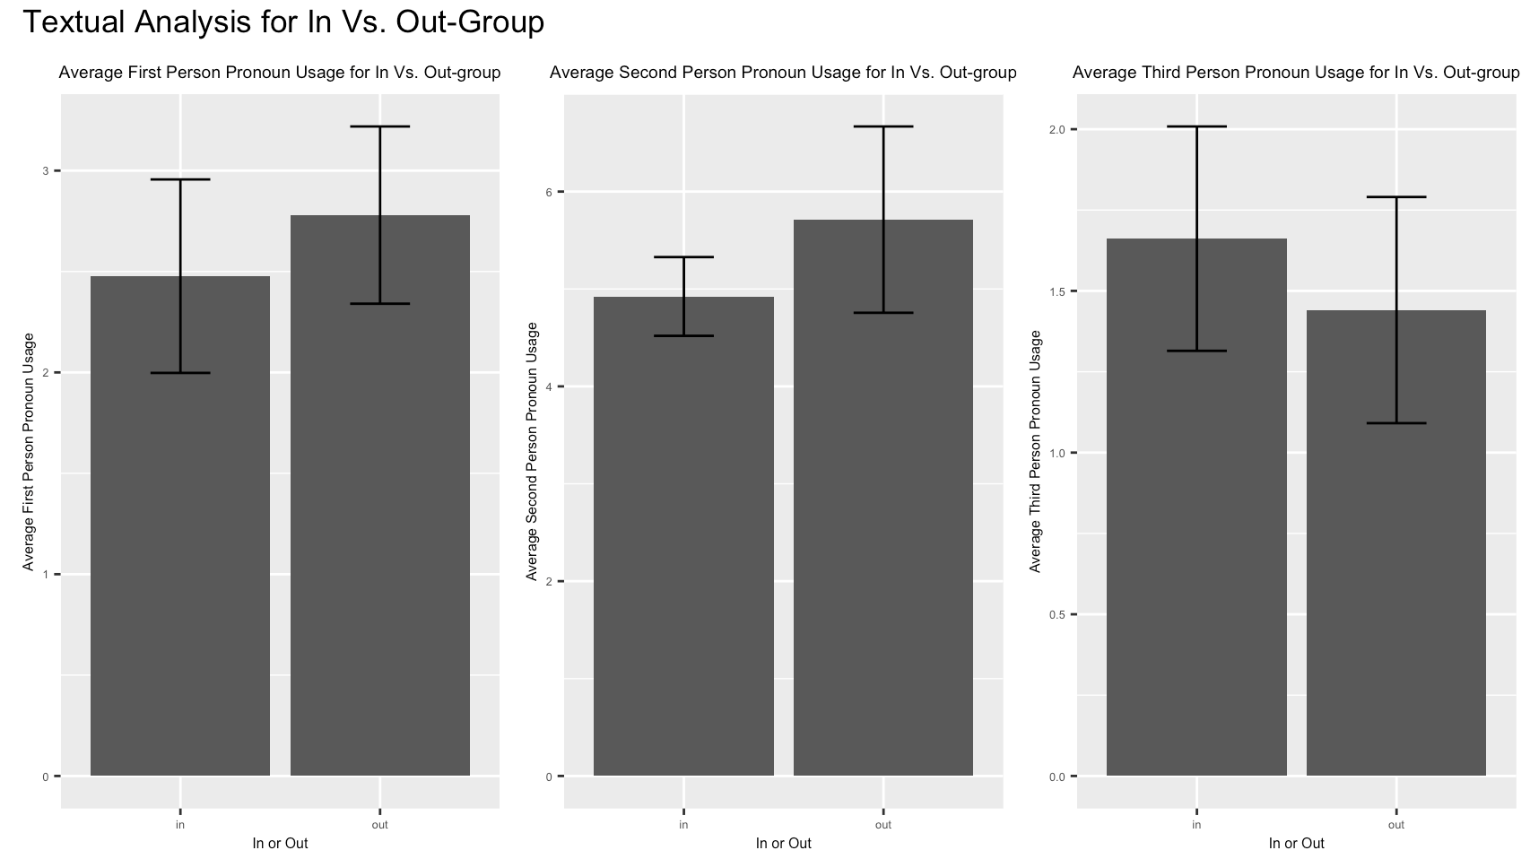
In-Group Vs. Out-Group Letter of Support
None of these appear to be significant differences, but the out-group participants used more first person and second and less third person pronouns than the in-group participants
Notes:
Christiana

Slide 13
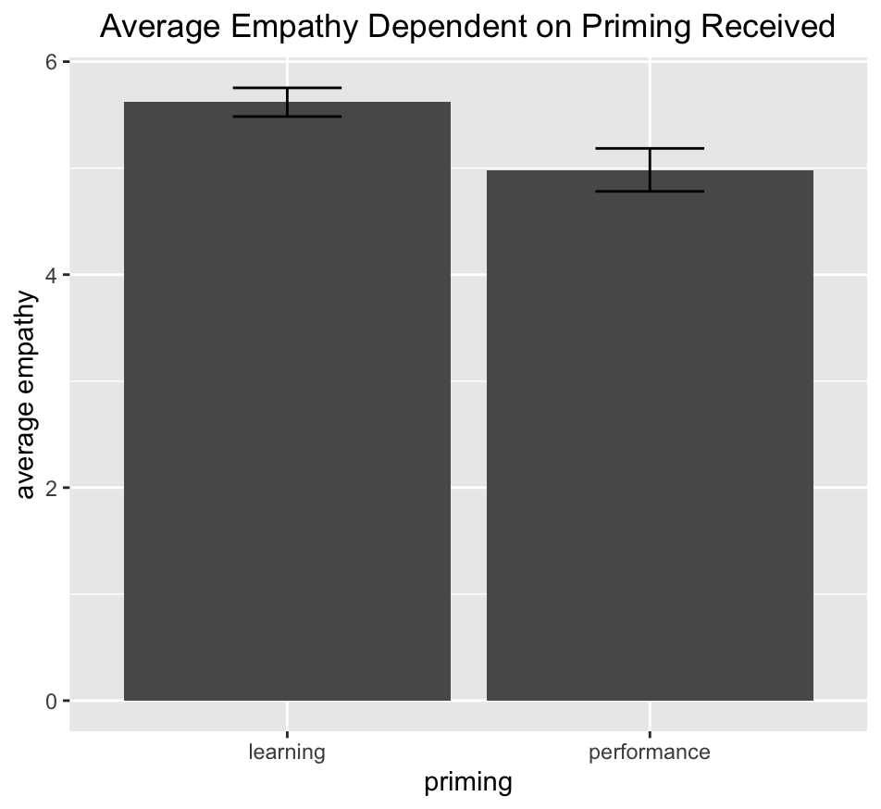
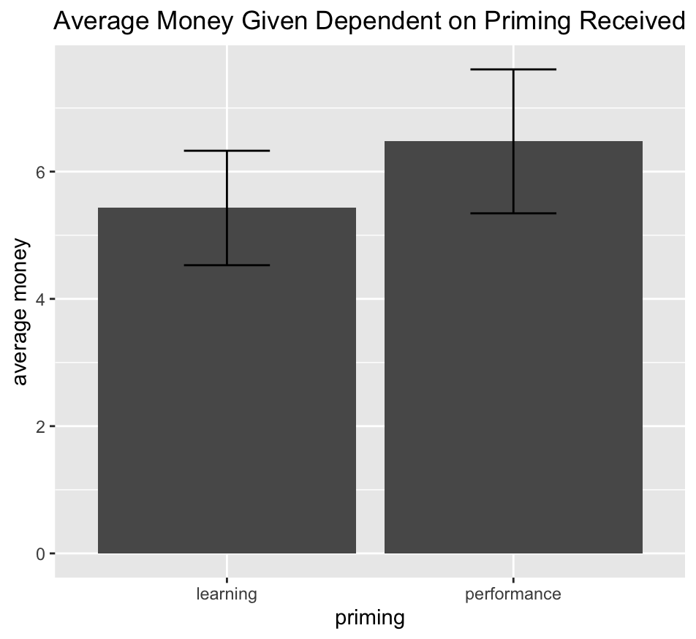
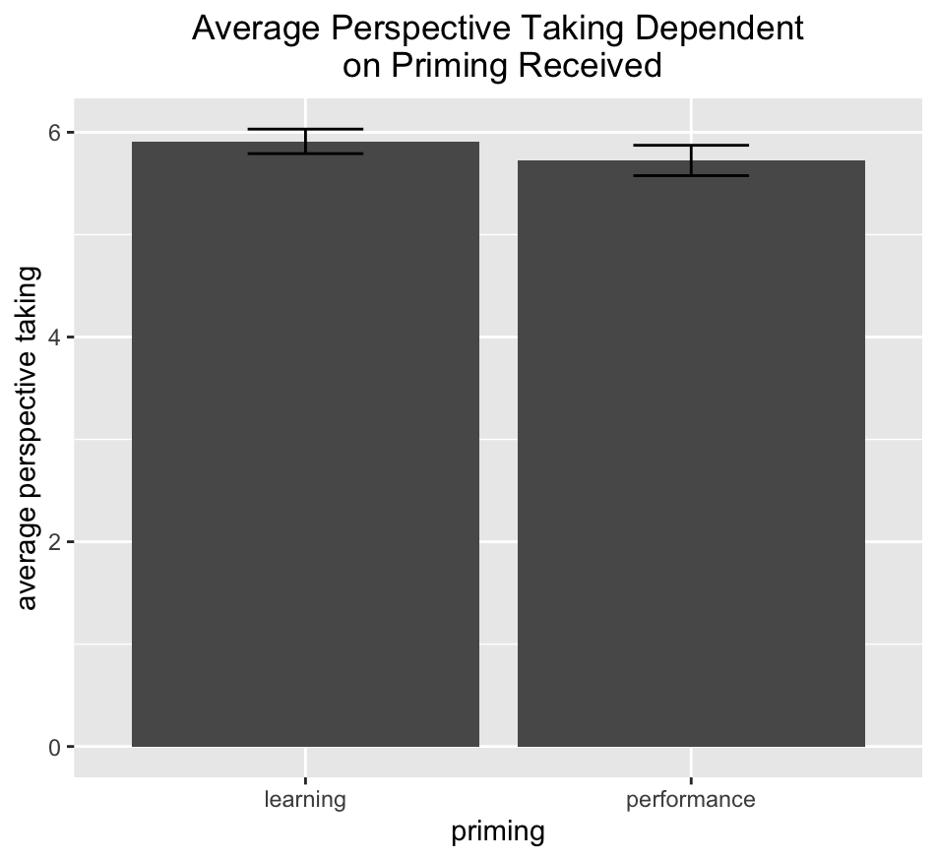
Survey Responses Dependent on Priming Received
Participant’s who received the learning priming may expressed more empathy towards and had an easier time understanding the stranger they read about
More money given on average by people who received the performance priming, but this difference isn’t statistically significant
Notes:
Kaylee
Note that covariates are variables aside from the priming received and the group assignment that may have influenced how much empathy, altruism, and perspective taking someone indicated on the survey
The difference in empathy is likely significant, while the difference in perspective taking may be trending towards significance. Can’t say without conducting formal tests though

Slide 14
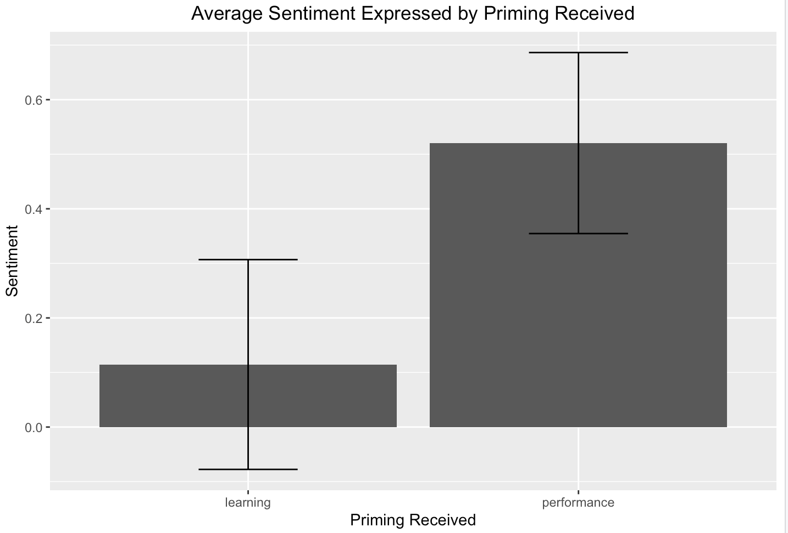
Survey Responses Dependent on Priming Received
Participants who received the performance priming tended to use more positively valenced words in the letter of support, and this difference may have been significant
Notes:
Kaylee

Slide 15
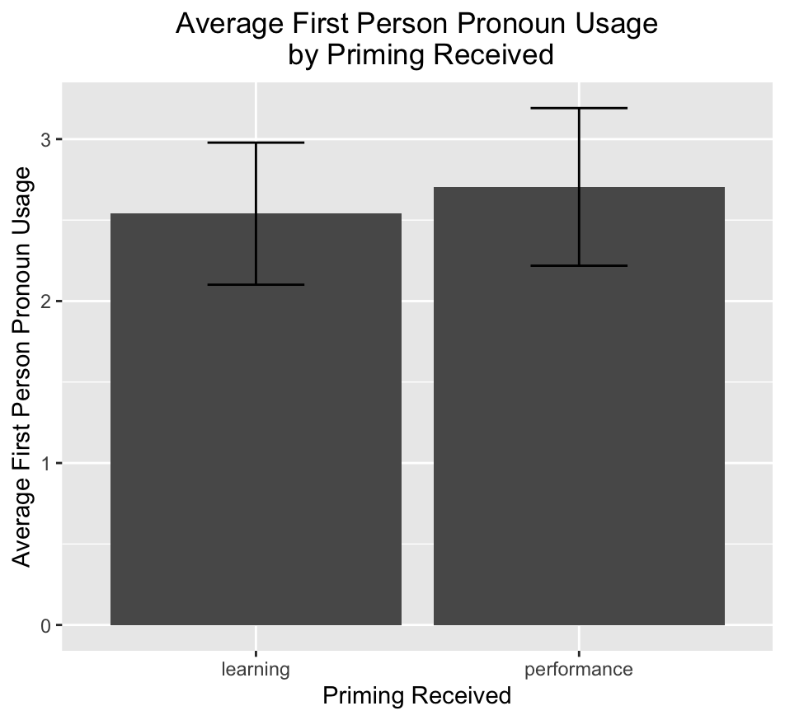
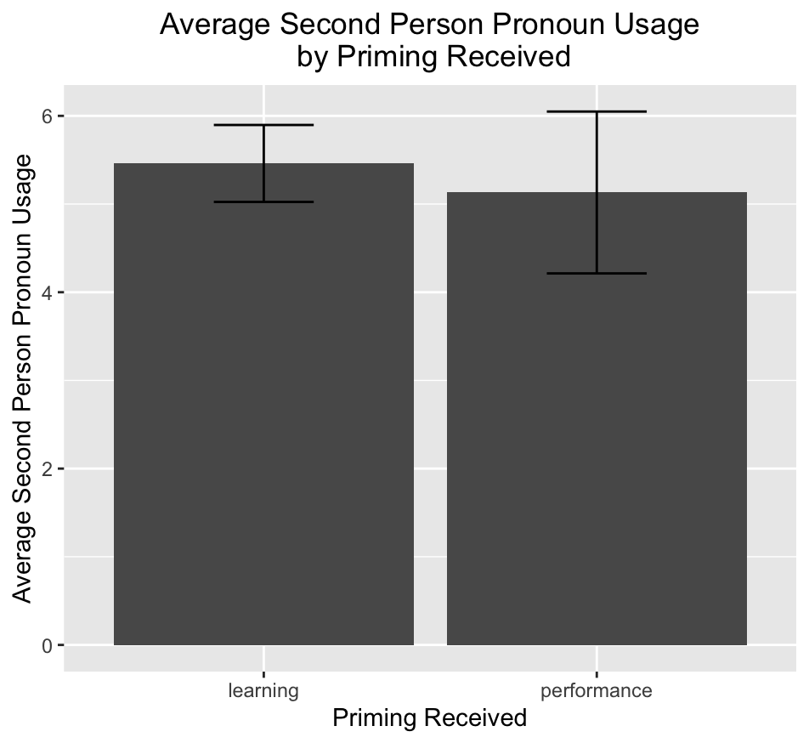
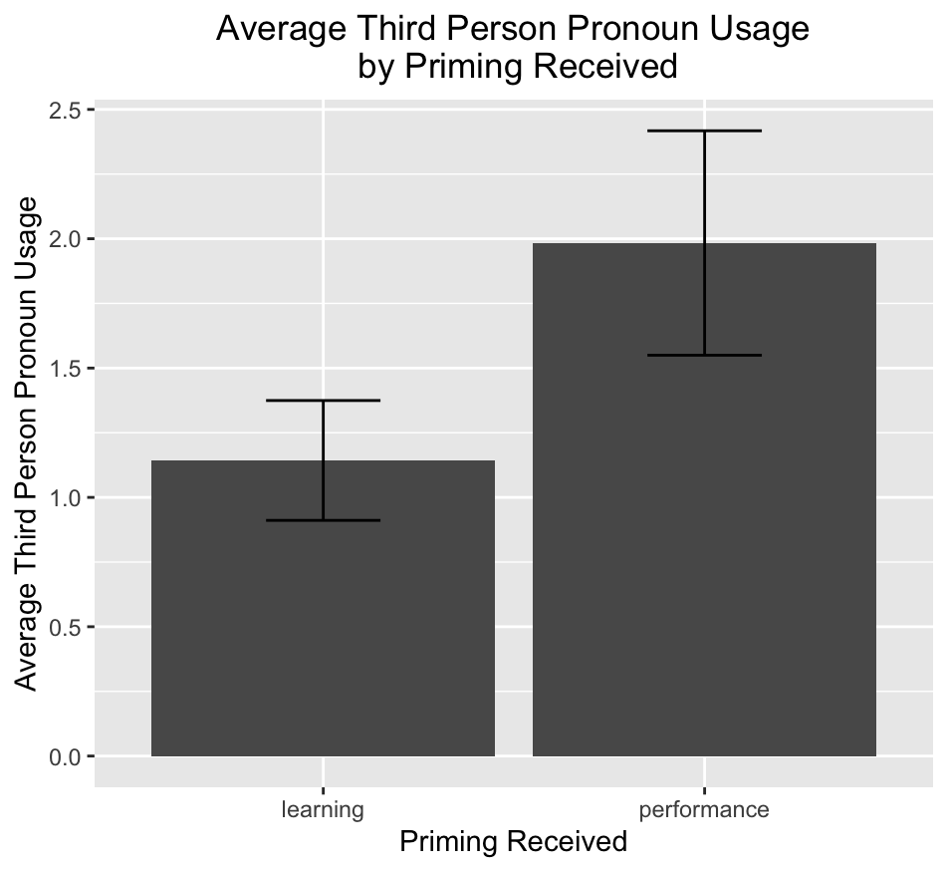
Survey Responses Dependent on Priming Received
Participants who received the performance priming used more first person and less second person pronouns in their letter of support. These differences likely aren’t significant.
Potentially significant difference in the usage of third person pronouns
Notes:
Kaylee

Slide 16
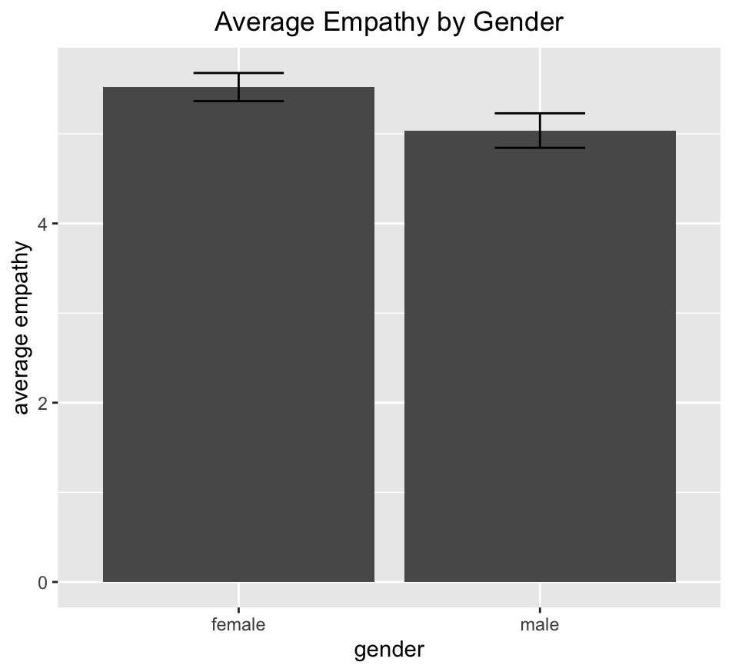
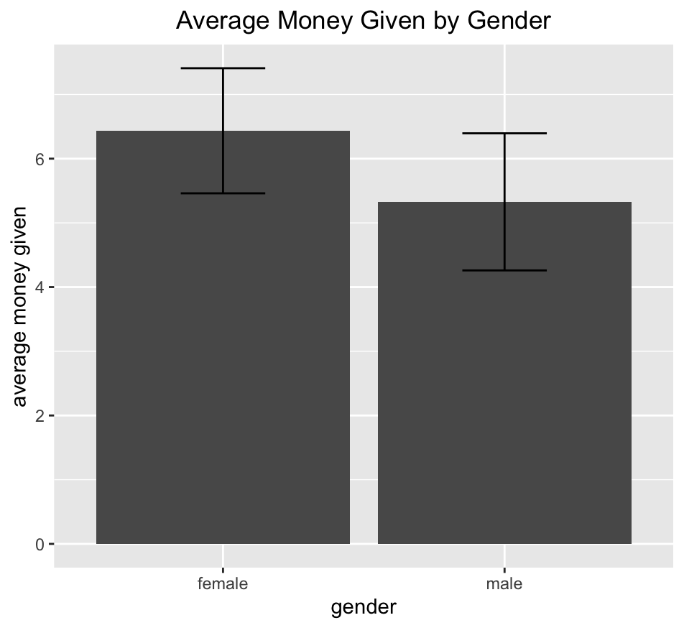
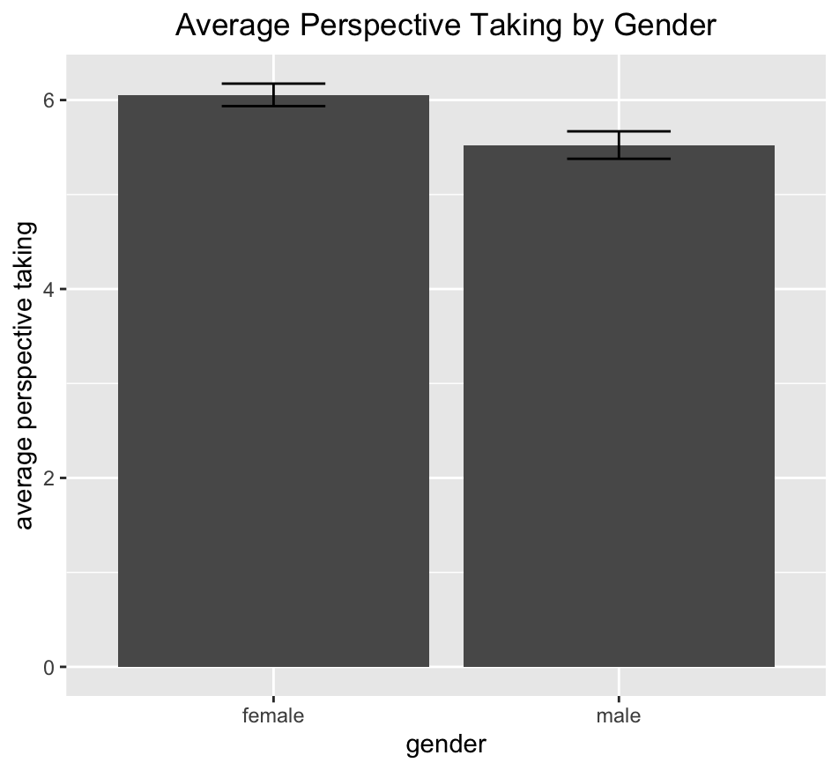
Survey Responses Dependent on Gender
Females expressed more empathy and had an easier time understanding the stranger they read about. Also tended to give more money, but this difference may not have been statistically significant.
Notes:
Jaqueline
Note that money given is a measure of altruism

Slide 17
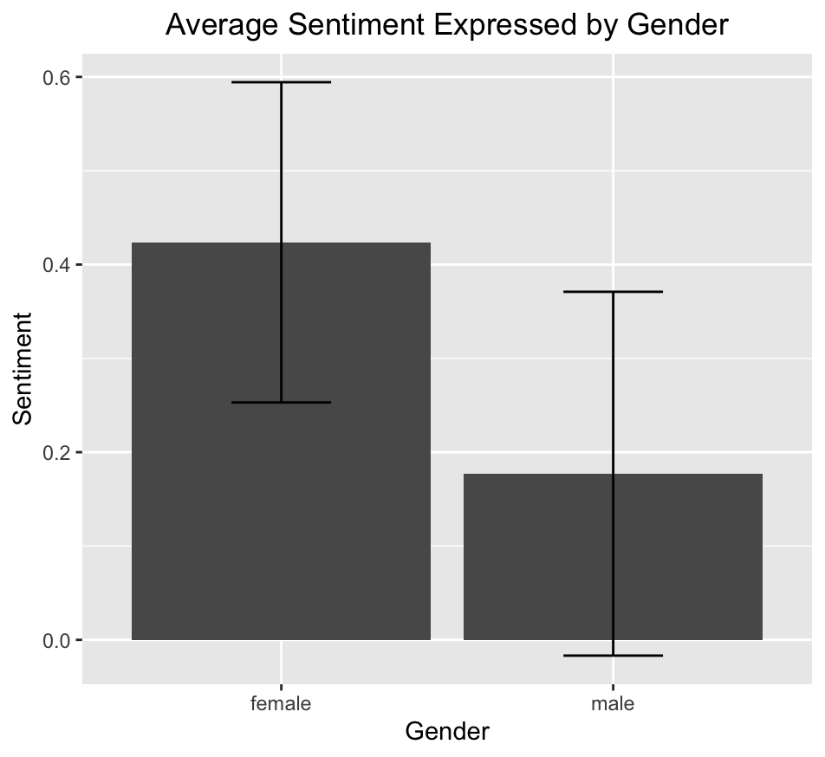
Survey Responses Dependent on Gender
No significant difference in the average sentiment expressed by gender, but females tended to express more positivity in this sample
Notes:
Jaqueline

Slide 18
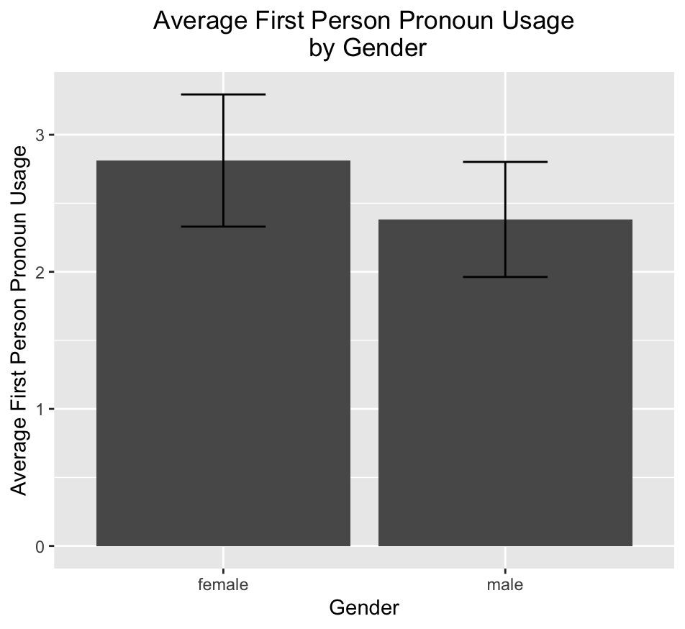
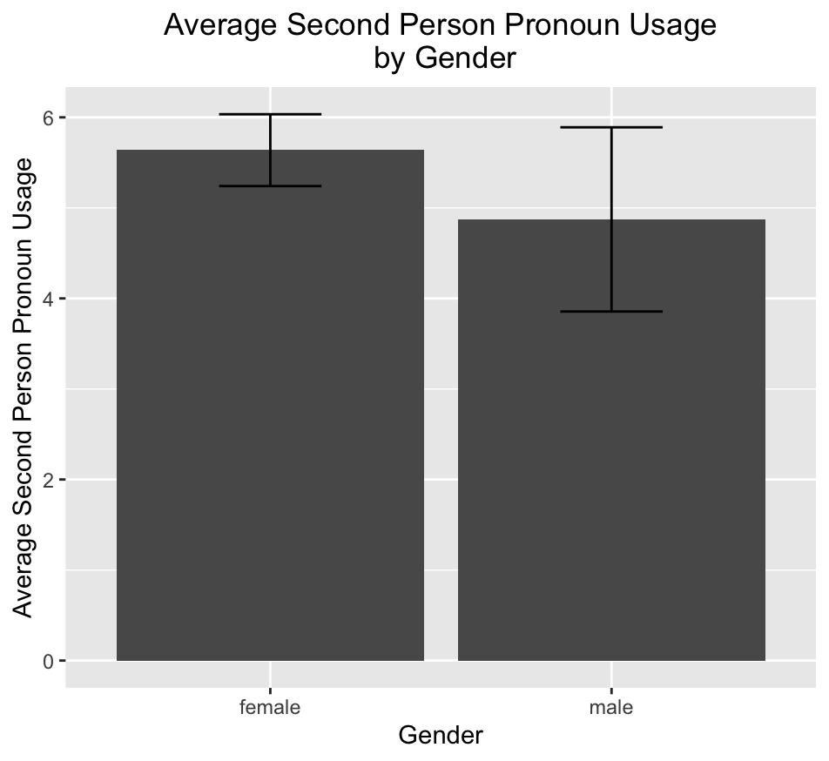
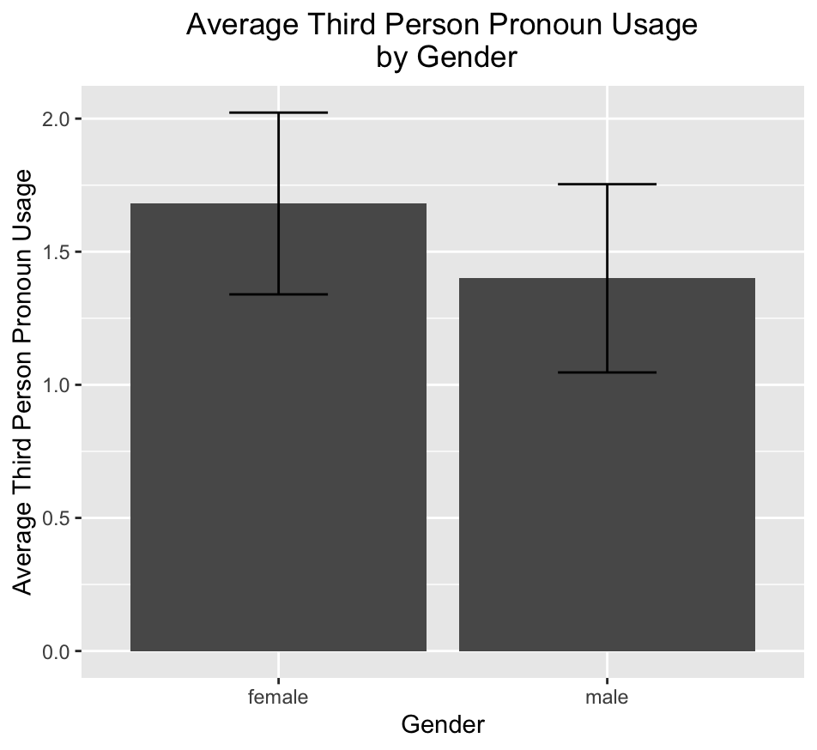
Survey Responses Dependent on Gender
Likely no significant differences in pronoun usage, but females tended to use more of all types of pronouns within this sample
Notes:
Jaqueline

Slide 19
Hypotheses
Likely not able to detect which group someone was in (in-group or out-group) based on their responses to the questions in the survey
May be able to predict which priming someone received based on their survey responses, particularly those related to empathy, perspective taking, sentiment expressed and pronoun usage in the letter of support
May be able to predict which gender someone is based on their survey responses, particularly those related to empathy and perspective taking
Notes:
Kennedy

Slide 20
Modeling

Slide 21
Modeling Assumptions & Justifications
Respondents took the survey seriously
Only white participants included and data potentially not missing at random, so should be careful generalizing beyond this sample
Logistic regression is a good model for our purposes
Responses represent what we think they do
Low compensation provided for completing the survey and only white participants included
Good for classification tasks, such as classifying people as in/out-group, their priming received, and their gender. Also easy to interpret the coefficients.
Model converges on a solution quicker and ensures equal contribution of predictors
Risk of overfitting due to small sample size
More interested in accurate predictions than reducing false positives or negatives
Should scale features
Should use a penalty for the predictors and 70/30 split for the training and test datasets
Accuracy is a good metric to assess our model with
Notes:
Kennedy
4 classification tasks, of which you will see 3

Slide 22
Discussion

Slide 23
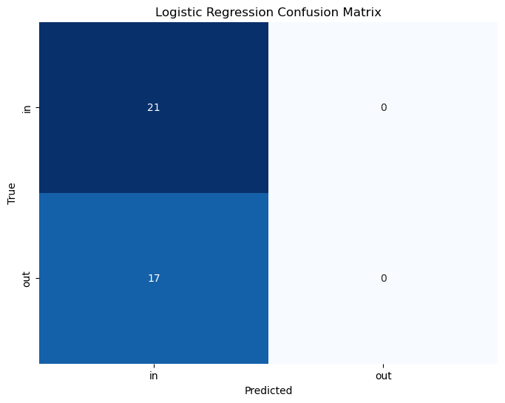
Classifying In-Group Vs. Out-Group
Predictors: perspective taking, empathy, altruism, sentiment expressed, and pronoun usage
Results: All coefficients set to 0 and accuracy = 55%
Conclusion: No difference in how participants treated in-group and out-group members. In-group bias might not exist in this sample.
Notes:
Kennedy
In line with EDA

Slide 24
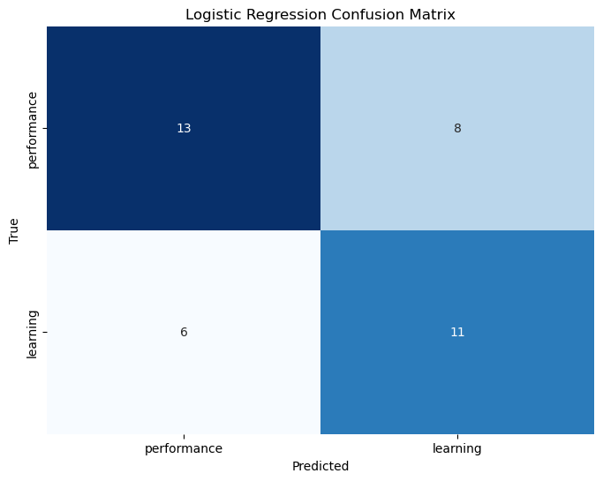
Predicting Priming Received
Predictors: perspective taking, empathy, altruism, average sentiment, and pronoun usage
Results:
The odds of being part of the learning group were most influenced by: greater empathy (β = 0.71), greater altruism (β = -0.21), greater 2nd person pronoun usage β = 0.14), and less 1st and 3rd person pronoun usage (β = -0.23, β = -0.44)
Accuracy = 63%
Conclusions:
Poor performance so conclusions are tentative
Respondents may have responded slightly differently depending on the priming they received
Priming may have particularly affected empathy and could be useful tool for increasing empathy
Notes:
Kirsten
Just pulled some of the predictors with the largest coefficients, but these weren’t the only coefficients used to predicting the priming received

Slide 25
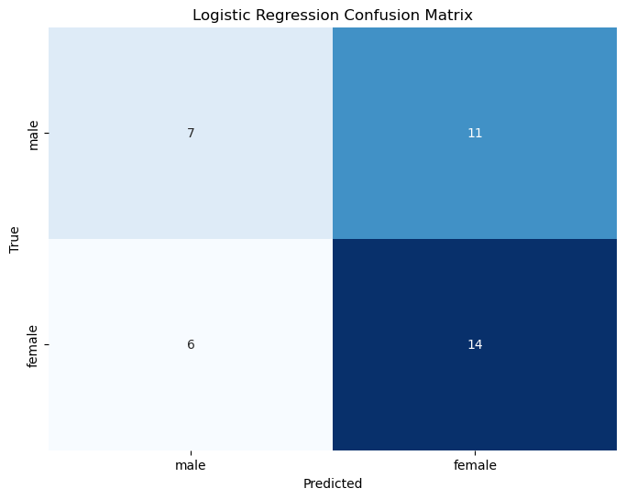
Predicting Gender
Predictors: perspective taking, empathy, altruism, average sentiment, and pronoun usage
Results:
Odds that someone was female most influenced by: greater ease of perspective taking (β = -0.29), greater empathy (β = 0.23), and greater use of positive language (β = 0.22)
Accuracy = 55%
Conclusions:
Poor performance of the model, so the differences in survey responses aren’t consistent
Most influential predictors are interesting nonetheless
Notes:
Kirsten
The coefficient for greater ease of perspective taking is specifically for the first perspective taking question

Slide 26
Limitations & future work
Possible that in-group bias didn’t exist within this sample because the priming obscured differences, particularly differences in empathy
Should be careful about drawing any conclusions from this data due to the exploratory nature of this project, the small sample size, and questionable data quality
Further exploration and formal hypothesis testing necessary to draw any formal conclusions but it could be particularly interesting to investigate if priming could be used as a tool to increase empathy
Notes:
Kirsten

Slide 27
Questions?

Slide 28
Bibliography
Bettencourt, B.A., Charlton, K., & Kernahan, C. (1997). Numerical Representation of Groups in Cooperative Settings: Social Orientation Effects on Ingroup Bias. Journal of Experimental Social Psychology, 33 (6): 630–59. https://doi.org/10.1006/jesp.1997.1334.
Wang, C., Wu, B., Liu, Y., Wu,X., & Han, S. (2015). Challenging Emotional Prejudice by Changing Self-Concept: Priming Independent Self-Construal Reduces Racial in-Group Bias in Neural Responses to Other’s Pain. Social Cognitive and Affective Neuroscience, 10. (9): 1195–1201. https://doi.org/10.1093/scan/nsv005.

