Slide 1
CSC 380: Foundations of Artificial Intelligence CSC 480: Artificial Intelligence I Assignment 2: Dots and Boxes Jonathan F. Gemmell School of Computing DePaul University

Slide 2
Dots and Boxes
Dots and Boxes is a pencil-and-paper game for two players (sometimes more). It was first published in the 19th century by Édouard Lucas, who called it la pipopipette. It has gone by many other names, including the game of dots, boxes, dot to dot grid, and pigs in a pen.
Starting with an empty grid of dots, two players take turns adding a single horizontal or vertical line between two unjoined adjacent dots. The player who completes the fourth side of a 1×1 box earns one point and takes another turn. (A point is typically recorded by placing a mark that identifies the player in the box, such as an initial.) The game ends when no more lines can be placed. The winner is the player with the most points. The board may be of any size. When short on time, a 2×2 board (a square of 9 dots) is good for beginners. A 5×5 is good for experts.

Slide 3
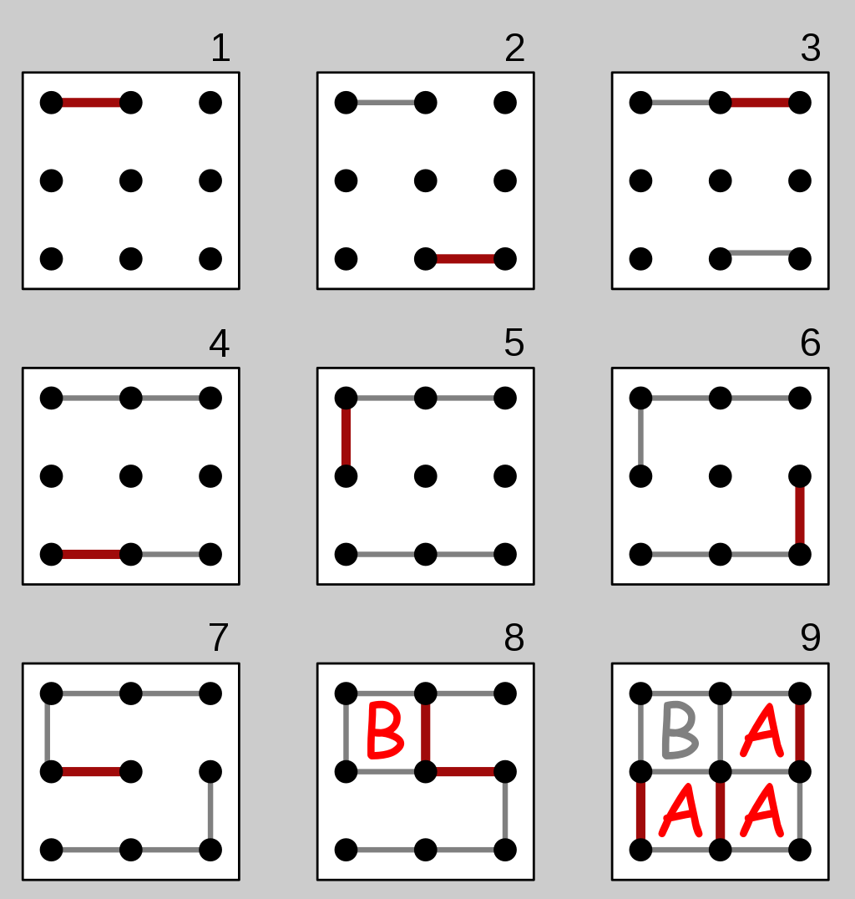
Dots and Boxes
The diagram on the right shows a game being played on the 2×2 board. The second player (B) plays the mirror image of the first player's move, hoping to divide the board into two pieces and tie the game. But the first player (A) makes a sacrifice at move 7 and B accepts the sacrifice, getting one box. However, B must now add another line, and connects the center dot to the center-right dot, causing the remaining boxes to be joined together in a chain (shown at the end of move 8). With A's next move, player A gets them all and wins 3–1.

Slide 4
Weighted Dots and Boxes
The game you implement will be slightly different than the traditional dots-and-boxes.
A player will **not** move again after completing a box.
When the game board is generated each box will be given a random value between 1 and 5.
A player’s score will be the sum of the values of the boxes claimed.
1 | 2 | 5 | 2
3 | 2 | 1 | 3
5 | 4 | 3 | 1
3 | 4 | 4 | 5

Slide 5
The AI
The AI will rely on the minimax algorithm to choose which dots to connect.
When the game starts the human player will choose
how many plys the AI will search.
The size of the board.
Use the scoring function to evaluate the leaves of the tree.
score(black) – score(white)
Graduate students have the additional requirement of implementing alpha-beta pruning.

Slide 6
Deliverables
You will deliver
Code
YouTube video (include the link at the top of your write up)
Write up
Submissions that do not include all three deliverables WILL NOT be graded
DO NOT ZIP YOUR CODE OR WRITE UP. SUBMIT EACH FILE SEPERATELY.

Slide 7
Code (60 points)
Function (20 points)
The code works as intended
A pleasant user interface (Just a text interface is fine)
Implementation (20 points)
Code demonstrates the author’s understanding of the algorithms
Code should be efficient
No spaghetti code
Code aesthetics (20 points)
Proper use of white space, structure, variable names, etc.
Code is appropriately commented
Every method/function/script should be commented
I will return assignments to you ungraded if I cannot read your code
Code should be well organized and adhere to modern programming standards

Slide 8
Video (20 points)
YouTube video
5 minutes. No more! I will stop watching after five minute.
Video capture of your desktop with voice over
Demonstrate your code running (not more than 1 minute)
Play through the first part of a game explaining your strategy.
Present your code
Describe/show how you modeled Weighted Dots-and-Boxes
Gameboard, moves, scoring, etc.
Describe/show how you implemented minimax
I need to see how your values percolate up the tree.
Describe/show how you implemented alpha-beta pruning (grads only)
I need to see the structure of your nodes and how you store alphas and betas.
I need to see how you compare alphas and betas to ignore a branch.
Leave the analysis for the written report. The video is about showing me you mastered the concepts needed to write the code.

Slide 9
Write up (20 points)
At the top of the document, include the link for the YouTube video
DOUBLE CHECK THE VIDEO IS ACCESSABLE
Play the game several times experimenting with different values for the number of plys evaluated and board sizes.
Give a subjective evaluation…
What values for the number of plys or board size makes the game easy, challenging, too challenging? Explain how this would impact the human’s experience with the game.
What values for the number of plys or board size makes the game run too slow? Is there a tradeoff between creating a challenging experience and the time it takes for the AI to make a move.
How much deeper into the tree can the AI explore using alpha-beta pruning? Does this change your answer to the first two questions? (Grad only)

Slide 10
POST
Forums
Post early
Post often
Post ideas
Post questions
Post helpful answers
Post good humored jokes
!!!!! Do not post code or solutions !!!!!

