Slide 1
From Care Plans to Care Coordination: Opportunities for Computer Support of Teamwork in Complex Healthcare
Ofra Amir, Barbara Grosz, Krzysztof Gajos
Harvard School of Engineering and Applied Sciences
Sonja Swenson, Lee Sanders
Stanford University

Slide 2




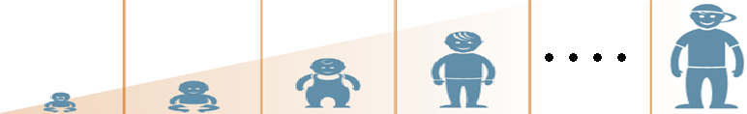





The Care for Children with Complex Chronic Conditions
Neurologist
Physical Therapist
Speech Therapist
GI
The Problem: care for children with complex conditions is poorly coordinated, leading to unmet health needs and preventable health care crises
Primary Care Provider
Parents
Health aide
Teacher
Camp counselor
School nurse

Slide 3
Team-Based Care Plans for Improved Coordination (LPFCH, 2014)
Goals | Actions | Caregivers
Move to oral feeds | Improve mouth muscle tone Adjust formula for weight gain | PCP, GI, OT, nutritionist
Start daycare | Minimize need for tube feeds Assess therapy needs | Parents, PCP, nutritionist, home nurse
Go on family trip | Arrange portable equipment Arrange funding and transportation | Parents, PCP, PT, social worker
Rationale: everybody “on the same page”
In practice: rarely deployed or consulted

Slide 4
Contributions
A qualitative study of complex care teams
Care coordination challenges
Barriers to effective care plan implementation
Defining “FLECS” teamwork characteristics
Foundations for technology design based on a computational teamwork theory

Slide 5
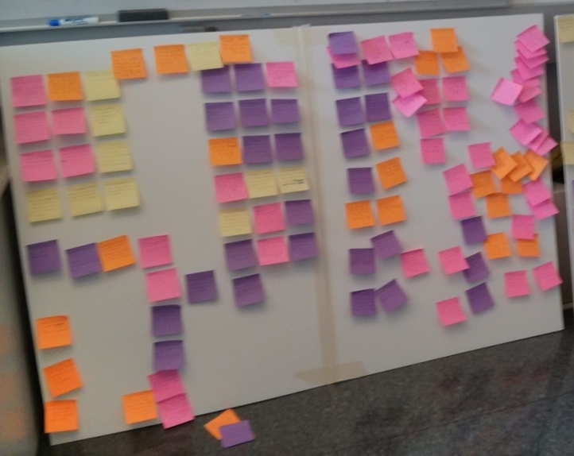
Study of Complex Care Teams
Goal: understand care coordination challenges
Interviews and observations of team members:
Parents (13)
Primary care providers (4)
Specialists (4)
Therapists (8)
Care coordinator (1)
Program directors (2)
Family services coordinator (1)
Social worker (1)
Analyzed using affinity diagramming

Slide 6
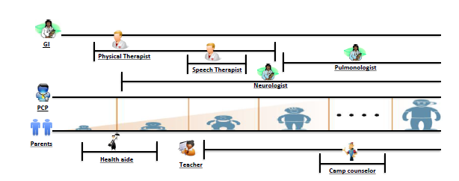
Barriers to Effective Care Plan Use: Complex Teamwork in Complex Care
“FLECS” teamwork characteristics:
Flat-structure of team
Loosely coupled plans and activities
Extended duration of plans
Continual distributed revision of plans
Syncopated time scales

Slide 7
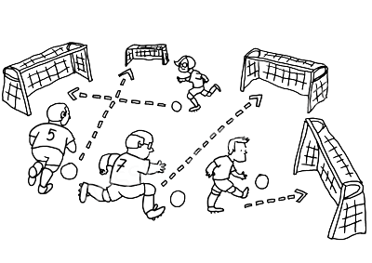
Flat Structure
No single person in charge:
“We have different goals for different specialists; it is hard to keep track.” (parent)
Need to prioritize goals because “everyone wants to work on everything.” (parent)

Slide 8
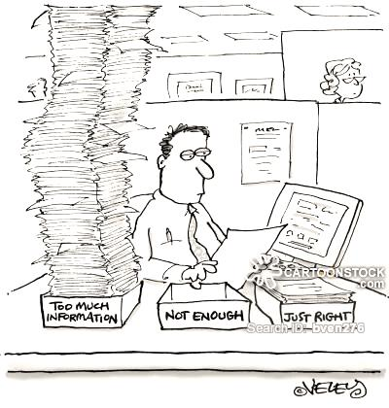
Loosely Coupled Activities
Loose coupling makes appropriate information sharing hard:
“There isn’t an example when I wasn’t missing information” (specialist)
“We need to relay information back and forth...” (parent)

Slide 9
Extended Duration, Continual Distributed Plan Revision
No mechanism to support plan revision:
Full-team meetings “totally not scalable” (specialist)
“All the status chats have to be provider initiated, and so if you don’t remember to do it or there’s no one coordinating it, it’s like where is it going, where do you even look for it?” (specialist)

Slide 10
Syncopated Time Scales
Different frequencies of seeing the patient
Primary care providers: 3 to 4 times a year
Specialists: 2 to 3 time a year
Therapists: 1 to 3 times a week
Different information needs:
“A doctor asks if she is walking and expects a yes/no answer; a physical therapist will ask how she is walking and how much progress she has made.” (parent)

Slide 11
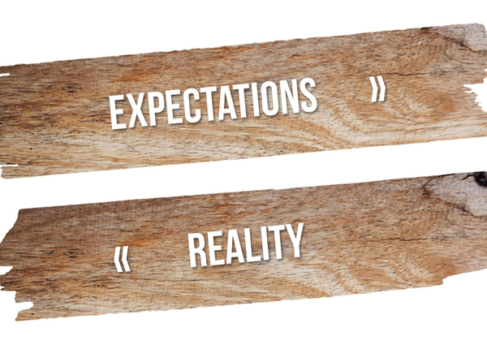
Team-Based Care Plans: Ideal vs. Reality
FLECS teamwork poses coordination challenges
Principles for successful care plan use (LPFCH, 2014) do not hold:
“The plan of care is systematized as a common, shared document; it is used consistently by every provider…”
“The team monitors progress against goals, provides feedback and adjusts the plan of care on an ongoing basis…”
“Family-centered care teams can access the information they need to make shared, informed decisions.”
How can technology better support such complex teamwork?

Slide 12
Technology for Supporting Teamwork
FLECS teamwork goes beyond prior work
Supporting healthcare teams
Temporal coordination (Bardram 2000)
Centralized re-planning (Bardram 2010)
Mobile home care teams (Pinelle & Gutwin 2006)
CSCW and social science teamwork theories and tools (Hutchins 1996 ; Star & Griesemer 1989; Hinds and McGrath 2006; Reddy & Spence 2008;…)

Slide 13
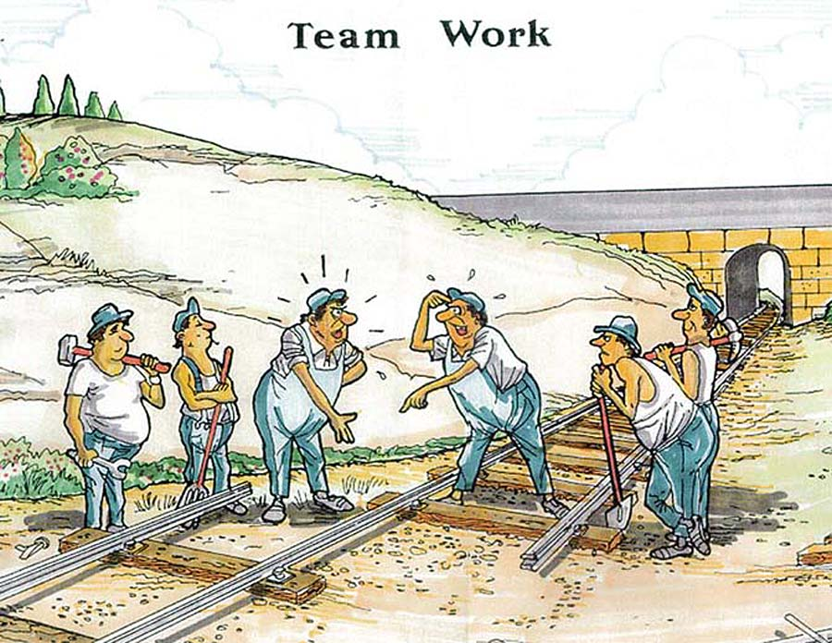
Foundations for Design of Systems to Support Complex Care Teams
SharedPlans (Grosz & Kraus 1996) :
A computational theory of collaboration
“..the capabilities needed for collaboration cannot be patched on but must be designed in from the start. "

Slide 14
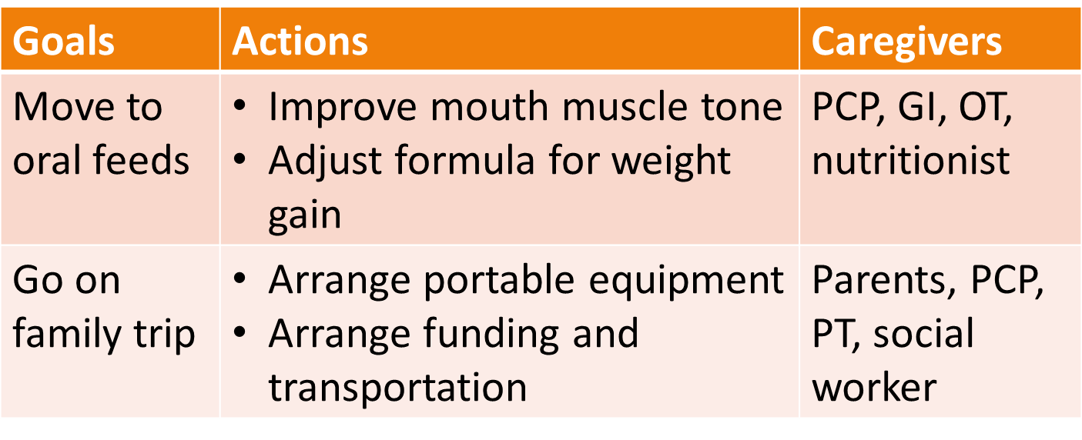
SharedPlans Representation
follow family priorities
{parents, primary care provider, specialists, therapists, community members}
move to oral feeds
{primary care provider, gastroenterologist, occupational therapist, nutritionist}
go on family trip
{primary care provider, physical therapist, social worker}
improve mouth muscle tone
adjust formula
arrange equipment
funding & transportation
{…}
{…}
{…}
{…}

Slide 15
SharedPlans Representation
follow family priorities
{parents, primary care provider, specialists, therapists, community members}
move to oral feeds
{primary care provider, gastroenterologist, occupational therapist, nutritionist}
go on family trip
{primary care provider, physical therapist, social worker}
improve mouth muscle tone
adjust formula
arrange equipment
funding & transportation
{…}
{…}
{…}
{…}

Slide 16
SharedPlans Representation
follow family priorities
{parents, primary care provider, specialists, therapists, community members}
move to oral feeds
{primary care provider, gastroenterologist, occupational therapist, nutritionist}
go on family trip
{primary care provider, physical therapist, social worker}
improve mouth muscle tone
adjust formula
arrange equipment
funding & transportation
{…}
{…}
{…}
{…}

Slide 17
Agreement on High-Level Approach, Mutual Beliefs
follow family priorities
{parents, primary care provider, specialists, therapists, community members}
move to oral feeds
{primary care provider, gastroenterologist, occupational therapist, nutritionist}
{primary care provider, physical therapist, social worker}
go on family trip
improve mouth muscle tone
adjust formula
arrange equipment
funding & transportation
{…}
{…}
{…}
{…}

Slide 18
Agreement on High-Level Approach, Mutual Beliefs
Current Systems:
care plans are not integrated
no adaptation of plan information
Opportunity for Technology Support:
make care plan “ever-present”
adapt presentation to team members

Slide 19
Dynamically Evolving Plans
follow family priorities
{parents, primary care provider, specialists, therapists, community members}
move to oral feeds
{primary care provider, gastroenterologist, occupational therapist, nutritionist}
go on family trip
{primary care provider, physical therapist, social worker}
improve mouth muscle tone
adjust formula
arrange equipment
funding & transportation
{…}
{…}
{…}
{…}
…
…
…
…

Slide 20
Dynamically Evolving Plans
Current Systems:
static, flat representation
Opportunity for Technology Support:
dynamic plan structure
support revision and expansion

Slide 21
Communication and Coordination
follow family priorities
{parents, primary care provider, specialists, therapists, community members}
move to oral feeds
{primary care provider, gastroenterologist, occupational therapist, nutritionist}
go on family trip
{primary care provider, physical therapist, social worker}
improve mouth muscle tone
adjust formula
arrange equipment
funding & transportation
{…}
{…}
{…}
{…}
…
…
…
…

Slide 22
Communication and Coordination
Current Systems:
little organization and context
information overload
Opportunity for Technology Support:
improved information sharing interfaces
reasoning about team members’ context

Slide 23
Key Roles for Technology for Supporting Complex Care Teams
Make the care plan “ever present”
Support plan revision and expansion
Support efficient information sharing
Challenges:
Eliciting plans
Inferring context in plan
Reasoning about information sharing

Slide 24
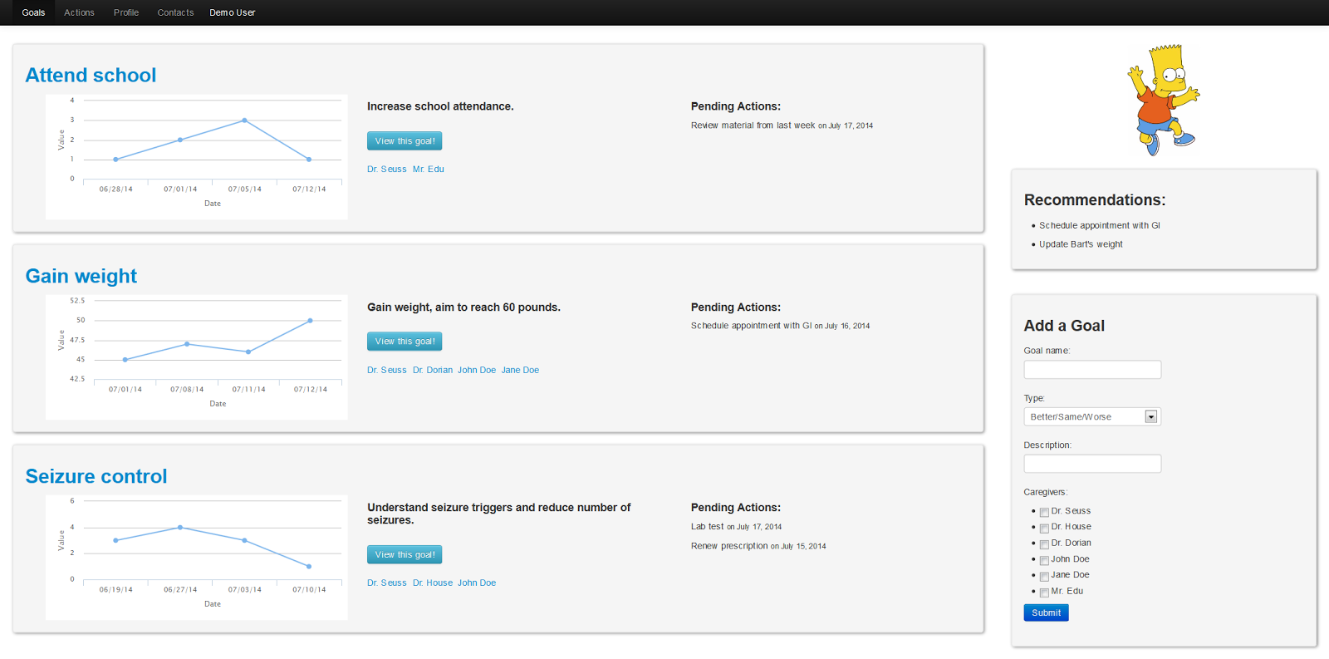
Ongoing Work: GoalKeeper

Slide 25
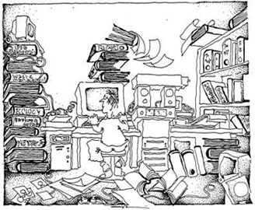




Ongoing Work: Information Sharing Algorithms
What information to share?
When to share information ?
Who to share information with?
How to present information?

Slide 26
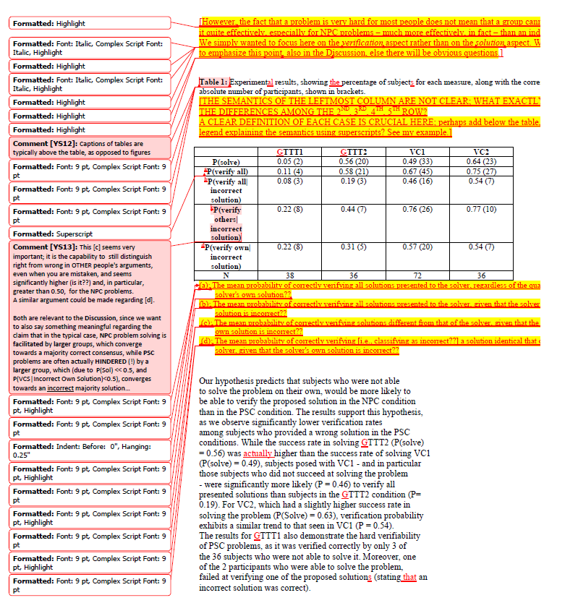
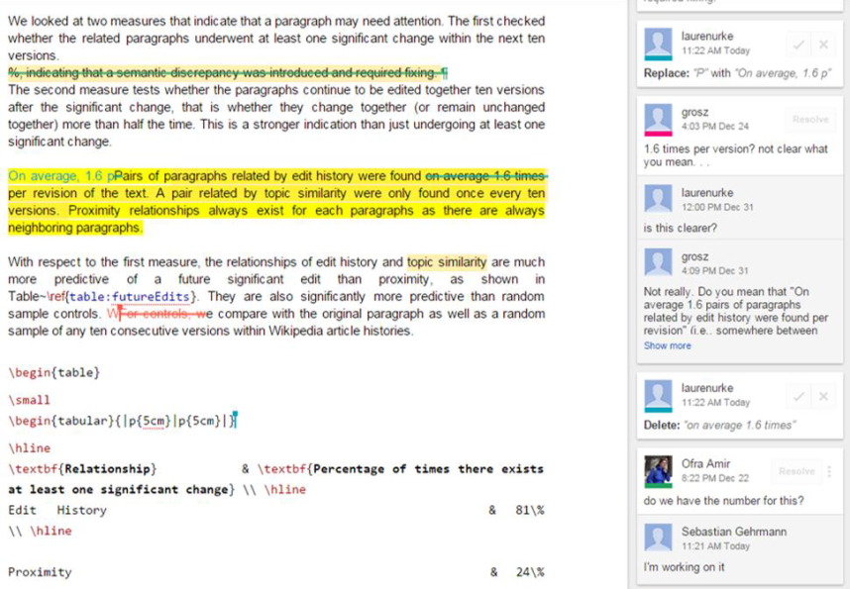
Ongoing Work: Supporting Collaborative Writing
**Come check out our WiP poster today**
Deploying AI Methods to Support Collaborative Writing:
a Preliminary Investigation
Gehrmann, Urke, Amir and Grosz, 2015

Slide 27
Conclusion
Qualitative study of complex care teams
Identifying FLECS teamwork characteristics
Foundations for technology design from computational teamwork theories
Ongoing work toward designing such systems…
Ofra Amir, Barbara Grosz, Krzysztof Gajos
Harvard School of Engineering and Applied Sciences
Sonja Swenson, Lee Sanders
Stanford University

