Slide 1
Query to Knowledge
Unsupervised Entity Extraction from Shopping Queries using Adaptor Grammars
Ke Zhai
Yahoo Labs!

Slide 2
Outline
Motivation – Query to Knowledge
Model – Adaptor Grammar
Framework Pipeline
Empirical Evaluation
Conclusion

Slide 3
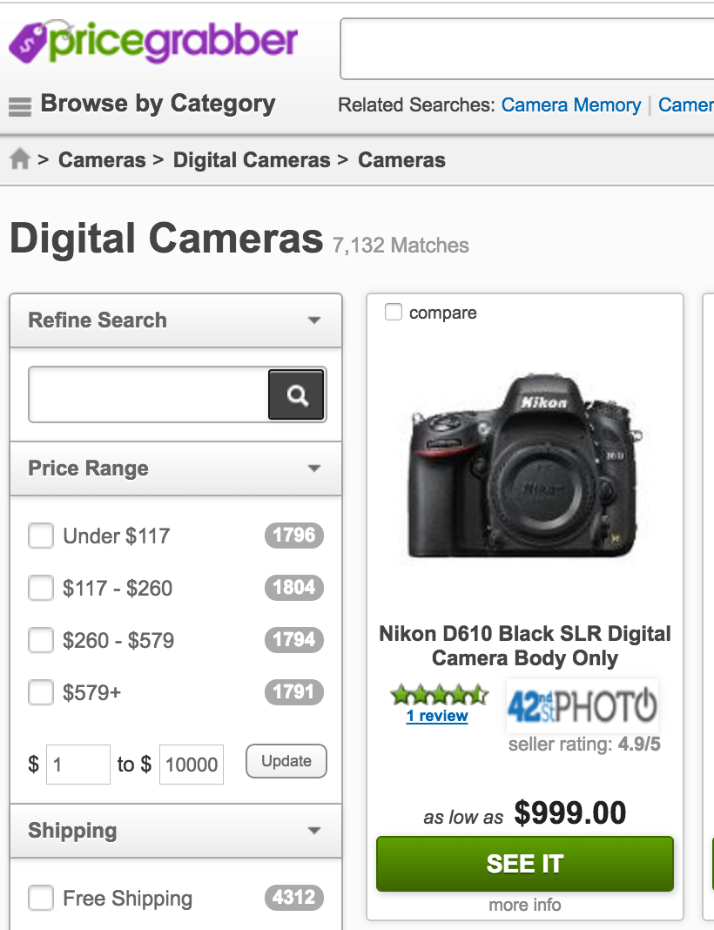
Knowledgebase for Shopping
Knowledgebase is critical
Entity linking
Search ranking
Query understanding
User intent modeling
Assistant chat bot
…
In this work…
Targeting at shopping domain
Brand and product entities
Knowledgebase is expensive
Build
Maintain

Slide 4


Motivation
too faced chocolate soleil bronzer
calvin klein brown tote bag
nikon d3000 digital camera
sally hansen miracle gel
fitbit flex wireless activity sleep wristband
john deere garden tractor
bag boy golf cart accessories
michael kors tote bag
kohler toilet paper holders
calvin klein underwear
…
too faced chocolate soleil bronzer
calvin klein brown tote bag
nikon d3000 digital camera
sally hansen miracle gel
fitbit flex wireless activity sleep wristband
john deere garden tractor
bag boy golf cart accessories
michael kors tote bag
kohler toilet paper holders
calvin klein underwear
…
Brand | Product
too faced | bronzer
calvin klein | tote bag
nikon | digital camera
sally hansen | miracle gel
fitbit | sleep wristband
john deere | garden tractor
bag boy | golf cart accessories
michael kors | toilet paper holders
kohler | underwear
… | …

Slide 5
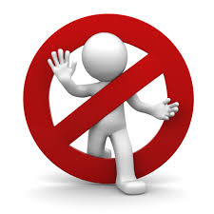

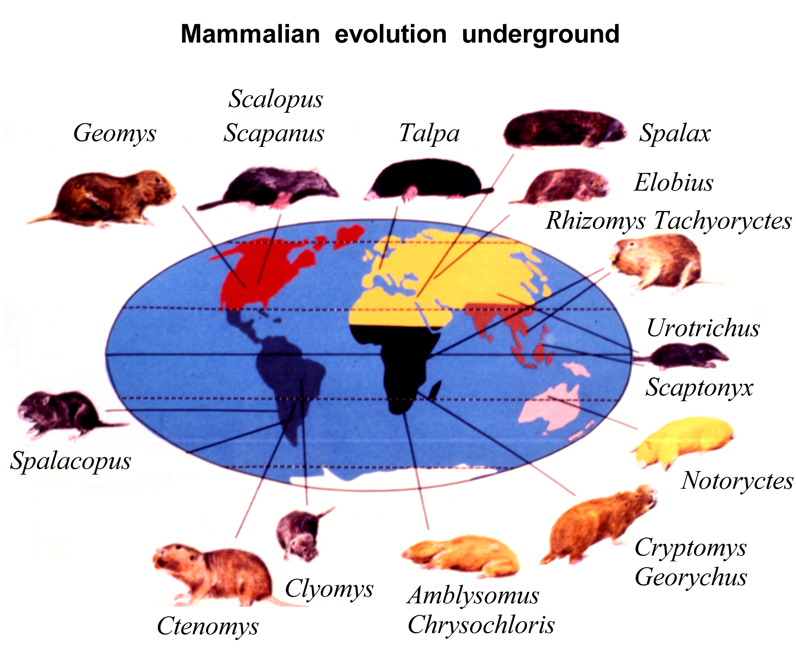

Goals
Unsupervised
Minimum human efforts in the loop
No editorial labeling nor annotation
Robust
Effectively model the data and robust to noise commonly appeared in large scale web query dataset
Domain-independent
Applicable to multiple domains with minimum adaptation efforts
Data-driven
Numbers and granularities of brand and product are not known a priori
Discover more/new brand and product given additional data
Context-free (Domain-independent)
Grammar (Unsupervised)
Probabilistic (Robust)
Non-parametric (Data-driven)
Adaptor Grammar

Slide 6
Probabilistic Context-free Grammar
Query
Brand
Words
Word
pottery
Words
Word
barn
Product
Words
Word
coffee
Words
Word
table
pottery barn coffee table
Prob | Rule
1.0 | Query → Brand Product
1.0 | Brand → Words
1.0 | Product → Words
0.5 | Words → Word Words
0.5 | Words → Word
0.1 | Word → pottery
0.1 | Word → barn
0.1 | Word → coffee
0.1 | Word → table
… | …
Prob | Rule
1.0 | Query → Brand Product
1.0 | Brand → Words
1.0 | Product → Words
0.7 | Words → Word Words
0.3 | Words → Word
0.2 | Word → pottery
0.2 | Word → barn
0.07 | Word → coffee
0.07 | Word → table
… | …
Prob | Rule
1.0 | Query → Brand Product
1.0 | Brand → Words
1.0 | Product → Words
0.5 | Words → Word Words
0.5 | Words → Word
0.1 | Word → pottery
0.1 | Word → barn
0.1 | Word → coffee
0.1 | Word → table
… | …
Query
Brand
Words
Word
pottery
Product
Words
Words
Words
Word
chest
Words
Word
barn
Word
drawer
pottery barn drawer chest
Query
Brand
Words
Word
ashley
Words
Word
zelen
Product
Words
Word
drawer
Words
Word
chest
ashley zelen drawer chest

Slide 7
Adaptor Grammar (Johnson et al., 2007)
Query
Brand
Words
Word
pottery
Words
Word
barn
Product
Words
Word
coffee
Words
Word
table
Prob | Rule
1.0 | Query → Brand Product
1.0 | Brand → Words
1.0 | Product → Words
0.7 | Words → Word Words
0.3 | Words → Word
0.1 | Word → pottery
0.1 | Word → barn
0.2 | Word → coffee
0.2 | Word → table
 | …
Prob | Rule
1.0 | Query → Brand Product
0.81 | Brand → Words
0.75 | Product → Words
0.7 | Words → Word Words
0.3 | Words → Word
0.1 | Word → pottery
0.1 | Word → barn
0.2 | Word → coffee
0.2 | Word → table
 | …
0.19 | Brand → pottery barn
0.25 | Product → coffee table
Prob | Rule
1.0 | Query → Brand Product
1.0 | Brand → Words
1.0 | Product → Words
0.7 | Words → Word Words
0.3 | Words → Word
0.1 | Word → pottery
0.1 | Word → barn
0.2 | Word → coffee
0.2 | Word → table
 | …
Brand
Words
Word
pottery
Words
Word
barn
Product
Words
Word
coffee
Words
Word
table

Slide 8
Adaptor Grammar (Johnson et al., 2007)
Dirichlet Process (Chinese Restaurant Franchise)
adjust the supports + maintain valid distribution

Slide 9
All about “Proper” Rules
…
all in one remote control
amazon fire tv remote control
best home theater remote control
best remote control
best rf remote control
big button tv remote control
boombox with remote control
bose wave music system remote control
buy remote control
code for dish remote control
comcast controller codes remote control
curtis mathes remote control
directv universal remote control
dish network program remote control
dish network replacement remote control
dish remote control
dji phantom remote control
dta800b1 remote control
emerson universal remote control
fujitsu remote control
genesis remote control
hisense tv codes universal remote control
home theater remote control
…
Prob | Rule
1.0 | Query → Brand Product
0.75 | Brand → Words
0.93 | Product → Words
0.7 | Words → Word Words
0.3 | Words → Word
0.1 | Word → pottery
0.1 | Word → barn
0.2 | Word → coffee
0.2 | Word → table
 | …
0.07 | Product→ control
 | …
Prob | Rule
1.0 | Query → Brand Product
0.75 | Brand → Words
0.92 | Product → Words
0.7 | Words → Word Words
0.3 | Words → Word
0.1 | Word → pottery
0.1 | Word → barn
0.2 | Word → coffee
0.2 | Word → table
 | …
0.01 | Product → remote control
0.07 | Product → control
 | …

Slide 10
All about “Proper” Rules
…
all in one remote control
amazon fire tv remote control
best home theater remote control
best remote control
best rf remote control
big button tv remote control
boombox with remote control
bose wave music system remote control
buy remote control
code for dish remote control
comcast controller codes remote control
curtis mathes remote control
directv universal remote control
dish network program remote control
dish network replacement remote control
dish remote control
dji phantom remote control
dta800b1 remote control
emerson universal remote control
fujitsu remote control
genesis remote control
hisense tv codes universal remote control
home theater remote control
…
Prob | Rule
1.0 | Query → Brand Product
0.76 | Brand → Words
0.92 | Product → Words
0.7 | Words → Word Words
0.3 | Words → Word
0.1 | Word → pottery
0.1 | Word → barn
0.2 | Word → coffee
0.2 | Word → table
 | …
0.01 | Product → remote control
0.07 | Product → control
 | …
Prob | Rule
1.0 | Query → Brand Product
0.74 | Brand → Words
0.92 | Product → Words
0.7 | Words → Word Words
0.3 | Words → Word
0.1 | Word → pottery
0.1 | Word → barn
0.2 | Word → coffee
0.2 | Word → table
 | …
0.08 | Product → remote control
0 | Product → control
 | …

Slide 11
Granularity – All about “Proper” Rules
Adaptor grammar offers a good balance
Conservative adapted rules:
Can be used to parse multiple instances
Requires additional efforts to parse some specific instances
Example:
Product → phone
Product → table
…
Aggressive adapted rules:
Easy to parse more specific instances
Lose representation power to parse more generic instances
Example:
Product → android smart phone
Product → toilet paper towel holder
…
Product granularity
Phone
Smart phone
Android smart phone
…
Table
Coffee table
Round coffee table
Glass round coffee table
…
Holder
Towel holder
Paper towel holder
Toilet paper towel holder
…

Slide 12
Framework Pipeline
Preprocessing
Standardization
Aggregate/reduce a query family to its most frequent pattern.
Grammar Rules
Query Patterns
Informational
Navigational
Transactional
which, what, why, …
www, com, site, …
# best, top #, …
Stopwords
Marketing events
promo, sale, …
Working Condition
used, refurbished, …
Shopping fashion
online, shopping, …
…
Chunk+Prep
Chunk+Prep+Mod
Query → Brand
Query → ModProd
Query → Query PrepPhrase
Brand → Words
Product → Words
Query → Brand ModProd
ModProd → Words
ModProd → Modifier Product
PrepPhrase → Prep Words
Prep → for|to|by|with|…
Words → Word Words
Words → Word
Word → …
Chunk
air optix contact lenses | 98.00%
contact lenses air optix | 1.06%
optix air contact lenses | 0.94%
➔
air optix contact lenses
paul mitchell neuro flat iron | 98.70%
paul mitchell flat iron neuro | 0.65%
neuro paul mitchell flat iron | 0.65%
➔
paul mitchell neuro flat iron

Slide 13
Chunk+Prep+Mod Grammar
Query
Brand
Words
Word
Words
Word
Product
Words
Word
Words
Word
PrepPhrase
ModifierProduct
Modifier
Words
Word
Words
Word
Words
Prep
Word
Words
Word
Query → Brand
Query → ModProd
Query → Brand ModProd
Query → Query PrepPhrase
Brand → Words
Product → Words
ModProd → Words
ModProd → Modifier Product
PrepPhrase → Prep Words
Prep → for|to|by|with|…
Words → Word Words
Words → Word

Slide 14
Experiments
Raw queries
Collected over 9 months, across five different domains
Baseline
Probabilistic context-free grammar (without adaptors)
Semi-supervised method with entity seeds (Pasca, CIKM 2007)
Evaluation
Intrinsic: Qualitative results and Precision @ Rank
Extrinsic: Query understand task
 | total queries | unique queries | queries after standardization
Apparel | 561M | 906K | 535K
Electronics | 218M | 444K | 160K
Health & Beauty | 222M | 625K | 176K
Home & Garden | 359M | 1068K | 554K
Sporting Goods | 148M | 412K | 206K

Slide 15
Discovered Entities (1/2)
 | Apparel | Electronics | Health & Beauty | Home & Garden | Sporting Goods
Brand | michael kors | samsung | estee lauder | home depot | under armour
 | north face | sony | gnc | walmart | dallas cowboys
 | under armour | dell | walmart | john deere | nike
 | vera bradley | verizon | urban decay | sears | green bay packers
 | kate spade | apple | mac | target | denver broncos
 | alex and ani | walmart | opi | lowes | chicago bears
 | tiffany and co | bose | neutrogena | craftsman | seahawks
 | columbia | rca | lancome | hamilton beach | notre dame
 | oakley | at t | bath and body works | battery operated | orleans saints
 | dooney and bourke | straight talk | too faced | bed bath and beyond | adidas
Product | running shoes | printer | supplement | lights | apparel
 | wedding dresses | phone | hair products | chairs | jacket
 | handbags | tablet | nail polish | curtains | accessories
 | engagement ring | cell phone | soap | lamps | bike
 | hats | remote control | lipstick | pillows | hoodie
 | jeans | phone cases | eyeglass frames | cabinets | backpack
 | necklace | cable | essential oil | bed | knife
 | watch | ink cartridges | contact lenses | coffee table | pants
 | rain boots | printers | protein powder | lighting fixtures | helmet
 | sunglasses | adapter | shampoo and conditioner | shower curtain | socks
 | Apparel | Electronics | Health & Beauty | Home & Garden | Sporting Goods
Brand | michael kors | samsung | estee lauder | home depot | under armour
 | north face | sony | gnc | walmart | dallas cowboys
 | under armour | dell | walmart | john deere | nike
 | vera bradley | verizon | urban decay | sears | green bay packers
 | kate spade | apple | mac | target | denver broncos
 | alex and ani | walmart | opi | lowes | chicago bears
 | tiffany and co | bose | neutrogena | craftsman | seahawks
 | columbia | rca | lancome | hamilton beach | notre dame
 | oakley | at t | bath and body works | battery operated | orleans saints
 | dooney and bourke | straight talk | too faced | bed bath and beyond | adidas
Product | running shoes | printer | supplement | lights | apparel
 | wedding dresses | phone | hair products | chairs | jacket
 | handbags | tablet | nail polish | curtains | accessories
 | engagement ring | cell phone | soap | lamps | bike
 | hats | remote control | lipstick | pillows | hoodie
 | jeans | phone cases | eyeglass frames | cabinets | backpack
 | necklace | cable | essential oil | bed | knife
 | watch | ink cartridges | contact lenses | coffee table | pants
 | rain boots | printers | protein powder | lighting fixtures | helmet
 | sunglasses | adapter | shampoo and conditioner | shower curtain | socks
 | Apparel | Electronics | Health & Beauty | Home & Garden | Sporting Goods
Brand | michael kors | samsung | estee lauder | home depot | under armour
 | north face | sony | gnc | walmart | dallas cowboys
 | under armour | dell | walmart | john deere | nike
 | vera bradley | verizon | urban decay | sears | green bay packers
 | kate spade | apple | mac | target | denver broncos
 | alex and ani | walmart | opi | lowes | chicago bears
 | tiffany and co | bose | neutrogena | craftsman | seahawks
 | columbia | rca | lancome | hamilton beach | notre dame
 | oakley | at t | bath and body works | battery operated | orleans saints
 | dooney and bourke | straight talk | too faced | bed bath and beyond | adidas
Product | running shoes | printer | supplement | lights | apparel
 | wedding dresses | phone | hair products | chairs | jacket
 | handbags | tablet | nail polish | curtains | accessories
 | engagement ring | cell phone | soap | lamps | bike
 | hats | remote control | lipstick | pillows | hoodie
 | jeans | phone cases | eyeglass frames | cabinets | backpack
 | necklace | cable | essential oil | bed | knife
 | watch | ink cartridges | contact lenses | coffee table | pants
 | rain boots | printers | protein powder | lighting fixtures | helmet
 | sunglasses | adapter | shampoo and conditioner | shower curtain | socks
 | Apparel | Electronics | Health & Beauty | Home & Garden | Sporting Goods
Brand | michael kors | samsung | estee lauder | home depot | under armour
 | north face | sony | gnc | walmart | dallas cowboys
 | under armour | dell | walmart | john deere | nike
 | vera bradley | verizon | urban decay | sears | green bay packers
 | kate spade | apple | mac | target | denver broncos
 | alex and ani | walmart | opi | lowes | chicago bears
 | tiffany and co | bose | neutrogena | craftsman | seahawks
 | columbia | rca | lancome | hamilton beach | notre dame
 | oakley | at t | bath and body works | battery operated | orleans saints
 | dooney and bourke | straight talk | too faced | bed bath and beyond | adidas
Product | running shoes | printer | supplement | lights | apparel
 | wedding dresses | phone | hair products | chairs | jacket
 | handbags | tablet | nail polish | curtains | accessories
 | engagement ring | cell phone | soap | lamps | bike
 | hats | remote control | lipstick | pillows | hoodie
 | jeans | phone cases | eyeglass frames | cabinets | backpack
 | necklace | cable | essential oil | bed | knife
 | watch | ink cartridges | contact lenses | coffee table | pants
 | rain boots | printers | protein powder | lighting fixtures | helmet
 | sunglasses | adapter | shampoo and conditioner | shower curtain | socks

Slide 16
Discovered Entities (2/2)
 | Apparel | Electronics | Health & Beauty | Home & Garden | Sporting Goods
PrepPhrase | for toddlers | at walmart | for weight loss | at home depot | for football
 | with sleeves | for laptop | for natural hair | for the home | for hunting
 | for babies | with microphone | for thinning hair | for bathroom | for the money
 | for teens | for mac | for plantar fasciitis | with lights | for baseball
 | with pockets | with answering machine | for adults | with storage | for fishing
 | for little girls | for the money | for fine hair | for living room | with wheels
 | with hood | for ipad mini | at home | with wheels | for home
 | with diamonds | for cars | for oily skin | with drawers | for bikes
 | for school | for windows | for curly hair | by the yard | for beginners
 | with rhinestones | for seniors | for babies | for crafts | for guns
Modifier | halloween | cell phone | blood pressure | dining room | football
 | girls | wireless | hair | outdoor | golf
 | leather | mini | natural | kitchen | pro
 | gold | all in one | gel | stainless steel | fishing
 | sexy | tv | weight loss | christmas | super bowl
 | toddler | pro | liquid | electric | youth
 | baby | phone | nail polish | christmas tree | baseball
 | boys | portable | anti aging | cast iron | elite
 | vintage | wifi | plus | furniture | training
 | ladies | smart | pro | glass | marine
 | Apparel | Electronics | Health & Beauty | Home & Garden | Sporting Goods
PrepPhrase | for toddlers | at walmart | for weight loss | at home depot | for football
 | with sleeves | for laptop | for natural hair | for the home | for hunting
 | for babies | with microphone | for thinning hair | for bathroom | for the money
 | for teens | for mac | for plantar fasciitis | with lights | for baseball
 | with pockets | with answering machine | for adults | with storage | for fishing
 | for little girls | for the money | for fine hair | for living room | with wheels
 | with hood | for ipad mini | at home | with wheels | for home
 | with diamonds | for cars | for oily skin | with drawers | for bikes
 | for school | for windows | for curly hair | by the yard | for beginners
 | with rhinestones | for seniors | for babies | for crafts | for guns
Modifier | halloween | cell phone | blood pressure | dining room | football
 | girls | wireless | hair | outdoor | golf
 | leather | mini | natural | kitchen | pro
 | gold | all in one | gel | stainless steel | fishing
 | sexy | tv | weight loss | christmas | super bowl
 | toddler | pro | liquid | electric | youth
 | baby | phone | nail polish | christmas tree | baseball
 | boys | portable | anti aging | cast iron | elite
 | vintage | wifi | plus | furniture | training
 | ladies | smart | pro | glass | marine
 | Apparel | Electronics | Health & Beauty | Home & Garden | Sporting Goods
PrepPhrase | for toddlers | at walmart | for weight loss | at home depot | for football
 | with sleeves | for laptop | for natural hair | for the home | for hunting
 | for babies | with microphone | for thinning hair | for bathroom | for the money
 | for teens | for mac | for plantar fasciitis | with lights | for baseball
 | with pockets | with answering machine | for adults | with storage | for fishing
 | for little girls | for the money | for fine hair | for living room | with wheels
 | with hood | for ipad mini | at home | with wheels | for home
 | with diamonds | for cars | for oily skin | with drawers | for bikes
 | for school | for windows | for curly hair | by the yard | for beginners
 | with rhinestones | for seniors | for babies | for crafts | for guns
Modifier | halloween | cell phone | blood pressure | dining room | football
 | girls | wireless | hair | outdoor | golf
 | leather | mini | natural | kitchen | pro
 | gold | all in one | gel | stainless steel | fishing
 | sexy | tv | weight loss | christmas | super bowl
 | toddler | pro | liquid | electric | youth
 | baby | phone | nail polish | christmas tree | baseball
 | boys | portable | anti aging | cast iron | elite
 | vintage | wifi | plus | furniture | training
 | ladies | smart | pro | glass | marine

Slide 17
Precision @ Rank

Slide 18
Query Understanding
canon | hd | digital | camera |  |  | zoku | mini | ice | cream | maker
sally | hansen | miracle | gel |  |  | weed | eater | lawn | mowers | at | walmart
paul | mitchell | neuro | flat | iron |  | mi | zone | katelyn | coral | teen | comforter | set
canon | hd | digital | camera |  |  | zoku | mini | ice | cream | maker
sally | hansen | miracle | gel |  |  | weed | eater | lawn | mowers | at | walmart
paul | mitchell | neuro | flat | iron |  | mi | zone | katelyn | coral | teen | comforter | set

Slide 19
Conclusion
Motivation – Query to Knowledge
Model – Adaptor Grammar
All about the “Proper” Rules
Framework Pipeline and Grammars
Empirical Evaluation
Qualitative Examples
Precision @ Rank
Query Understanding
And many more details in
Ke Zhai, Zornitsa Kozareva, Yuening Hu, Qi Li, and Weiwei Guo,“Query to Knowledge: Unsupervised Entity Extraction from Shopping Queries using Adaptor Grammars”, Proceedings of SIGIR, ACM 2016.

Slide 20
Thank you very much!
Questions?

