Slide 1
Attacker Strategy: One gate withheld (one output)
Single stuck at fault model
Runtime: O (2^ # inputs)
x3
x2
x1
x3
x2
x1
SA0

Slide 2
Attacker Strategy: One gate withheld (one output)
x3
x2
x1
x3
x2
x1
SA0
Random
Manually
MATLAB
Benchmarks
ATALANTA
Runtime
Benchmark
2^ # inputs

Slide 3
Attacker Strategy: Multiple gates (outputs)
x3
x2
x1
x3
x2
x1
y1
y2
SA0
unknown
y2
x3
x2
x1
Single stuck at fault model when we have unknown inputs (values)
SA0
unknown
y2

Slide 4
How to withhold?
Multiple layers:
Theory
x3
x2
x1
Single ROM:
Same select bit
Multiple Outputs
y1
y2
Multiple pieces:
Simulation
% of gates
Number of MUXes
Inputs
Outputs

Slide 5
How to withhold?
Multiple layers:
Theory
x3
x2
x1
Single ROM:
Same select bit
Multiple Outputs
y1
y2
Multiple pieces:
Simulation
Generate the graph
Pick 2 gates randomly
Find all the paths
Calculate the number of
MUXes
Inputs
Outputs
% of gates
Generate the benchmarks
Pick 2 another 2 gates

Slide 6
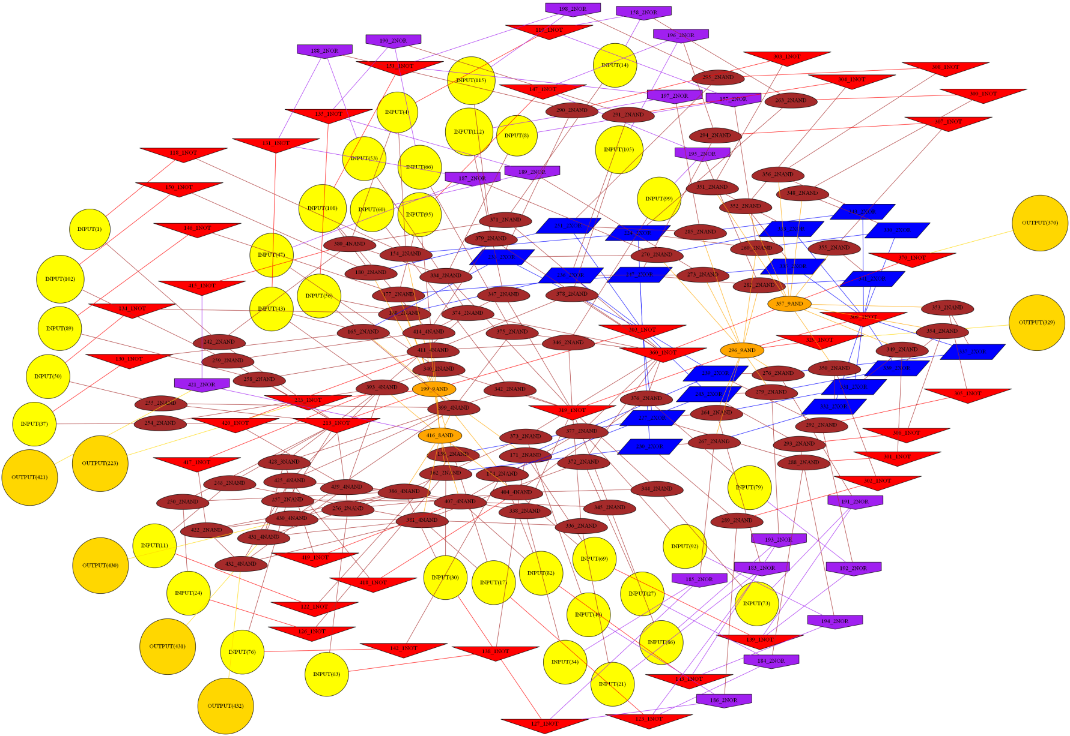
Circuit Graph Representation

