Slide 1
Excel Workshop III Introduction to VBA in Excel

Slide 2
Background
You are an actuary for Bruin Auto Liability Insurance, LLC, a Los Angeles based company insuring personal automobile casualty losses in Southern California.
Prior to your team's analysis of rates and reserves, you notice that the policy data is not the way you want it.
Each policy is only listed once, regardless of how many times it has been renewed.
This is extremely problematic for your team, since they need to be able to identify the specific 1-year term they're looking at when conducting their analyses.

Slide 3
Background
Your task is to update the way the company's data is stored.
If a policy has been renewed twice (i.e. it was inforce for 3 terms), there should be 3 rows; one for each term.
The listed start date should be the start date of each term (i.e. a new row is created upon renewal).

Slide 4
Background
Write a VBA macro to accomplish this task with the short excerpt of data.
Then, once you've ensured the macro works correctly, run it on the full set of policy data, splitting the 13,018 policies into 30,395 rows.

Slide 5
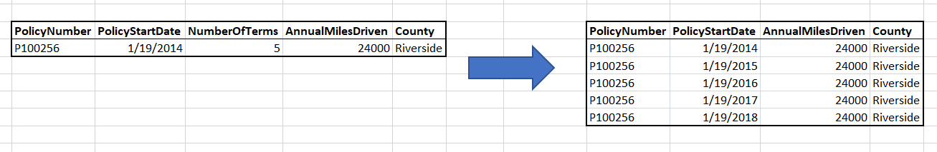
Our Goal

Slide 6
What is VBA?
VBA stands for Visual Basic with Applications
Closely related to Microsoft’s Visual Basic
Object-based language (similar to object-oriented languages)
Used in Excel to simplify repetitive or complex tasks

Slide 7
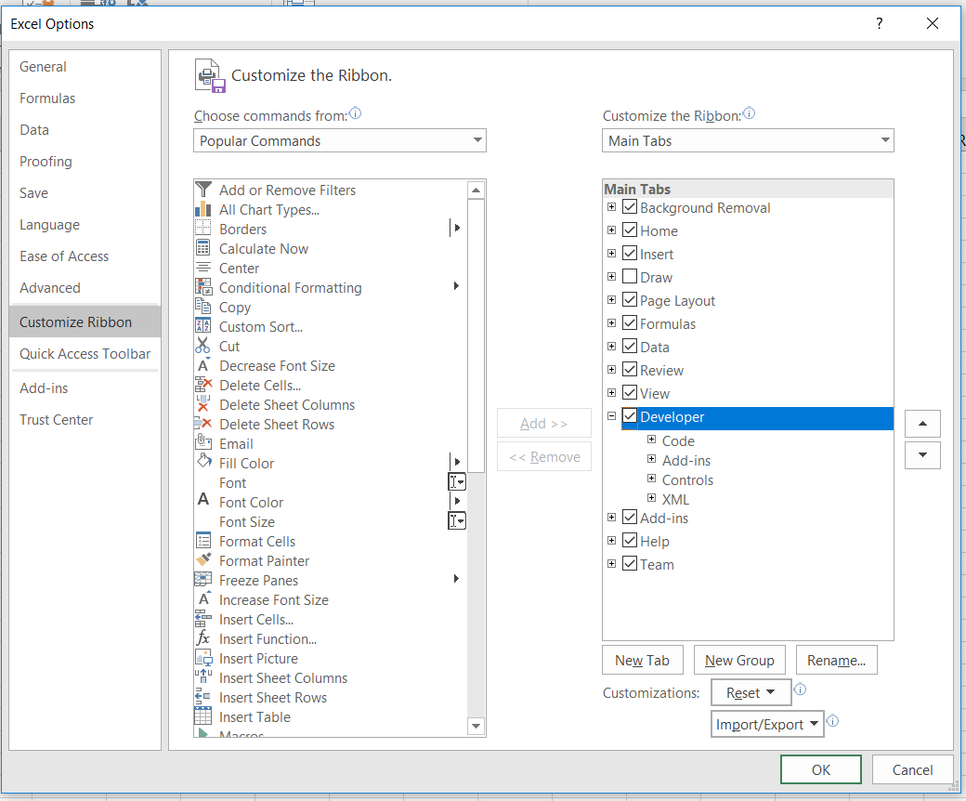
Enabling the Developer Tab
Under File → Options:
Customize Ribbon
Check “Developer”

Slide 8
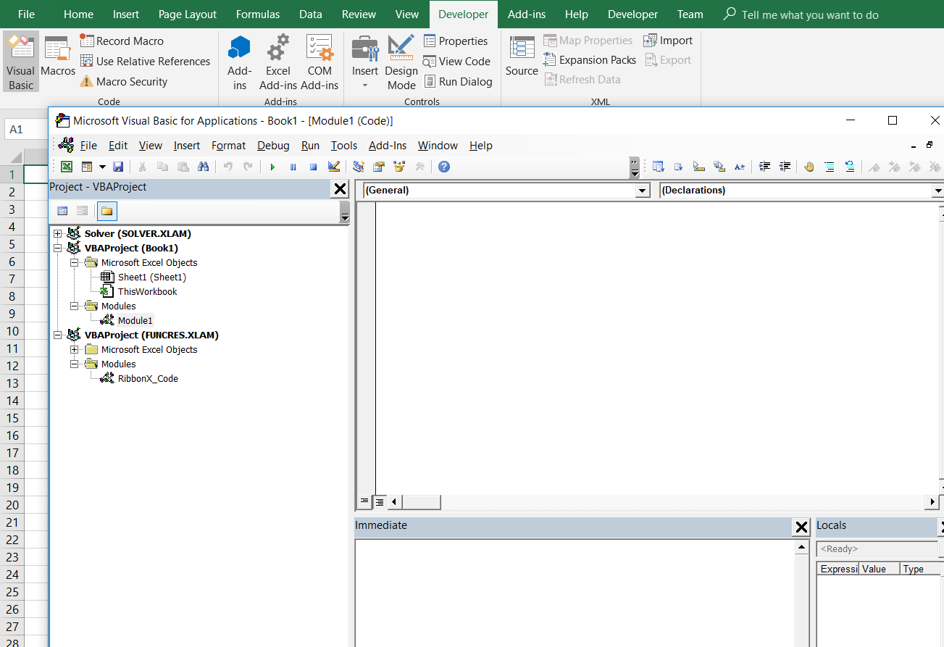
The VBA Environment

Slide 9
VBA in Microsoft Excel
We write subroutines (denoted Sub) to accomplish tasks that do not return values.
We write functions to take in inputs and return some output.
VBA objects include workbooks, worksheets, and ranges:
Application.Workbooks(“Book1.xlsm”).Worksheets(“Sheet1”).Range(“A1”)
Objects have properties and methods, the most important of which is:
Range(“A1”).Value

Slide 10
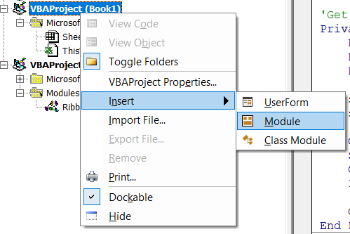
Getting started: Option Explicit
This is always a good idea to put in the declarations at the top of your module
This forces you to declare all your variables

Slide 11
Subroutines
We enclose our code in the following:
Sub Myroutine()
End Sub
This identifies our subroutine as being named “Myroutine()”
We can call our subroutine in several ways:

Slide 12
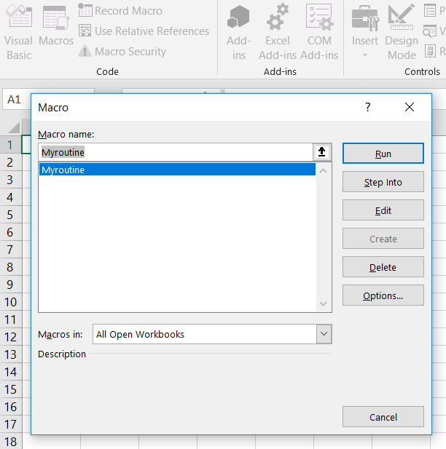
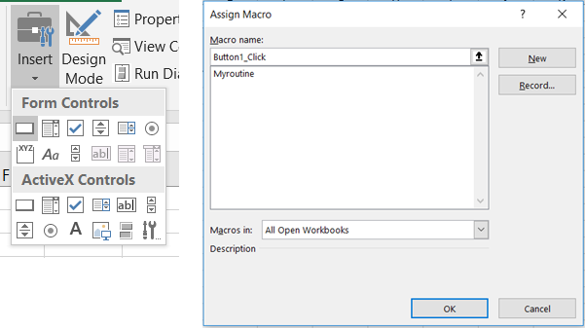
Subroutines
Clicking “Macros” in the Developer tab
Adding a button or some other tool

Slide 13
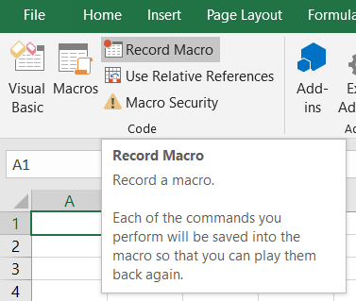
Macro Recorder: The easiest way to “write” a macro
Click “record macro”
All your actions will be translated into code
You can look at and modify this code to suit your purposes
Often slow and clunky, but can be a very powerful tool if used right (e.g. no one remembers how to filter/sort data in VBA, but this tool helps!)

Slide 14
Variables
We declare a variable with the Dim keyword:
Dim mystring As String
Dim dbl As Double
Dim num As Integer
Dim rng As Range
We assign them with “=”
mystring = “string”
num = 5
Except with ranges:
Set rng = Range(“A1:B3”)

Slide 15
Variables
If the data type is not specified, the variable will be declared as a variant
A variant can contain any kind of data
Try to avoid these if possible (they require a lot of memory)

Slide 16
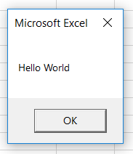
Message Boxes
Syntax: MsgBox(“Prompt”)
Can be very useful in debugging to display the value of variables

Slide 17
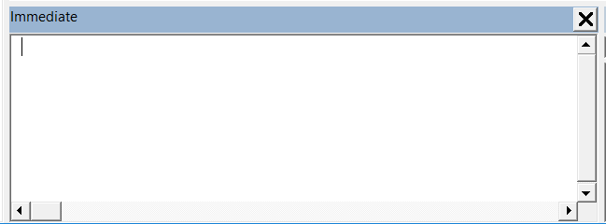
Another useful debugging tool: The Immediate Window
Short lines of code can be run here
You can also ask questions:
?Worksheets.Count
?Range(“B2”).Value
If you use Debug.Print in your code, the output goes to this window

Slide 18
If statements
Syntax:
If condition Then
[statements]
[ElseIf elseifcondition Then
elseifstatements]
[Else
elsestatements]
End If
If condition is true, runs statements. If not, but elseifcondition is true, runs elseifstatements. Otherwise, runs elsestatements.
There can be as many ElseIfs as needed

Slide 19
While loops
Syntax:
While condition
statements
Wend
Runs statements until condition evaluates to FALSE
Make sure that condition will not be TRUE forever, or you will have an endless while loop

Slide 20
For loops
Syntax:
For counter = start To end [Step increment]
statements
Next [counter]
Typically, counter is an Integer that we increment
“For i = 0 to 3” will run 4 times (i = 0, 1, 2, 3)
“For i = 2 to 7 Step 2” will run 3 times (i = 2, 4, 6)
“For i = 5 to 0 Step -3” will run 2 times (i = 5, 2)

Slide 21
For Each loops
Syntax:
For Each cell In range
statements
Next
A quick and simple way to loop through all the cells in a range
cell and range must both be Range objects
range should be initialized to some Range, cell need not be

Slide 22
Arrays
Arrays are created with parentheses to indicate size:
Dim array(5) as Integer
The size can be changed:
ReDim array(10)
But this will delete the data. To preserve the data inside, use
ReDim Preserve array(15)
Individual elements can be accessed and modified with parentheses:
array(0) = 5
There’s a lot more to be learned with arrays, but you can look online for more details. We’ll work primarily with Workbook objects instead.

Slide 23
Functions
Syntax:
Function MyFunction(param1 As dtype, param2 As dtype, …) As dtype
statements
MyFunction = value
End Function
Ultimately, you assign a return value by setting the name of the function to some value.
These functions can be called from workbook cells!

