Slide 1
Access SQL Workshop I: Introduction to SQL
What is a relational database?

Slide 2
What is a database?
A database is an organized collection of data, stored and accessed electronically.
This data requires interpretation to become information we can analyze.

Slide 3
What is a relational database?
A relational database is a digital database based on the relational model of data.
Virtually all relational database systems use SQL (Structured Query Language) for querying and maintaining the database.
SQL is pronounced “S-Q-L” or “sequel”.

Slide 4
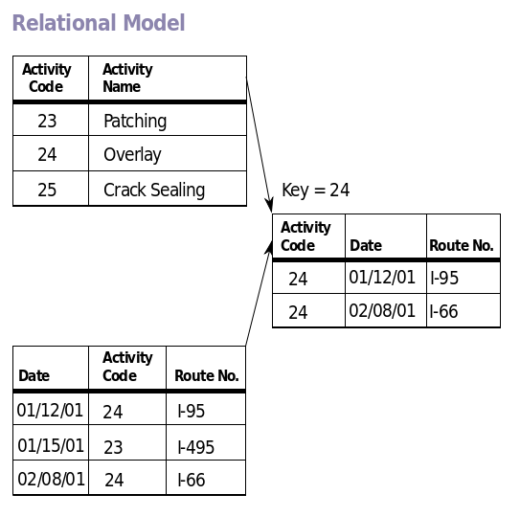
What is the relational model?
Data is organized in tables of columns (“attributes”) and rows (“records”), with a unique key (“primary key”) identifying each row
Rows in a table can be linked to rows in other tables by adding a columns for the unique key of the linked row (“foreign keys”)

Slide 5
I’m not a computer scientist. What does this mean for an actuary?
This abstract data stuff has more applications to actuarial work than you may think!
Consider the most basic example: policies and claims.

Slide 6
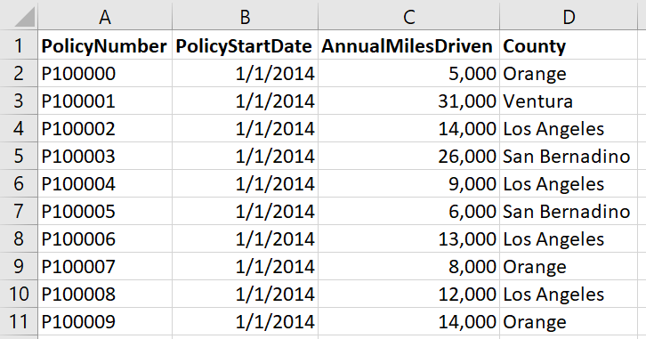
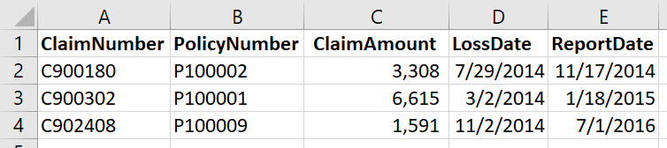
Example: Policies and Claims
Primary Key: PolicyNumber
Primary Key: ClaimNumber
Foreign Key: PolicyNumber

Slide 7
Example: Policies and Claims
We can see that the table for Claims can be linked to the table for Policies through the key PolicyNumber.
That’s a brief introduction to what we’re doing and why you should care.
In fact, this workshop will focus entirely on this seemingly-simple example of only two* tables.
*This isn’t quite true. We’ll create a few more later to play with, though that’s an issue for a later time.

Slide 8
Microsoft Access / SQL
Now that you know what we’re working with, let’s jump in!

Slide 9
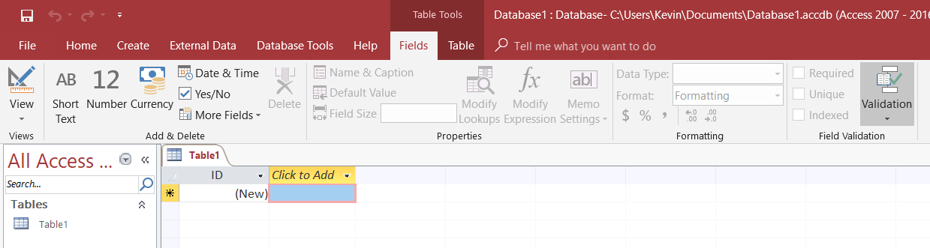
The Microsoft Access Environment

Slide 10
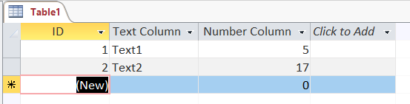
The Microsoft Access Environment
Data can be entered into data tables manually, and data tables can be viewed in their entirety manually

Slide 11
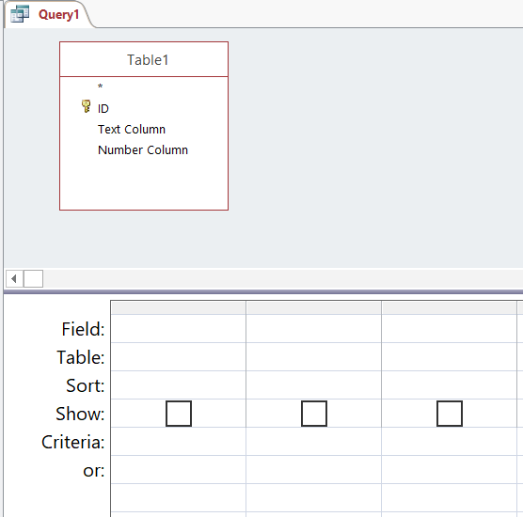
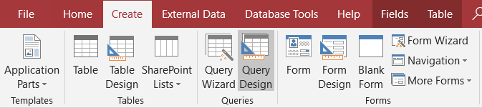
What we care about: Queries

Slide 12
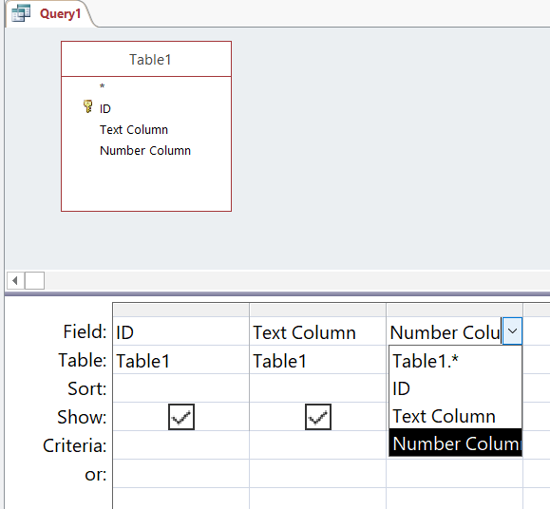
This user-friendly interface is good enough for some simple tasks…

Slide 13
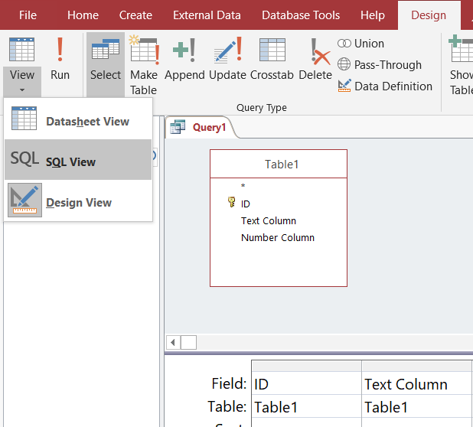
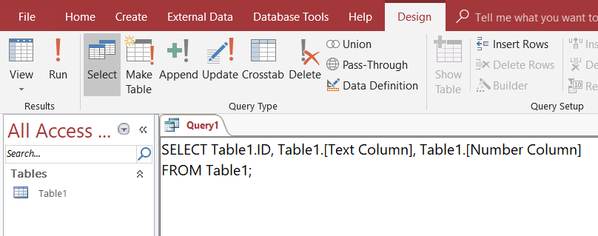
…but for more advanced tasks, we’ll want to use SQL.

Slide 14
Regardless of what view you choose, click Run to run the query.

Slide 15
SQL View
This may not make any sense now, but that’s what this workshop is for.
When we begin writing simple queries, you can always go back to design view to see the user-friendly depiction of what’s going on.
That’s enough introductory stuff. Let’s begin coding!

Slide 16
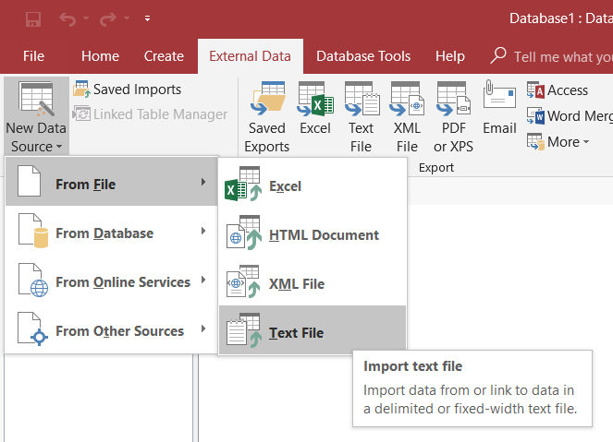
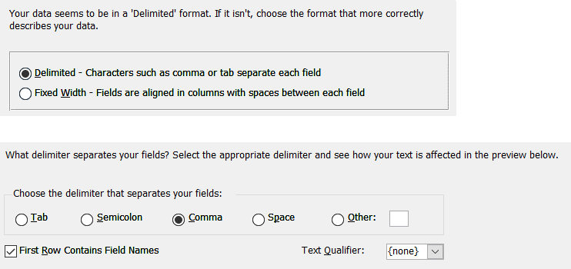
Getting our first tables: Importing from CSVs

Slide 17
SELECT column1, column2, ... FROM table_name; SELECT * FROM table_name;
The first line selects all rows, but only the specified columns, from table_name
The second line selects all rows and all columns from table_name

Slide 18
SELECT column1, column2, … FROM table_name WHERE condition;
Only selects rows from table_name where condition is true (and the appropriate columns)
condition can be a simple boolean:
WHERE column_name = “Value”
WHERE column_name <> 0
Or an IN statement:
WHERE column_name IN (value1, value2, value3)
Or a complex statement:
WHERE (column_name = 0 OR column_name = 1) AND another_column IN (“value1”, “value2”)

Slide 19
SELECT DISTINCT column1, column2, … FROM table_name;
Selects appropriate rows and columns, but removes duplicates

Slide 20
SELECT column1, column2, … FROM table_name ORDER BY column1, column2, … [DESC]
Selects appropriate rows and columns, then orders them in the given order
By default, sorts in ascending order
Use DESC to sort in descending order

Slide 21
SQL Variables
Any “unrecognized” text (that isn’t a reserved SQL keyword) is interpreted as a variable
Suppose our columns are “col1”, “col2”, and “col3”:
SELECT col1, col2 FROM table WHERE col1 <> 0 AND col3 = my_variable;
Since my_variable isn’t a column name or a keyword, SQL interprets it as a variable
You will be prompted to input a value for my_variable before the script runs

Slide 22
Aggregate Functions: SUM, COUNT, AVG, …
Aggregates numerical data in groups
Must be accompanied by a GROUP BY clause
SELECT SUM(Claim_Amount), ReportYear FROM claims GROUP BY ReportYear;
This will give the total claims for each year, since the aggregate data is grouped by report year.

Slide 23
WHERE vs. HAVING
WHERE
HAVING
Used to test variables in a single “cell” of the data table
Cannot be used with aggregate functions
The “equivalent” of WHERE for aggregate functions
Comes after the GROUP BY clause
We need to know what to group by before we know which groups to show!

Slide 24
To be continued…
A preview of next time:

Slide 25
Next time, we’ll see how powerful SQL is by learning how to link related data.

