Slide 1
Access SQL Workshop II: Intermediate SQL
Working with multiple tables

Slide 2
A quick recap of last time
What is a relational database, and what is the relational model?
How does the Microsoft Access environment work, and how does one write and execute queries?
The SELECT statement and all its modifications (FROM, WHERE, ORDER BY, DISTINCT)
SQL Variables
Aggregate functions (SUM, COUNT, AVG, …) and how to condition on them (WHERE vs. HAVING)

Slide 3
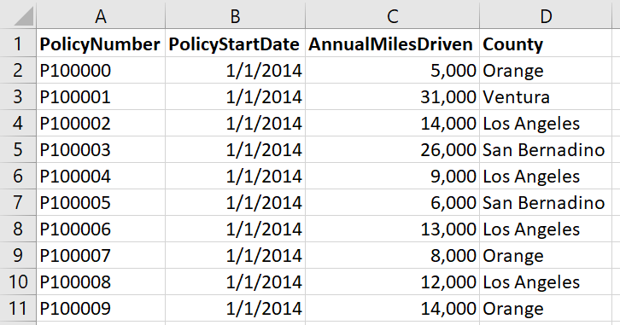
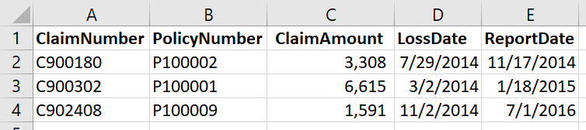
Last time, we left off at this slide. This is what we’re going to cover today.

Slide 4
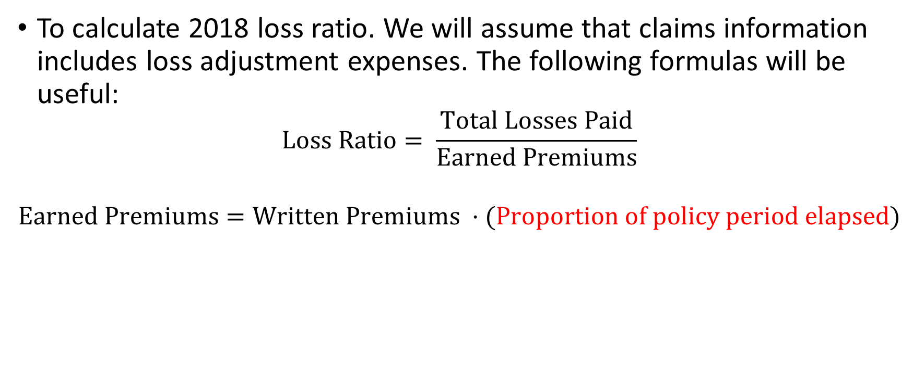
Our goal for today
To calculate 2018 loss ratio. We will assume that claims information includes loss adjustment expenses. The following formulas will be useful:
$$Loss Ratio= \frac{Total Losses Paid}{Earned Premiums}$$
$$Earned Premiums=Written Premiums ⋅(Proportion of policy period elapsed)$$

Slide 5
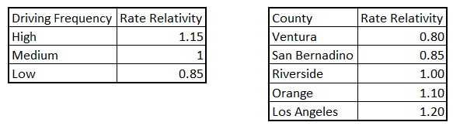
Our goal for today
Proportion of policy period elapsed, in red, is the hard part.
You may assume that for the entire duration a policy is inforce, driving frequency and county do not change.
The annual base rate is $2,200, and rate relativities for driving frequency and county are below.

Slide 6
But first...
Sometimes, the data isn’t given to you in nice files. Sometimes, it’s given as a screenshot of an Excel worksheet.
(Hopefully, this will only happen in learning demonstrations.)

Slide 7
CREATE TABLE table_name (column1 datatype, column2 datatype, …);
Creates a table with the given column names and datatypes
Access data types:
Text (text/numbers, 255 characters max)
Integer (whole numbers between -32,768 and 32,767)
Long (whole numbers between -2,147,483,648 and 2,147,483,647)
Double (double precision floating-point)
Date/Time (dates and times)

Slide 8
INSERT INTO table_name (column1, column2, … ) VALUES (value1, value2, …);
Inserts values into a table
If a column is omitted, the value of that column for the row inserted will be null
“Null” is not the same thing as “0” or the empty (zero-length) string “”.

Slide 9
UPDATE table_name SET column1 = value1, column2 = value2, ... WHERE condition;
Changes all row(s) of table_name where condition is true.
Changes the columns specified into the values specified.
Do not omit the WHERE clause! Otherwise, all rows will be changed!

Slide 10
DELETE FROM table_name WHERE condition;
Deletes all row(s) of table_name where condition is true.
Do not omit the WHERE clause! Otherwise, all rows will be deleted!

Slide 11
DROP TABLE table_name;
Drops a table from the database
Generally, it is a bad idea to run this command on your company’s databases*
*Unless it’s a table you created in your own schema or something like that…

Slide 12
SELECT column1, column2, … INTO new_table FROM old_table WHERE condition;
Any query will do here, but the general idea is the same
Instead of outputting the results of a query, saves it into a new table named new_table

Slide 13
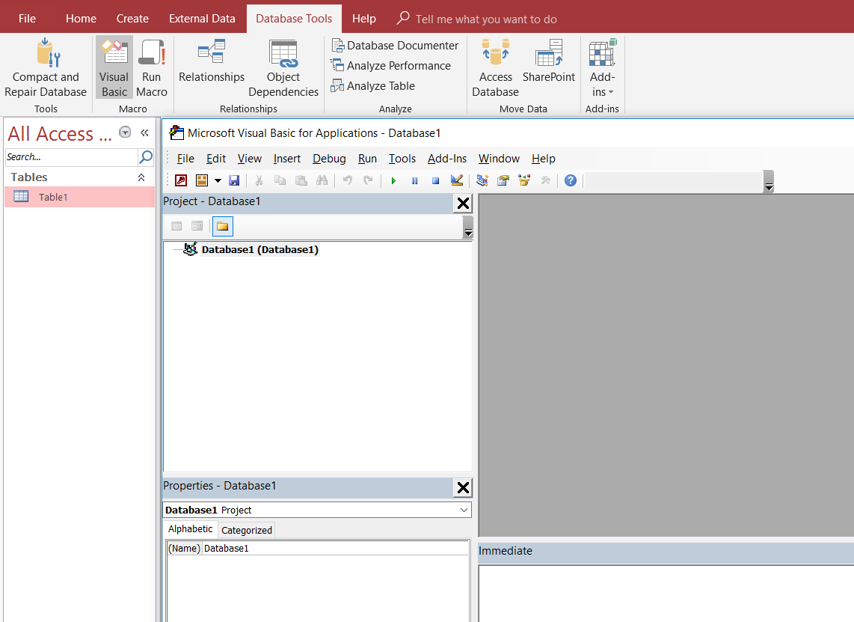
Speeding it up: Doing this in VBA

Slide 14
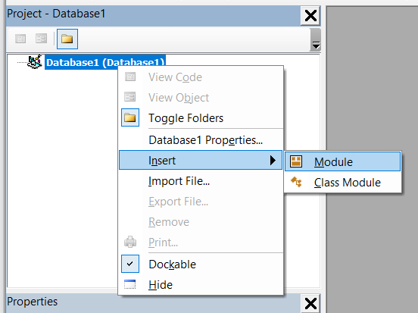
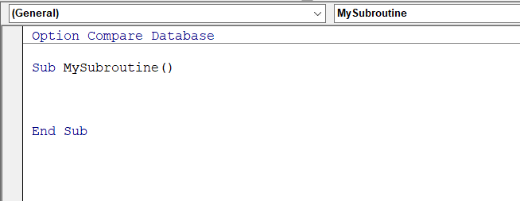
Speeding it up: Doing this in VBA

Slide 15
DoCmd.RunSQL sql
sql can be a string variable
Dim sql as string
sql = “my code here”
Or it can be a string literal
DoCmd.RunSQL “my code here”
This is the command to use to quickly create/update/delete tables and entries (instead of clicking “run” every time)

Slide 16
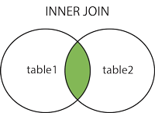
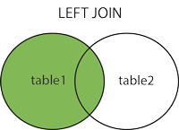
Why you came: Joins
Inner Join
Left (Outer) Join
Selects only the records that have matching values in both tables.
Returns all records from the left table, and the matched records from the right table.
The result is NULL from the right side, if there is no match.

Slide 17
SELECT column_name(s) FROM table1 INNER JOIN table2 ON table1.col_name = table2.col_name;
Joins table1 and table2 together on the variable col_name
Note that the columns don’t HAVE to be named the same thing
To select columns from the tables, the column name should be preceded by table1.col_name or table2.col_name, to identify which table to select from
SELECT table1.col1, table2.col2, table2.col3 FROM table1 INNER JOIN table2 ON table1.col4 = table2.col4;
Records will only be listed if they are in both tables

Slide 18
SELECT column_name(s) FROM table1 LEFT JOIN table2 ON table1.col_name = table2.col_name;
Left joins table1 and table2 together on the variable col_name
All records from table1 will be returned, with the potential for additional detail from table2, if applicable
If the table names are long, we can shorten them by SELECTing FROM table1 AS (alias)
SELECT t1.col1, t2.col2, t2.col3 FROM table1 AS t1 LEFT JOIN table2 AS t2 ON t1.col4 = t2.col4;

Slide 19
Subqueries: Feeding the output of one query as a table for another
Queries return a table (or a single value)
Regardless of which it is, we can enclose a query in parentheses and use that table/value in another query.
SELECT SUM(c2) FROM
(SELECT t1.c1 AS c1, t1.c2 AS c2 FROM t1
LEFT JOIN t2 ON t1.key = t2.key);
The highlighted portion is a perfectly valid standalone query

Slide 20
SWITCH(expression1, value1, expression2, value2, ... expression_n, value_n)
Kind of like a case statement / if statement
If expression1 is true, returns value1, and so on
Only the first expression that is true will be evaluated to the value

