Slide 1
Excel Workshop I: Introduction to Excel
With Applications from Ratemaking

Slide 2
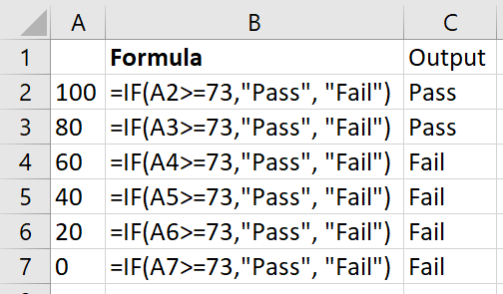
IF(logical_test, [value_if_true], [value_if_false])
If [value_if_true] or [value_if_false] are not given, they default to TRUE and FALSE
If logical_test is true, output is [value_if_true]
If logical_test is false, output is [value_if_false]
IF statements can be nested

Slide 3
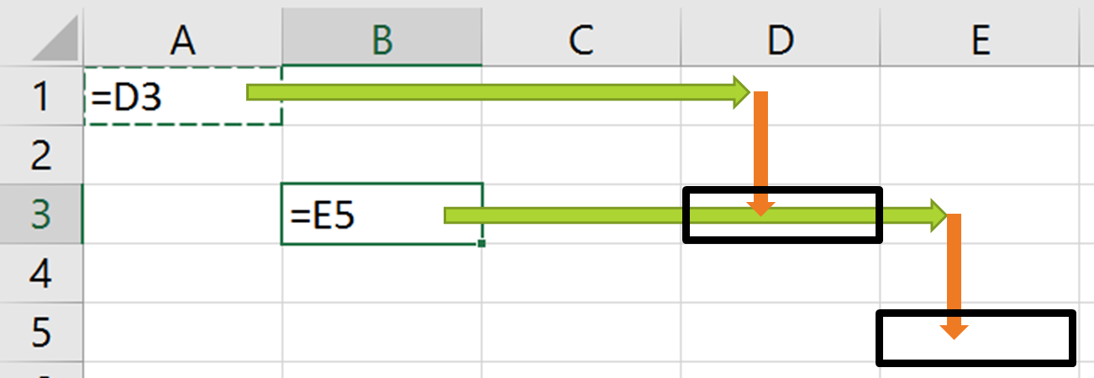
Relative Cell References

Slide 4
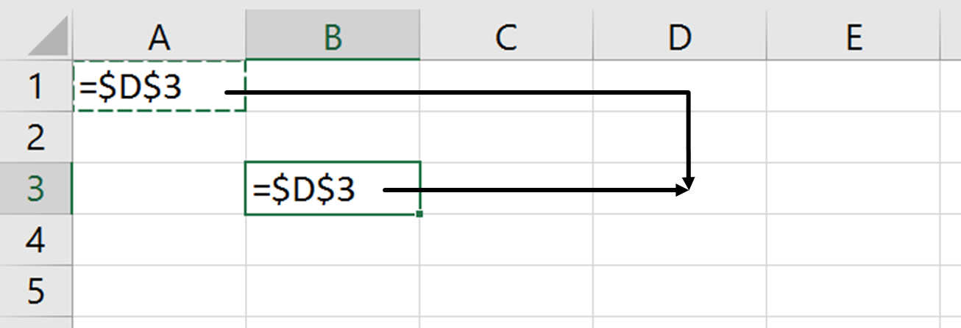
Absolute Cell References

Slide 5
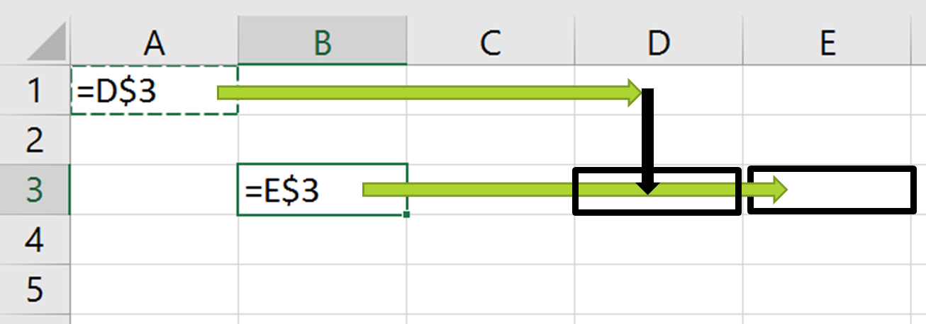
Mixed Cell References
Here, the black arrow does not indicate a relative shift, but an absolute shift to row 3.

Slide 6
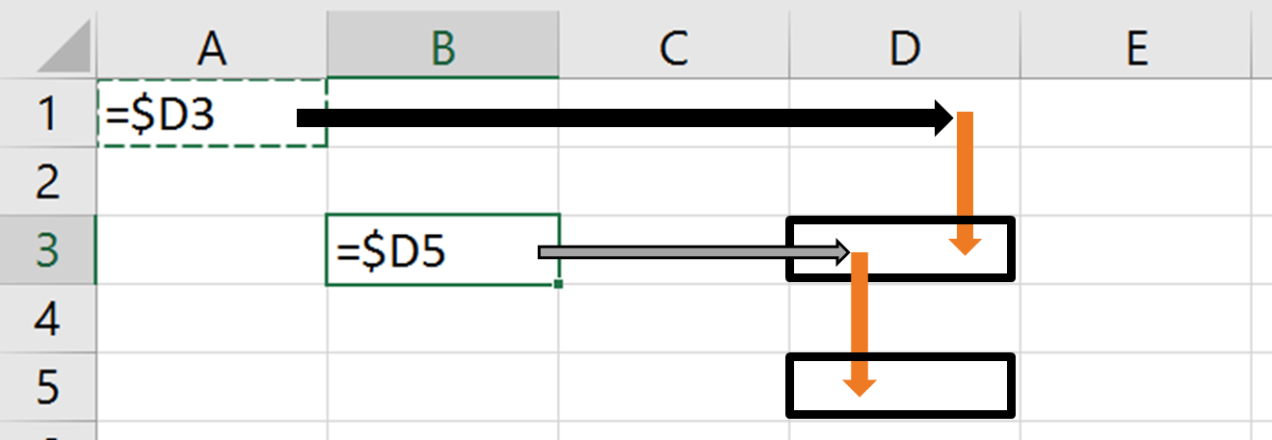
Mixed Cell References
Here, the black/gray arrows do not indicate relative shifts, but absolute shifts to column D.

Slide 7
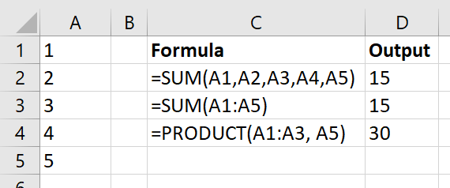
SUM(number1, [number2], …) PRODUCT(number1, [number2], …)
Each of the numbers can be either a reference to a single cell or to a range

Slide 8
VLOOKUP(lookup_value, table_array, col_index_num, [range_lookup])
Looks for lookup_value in the first column of table_array
Returns the value in the column number indicated by col_index_num
[range_lookup]: Default is TRUE (approximate match). FALSE means you want an exact match.
For approximate match, data must be sorted in ascending order.

Slide 9
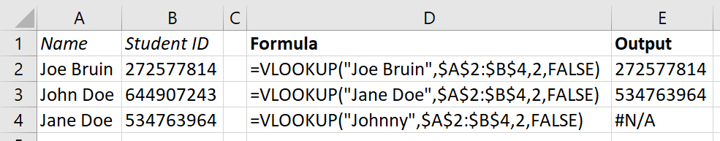
VLOOKUP(lookup_value, table_array, col_index_num, [range_lookup])

Slide 10
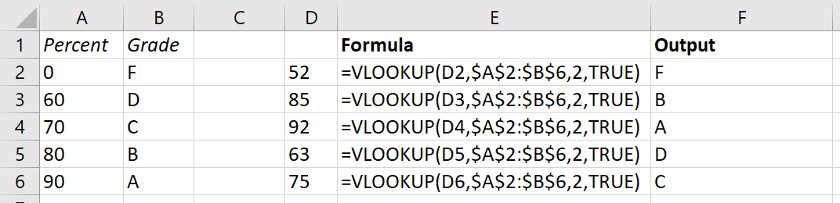
VLOOKUP(lookup_value, table_array, col_index_num, [range_lookup])

Slide 11
COUNTIF(range, criteria) SUMIF(range, criteria, [sum_range])
COUNTIF counts all cells in range that satisfy criteria.
The criteria can be given as a value, in which case the values in range must be equal to that value.
It can also be given as a boolean expression in quotes.
SUMIF is similar, but it sums the values in range instead of counting them.
Or, it sums across a different [sum_range], using the values in corresponding range-criteria pairs.

Slide 12
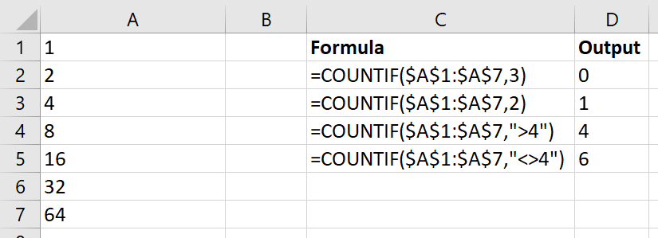
COUNTIF(range, criteria) SUMIF(range, criteria, [sum_range])

Slide 13
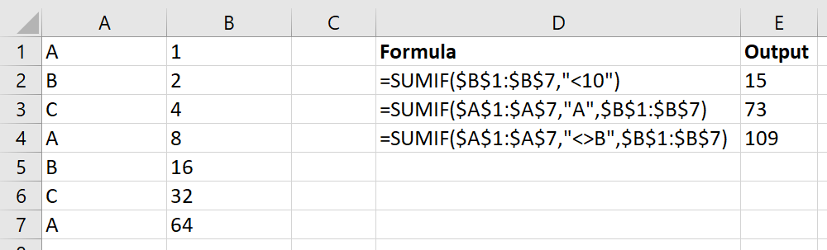
COUNTIF(range, criteria) SUMIF(range, criteria, [sum_range])

Slide 14
COUNTIFS(criteria_range1, criteria1,…) SUMIFS(sum_range, criteria_range1, criteria1,…)
These do the same thing as COUNTIF and SUMIF, but you can specify multiple criteria.
Note that for SUMIFS, sum_range comes first.

Slide 15
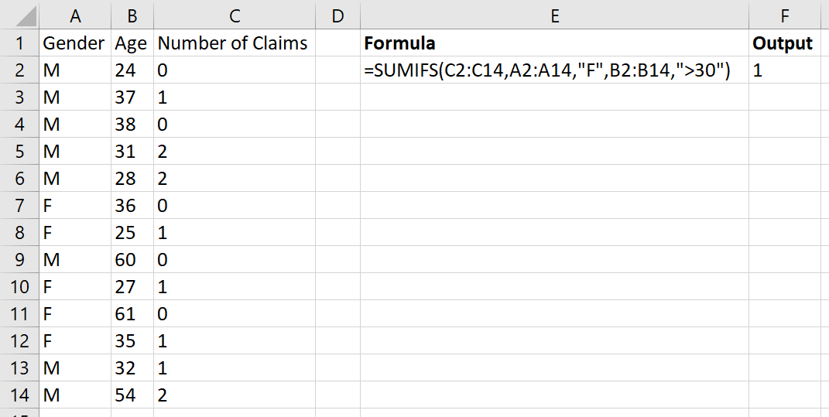
COUNTIFS(criteria_range1, criteria1,…) SUMIFS(sum_range, criteria_range1, criteria1,…)

Slide 16

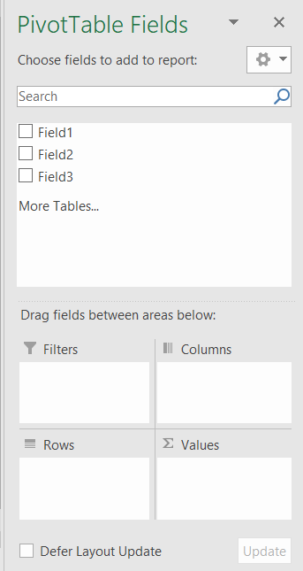
PivotTables
PivotTables can be used to quickly summarize data
Click and drag different fields to “columns”, “rows”, or “values”, depending on what you want
You can also filter data

Slide 17
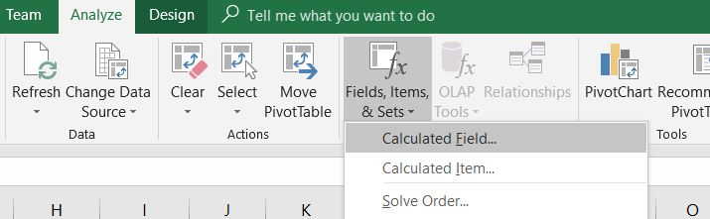
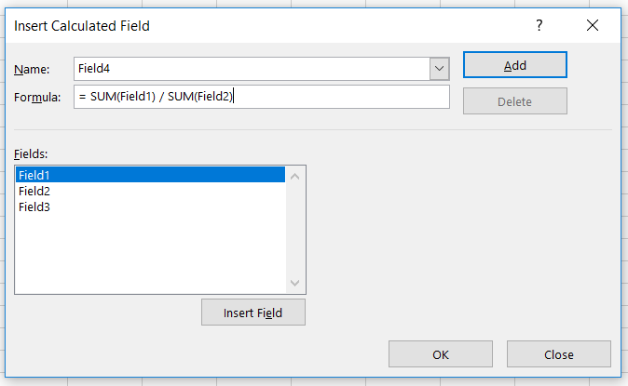
Calculated Fields
Calculated fields are useful for aggregate-level calculations
For example, we could look at the value of Field4 for each Field3

Slide 18
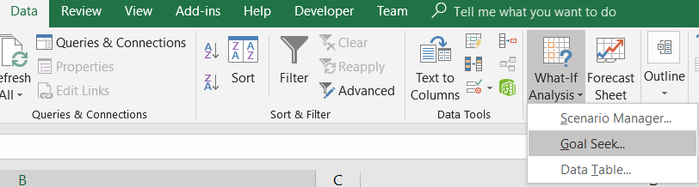
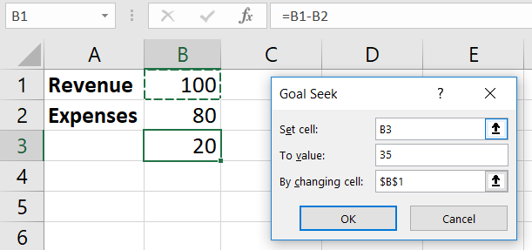
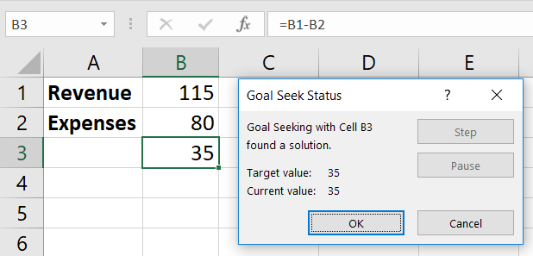
GoalSeek

Slide 19
Appendix
Background on the problem and mathematical justification

Slide 20
Background
You are a pricing actuary for Bruin Auto Liability Insurance, LLC, a Los Angeles based company insuring personal automobile casualty losses in Southern California.
Due to limited data collected, BAL Insurance only uses two variables in their pricing algorithm: driving frequency and county. Assume these two variables are independent.
You have been tasked with analyzing the premiums charged and claims filed to determine if the rates are adequate.

Slide 21
Background
It is January 1st, 2019. Through your discussions, you discover that sufficiently many claims for a given calendar year will be reported in 3 years.
Therefore, you have enough reliable data to analyze 2014 and 2015. However, volume of claims and policy in 2014 are fairly low.
Thus, you are to conduct an analysis of premiums and claims for policy year 2015.
For your convenience, the relevant policy data and claims data have been extracted from the full data tables.

Slide 22
Background
Management's target loss ratio is 85%.
Conduct an analysis of 2015 data and, based on your results, recommend an alternative rating algorithm to use in the future, if claims in 2016-2018 are similar to those in 2015.
Backtest your new rating algorithm on data from 2014.
Determine whether the rates you have set are feasible on the data from policy year 2014, and state the overall loss ratio on that sheet.

Slide 23
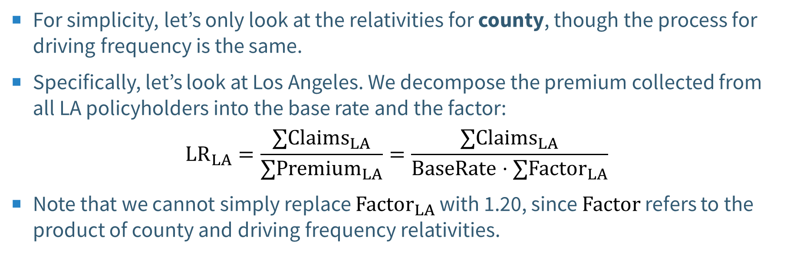
Adjusting the loss ratios
For simplicity, let’s only look at the relativities for county, though the process for driving frequency is the same.
Specifically, let’s look at Los Angeles. We decompose the premium collected from all LA policyholders into the base rate and the factor:
$${LR}_{LA}=\frac{{∑Claims}_{LA}}{∑{Premium}_{LA}}=\frac{{∑Claims}_{LA}}{BaseRate⋅∑{Factor}_{LA}}$$
Note that we cannot simply replace ${Factor}_{LA}$ with 1.20, since $Factor$ refers to the product of county and driving frequency relativities.

Slide 24
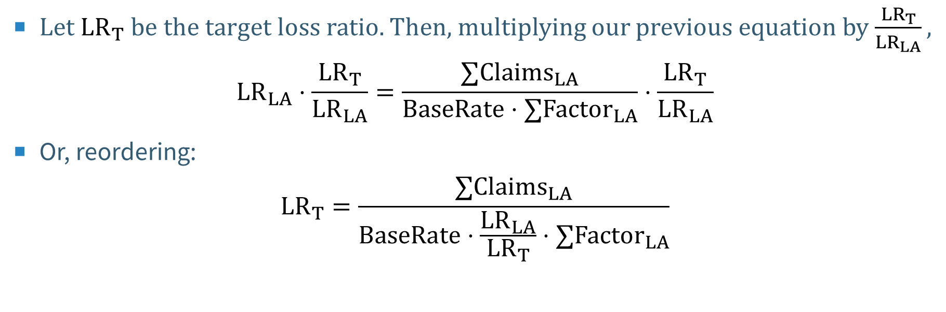
Adjusting the loss ratios
Let ${LR}_{T}$ be the target loss ratio. Then, multiplying our previous equation by $\frac{{LR}_{T}}{LR_{LA}},$
$${LR}_{LA}⋅\frac{{LR}_{T}}{LR_{LA}}=\frac{{∑Claims}_{LA}}{BaseRate⋅∑{Factor}_{LA}}⋅\frac{{LR}_{T}}{LR_{LA}}$$
Or, reordering:
$${LR}_{T}=\frac{{∑Claims}_{LA}}{BaseRate⋅\frac{{LR}_{LA}}{{LR}_{T}}⋅∑{Factor}_{LA}}$$

Slide 25
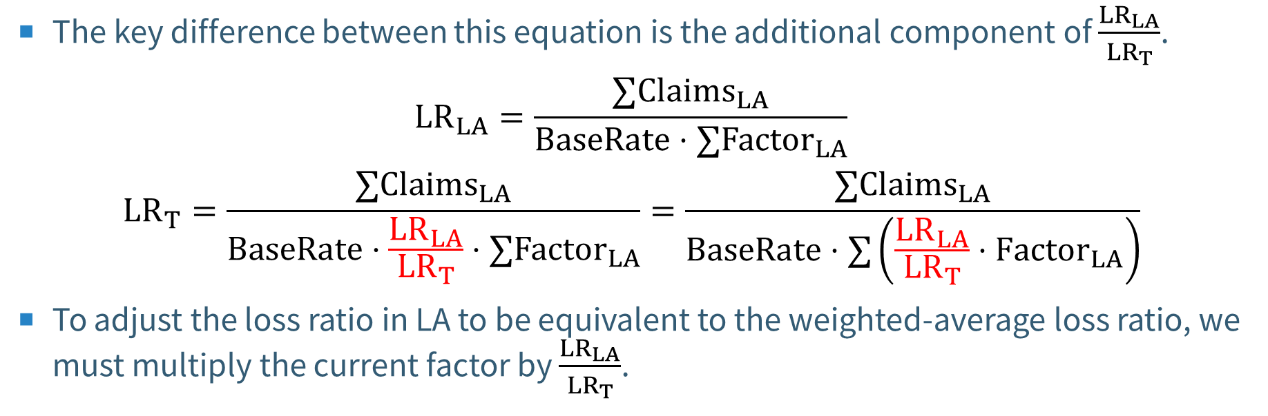
Adjusting the loss ratios
The key difference between this equation is the additional component of $\frac{{LR}_{LA}}{{LR}_{T}}$.
$${LR}_{LA}=\frac{{∑Claims}_{LA}}{BaseRate⋅∑{Factor}_{LA}}$$
$${LR}_{T}=\frac{{∑Claims}_{LA}}{BaseRate⋅\frac{{LR}_{LA}}{{LR}_{T}}⋅∑{Factor}_{LA}}=\frac{{∑Claims}_{LA}}{BaseRate⋅∑\left(\frac{{LR}_{LA}}{{LR}_{T}}⋅{Factor}_{LA}\right)}$$
To adjust the loss ratio in LA to be equivalent to the weighted-average loss ratio, we must multiply the current factor by $\frac{{LR}_{LA}}{{LR}_{T}}$.

Slide 26
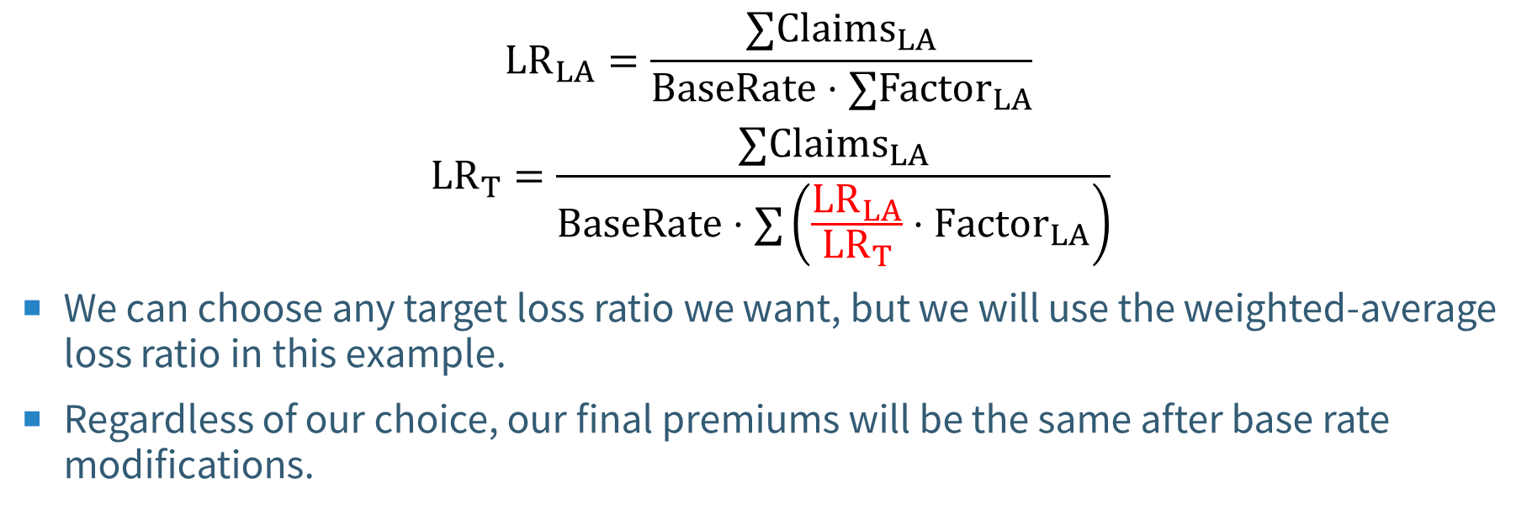
Adjusting the loss ratios
$${LR}_{LA}=\frac{{∑Claims}_{LA}}{BaseRate⋅∑{Factor}_{LA}}$$
$${LR}_{T}=\frac{{∑Claims}_{LA}}{BaseRate⋅∑\left(\frac{{LR}_{LA}}{{LR}_{T}}⋅{Factor}_{LA}\right)}$$
We can choose any target loss ratio we want, but we will use the weighted-average loss ratio in this example.
Regardless of our choice, our final premiums will be the same after base rate modifications.

