Slide 1
Excel Workshop II: Intermediate Excel
With Applications from Reserving

Slide 2
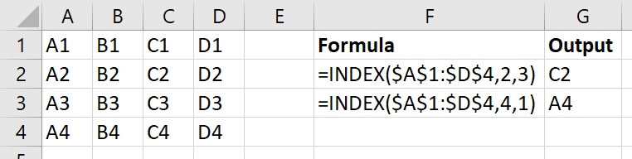
INDEX(array, row_num, [column_num])
Returns the value of array in the position by row_num and [column_num]

Slide 3
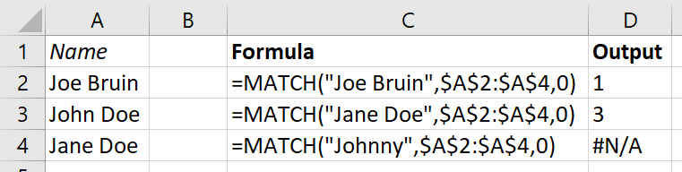
MATCH(lookup_value, lookup_array, [match_type])
Similar to VLOOKUP, searches for lookup_value in a one-dimensional lookup_array
Returns the index of the value
[match_type]
1 (DEFAULT): finds largest value <= lookup_value (lookup_array must be sorted ascending)
0: finds first value = lookup_value
-1: finds smallest value >= lookup_value (lookup_array must be sorted descending)

Slide 4
INDEX and MATCH can be combined to create a more powerful, error-resistant VLOOKUP
VLOOKUP requires us to count how many columns over the return value is found
VLOOKUP can only search for lookup_value in the first column of table_array
If we insert a column, VLOOKUP will either return the wrong column’s value or break completely
INDEX MATCH allows us to look up across both rows and columns, whereas VLOOKUP and HLOOKUP only allow one dimension

Slide 5
Example: VLOOKUP vs. INDEX MATCH
VLOOKUP is essentially a special case of INDEX MATCH:
VLOOKUP(lookup_value, table_array, col_index_num, FALSE)
is the same as
INDEX(table_array, MATCH(lookup_value, lookup_array, 0), col_index_num)
If we wanted INDEX MATCH to do the same thing as VLOOKUP, lookup_array would simply be the first column of table_array.
We can see INDEX MATCH gives much more freedom:
We can select any lookup_array we want
We can even replace col_index_num with another MATCH statement!

Slide 6
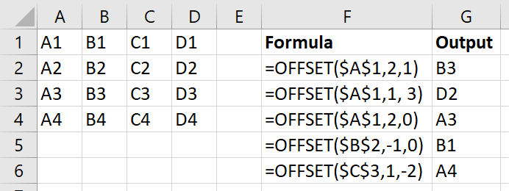
OFFSET(reference, rows, cols, [height], [width])
Returns a reference to a range a specified number of rows and cols away from an “anchor” cell called reference.

Slide 7
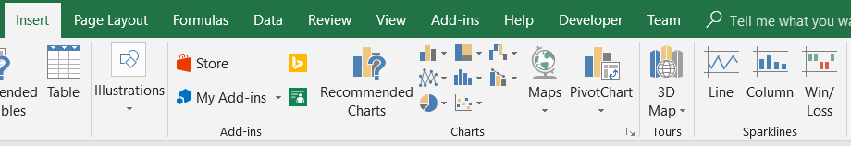
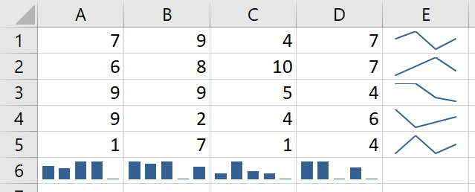
Sparklines
Useful tool for quickly visualizing a lot of data without having to go through the trouble of making a chart
For example, summarizing data in each row and each column:

Slide 8
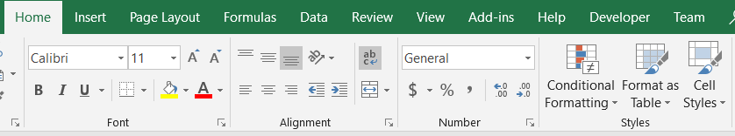
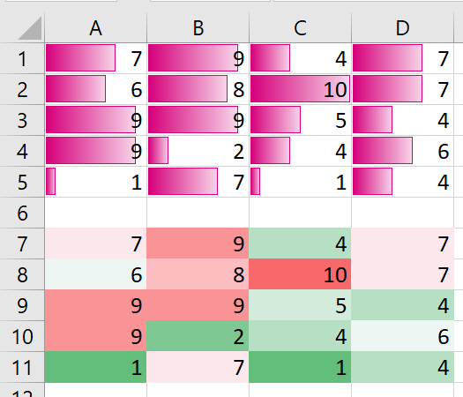
Conditional Formatting
Another quick way to format cells and visualize the data within

Slide 9
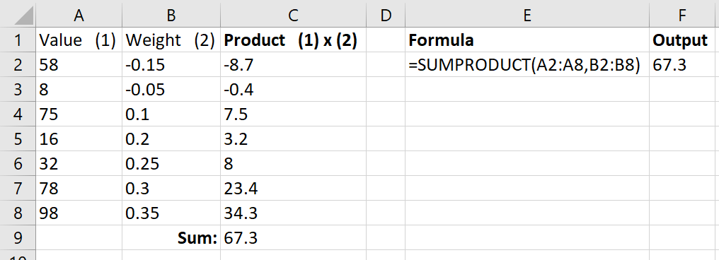
SUMPRODUCT(array1, [array2], [array3], …)
Multiplies the corresponding values in the arrays (all of which are the same dimension), then adds them together

Slide 10
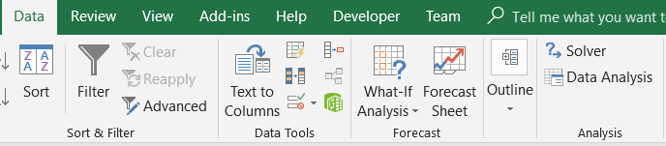
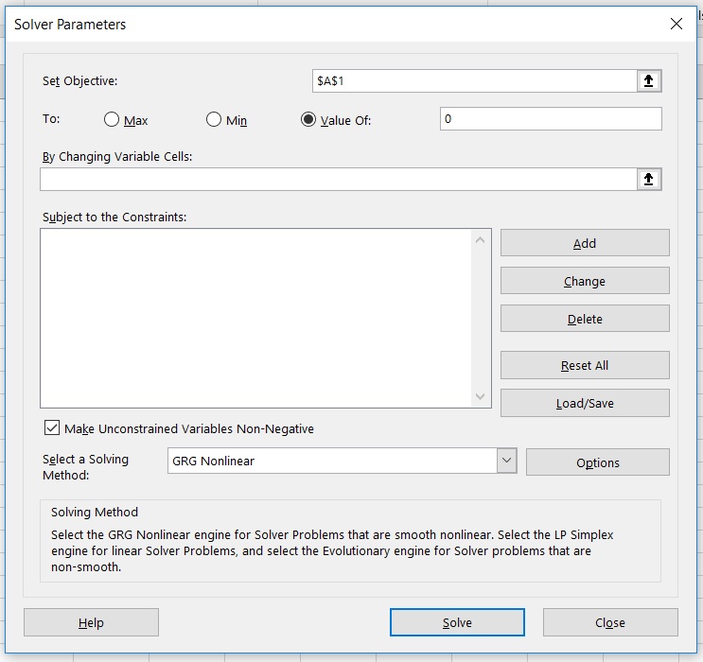
Solver
https://support.office.com/en-us/article/load-the-solver-add-in-in-excel-612926fc-d53b-46b4-872c-e24772f078ca
A more powerful version of GoalSeek that can optimize (min/max) with constraints

Slide 11
Appendix
Background on the problem and mathematical justification

Slide 12
Background
You are a reserving actuary for Bruin Auto Liability Insurance, LLC, a Los Angeles based company insuring personal automobile casualty losses in Southern California.
BAL's reserving practice is quite limited, and you have been asked to create a basic model of loss development to evaluate the state of the company’s reserves.

Slide 13
Background
It is January 1st, 2019. The reserving team in the actuarial department has set aside a pure IBNR reserve of $7M to pay for losses occurring before 2019 reported in 2019.
It is your task to determine whether this reserve is too low, appropriate, or too high. If the current reserve is not representative of what BAL expects to pay out, suggest a new reserve level.
During your analysis, you may ignore claims occurring in 2019, as these trends will be analyzed by a different team.
If there are significant differences in claim development by county, report this to management as well.

Slide 14
Background
You have also been presented with an excerpt of the company’s income statement for 2018. Analyze the effects changing reserves will have on the company’s financials (assuming an 85% loss ratio), and suggest a target expense ratio to maintain the overall profit margin.
If this expense ratio is not feasible, what rate of return must BAL receive on its investments to maintain the overall profit margin, assuming a reasonable expense ratio?

Slide 15
Development Triangles: The Idea
For simplicity, assume this is 0.
Key idea: Not all accidents that occur in a year are reported in that year.
For instance, only $149 of losses occurring in 2015 were reported in 2015.
$171 was reported in 2016, $55 in 2017, and $11 was reported in 2018.
We want to estimate, for instance, how much we will pay for losses from 2016.
Report ­ AY | 2015 | 2016 | 2017 | 2018 | 2019
2015 | 149 | 171 | 55 | 11 | 0
2016 | 0 | 184 | 182 | 66 | ??
2017 | 0 | 0 | 195 | 209 | ??
2018 | 0 | 0 | 0 | 218 | ??

Slide 16
Development Triangles: Using lags instead of years
Lag ­ AY | 1 | 2 | 3 | 4
2015 | 149 | 171 | 55 | 11
2016 | 184 | 182 | 66
2017 | 195 | 209
2018 | 218
It doesn’t matter to us in what year we pay.
Rather, we care about how many years after the loss we pay. This allows us to combine data meaningfully.
$171 of losses from 2015 were reported after 1 year, but before the end of 2 years (i.e., 2016).
This is $182 for the 2016 2-year lag and $209 for the 2017 2-year lag.

Slide 17
Development Triangles: Cumulative paid amounts
Lag ­ AY | 1 | 2 | 3 | 4
2015 | 149 | 320 | 375 | 386
2016 | 184 | 366 | 432
2017 | 195 | 404
2018 | 218
Next, we convert our amounts to cumulative amounts.
This allows us to see the proportional increase over lags.

Slide 18
Development Triangles: Loss Development Factors
Lag ­ AY | 1 | 2 | 3 | 4
2015 | 149 | 320 | 375 | 386
2016 | 184 | 366 | 432
2017 | 195 | 404
2018 | 218
x 2.15
x 1.17
x 1.03
x 1.99
x 1.18
x 2.07

Slide 19
Development Triangles: Loss Development Factors
Lag ­ AY | 1 – 2 | 2 - 3 | 3 - 4
2015 | 2.15 | 1.17 | 1.03
2016 | 1.99 | 1.18
2017 | 2.07
These multiplicative factors are called loss development factors.
From this, we can take weighted average, simple average, etc. to determine what factor we want to pick.

Slide 20
Development Triangles: Loss Development Factors
Lag ­ AY | 1 – 2 | 2 - 3 | 3 - 4
2015 | 2.15 | 1.17 | 1.03
2016 | 1.99 | 1.18
2017 | 2.07
Simple Average | 2.07 | 1.18 | 1.03
For simplicity, suppose we use the simple average.
This means between the first and second year, we can expect the cumulative paid amount to be multiplied by 2.07.

Slide 21
Development Triangles: Filling in our triangle
Lag ­ AY | 1 | 2 | 3 | 4
2015 | 149 | 320 | 375 | 386
2016 | 184 | 366 | 432 | 445
2017 | 195 | 404 | 475 | 489
2018 | 218 | 451 | 531 | 546
x 1.03
x 1.18
x 1.03
x 2.07
x 1.18
x 1.03

Slide 22
Development Triangles: Cumulative Development Factors
Instead of calculating each cell, we can jump straight to the end with cumulative development factors.
Lag | 1 – 2 | 2 - 3 | 3 - 4
Simple Average | 2.07 | 1.18 | 1.03
CDF | 2.51 (2.07 x 1.21) | 1.21 (1.18 x 1.03) | 1.03

Slide 23
Development Triangles: Cumulative Development Factors
Lag ­ AY | 1 | 2 | 3 | 4
2015 | 149 | 320 | 375 | 386
2016 | 184 | 366 | 432 | 445
2017 | 195 | 404 |  | 489
2018 | 218 |  |  | 546
x 1.03
x 1.21
x 2.51

Slide 24
Development Triangles: Cumulative Development Factors
Lag ­ AY | 1 | 2 | 3 | 4
2015 | 149 | 320 | 375 | 386
2016 | 184 | 366 | 432 | 445
2017 | 195 | 404 |  | 489
2018 | 218 |  |  | 546
The final column (in red) indicates how much we expect to pay, in total, from losses occurring in each of the accident years.
Our IBNR reserve is what we expect to pay less what we already paid.

