Slide 1
Excel Workshop II: Intermediate Excel
With Applications from Reserving

Slide 2
Background
You are a reserving actuary for Bruin Auto Liability Insurance, LLC, a Los Angeles based company insuring personal automobile casualty losses in Southern California.
BAL's reserving practice is quite limited, and you have been asked to create a basic model of loss development to evaluate the state of the company’s reserves.

Slide 3
Background
It is January 1st, 2019. The reserving team in the actuarial department has set aside a pure IBNR reserve of $7M to pay for losses occurring before 2019 reported in 2019.
It is your task to determine whether this reserve is too low, appropriate, or too high. If the current reserve is not representative of what BAL expects to pay out, suggest a new reserve level.
During your analysis, you may ignore claims occurring in 2019, as these trends will be analyzed by a different team.
If there are significant differences in claim development by county, report this to management as well.

Slide 4
Background
You have also been presented with an excerpt of the company’s income statement for 2018. Analyze the effects changing reserves will have on the company’s financials (assuming an 85% loss ratio), and suggest a target expense ratio to maintain the overall profit margin.
If this expense ratio is not feasible, what rate of return must BAL receive on its investments to maintain the overall profit margin, assuming a reasonable expense ratio?

Slide 5
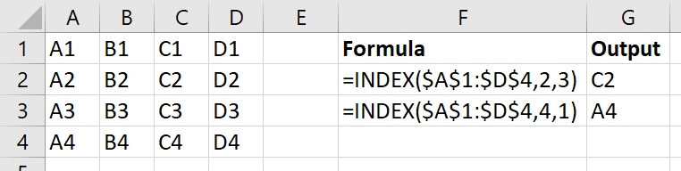
INDEX(array, row_num, [column_num])
Returns the value of array in the position by row_num and [column_num]

Slide 6
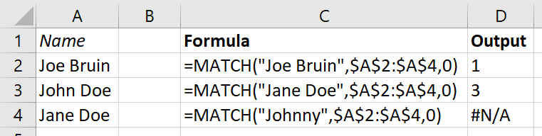
MATCH(lookup_value, lookup_array, [match_type])
Similar to VLOOKUP, searches for lookup_value in a one-dimensional lookup_array
Returns the index of the value
[match_type]
1 (DEFAULT): finds largest value <= lookup_value (lookup_array must be sorted ascending)
0: finds first value = lookup_value
-1: finds smallest value >= lookup_value (lookup_array must be sorted descending)

Slide 7
INDEX and MATCH can be combined to create a more powerful, error-resistant VLOOKUP
VLOOKUP requires us to count how many columns over the return value is found
VLOOKUP can only search for lookup_value in the first column of table_array
If we insert a column, VLOOKUP will either return the wrong column’s value or break completely
INDEX MATCH allows us to look up across both rows and columns, whereas VLOOKUP and HLOOKUP only allow one dimension

Slide 8
Example: VLOOKUP vs. INDEX MATCH
VLOOKUP is essentially a special case of INDEX MATCH:
VLOOKUP(lookup_value, table_array, col_index_num, FALSE)
is the same as
INDEX(table_array, MATCH(lookup_value, lookup_array, 0), col_index_num)
If we wanted INDEX MATCH to do the same thing as VLOOKUP, lookup_array would simply be the first column of table_array.
We can see INDEX MATCH gives much more freedom:
We can select any lookup_array we want
We can even replace col_index_num with another MATCH statement!

Slide 9
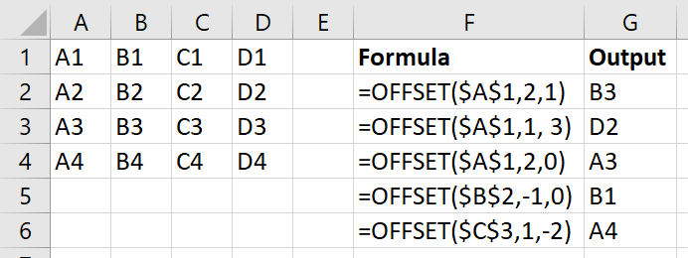
OFFSET(reference, rows, cols, [height], [width])
Returns a reference to a range a specified number of rows and cols away from an “anchor” cell called reference.

Slide 10
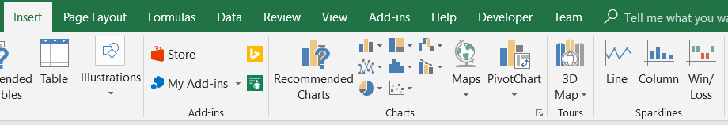
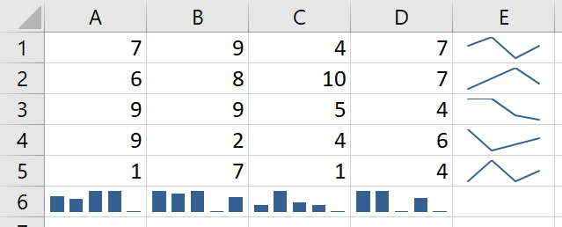
Sparklines
Useful tool for quickly visualizing a lot of data without having to go through the trouble of making a chart
For example, summarizing data in each row and each column:

Slide 11
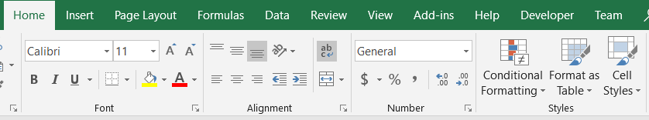
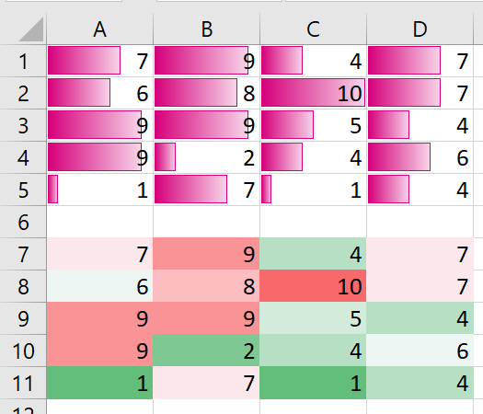
Conditional Formatting
Another quick way to format cells and visualize the data within

Slide 12
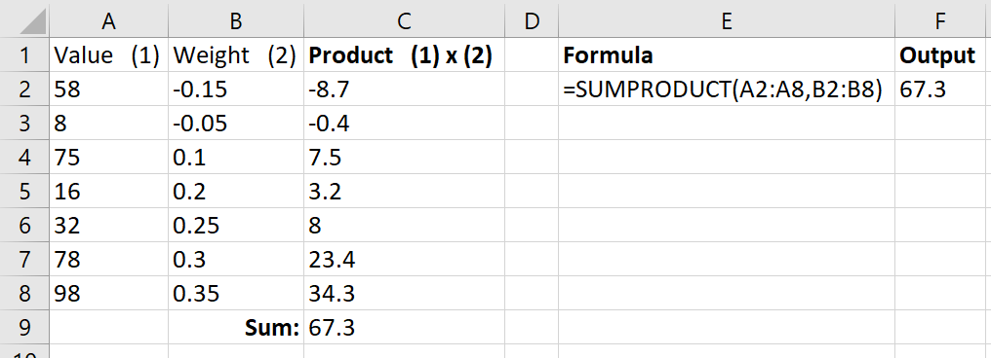
SUMPRODUCT(array1, [array2], [array3], …)
Multiplies the corresponding values in the arrays (all of which are the same dimension), then adds them together

Slide 13
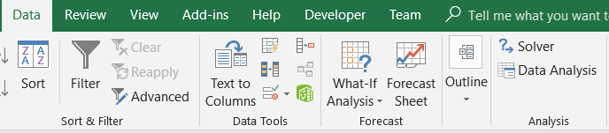
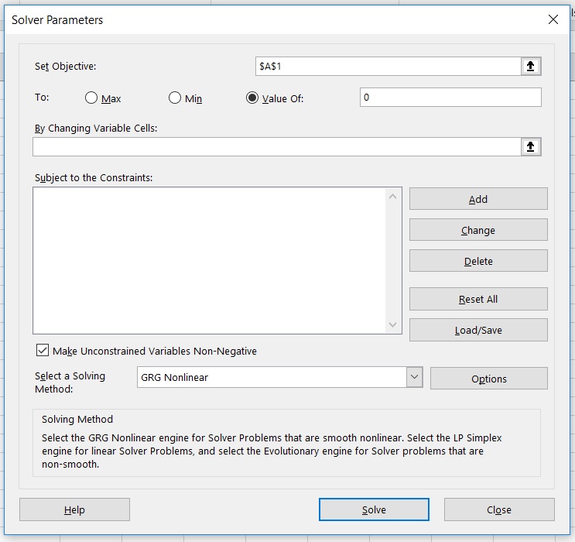
Solver
https://support.office.com/en-us/article/load-the-solver-add-in-in-excel-612926fc-d53b-46b4-872c-e24772f078ca
A more powerful version of GoalSeek that can optimize (min/max) with constraints

