Slide 1

COGENT INFOTECH
SHOP FOR HOME DEĆOR E-COMMERCE APPLICATION
Mr. Chandrakant Panday
March 11, 2024
TEAM MEMBERS
Kidist Zihon
Samantha Oh
Gerard Segismundo

Slide 2
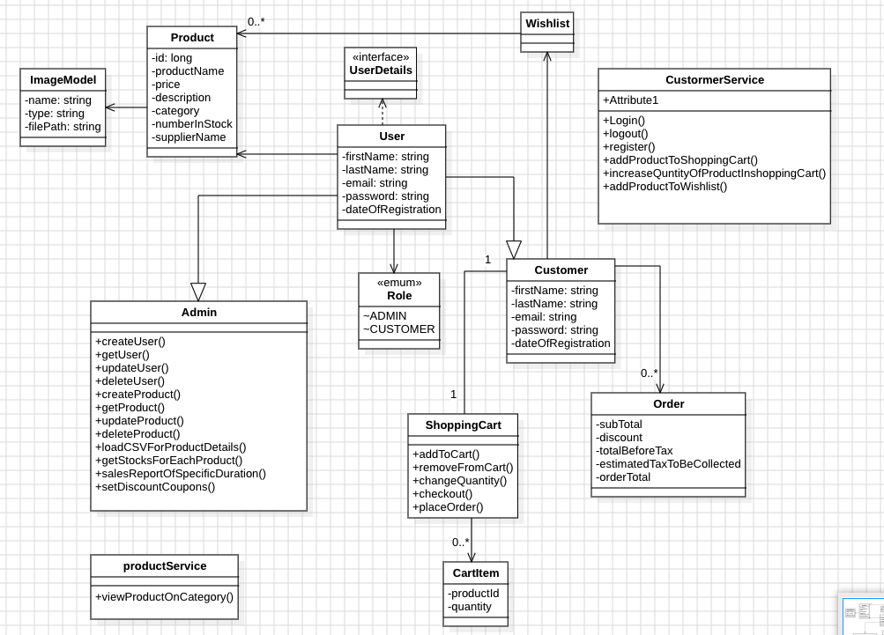
Backend Architecture

Slide 3
Admin Functionalities
Admin Functionalities
Sign in, Logout
Customer CRUD
Product CRUD
Track low in stack products
Coupon CRUD

Slide 4
Customer Functionalities
Signup, Sign In, Logout
Shop by category
Sort Products by price
View product details
Add/remove Items from shopping-cart
Add/remove product from wish-list
Verify Coupon code
Check out with or with out coupon
Get order summary with tax calculated

Slide 5
Gust Functionalities
Get all products
Get product by category
Sort product by price
View product details

Slide 6
Technology Stack
Frontend: Angular, Angular Material
Security: Spring Security
Backend: Spring-boot, JPA, Hibernate, Validators
Database: Mysql
Tools: Maven, Tomcat, Postman, Dev-tools

Slide 7
GitHub Links
https://github.com/kzihon/Shop-for-Home-Frontend
https://github.com/kzihon/ShopForHomeCompleteBackend/tree/main

Slide 8
Thank You!

