Slide 1


Slide 2
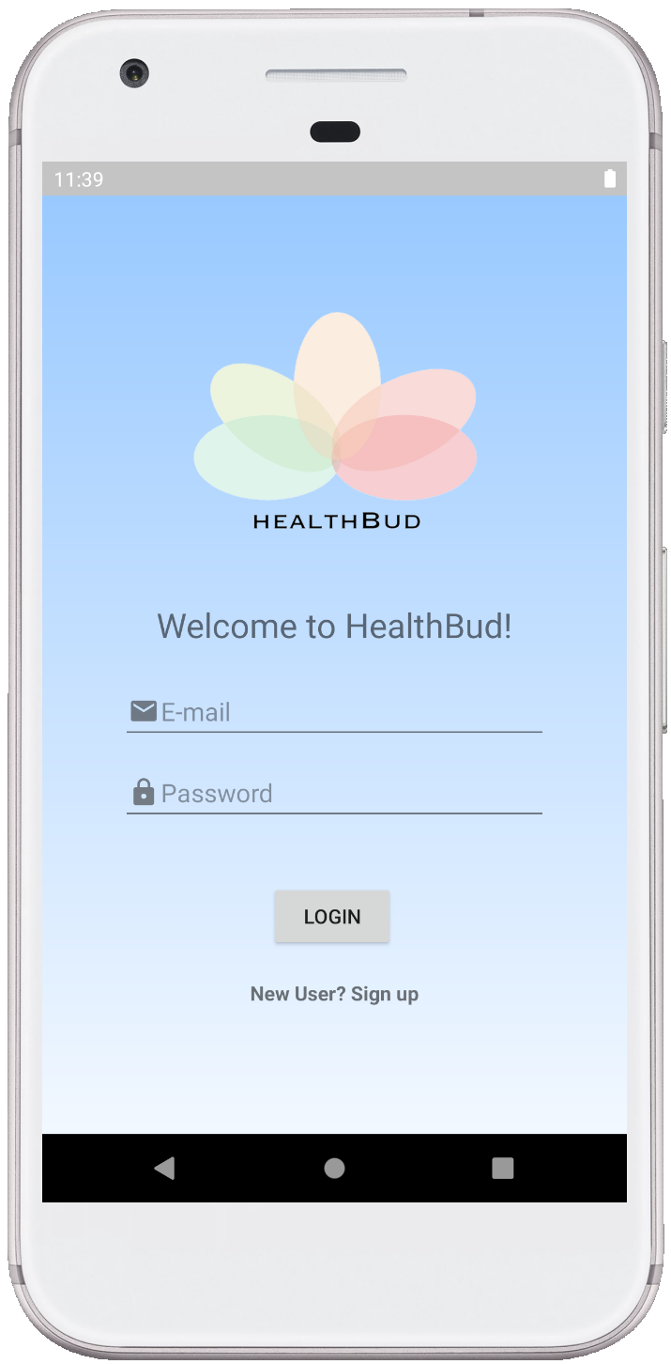
Enter HealthBud
Application targeted to women, for finding workout partners
Creates safe spaces for new mothers, students, and seniors
Provides helpful tips about weather condition, safety, and accessibility

Slide 3
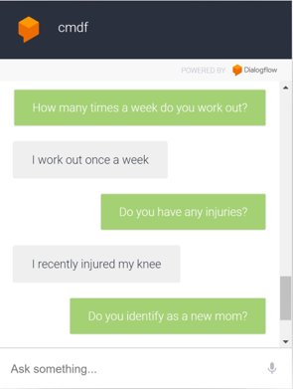
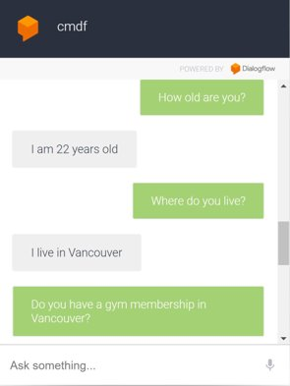
Google Dialogflow: Create an account via ChatBot

Slide 4
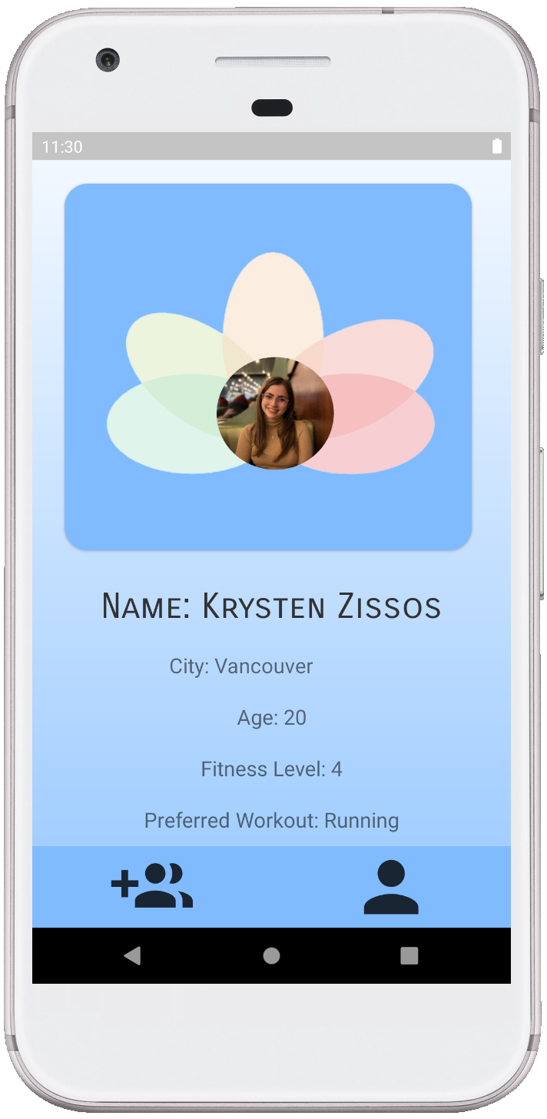
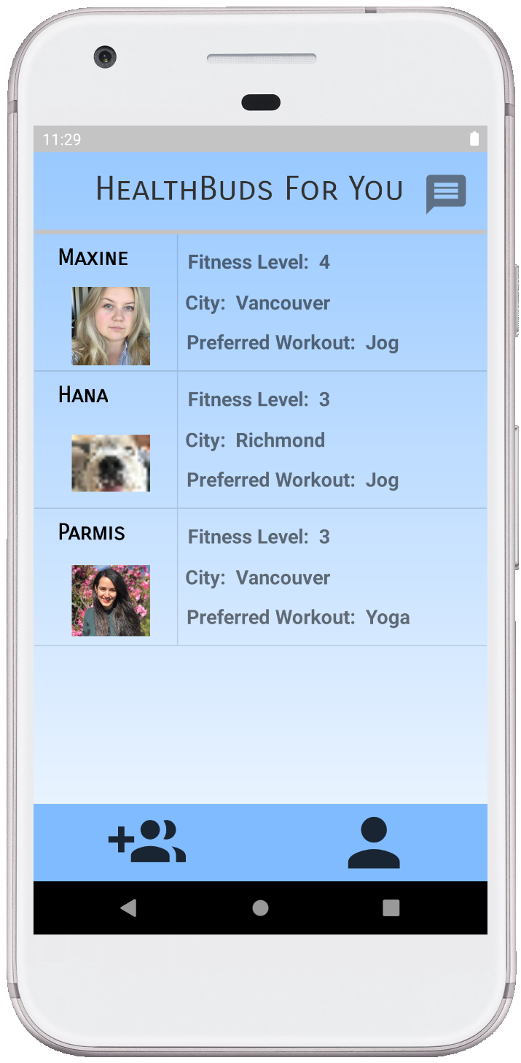
Connect with others

Slide 5
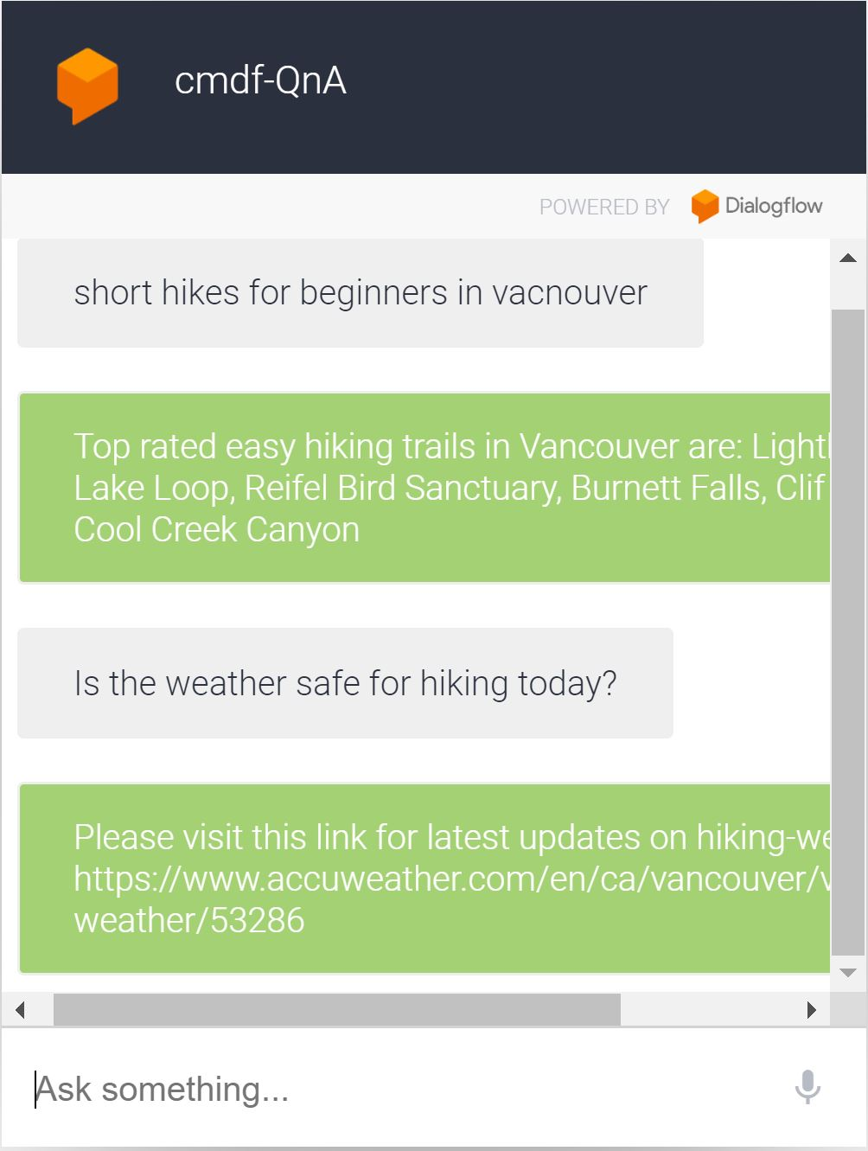
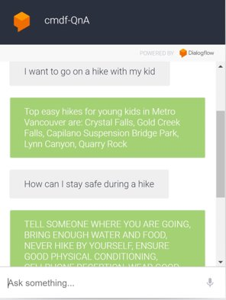
Google Dialogflow: Safety Recommendations

Slide 6





Future Plan: Improved Fitness Pairing Algorithm
Generate similarity score based on criteria (distance, interest, demographic, exercise frequency, and more)
As use of App provides us with more data, we can use ML to weigh criteria

Slide 7

Promoting Safety, Community, and Health

