Slide 1
iKAla automation architecture design
Keith chuang

Slide 2
Process design
Jenkins
Zalenium
Reporting
Tagging
Notification

Slide 3





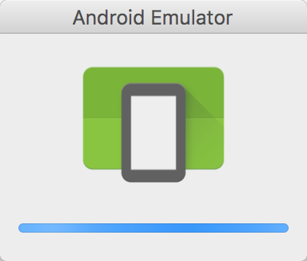
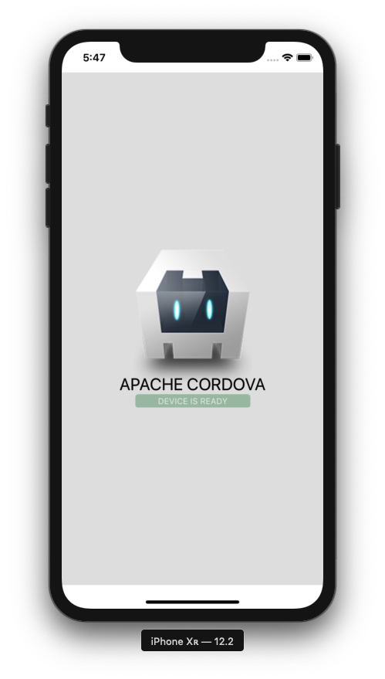




Process design
Automation framework
API
Push tag with build info/ timestamp/test suite info to repo
API
API
Slack webhooks for summary of test run result
Report portal

Slide 4

jenkins

Slide 5
Jenkins setup
Trigger automation after build is deployed by using below methods
Poll SCM
After a project is built and passed
Configure different Jenkins jobs which pass argument values via test framework command line to determine what kind of tests should be run such as Build Verification Test, Smoke Test or Regression Test where the arguments can include but not limit to:
Test suite type, e.g. build verification, smoke test, regression test etc
Browser type, e.g. chrome, firefox, internet explorer, edge, safari
Device type, e.g. windows, linux, real android device, real iOS device, android emulators, iOS simulators

Slide 6

Automation framework in selenium

Slide 7
Automation framework & ARCHTITEUCTURE
Test framework: testNG (Java), Pytest/unitest (Python)
Build framework: maven (Java)
Collaboration framework
Cucumber (Java/Python)
Robot framework (Python)
UI framework: Selenium
Mobile framework: Appium
Restful API framework:
Rest Assured/apache http client (Java)
Requests (python)
Architecture:
Page Object Model along with dependency injection
WebDriver Factory
Managers
Utilities

Slide 8
Context Helper holding managers
ConfigManager
PageObjectManager
Settings in configurations
CommandLineArgsManager
Holds different page objects
Holds values of arguments
Test Runner (testNG/pytest)
WebDriverFactory
RemoteWebDriver
WebDriver (local & remote)
Utilities
Reporting Utils
AppiumDriver
Git Utils
WebHooks Utils
Reporting API that updates test results
Git API that pushes tag
WebHooks API that pushes data
Test Suites written with collaboration tool (cucumber/robot)
UI
API
RESTFul API related
DesiredCapabilitesManager
Manage caps for different needs

Slide 9
Kubernetes & zalenium

Slide 10
Kubernetes & ZAlenium
Kubernetes deploys worker nodes
Zalenium for Chrome and Firefox
Android emulator nodes
iOS Simulator nodes
Real Android devices
Real iPad/iPhone/Mac devices
Reference:
http://www.kieftsoft.nl/how-to-set-up-zalenium-with-kubernetes-on-linux/

Slide 11

reporting

Slide 12

Reporting – report portal
Update test result in real time
Machine learning
Open source
Integrated with popular test framework
https://reportportal.io/installation/integration
Visualize test report
Reference:
https://reportportal.io/features

Slide 13

Notification via webhooks

Slide 14
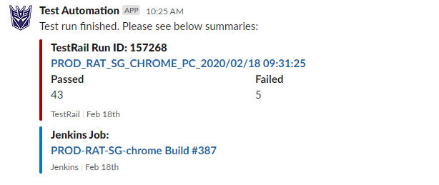
notifications
Push summary of test run result to Slack or other communication tools via webhooks
Timestamp
Test objective
Test result status
Execution time

Slide 15

tagging

Slide 16
tagging
Push a tag to automation repo with following information after each test run
Build version
Test Type
Test result
Test environment
Timestamp
Benefits
Easy to track
Record for references

