Slide 1

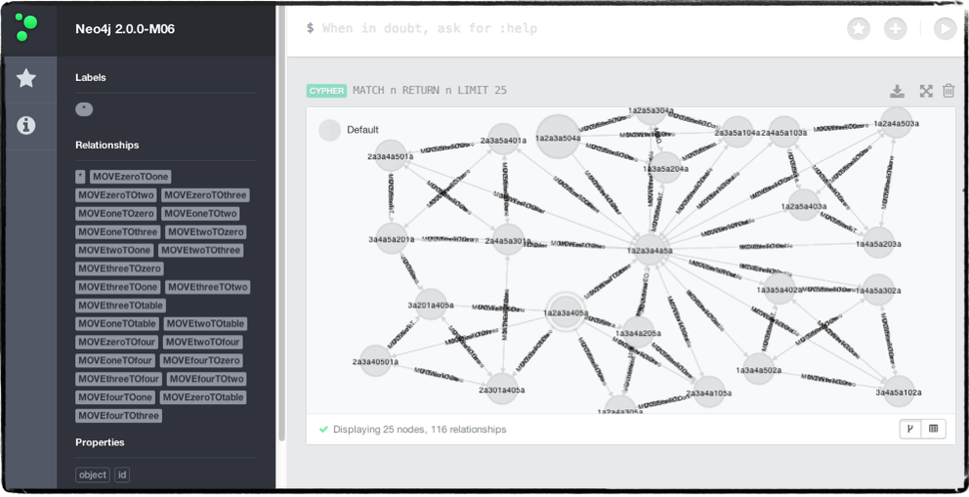
Traversal of BlocksWorld by semi-Autonomous Agent
by: Ken Zyma, Erin Fowler, Nathan Trone, and Patrick Schemm

Slide 2
OVERVIEW
Creating Blocks World (neo4j, py2neo)
Project Design (Agent-Principle-World)/ SCE Framework
Demo
Python GUI using TKinker
Agent-Principle Interaction and NLP
Agent J’s Base class and the State Machine class
Future of blocks world

Slide 3
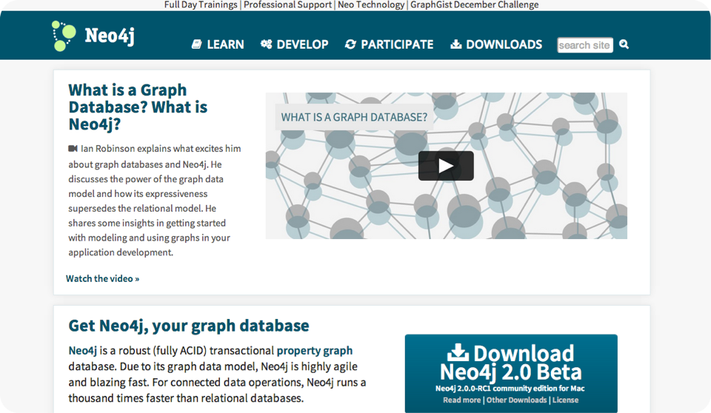
NEO4J
http://www.neo4j.org/

Slide 4
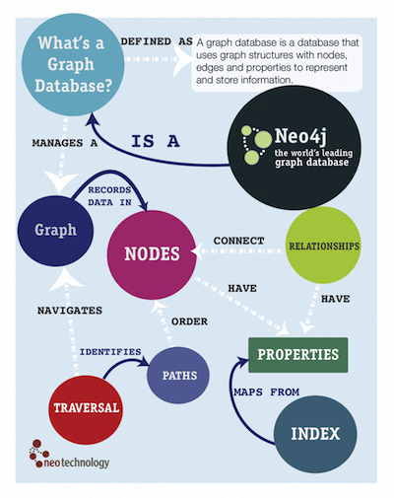
Property graph database.
Allows for agility in representing complex “networks” of data.
Lends itself to be a powerful match for utilizing relationships to “link” nodes, searching through those nodes, locating properties within them and doing so extremely fast.
http://assets.neo4j.org/img/neo4j/visually_refcard.gif

Slide 5
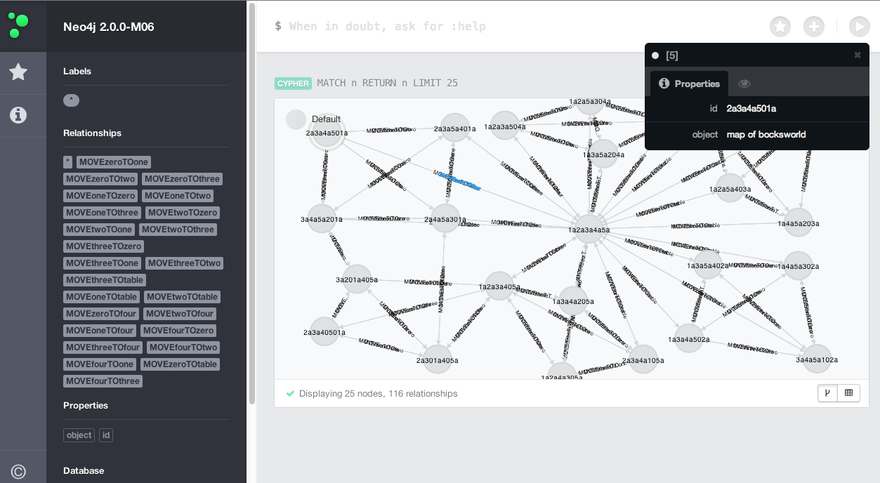
OUR GRAPH DATABASE

Slide 6

PY2NEO
Python package which allows the creation of, manipulation of, and traversal of neo4j via the python environment.
Allowed our team the ability to view the data in a familiar way but also to utilize some previously created code without having to “reinvent the wheel”.
Thus, output was also familiar and in turn easier to test code.
Cypher query using py2neo

Slide 7
CYPHER
the neo4j query language
most keywords like WHERE and ORDER BY inspired by SQL.
add property to node
START n=node(*)
WHERE n.id = 10203a
SET n.object = ‘map of BW’
RETURN n
find node by relation
START n=node(*)
WHERE n.id = 10203a
MATCH p=n-[rel:<name>]->m
return m

Slide 8
FREE HOSTING….

Slide 9

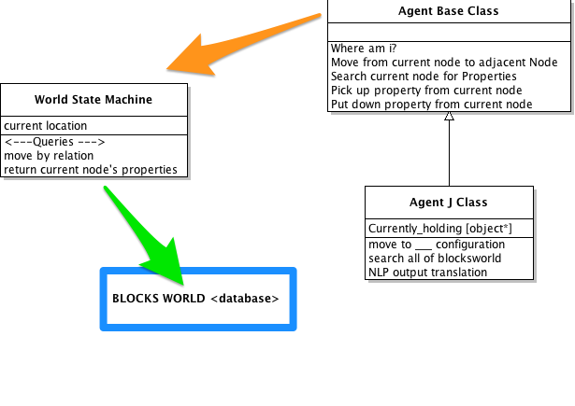
PROJECT DESIGN
AGENT-PRINCIPLE-WORLD
Similar to the world-sim and bb-sim design.
  Principle->Agent = Raw_input
  Agent->Principle = Return Agent Knowledge
  World->Principle = Return current state of world
  World->Agent = Sensory Information

Slide 10
SCE FRAMEWORK
Sensory-Control-Effectory
Sensory- details about the current node. Input from principle
Control- Rules of moving from node to node. Generating path (A star).
Effectory- ability to place/remove items from world and move by relation.

Slide 11

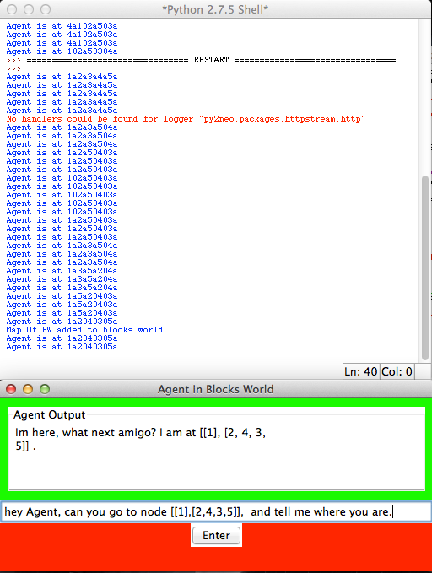
OUTPUT FROM OUR DESIGN
gives us both output from our Agent, reporting his knowledge base.
and output from the world, so we can make sure the Agent is actually behaving by the rules of the world.

Slide 12
DEMO

Slide 13
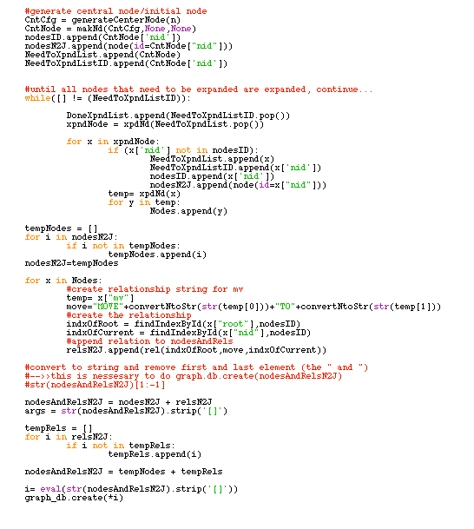
CREATING BLOCKS WORLD
py2neo query
graph_db.create(
node(id=#),
node(id=#2),
…
rel(0,move,1),
rel(1,move2))

Slide 14

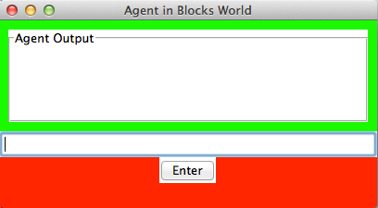
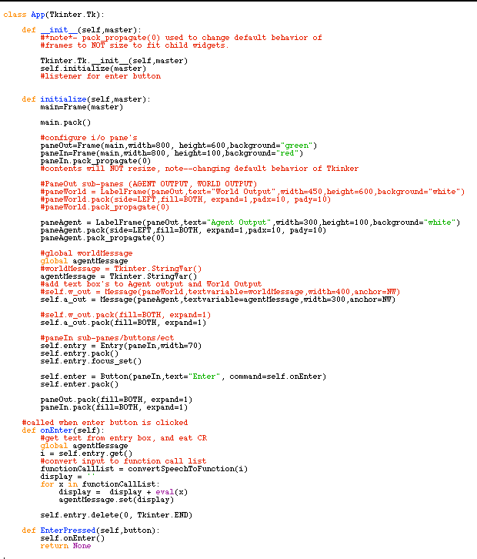
GUI DESIGN
with TKinter
Simple…just bind event
listeners and start
root.mainloop()

Slide 15
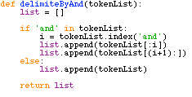
NATURAL LANGUAGE PROCESSING
Step 1: Token-ize!
-using NLTK-

Slide 16
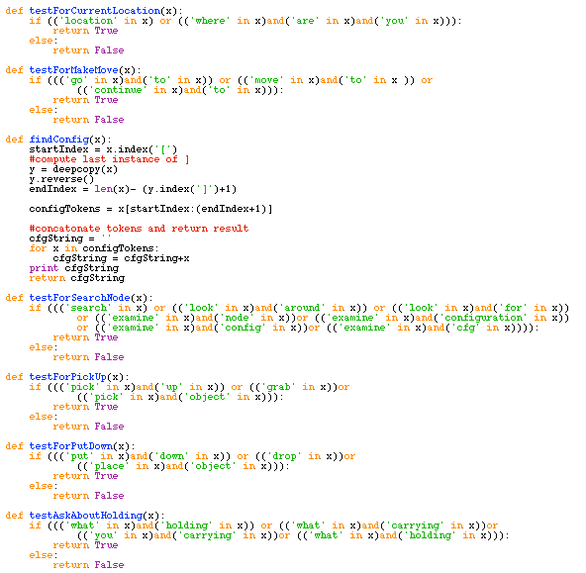
NLP CONT’
Step 2: Decision Tree
Asking about current location?
no
Move to a new node?
by config?
by ID?
no
Search?
All BW?
no
current id?
..ect

Slide 17
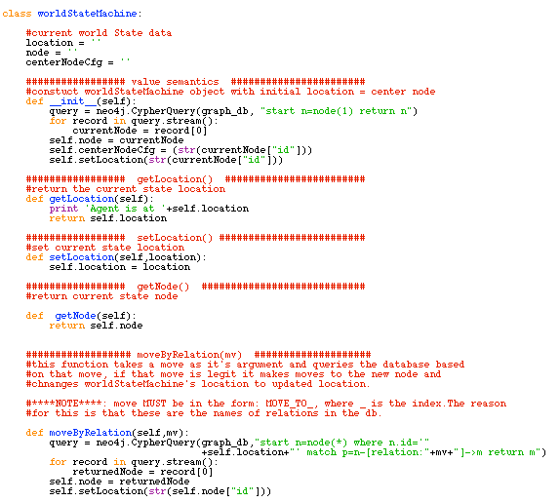
STATE MACHINE CLASS

Slide 18
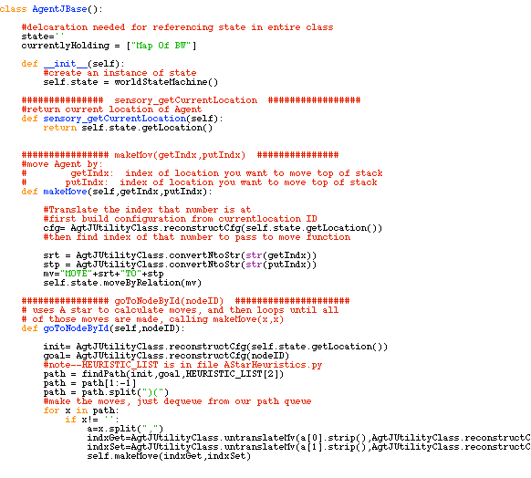
AGENT-J CLASS

Slide 19
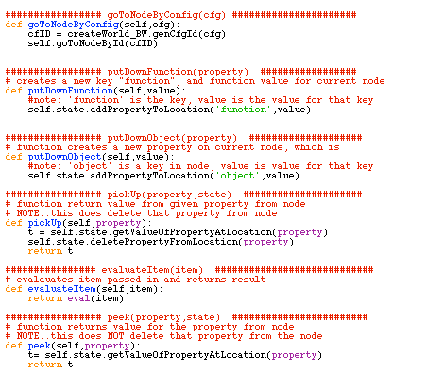
AGENT-J CLASS CONT’

Slide 20
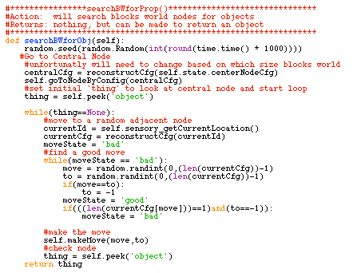
AGENT CLASS CONT’

Slide 21
FUTURE OF BLOCKS WORLD

