Slide 1
EDES 301
Responsive Path Lighting Proposal
2026/09/30
Kathy Xu

Slide 2
Background Information
As an architecture student, I am interested in how lighting can guide movement and shape spatial experience. Instead of treating circulation lighting as a static condition, this project explores how light can respond directly to a person moving through a space, illuminating only the areas currently being used.
What is being proposed?
  A lighting system that responds to a person moving through a circulation space.
  Four sensing zones detect the user’s position along a path.
  Each sensor controls a corresponding lighting zone.
  Lights activate sequentially as the user moves through the space.
  Lighting can fade/dim after the user leaves a zone.

Slide 3
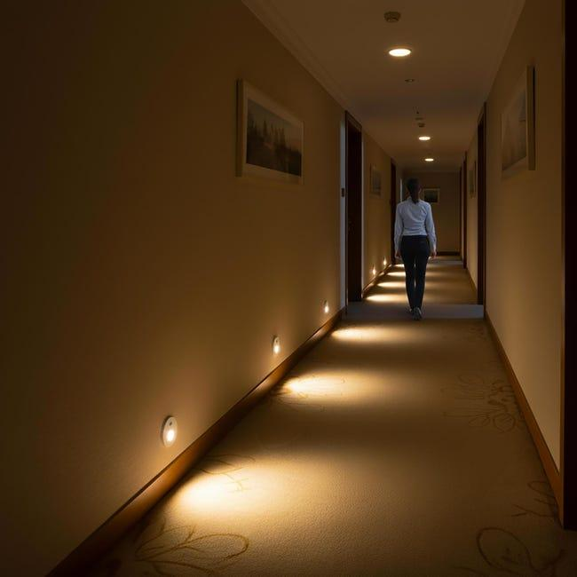
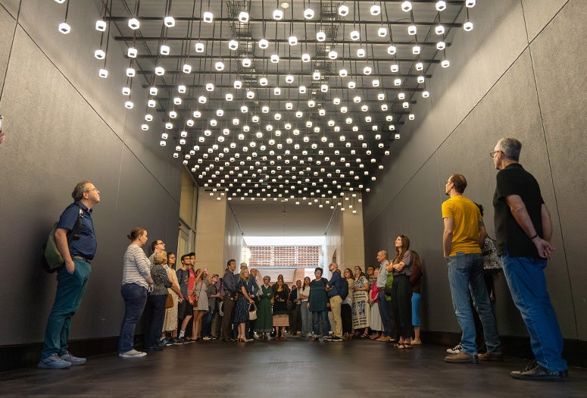
Background Information

Slide 4
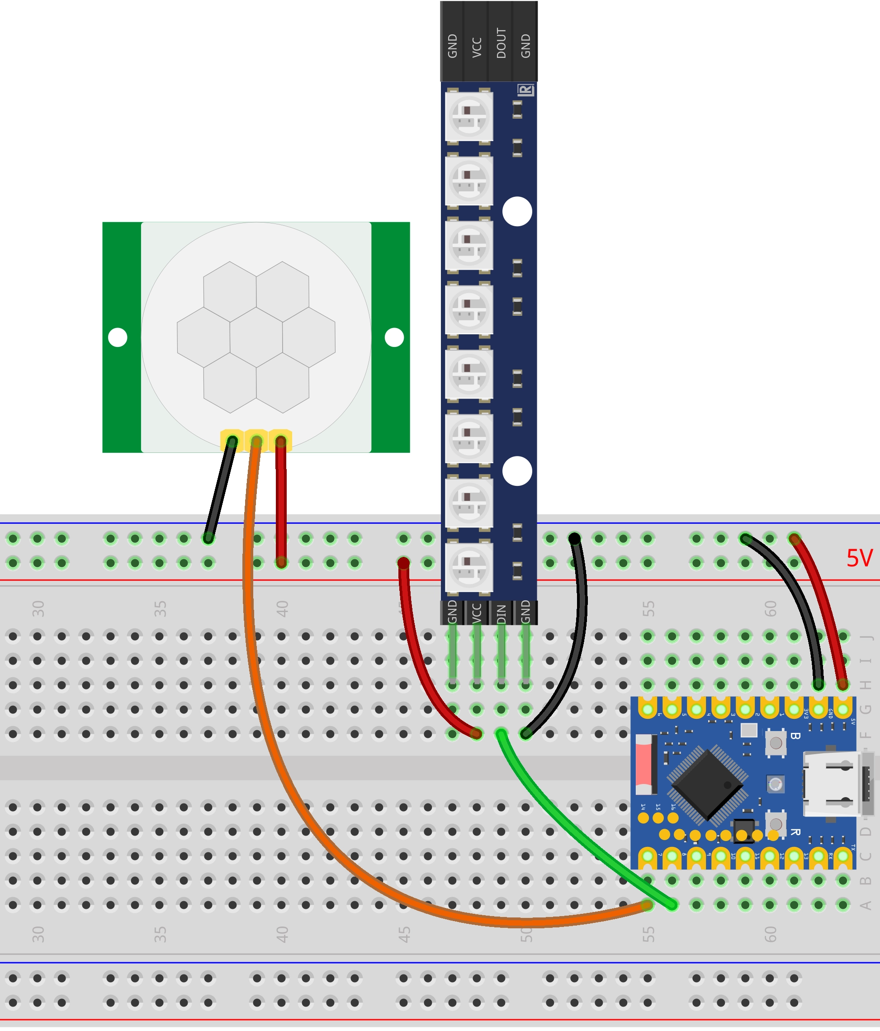
Background Information
What improvements / additions over existing project
  Link: https://docs.waveshare.com/ESP32-Arduino-Tutorials/13-3-Presence-Light
  expands from 1 motion sensor and 1 lighting zone to 4 of each
  Adds sequential lighting, so different zones activate as a person progresses along the path.
  Adds graduated brightness / fading, allowing nearby zones to remain dim while the occupied zone is brightest.
  Adds movement through space as the design concept

Slide 5
System Block Diagram
HC-SR501 PIR
Sensor 1
Zone 1
GPIO
WS2812B LED
Strip 1
Zone 1
HC-SR501 PIR
Sensor 2
Zone 2
GPIO
PocketBeagle
Python Program
Read sensors
Identify zone
Lighting logic
Fade/delay light
WS2812B LED
Strip 2
Zone 2
GPIO / digital data
Level Shifter
(3.3V → 5V data)
WS2812B data line
HC-SR501 PIR
Sensor 3
Zone 3
GPIO
WS2812B LED
Strip 3
Zone 3
HC-SR501 PIR
Sensor 4
Zone 4
GPIO
WS2812B LED
Strip 4
Zone 4

Slide 6
Power Block Diagram
5V USB Power
PocketBeagle
5V out
3.3V
HC-SR501 ×4
PIR Sensors
5V Supply
WS2812B ×4
LED Strips
5V Supply
Level Shifter
Logic Side
3.3V Supply
Common ground

Slide 7
Components / Budget
Component | EDES301 to Buy? | Cost
HC-SR501 motion sensors (4) | yes | $7.91
Bidirectional level shifters (1) | yes | $1.60
BTF-LIGHTING WS2812B IC PC Light Strip | yes | $17.99
PocketBeagle | no | provided
Breadboard / Jumper Wires | no | provided
USB Power Supply / Cable | no | provided
Total |  | $27.50

Slide 8
Power Block Diagram
Create a Power Block Diagram
  Label voltages / currents of components
Need All Power Inputs and Outputs

Slide 9
System Block Diagram
Create a System Block Diagram
  Label interfaces (I2C, SPI, GPIO, etc.; You do not need to know all of the connections)
  Components (part numbers if possible)
Need Moderate Level of Detail

Slide 10
Component Selection (Remove slide for submission)
All components must be from either: Amazon, Adafruit, Sparkfun, Digi-Key, or Mouser
Select no more than two (2) components that are not on approved component spreadsheet
  See Canvas → Files → assignments → EDES301_project_01_parts_list.xlsx
  If there is a cheaper part that you would like to use, we can discuss in the project meeting
All components needed for the project should be listed on Slide 5
All components should have links to the website where they can be purchased
  Please trim URLs for links to Amazon
EDES301 will supplement $25 to $35 dollars for components
  Please indicate what components need to be purchased by EDES301
If you have a special request, we can discuss in the project meeting

