Slide 1
EDES 301
Responsive Path Lighting Proposal
2026/09/30
Kathy Xu

Slide 2
Background Information
As an architecture student, I am interested in how lighting can guide movement and shape spatial experience. Instead of treating circulation lighting as a static condition, this project explores how light can respond to both people moving through a path and changing environmental conditions, using brightness and color to create a more responsive outdoor space.
What is being proposed?
  A responsive outdoor circulation lighting system that reacts to movement and environmental conditions.
  Three VL53L0X distance sensors detect a user’s position and proximity along a path.
  Each sensor controls a corresponding lighting zone.
  Lights intensity changes according to the user’s distance from each zone.
  Temperature data influence the color of the lighting.
  Time of day adjusts the baseline lighting level.

Slide 3
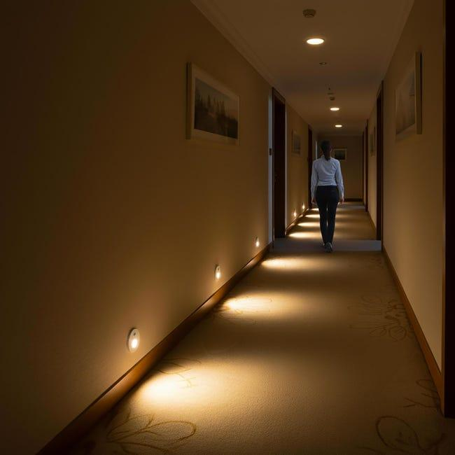
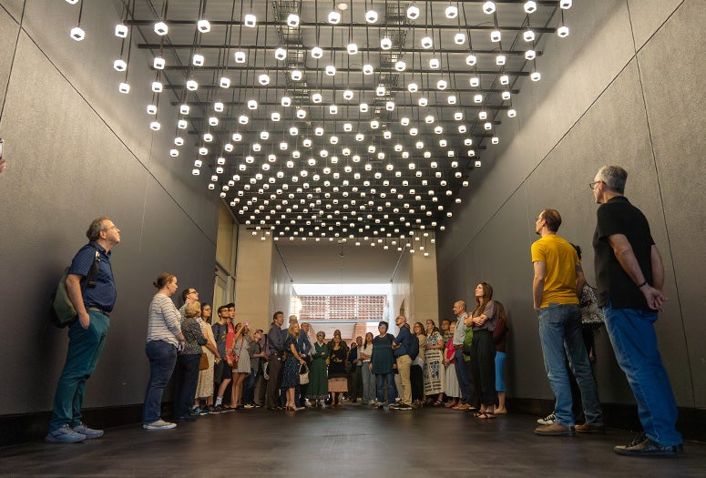
Background Information

Slide 4
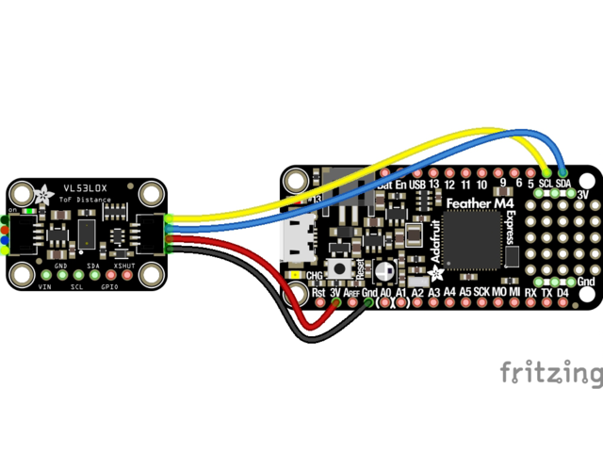
Background Information
What improvements / additions over existing project
  Link: https://learn.adafruit.com/adafruit-vl53l0x-micro-lidar-distance-sensor-breakout/python-circuitpython
  Expands from basic distance-sensor reading to three sensing zones along an outdoor circulation path.
  Uses distance measurements to control lighting intensity, rather than only displaying or printing distance values.
  Adds temperature as a second environmental input that controls lighting color.
  Adds time-of-day behavior to modify the overall lighting mode or brightness.

Slide 5
System Block Diagram
VL53L0X
Sensor 1
Zone 1
I2C
WS2812B LED
Strip 1
Zone 1
PocketBeagle
Python Program
Read distance
Read Temperature
Identify zone
Set Brightness
Set color
Fade/timing
VL53L0X
Sensor 2
Zone 2
I2C
GPIO / digital data
Level Shifter
(3.3V → 5V data)
WS2812B data line
WS2812B LED
Strip 2
Zone 2
HC-SR501 PIR
Sensor 3
Zone 3
I2C
WS2812B LED
Strip 3
Zone 3
Temp/Humidity Sensor
I2C

Slide 6
Power Block Diagram
5V USB Power
PocketBeagle
5V in
WS2812B ×4
LED Strips
5V Supply
Level Shifter
Logic Side
HV = 5V
3.3V
VL53L0X ×3
Distance Sensors
3.3V Supply
AHT10
Temp/Hum. Sensor
3.3V Supply
Level Shifter
Logic Side
LV = 3.3V
Common ground

Slide 7
Components / Budget
Component | EDES301 to Buy? | Cost
VL53L0X Distance Sensors (3) | yes | $8.99
AHT10 Temp/Humidity Sensor | yes | $1.70
Bidirectional level shifters | yes | $1.60
BTF-LIGHTING WS2812B IC PC Light Strip (3) | yes | $13.49
PocketBeagle | no | provided
Breadboard / Jumper Wires | no | provided
USB Power Supply / Cable | no | provided
Total |  | $25.78

