Slide 1
Counterargument
Secondary

Slide 2
Counterargument?
A counterargument is an argument opposed to your thesis, a part of your thesis, or a claim made elsewhere in your essay.
It expresses the view of a person (real or hypothetical) who disagrees with one or more of your positions.

Slide 3
Counterargument-why?
Analyzing counterarguments strengthens your claims by addressing the opposition.

Slide 4
Where does it go?
A counterargument can appear anywhere in your essay, but it most commonly appears:
As a paragraph following the paragraph containing the disputed claim;
As the latter half of the paragraph containing the disputed claim;
As a section or paragraph just before the conclusion of your essay.

Slide 5
Counterargument Parts
Claim (Your position)
Counterclaim (Opponent’s perspective)
Concession (Acknowledging validity in their reasoning)
Rebuttal (Why your position is stronger)
Evidence (Supporting quote(s) and other evidence)
Resolved Position (Analysis) (Why the evidence proves your point)

Slide 6
Counterargument Paragraph Structure
Topic Sentence
Previews the structure of the counterargument paragraph.
Identify Opponent
Opponent’s Counterclaim
Opponent’s Rationale
Who, or what type of reader, would take issue with your claim?
State the counterclaim.
Explain the reasoning behind the opponent’s counterclaim.
Concede in Part
Rebut the Counterclaim
Resolved Position
In what way(s) is the opponent’s counterclaim true? Under what circumstances?
Explain why your claim is stronger than the counterclaim.
Explain why your opponent’s counterclaim does not outweigh your initial claim.

Slide 7
Part 1
First, you turn against your own argument to challenge it.
State the case against yourself as
briefly (but as clearly and forcefully) as you can, pointing to evidence where possible.

Slide 8
Imagine a skeptical reader
Yet some readers may challenge the view that _________.
After all, many believe _________.
Indeed, my own argument that _________ seems to ignore _________ and _________.
Of course, many will probably disagree with this assertion that _________.

Slide 9
Cite your critics
Cite an actual source, critic, or group of critics, who might resist your argument:
Here many conservatives would probably object that _________.
But social Darwinists would certainly take issue with the argument that _________.
Nevertheless, both followers and critics of Malcolm X will probably argue that _________.

Slide 10
Look at your arguments
Problems with your conclusion:
Others, however, may conclude _________.
Disadvantages to what you propose:
This proposed solution does have some disadvantages __________.
Alternative explanations that make sense:
Alternatively, this issue could be viewed _________.

Slide 11
Part 2
Second, you turn back to reaffirm your argument.

Slide 12
Quote acknowledged experts
Quote acknowledged experts that support your position:
While many may see this argument as flawed, ____________John Smith, an expert in his field, also finds_________.

Slide 13
Redefine the criteria
Redefine the criteria of “known” concepts:
Although I grant that _________, couldn’t it also be possible that _________.

Slide 14
Show supports a shared idea
Find agreement and show how your new idea supports a shared idea:
I agree with X that _________.
Furthermore, this idea actually supports my point because _________.

Slide 15
Pointing out faulty assumptions
Pointing out faulty assumptions in your critic’s arguments where:
the facts are wrong: Proponents of X are right to argue that _________. But they exaggerate when they claim that _________.
the analysis is incorrect: While it is true that _________, it does not necessarily follow that _________.
the values it is based on are not acceptable: It is dangerous to believe _________________ because ___________________.

Slide 16
Resolved Position
Suggest why the opposing counterclaim is relatively less important or less likely than your claim, and thus, doesn't overturn or invalidate it.
If the counterclaim analysis reveals that the claim should be modified, then do so.

Slide 17
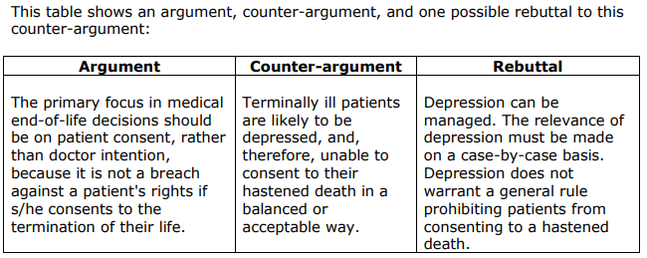

Slide 18
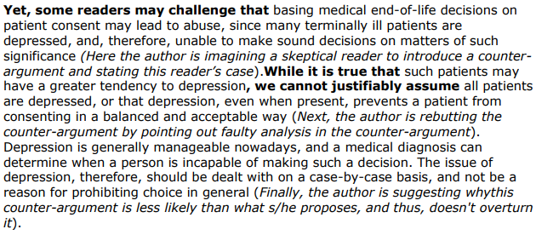

Slide 19
Example Rebuttal
Opponent’s Claim
My Rebuttal
George was selfish in shooting Lennie to protect himself.
While George’s choice was tragic, it was actually a selfless act that spared Lennie from a worse fate.

